Slide 1



Footprinting. Сбор данных

Slide 2
Objectives of Footprinting
Network information
System information
Organization's information
Domain name
Internal domain names
Networking protocols
Rogue website
Privet website
Networking protocols
Operating system
Server version
System architecture
Employee details
Company director
Location details
Address and phone numbers
Web server links relevant to organization

Slide 3
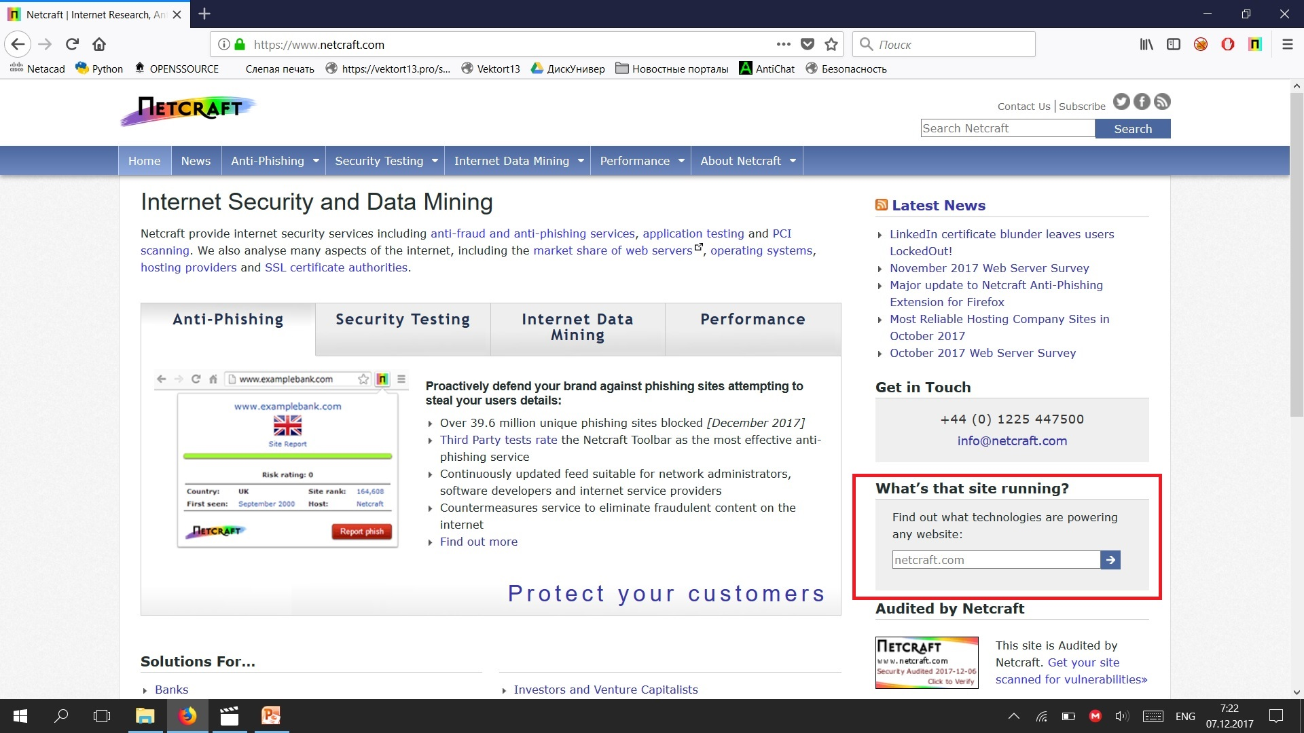
Footprinting through Search Engines

Slide 4
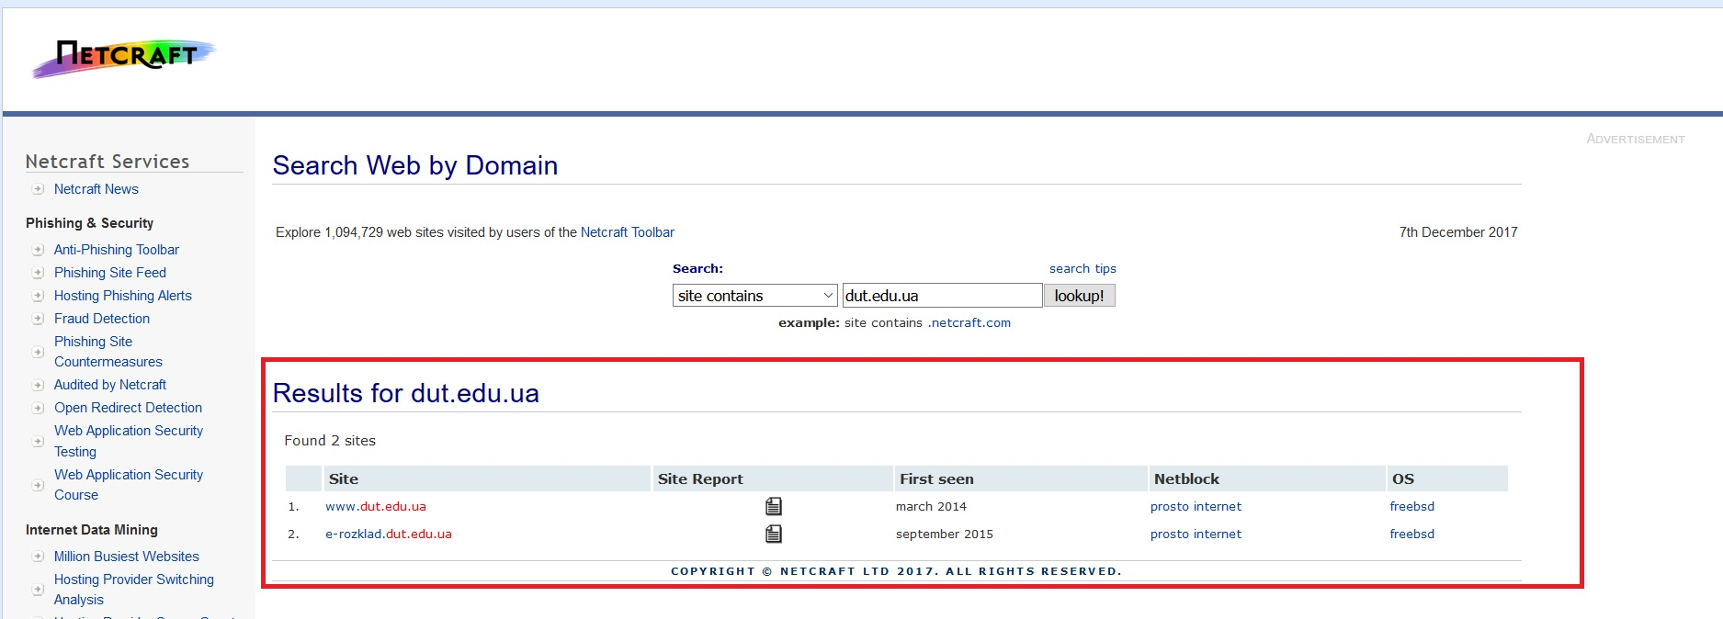

Slide 5
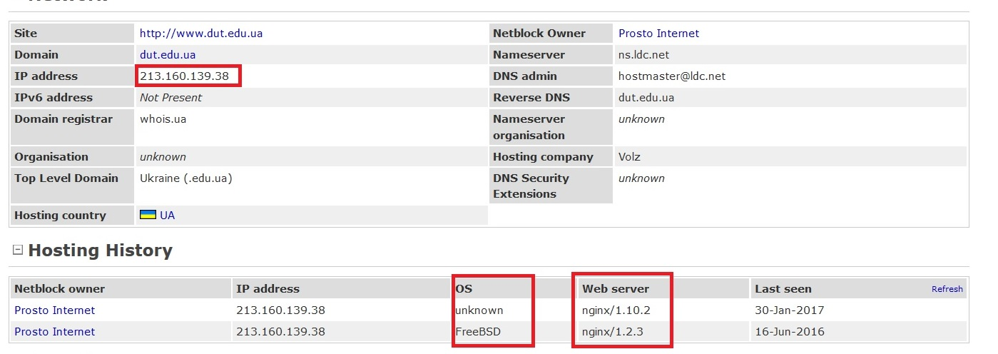

Slide 6
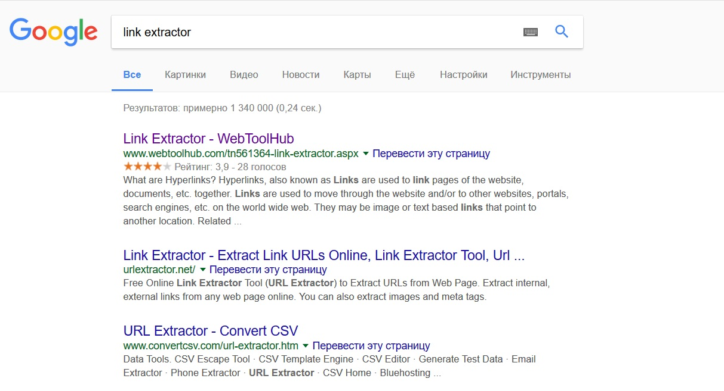

Slide 7
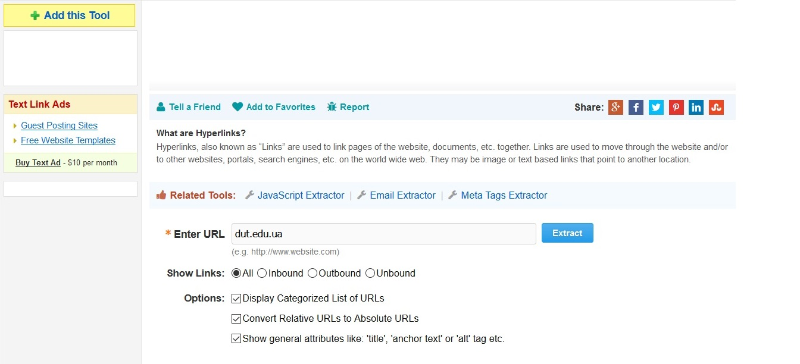

Slide 8
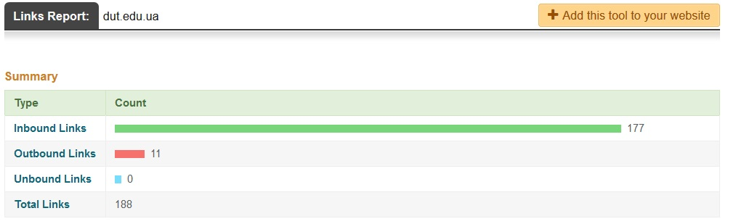
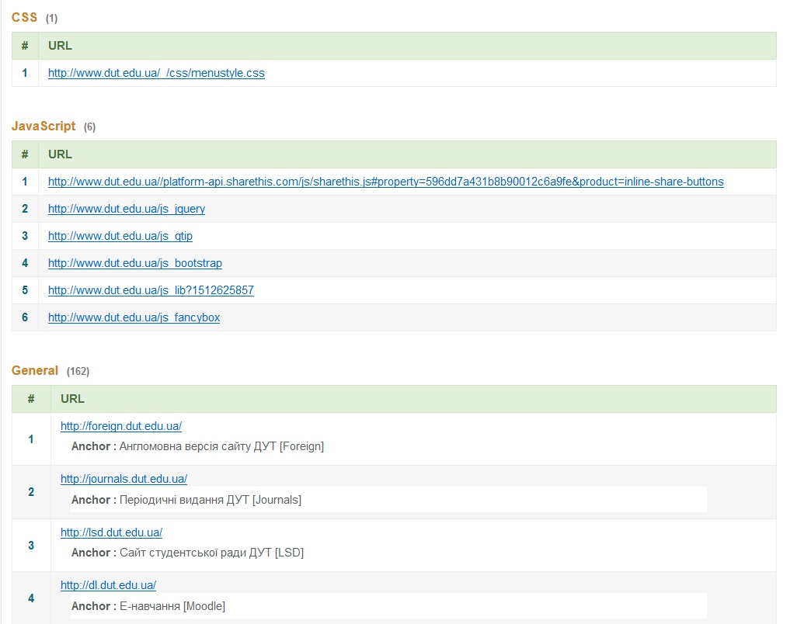

Slide 9
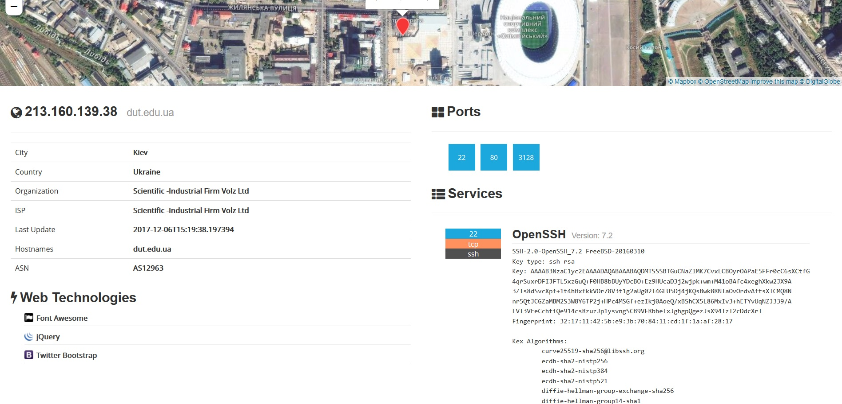

Slide 10
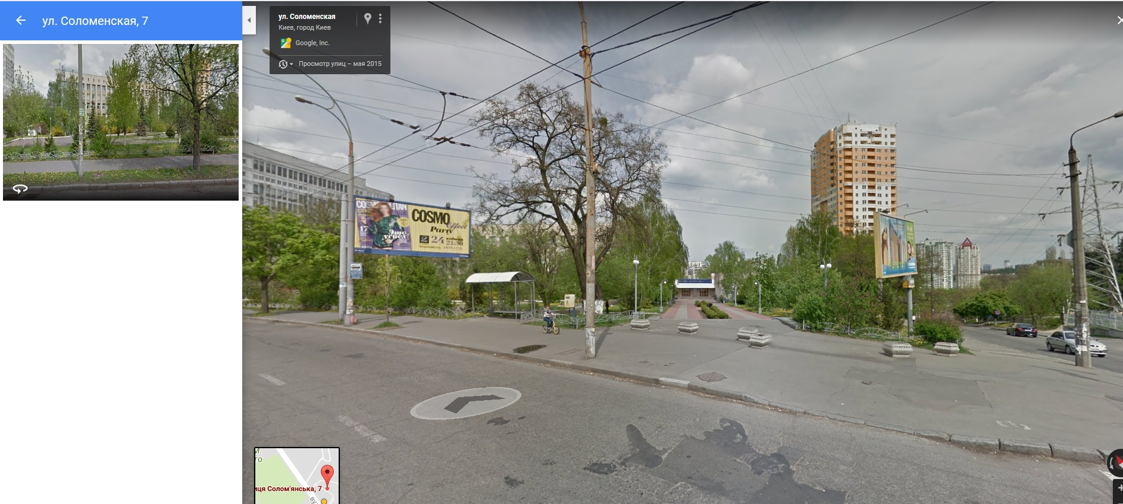

Slide 11
Footprinting through Job Sites
Look for this:
Job requirements
Employee`s profile
Hardware information
Software information
https://www.linkedin.com/
https://www.monster.com
https://www.dice.com/
https://hh.ua/
https://indeed.com/

Slide 12
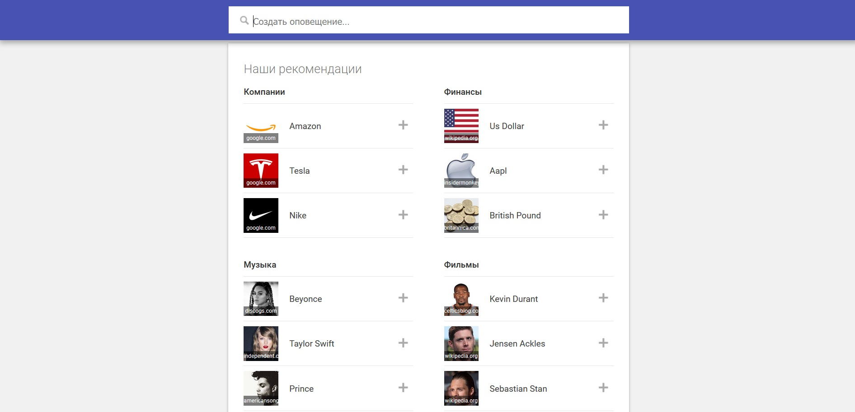

Slide 13
To be continued…

