Slide 1



(Threats & Risks)
MiTM in Public Networks
+
=
Hackers
Alert
Damage

Slide 2
Index!
Introduction to Cyber Security
Man In The Middle
Practical Demonstration
Technical Methods
Protection
Questions & answers

Slide 3
Introduction to Cyber Security
Cyber Attacks can cause a serious damage to your devices & life , tasting an example, it can lead hackers to a top confidential information or even a personal one, therefore Cyber Security involves protecting information and systems from major cyber threats

Slide 4
Man In The Middle
It is a popular method, were the attacker keeps himself / herself between two parties, making them believe that they are talking directly to each other over a private connection, when actually the entire conversation is being controlled by the attacker

Slide 5

Practical Demonstration
Now we will practically demonstrate the methods of “Man In The Middle” with the help of the audience

Slide 6
Technical Methods
“Here is how we did it!”

Slide 7
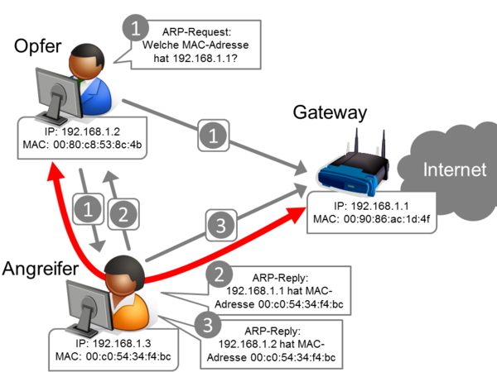
ARP Poisoning

Slide 8
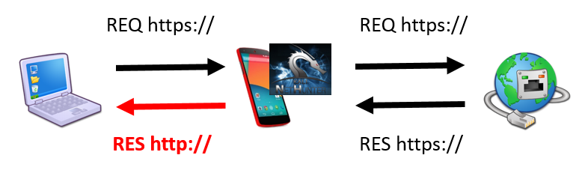
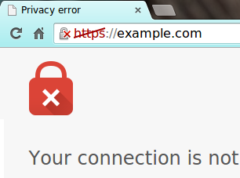
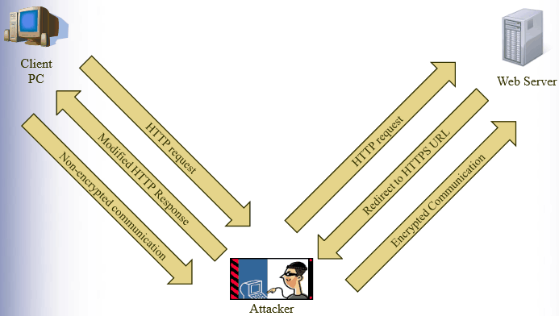
SSL Strip

Slide 9
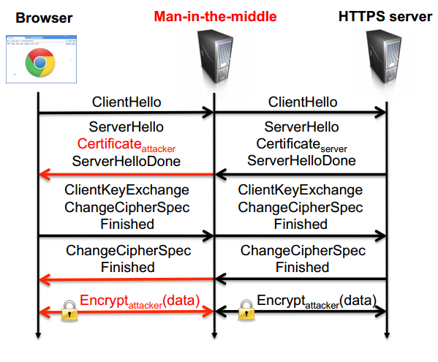
SSL Spoofing

Slide 10
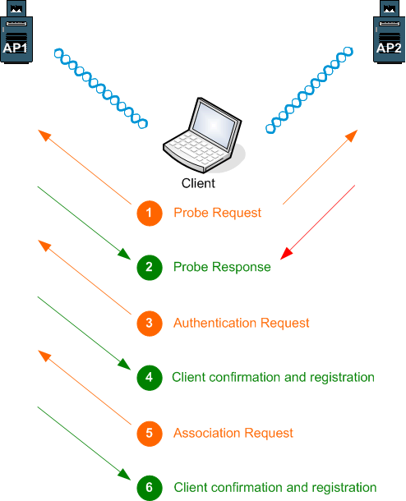
Wi-Fi Negotiation

Slide 11
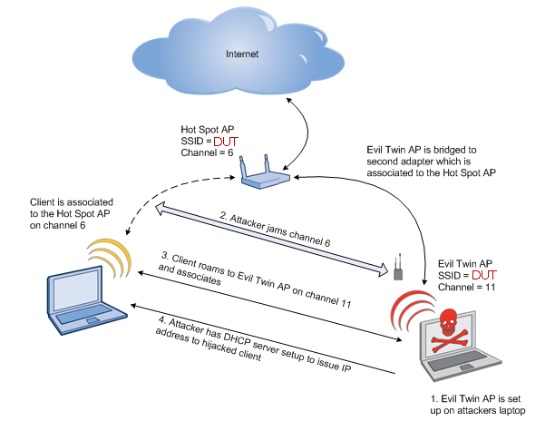
Fake AP

Slide 12
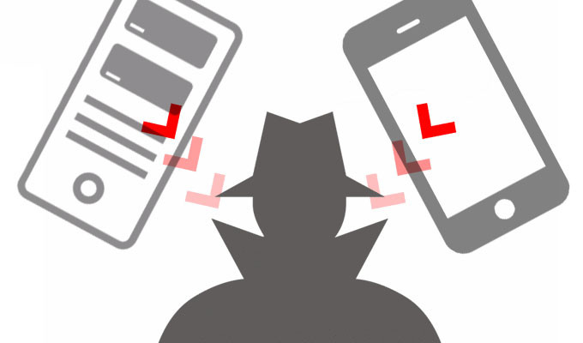
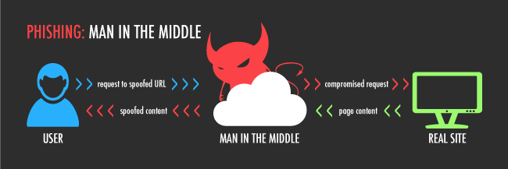
Man In The Middle

Slide 13
Protection Methods
“7 ways to Protect Yourself”

Slide 14
Use VPN or Proxy Server with encryption
The most common used method for a secure connection is Virtual Private Network (VPN). A VPN extends a private network across a public network. It enables a computer to send and receive data across shared or public networks as if it were directly connected to the private network.

Slide 15
Don’t use sensitive data while using unknown network.
Almost programs and sites crypt your authorization data, but not the following after it. So, even if hacker will not get your password, he will be able to see everything you’re sending using your network.

Slide 16
Always scan your network and determine, who is connected to it.
For example if you’re using your home network, you know that there must be not more than three devices connected at one time. Simple ip-scanning can show you how much devices are connected at this moment, and if you see illegal device you will be able block it.

Slide 17
At home or office network use whitelist
Another solution is using whitelist on your access point router at you home and/or office network. This solution will be ideal if you got limited number of devices, that will surely connect to your network and there have to be no other devices excepting yours.

Slide 18
Add a static ARP
Static ARP allows you to manually set IP and MAC compliance records. In normal mode, you use a dynamic ARP, which updates every twenty minutes. In addition to protection from spoofing.

Slide 19
Using Data Leakage Prevention
Data leakage prevention software is designed to detect potential data breaches / data ex-filtration transmissions and prevent them by monitoring, detecting and blocking sensitive data.

Slide 20
Certificate pinning
One way to detect and block many kinds of man-in-the-middle attacks is "certificate pinning", sometimes called "SSL pinning", but more accurately called "public key pinning".

Slide 21

Thank You!
Stay Safe…

