Slide 1
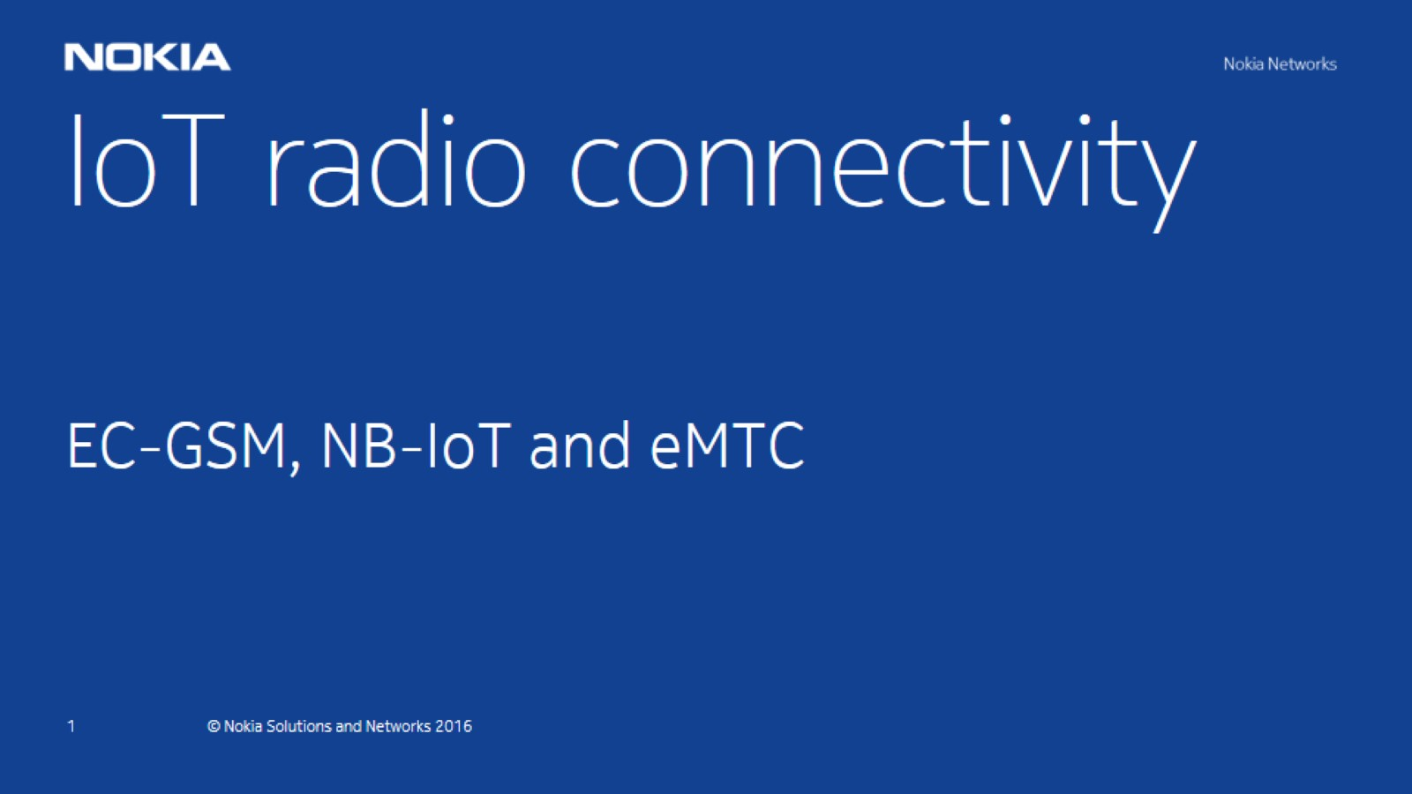

Slide 2
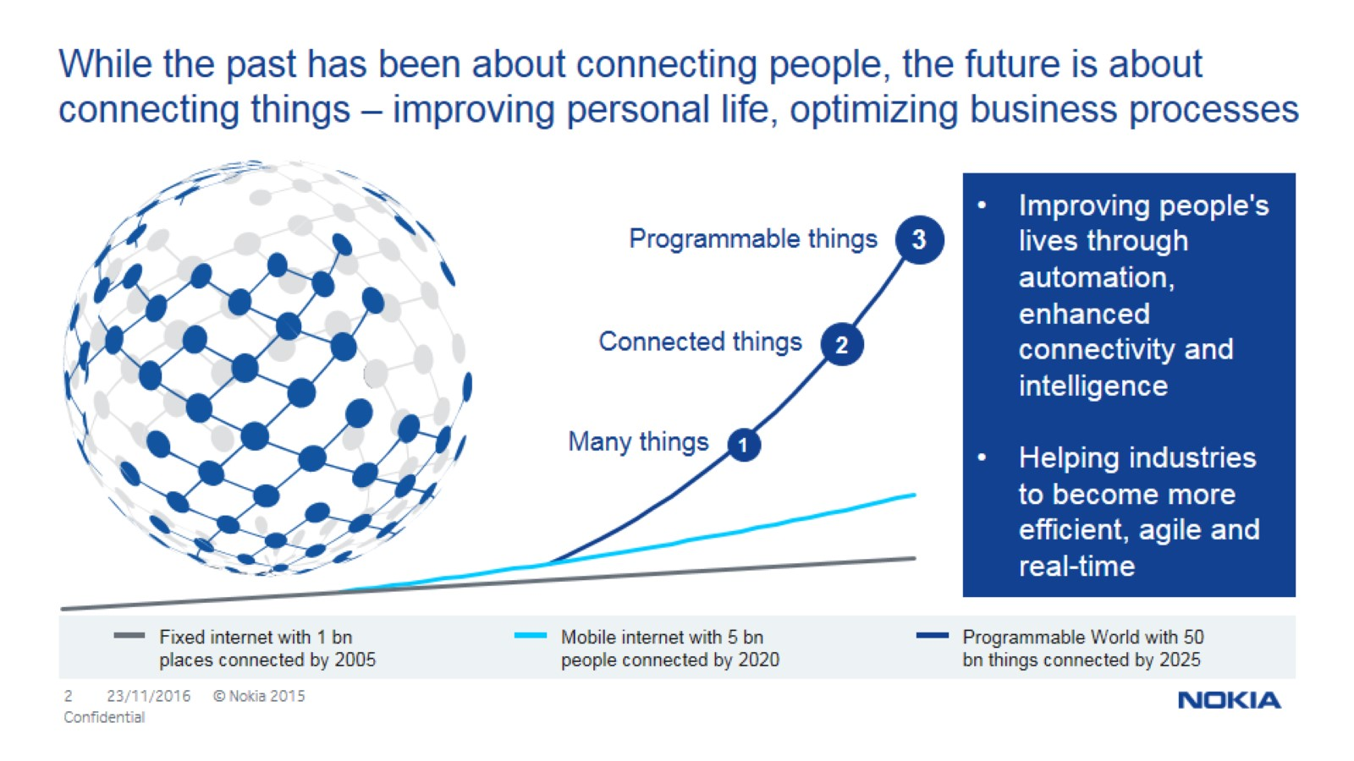
While the past has been about connecting people, the future is about connecting things – improving personal life, optimizing business processes

Slide 3
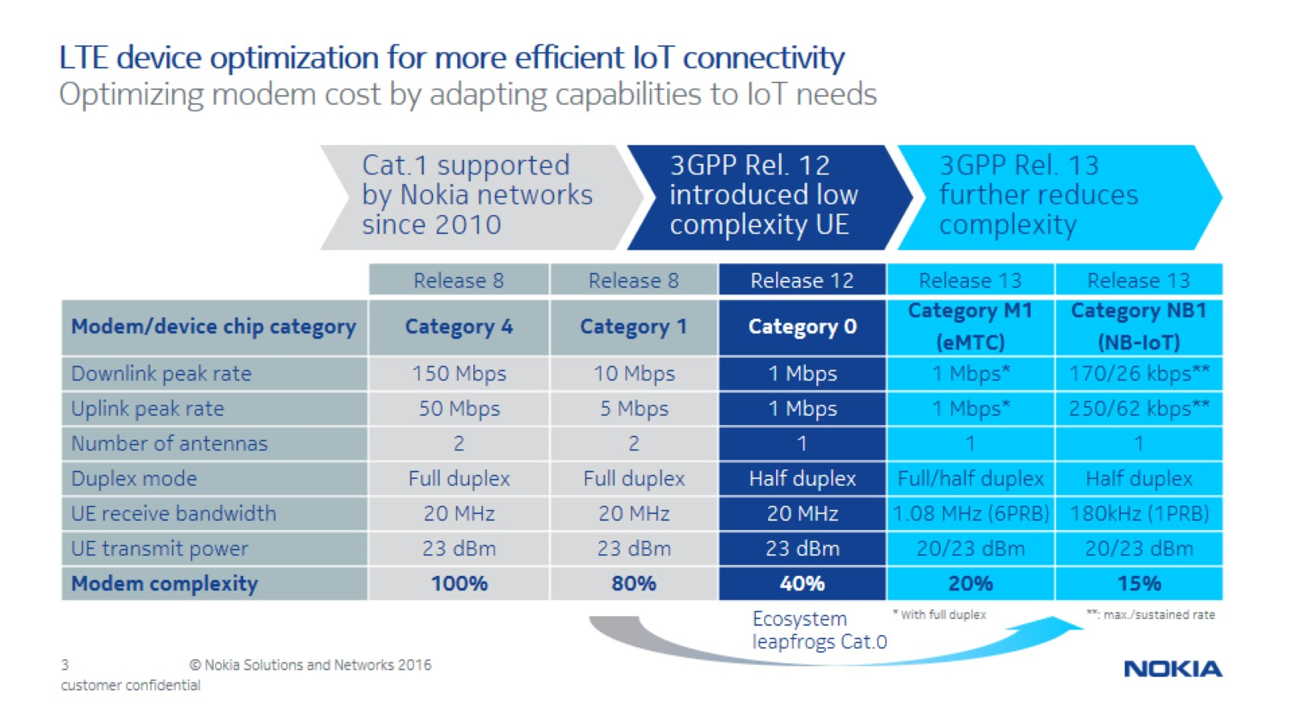
LTE device optimization for more efficient IoT connectivity

Slide 4
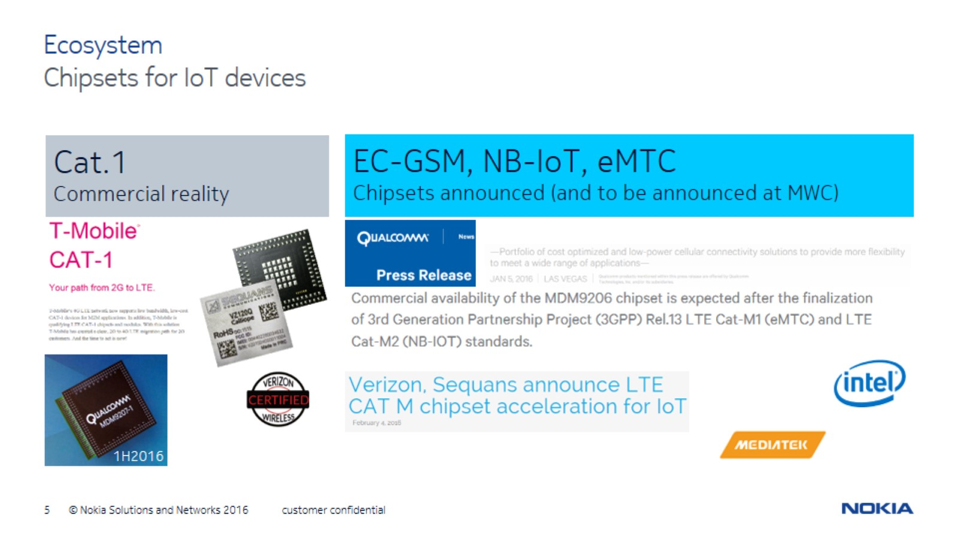
Ecosystem

Slide 5
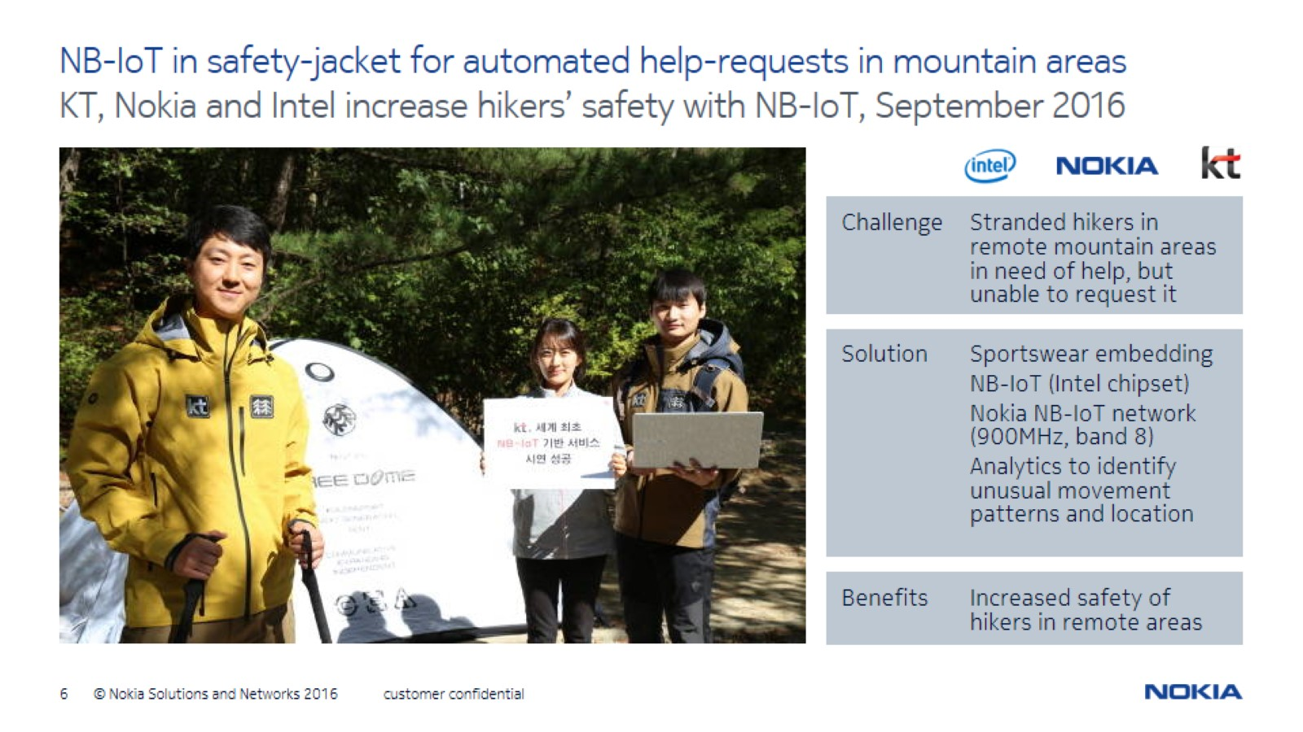
NB-IoT in safety-jacket for automated help-requests in mountain areas

