Slide 1

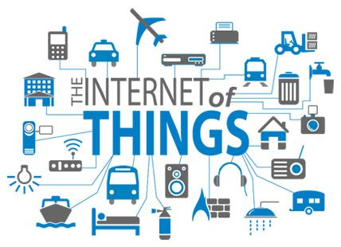
IPv6 For IoT
Mahyar Tajdini, DUT, Dec 2016

Slide 2
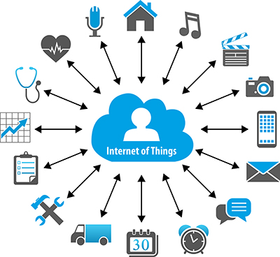
What is IoT ?
The Internet of Things (IoT) is a system of interrelated computing devices, mechanical and digital machines, objects, animals or people that are provided with unique identifiers and the ability to transfer data over a network without requiring human-to-human or human-to-computer interaction.

Slide 3
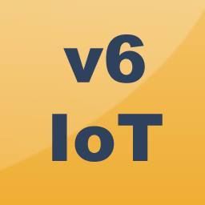
The Future of IoT
As far as the reach of the Internet of Things, there are more than 12 billion devices that can currently connect to the Internet, and researchers at IDC estimate that by 2020 there will be 26 times more connected things than people.
According to Gartner, consumer applications will drive the number of connected things, while enterprise will account for most of the revenue. IoT adoption is growing, with manufacturing and utilities estimated to have the largest installed base of Things by 2020.

Slide 4
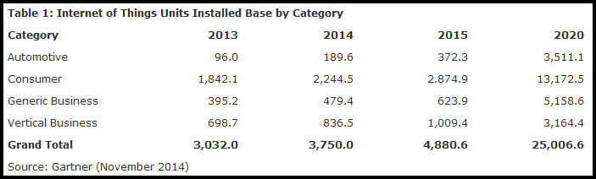
The Future of IoT

Slide 5
Why IPv6 ?
Adoption is just a matter of time
Scalability
Solving the NAT barrier
Strong Security enablers
Tiny stacks available

Slide 6
Why IPv6 ?
Enabling the extension of the Internet to the web of things
Mobility
Address self-configuration
Fully Internet compliant

Slide 7


