Slide 1
Connecting the Last Mile, a Fundamental of Digital Transformation
Presented at the ITU Workshop for Europe and CIS “ICT Infrastructure as a Basis for Digital Economy”
Kiev, Ukraine, 14 May 2019
Aminata A. Garba
International Telecommunications Union

Slide 2
Outline
Introduction
Technologies for Last Mile Connectivity
Business and Policy Models for Last Mile Connectivity
ITU Project on Last Mile Connectivity
Conclusion

Slide 3
Introduction
The Digital Transformation requires using digital technologies in various activities of an organization/country to improve efficiency and livelihood.
  Digital transformation has been ongoing for many years
  Resurge (last few years) with many organizations undergoing digital transformation
  Different organizations/countries are at different stage of the process
Digital Transformation Tools
  Tools for diagnostic and prognostic
  A national digital transformation strategy and plan
  A comprehensive solution for a digital transformation
  A mean to monitor/evaluate the digital transformation process and take corrective measures

Slide 4
Introduction (cont.)
Infrastructure is central for enabling digital transformation through universal, sustainable, ubiquitous & affordable access to ICT services
Last mile Connectivity (also referred to as first mile connectivity)
  In most places, the main backbone network exists
    But connectivity does not reach many people to their homes or work places
    Especially the rural and remote areas
    The last mile connectivity is defined as the connectivity between the main backbone network and the users’
  Accelerating the digital transformation requires:
    Connecting the unconnected to the broadband core networks
    Choosing efficient, cost-effective and fast deployment technologies, business and policy models to improve accessibility

Slide 5
Introduction (cont.)
Key observations
  About half of the households in the world do not have access to the internet
  More than half of the households in developing countries and up to 15% in the developed world do not have access to the Internet
Pointers to Solutions
  Use of hybrid communications to allow moving towards universalization of the connectivity
  Innovative policy and business models

Slide 6
Last Mile Connectivity Technologies
Diverse technologies are used
  Wireless technologies
    Mobile Cellular
    Satellite
    Wi-Fi
    LAN and IoT technologies
    Etc.
  Wired technologies
    Fiber optic
    Coaxial Cable
    Asymmetric digital subscriber line (ADSL)
Diverse application requirements
  Energy consumption
  Range
  Bandwidth
  Mobility
  Cost
Technologies have different
  Signal penetration
  Frequency use
  Cost
  Market size
  Age, integration

Slide 7
Last Mile Connectivity Technologies ( Cont.)
Diverse deployments
  Provisioned or unprovisioned
    Provisioning involves preparing and equipping a network to allow it to provide new services to its users
  Licensed versus unlicensed
IrDA
100
UWB
10
WiFi
WiMAX
Throughput (Mbps)
Unlicensed spectrum
Low cost /no license fees Regulatory limits (e.g., power restrictions)
Non-guaranteed QoS
Licensed spectrum
1
BT
Zigbee
Better Inference management
Network Security
Reliability
1m
10m
100m
1Km
10km
100km
Range
Data Rate vs. Range of Various Technologies

Slide 8
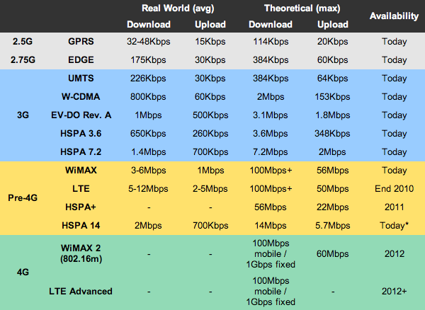
Mobile Cellular Technologies
Spectrum regime: Licensed
Coverage: Wide area or metropolitan area
Data rate: increasingly high
Evolution: 5 generations
  1G : Analog
  2G : Digital
  3G : Voice and data (Broadband)
  4G : Broadband evolution, LTE, LTE advanced, Multimedia
  5G : High data rate, intensive M2M, low delay, etc.
Figure from: http://sudhakarreddymr.wordpress.com/2011/06/01/ difference-between-1g-2g-2-5g-3g-pre-4g-and-4g/

Slide 9
Mobile Cellular Technologies (cont.)
Key Observations
  Advantage: Popular solution for last mile connectivity
  Challenge: Service providers are reluctant to provide services in some remote and rural areas due to so called “low return in investment”
  Case Study: Many others rural areas are connected using mobile cellular technologies
Source ITU: Figure from: https://www.itu.int/en/ITU-D/Statistics/Documents/facts/ICTFactsFigures2017.pdf

Slide 10
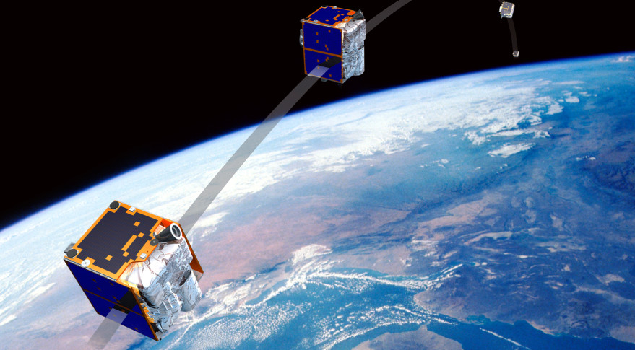
Satellite Technologies
Spectrum regime: Licensed
Coverage: Wide area
Data rate: increasingly high
  Modern satellites induce low propagation delay
  Satellite in lower orbits used for data services ( orbits between 400 and 1,000 miles above the earth's surface)
  Increase in capacity: high Throughput (100s – 1000 Mbps uplink)
Advantages: Offers the possibility to connect remote and hard-to-access places
  Used in some cases as a preferred last mile connectivity solution
Challenge: Satellites cost, considered high, is the main limitation
Case study:
  Mexico is using satellite technology to connect thousands of villages and millions of people in rural and remote areas through new business models
  Small satellites argue the reduced cost for satellite services
Source: ITU Symposium on small satellite regulation
https://www.itu.int/en/ITU-R/space/workshops/2016-
small-sat/Pages/default.aspx

Slide 11
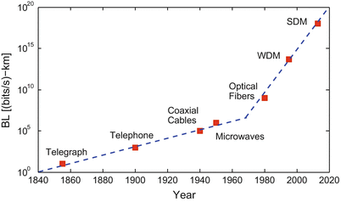
Optical Fiber Technology
Fiber is used until the premise, e.g., home
Coverage: Wide area
Data rate: Very high (highest)
  Figure shows evolution of communication technologies. last 3 are optical fibers technologies
Advantages
High performance
High capacity of the fiber
Low error rates in the transmission
Challenges
High cost of installing fiber to each premise
The end to end path needs to have similar performance
Case study: Fiber to the promises is used in many urban areas, especially in developed countries
Ref: “Optical Communication: Its History and Recent Progress” Springer book by Govind P. Agrawal
Notes:
WDM : Wavelength Division multiplexing is a technique in fiber optic transmission that enables the use of multiple light wavelengths (or colors) to send data over the same medium. Two or more colors of light can travel on one fiber and several signals can be transmitted in an optical waveguide at differing wavelengths.
Space-division multiplexing (SDM) uses multiplicity of space channels to increase capacity for optical communication. It is applicable for optical communication in both free space and guided waves. T

Slide 12
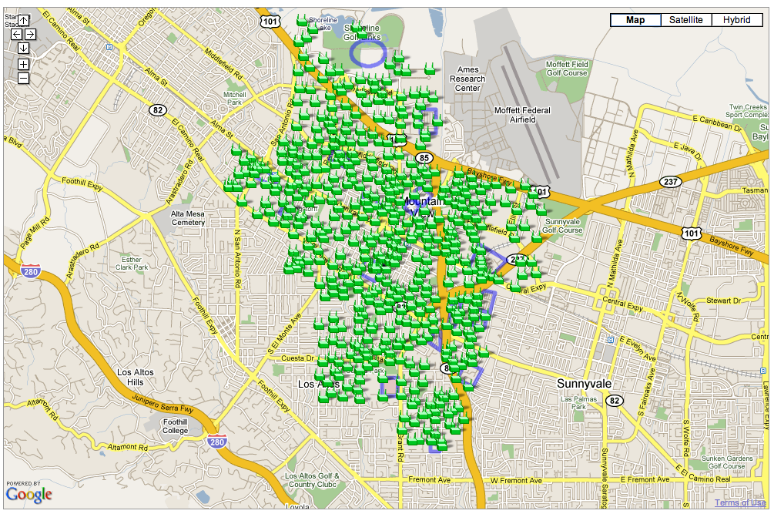
Wi-Fi Technology
Google Wi-Fi Network in CA
Family of 802.11 standards
Spectrum Regime: Unlicensed spectrum band (ISM, 2.4 GHz, band)→ Low cost
Coverage: Local area network, e.g., campus
Data rate:
  802.11a ( initial version) ~54 Mbps
  Increased data rate e.g., 2.4 Gbps expected for 802.11ax (Wi-Fi 6) with ratification expected in Q4 2019)
    Multiple antennas, (2 antennas at the transmitter and 2 antennas at the receiver)
    OFDMA (orthogonal frequency division multiple access)
Advantage
  Good candidate if the backbone is not far from the locality
  Wi-Fi technology has been used to create mesh networks
Challenge
  Reduced range, i.e., not applicable when the backbone is far
Case study
  In India, several rural areas have been connected using Wi-Fi as last mile connectivity solution

Slide 13





High Altitude Platform Station (HAPS) and UAVs
Many projects aiming to deliver connectivity to people in unserved/ underserved communities
  Drones (Unnamed Aerial Vehicle, UAVs) to serve as mobile base stations to provide connectivity, as shown in figure below
    Case study: The Airbus Zephyr, a series of lightweight solar-powered UAV
  Google Loon , using a network of balloons flying 20 km up traveling on the edge of space
Drone-to-drone relay to extend coverage
Fill in missing backhaul
BS
BS
Switching Office
BS
  Ref: Figure reused from a joint proposal with Tim Brown

Slide 14
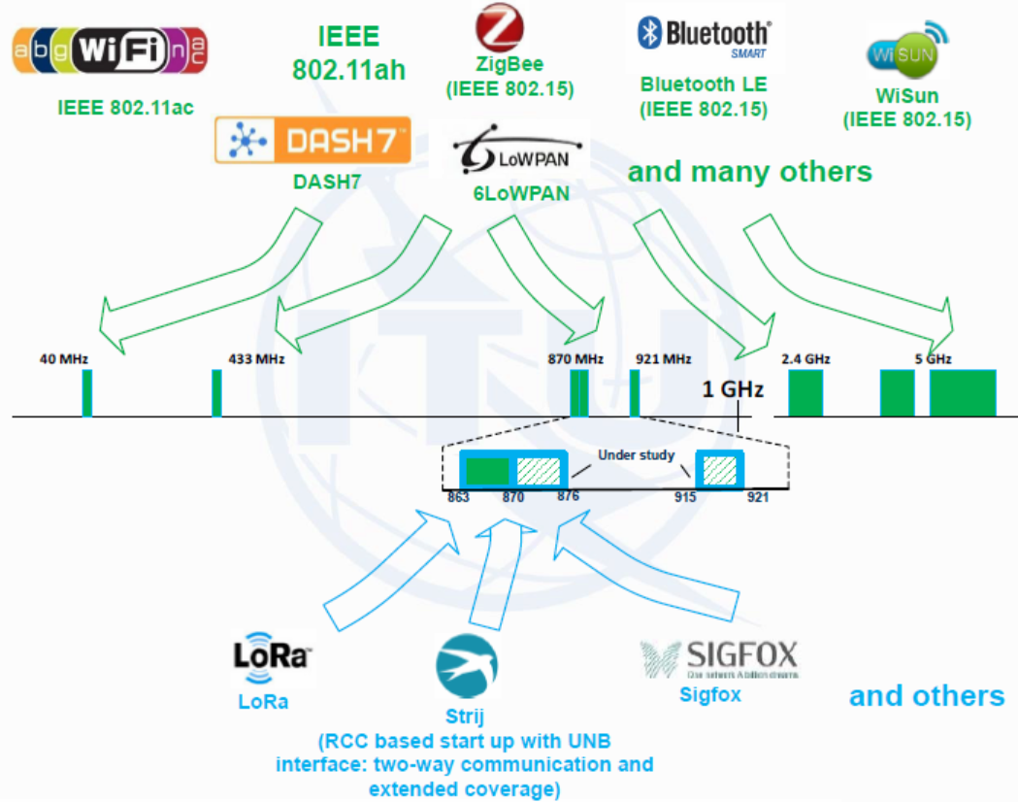
Other Technologies
Other Local area, home area and personal area technologies, e.g., for IoT

Slide 15
Business and Regulatory Models
Large Operators (e.g., mobile service providers, satellite providers)
  Usually operate under a licensing regime
  Use licensed spectrum
  Offer traditional voice and data
    Advantage: have a large coverage and some guaranteed quality of services
    Challenge: Reluctant to serve some areas considered with to have low return on investment
    Case Study: This is the traditional business model for mobile cellular or satellite service providers, e.g., Deutsche Telecoms, France Telecoms
Mobile Virtual Network Operator (MVNO)
  Do not own the network
  Use networks of large(r) operators with specific business agreement
  Create their own business model
    Advantage: Can increase accessibility by providing different business models, e.g., provide prepaid when the larger operator provides postpaid services, e.g.,
    Challenge: MVNO have the same coverage as the large operator since they use the same network, hence do not present a solution to extend connectivity
    Case study: Voiceworks Netherlands, Welcome Italia, a B2B telecommunications provider, Transatel launched over 150 MVNOs with expertise in Machine-to-Machine connectivity and IoT (Internet of Things)

Slide 16
Business and regulatory models (cont.)
3. Small Operators, e.g., Internet Service Providers (ISP)
  Operate under authorization (Less stringent than a license and most times free or low with low fees)
  Usually small to mid-sized operators
  Can operate in unlicensed (e.g., Wi-Fi) or licensed regime spectrum
  In some countries they can provide data and voice but in many countries, they provide only data and are not allowed to provide voice over IP using a number, to “protect” the large operators who pay fees.
    Advantages: Increase competition
    Challenge: Their geographical coverage is rather small and therefore, do not mostly cover remote areas
    Case study: Business case for small operators has been experimented in various countries in Latin America

Slide 17
Business and regulatory models (cont.)
4. Community Networks
  Usually very small networks managed by the community itself
  Different business models exist
    Advantage: Allows unconnected community to be connected
    Challenge: Sustainability of the community network is rather a challenge
    Case study: Community networks have been experimented in many countries, particularly in Central and Latin America
5. Hybrid Model
  Interesting models arise when combining two or more business models
  E.g., Large Operators and small Operators: Small operator can provide the local solution to the last mile connectivity and big operator provides capacity to connect to the Internet.
    Advantages: Can allow expanding the geographical connectivity
    Challenge: necessitate a fair model to allow accessibility (low cost)
    Case study: This model has been experimented in different places, e.g., in India

Slide 18
ITU Last Mile Connectivity Project:
Objectives
Objective: Provide guidelines, toolkits and solutions to support ITU Members in setting last miles connectivity infrastructure and applications in order to close the connectivity gap
  Increased access to broadband
    Increased last mile networks
    Interconnection of (local, national and regional) networks
  Reduced cost of access
  Increased development of digital Skills
  Enhanced development and use of local solutions, applications, content & data

Slide 19
ITU Last Mile Connectivity Project:
Deliverables
Compilation of case studies, from different regions of the world, on last mile connectivity solutions
Analysis of the use of different technologies, policies, regulations and business models to provide citizens with affordable and accessible last mile connectivity solutions
Guidelines and/or toolkits for setting, maintaining and using last mile connectivity solutions
Capacity building for local applications development as well as innovations
Local data and content production, storage and processing
Implementation of last mile connectivity solutions

Slide 20
ITU Last Mile Connectivity Project:
Implementation
The project will be implemented by the ITU and various partners
  The project will be under the umbrella of the ITU
  Potential partners are invited to provide contributions in any part of the study
    Case studies
    Last mile connectivity technologies
    Sustainable business solutions for last mile connectivity
    Regulations and Policies
    Applications
    Implementation of the last mile connectivity solutions
    Financing the project implementation
The contributors and their organizations will be recognized (as contributors or authors)

Slide 21
Please contact Aminata A. Garba, aminata.amadou-garba@itu.int, for more information, questions or interests about the ITU Last Mile Connectivity Project
Thank You

