Slide 1
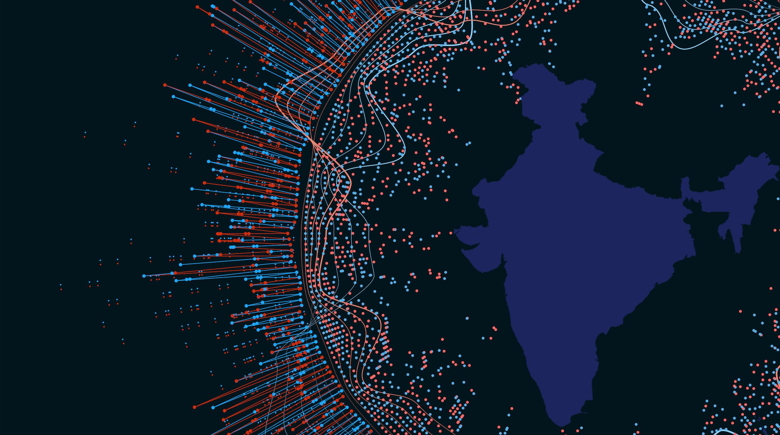
ICT Infrastructure as a Basis for Digital Transformation
Dr R S Sharma
Chairman, TRAI
May 14, 2019
ITU Workshop for Europe and CIS,
Kiev, Ukraine

Slide 2

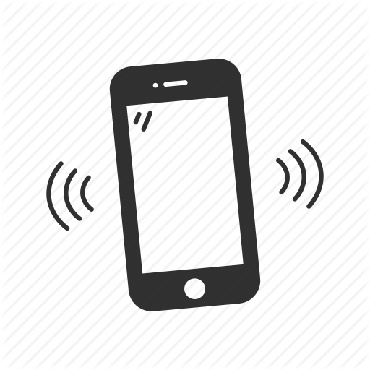



In 2008, India was lagging on various indicators
1.59 out of 10
ICT Development Index put India 118th in the world
5%
Digital Payments Adoption
61%
Mobile coverage
6 million
Tax-paying businesses serving a 1 billion+ people
>35%
Banked Population
20-30%
Leakages across govt schemes, eg LPG
Notes:
Removed: Demographic dividentd; NPR effort

Slide 3
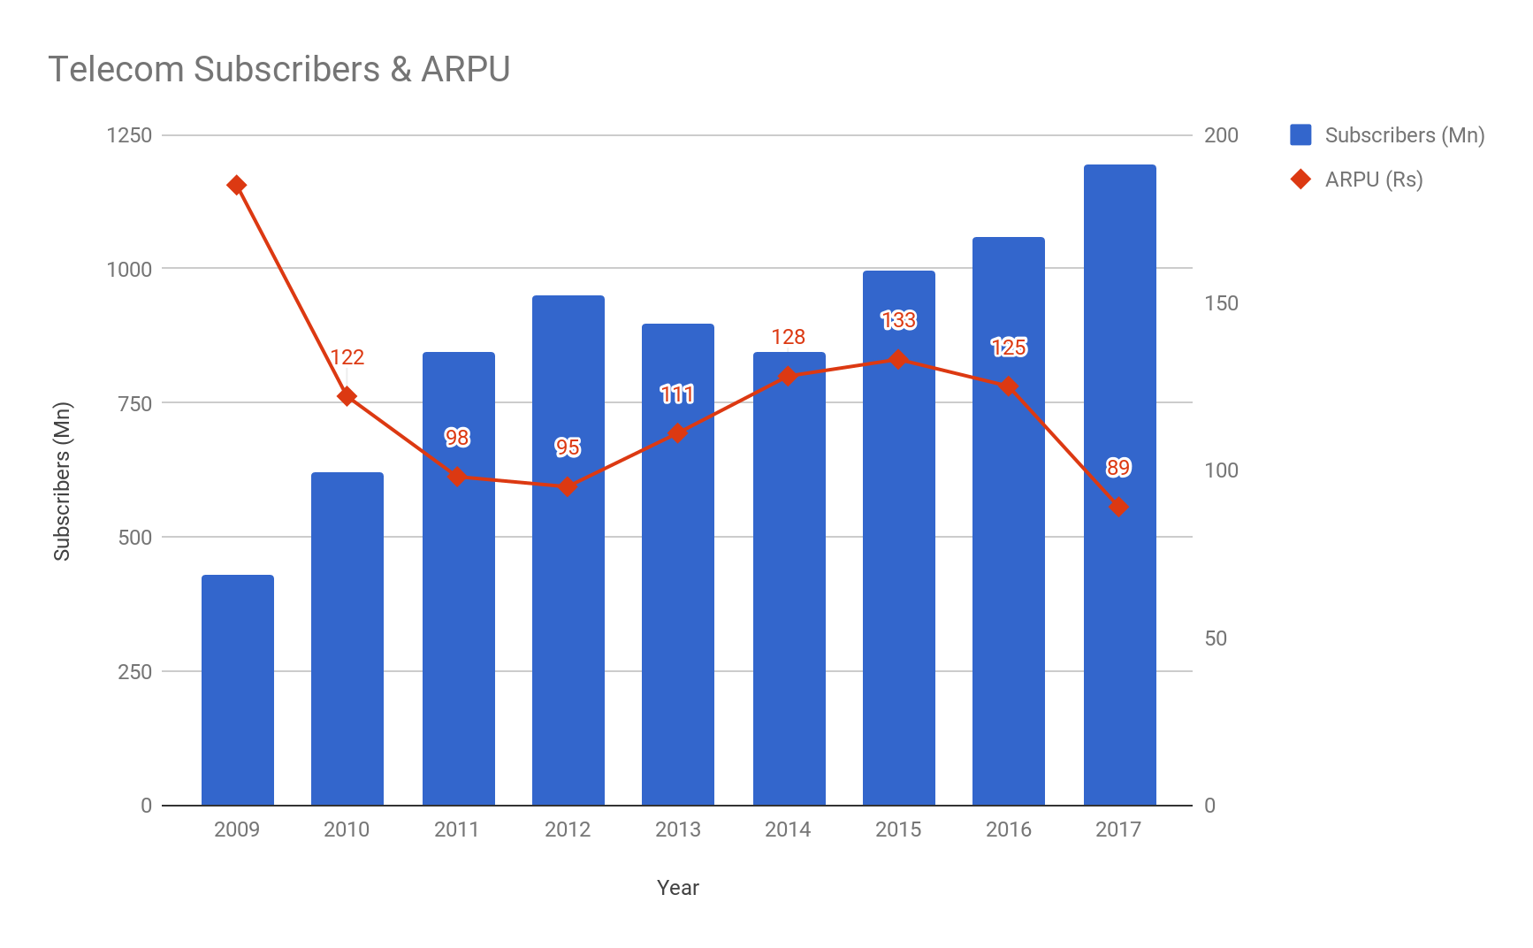

India went from 37% to 93% Teledensity in 8 years ...
There are now 1200+ Mn mobile connections, connecting over 700+ Mn Unique Subscribers
Many of them are accessing 4G internet speeds with quotas of 1 GB/day, at a ARPU of less than 90 Rupees.
Source: COAI, TRAI
Notes:
Example Netflix

Slide 4
India’s boom in Internet services
Data consumption per SIM is the highest in the world!
Average data usage increased over 12 times in last three years
Likely to continue at 73% CAGR
Broadband subscribers increased from around 85 million at the end of 2014 to approximately 525 million at the end of 2018.
Cost per GB data rates is the lowest in the world
The only outlier among developed and developing countries
Teledensity
Growth from 4 to 92 connections per 100 population

Slide 5
The JAM Trinity
Janadhan
Aadhaar
Mobile

Slide 6
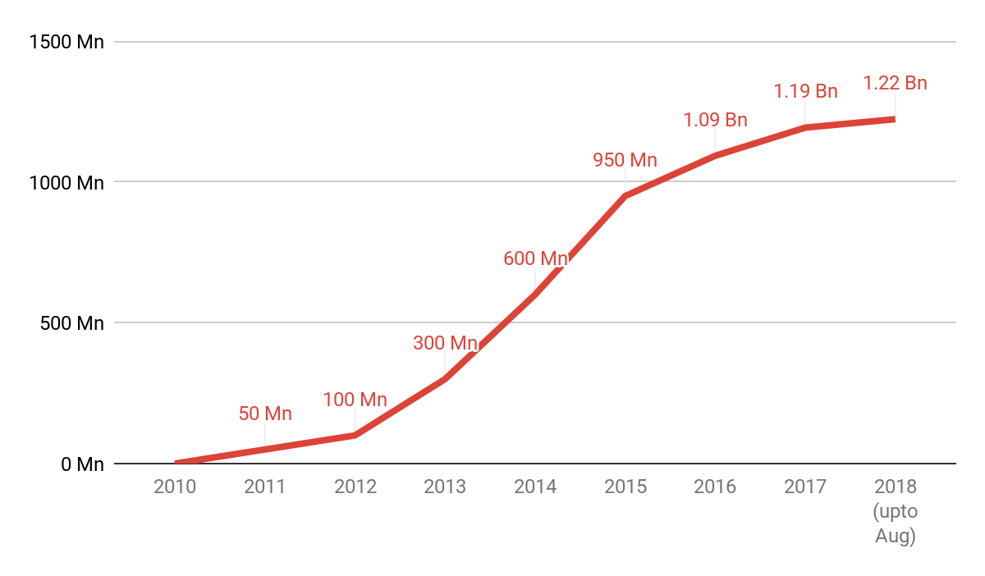

Aadhaar - the world’s largest biometric identification system
Aadhaar has enrolled 99% of the adult population across India - enrolling 2M/day at its peak
Source: UIDAI website
Notes:
Took 5 years

Slide 7
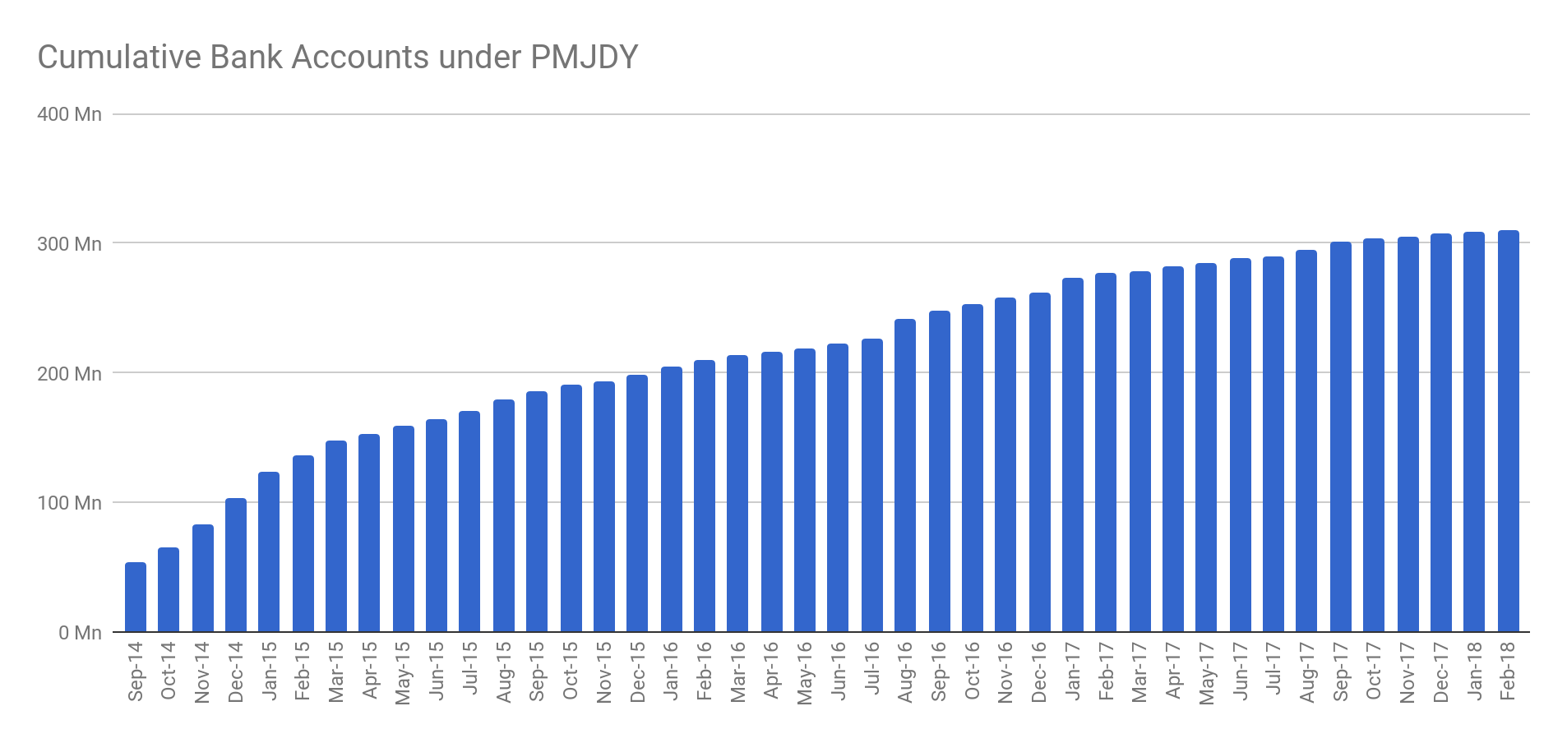
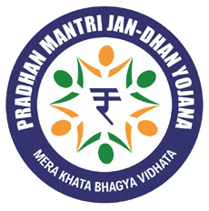
10X number of Jandhan Bank Accounts in 3 years
Starting with 30 Mn accounts in Sep-2014, India crossed 355 Mn Jandhan accounts in April 2019
850 Mn
582 Mn
Aadhaar-Seeded Bank Accounts
Unique Bank Account Holders
Source: UIDAI website, PMJDY Website, as of Feb-2018
Notes:
Example Netflix

Slide 8

The marvel called smartphone
Low cost
Functions despite interruption in power supply or breakage of cables
Supports local languages
It’s a bank, a library, the newspaper, a substitute for television and cinema, and much more ….
Combines with Aadhaar and Jan Dhan to create a new paradigm

Slide 9
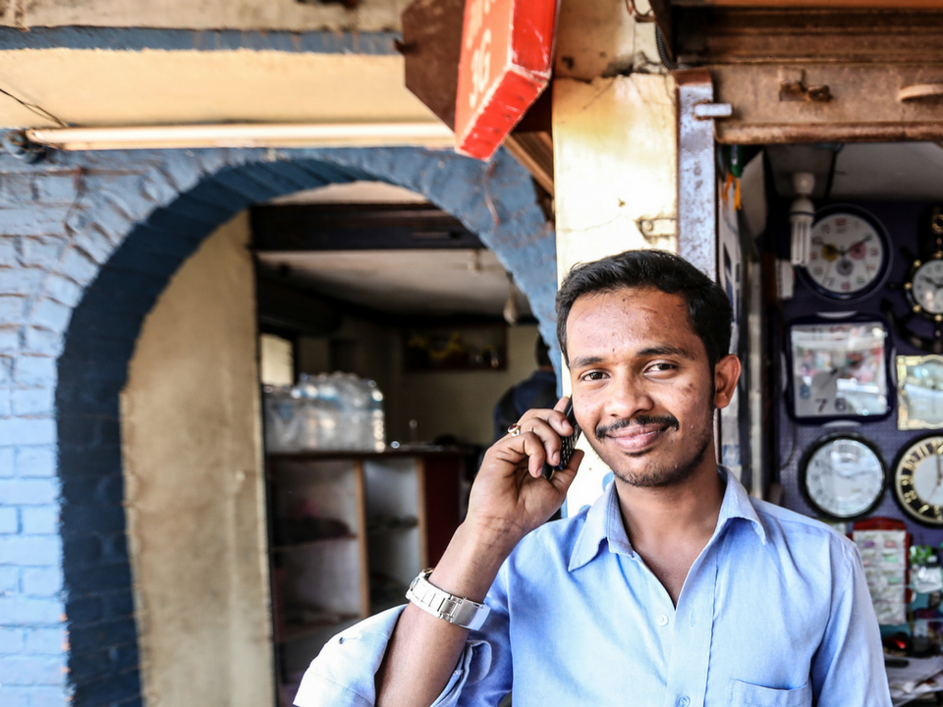


By 2018, due to JAM, India embraced digital
1.21 Bn
1.22 Bn
Mobile Connections
Aadhaar Enrolments
462M
$20B
Internet Users
Digital payment transactions monthly
582M
10M
Unique Bank Accounts
Registered Businesses

Slide 10
10
1
India achieved this by building Foundational Digital platforms.
Paperless, cashless, presenceless, and with electronic consent
Notes:
3 reasons : Consumer side, indians are going digital.
Businesses are becoming tax compliant, friendlier policies.

Slide 11
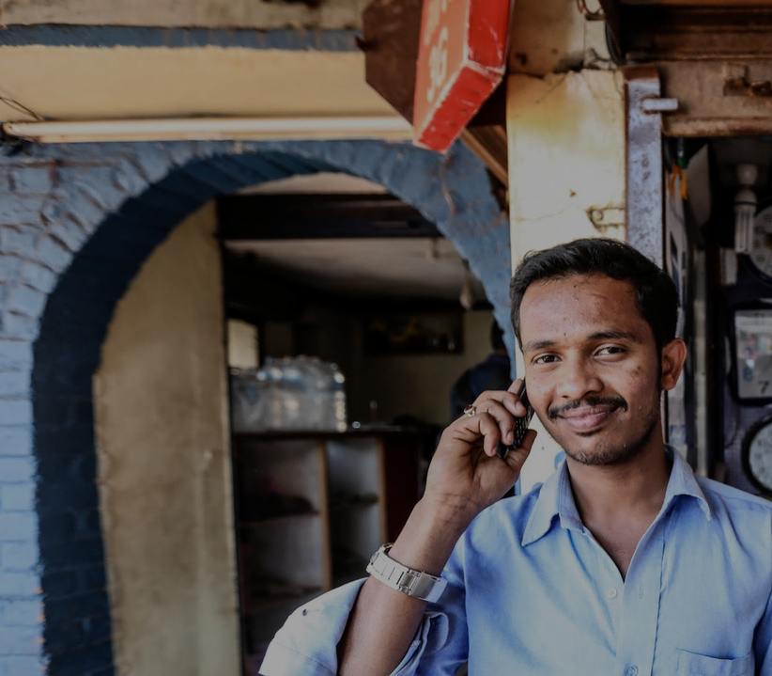

India’s
Digital DNA
Powered at scale by
India Stack
IDENTITY LAYER
A unique digital biometric identity with open access of nearly a Billion users

Slide 12


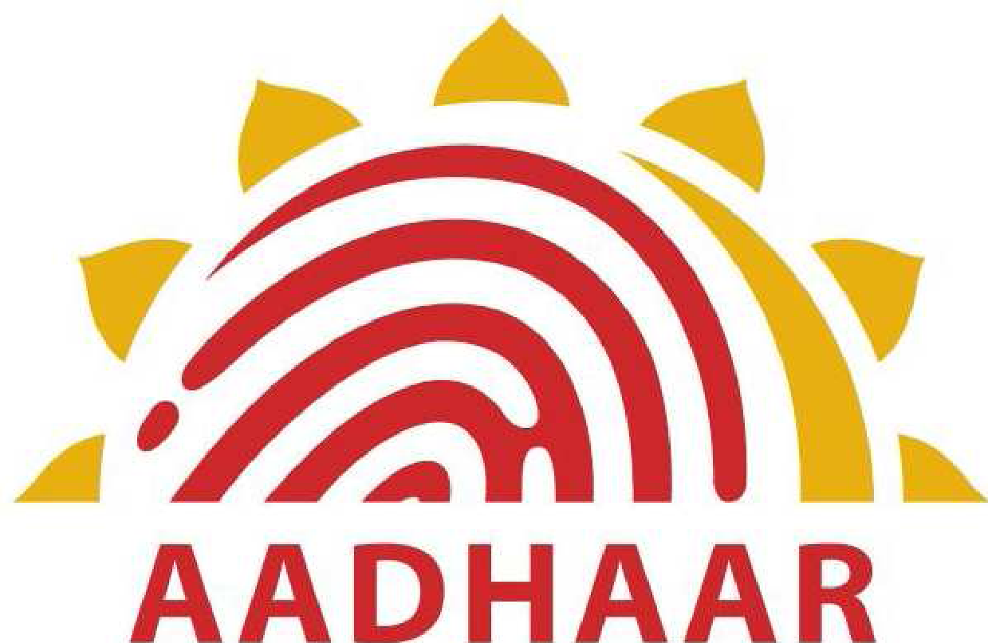
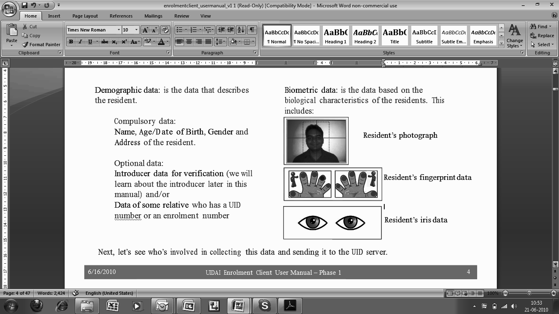
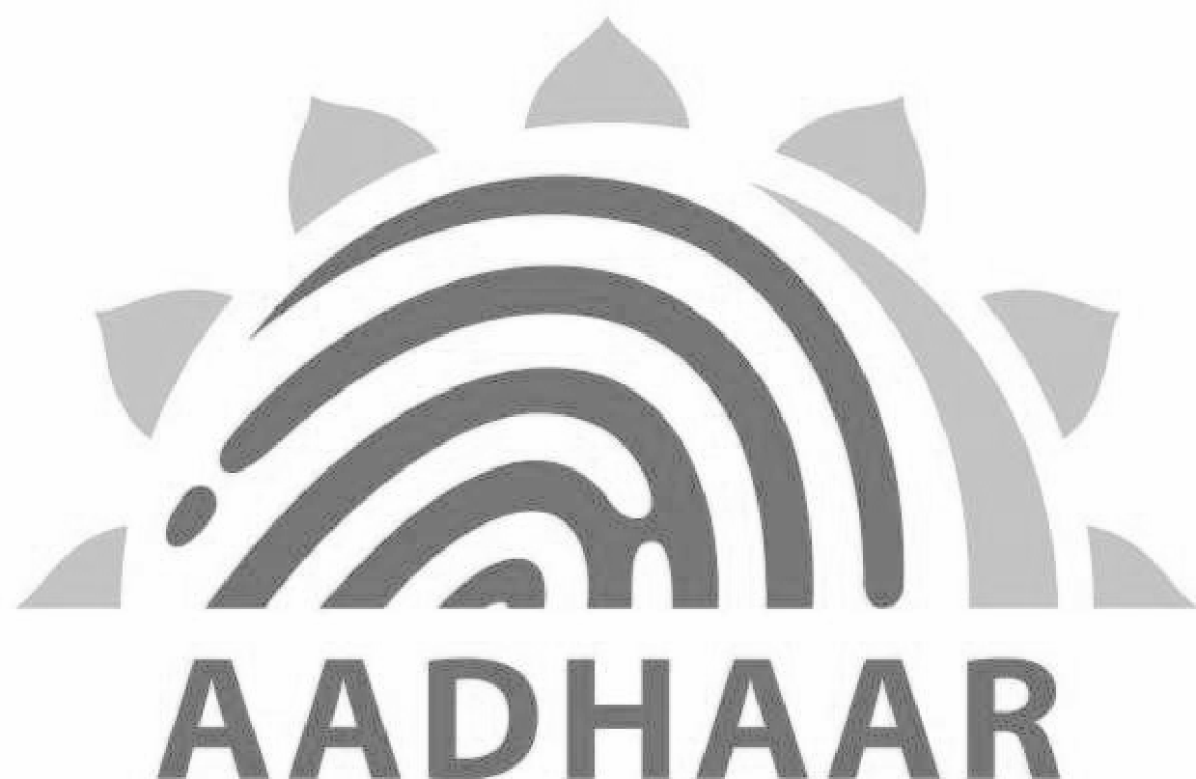
Aadhaar - The country’s first Digital Identity Platform
Name
DoB/Age
Gender
Address
Mobile/Email
1234 5678 9012
Foundational
Minimal
Unique
Lifetime
Source: http://uidai.gov.in

Slide 13




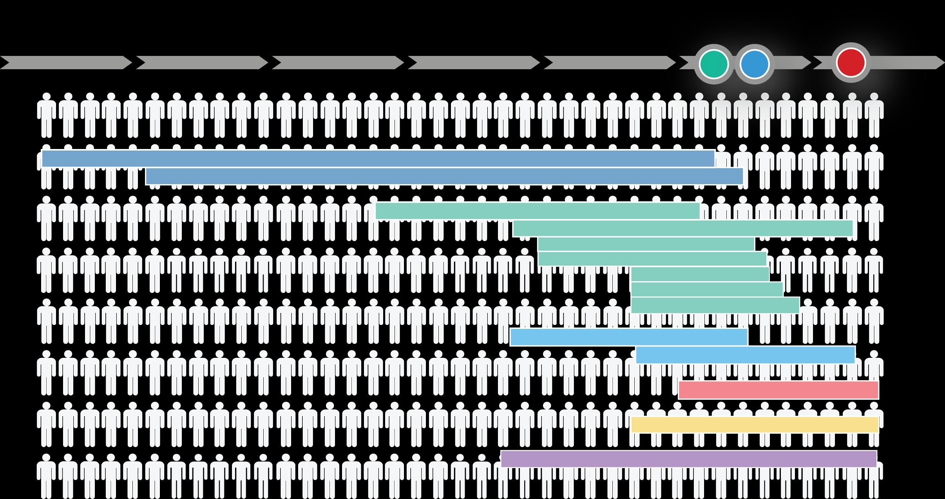


It is one of only 7 global
platforms to reach a billion
users!
12Yrs
8.7Yrs
25Yrs
5.5Yrs
‘11
‘13
‘16
1985
1990
1995
2000
2005
2010
2015
AADHAAR
Fastest (5.5 yrs) to 1b
Only Govt system
Only non-US system
Windows
25 Yrs
Office
Google Search
12 Yrs
GMail
YouTube & Maps
8 Yrs
Android, Chrome
6 Yrs
Facebook
8.7 Yrs
WhatsApp
6.8 Yrs
Aadhaar
5.5 Yrs
App Store
??
WeChat
??
Source: http://www.cbinsights.com , portal.uidai.gov.in, wikipedia

Slide 14
India’s
Digital DNA
Powered at scale by
India Stack
AUTH LAYER
Rapidly growing base of paperless systems with billions of artifacts
IDENTITY LAYER
A unique digital biometric identity with open access of nearly a Billion users

Slide 15
Aadhaar - Identity APIs enable presence-less and paperless verification
Authentication
Electronic KYC
ELIMINATES
PHYSICAL PRESENCE
Are you who you claim to be?
ONLY a yes/no answer
Anytime anywhere
ELIMINATES PAPER BASED
KNOW YOUR CUSTOMER
ONLY done with authentication
No more fake documents
Anytime anywhere
Source: http://uidai.gov.in

Slide 16
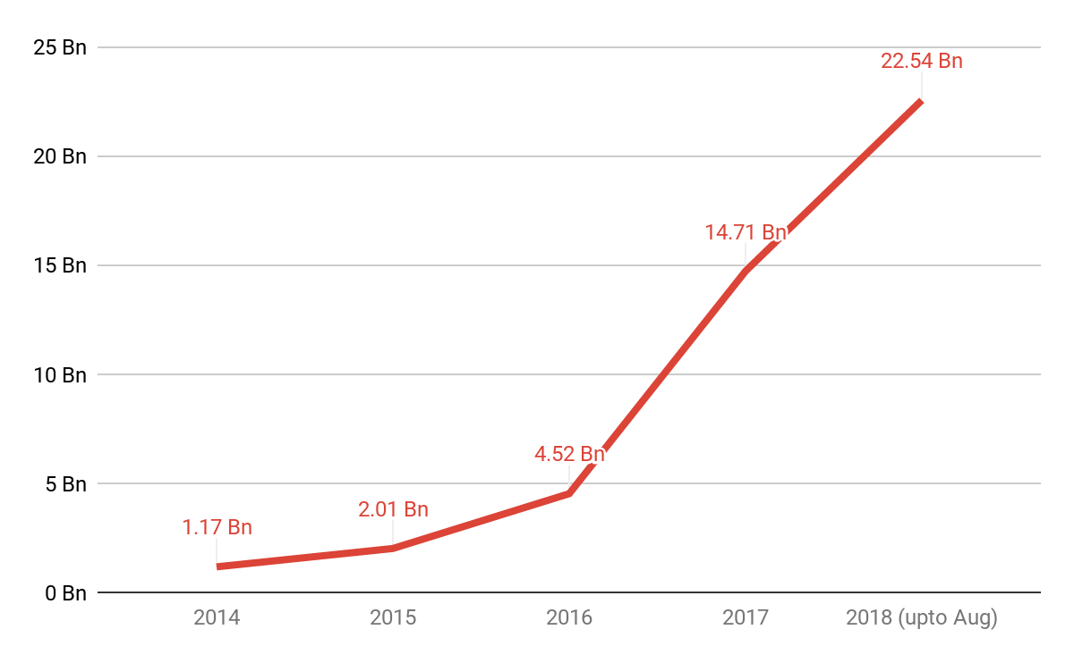
10 Bn Aadhaar Authentications in 2017 - 8 Bn till Aug 2018!
Aadhaar Authentication is being used to:
Open bank accounts,
Get SIM cards,
Mark attendance of public sector employees,
....And many more uses
27.5 millions transactions per day in the last 30 days!
Source: UIDAI website
Notes:
@ 27.5 million transactions per day works out to 10 billion per annum

Slide 17
India’s
Digital DNA
Powered at scale by
India Stack
PAYMENTS LAYER
Game changing electronic payment systems and
transition to cashless
AUTH LAYER
Rapidly growing base of paperless systems with billions of artifacts
IDENTITY LAYER
A unique digital biometric identity with open access of nearly a Billion users

Slide 18
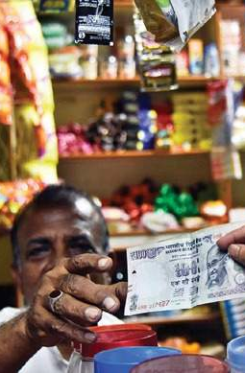
<15%
Transactions are Digital Payments
Pre-2016, most Indians still transacted in cash because of:
Fragmented digital payment modes
Complexity
High cost of transactions
<10%
Bills are paid online
<2 POS
/1000 Debit Cards
Source: Google-BCG report

Slide 19

Unified Payments Interface standardized language of money transfer
We created a foundational, Interoperable, multi-provider instant money exchange framework
Universally interoperable
Single Payment Address
@
Anyone with a bank or mobile money account can send money to any other account in India!
No need to disclose account information.
Allows account portability, enhances privacy.
Minimal Issuer/Acquirer Cost
Mobile First Payments
To leverage the increasing proliferation of mobile phones
Smartphone replaces card and Payment Address replaces PoS machine!
Source: http://npci.org.in

Slide 20
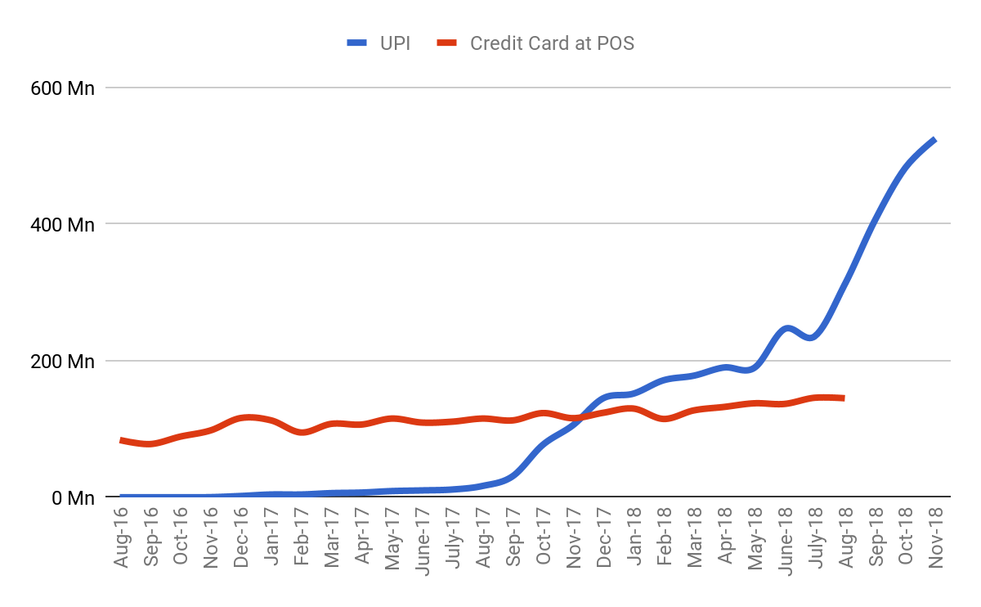
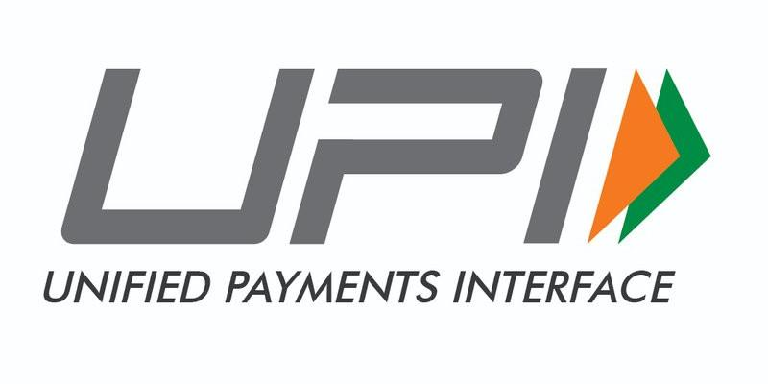
UPI is the fastest growing digital payments platform globally
799 Mn Txns &
19 B$ in Mar 2019
More transactions per month on UPI in 18 months than on Credit and Debit Cards after nearly 40 years!
Source: RBI website
Notes:
Debit cards crossed at point of sale

Slide 21
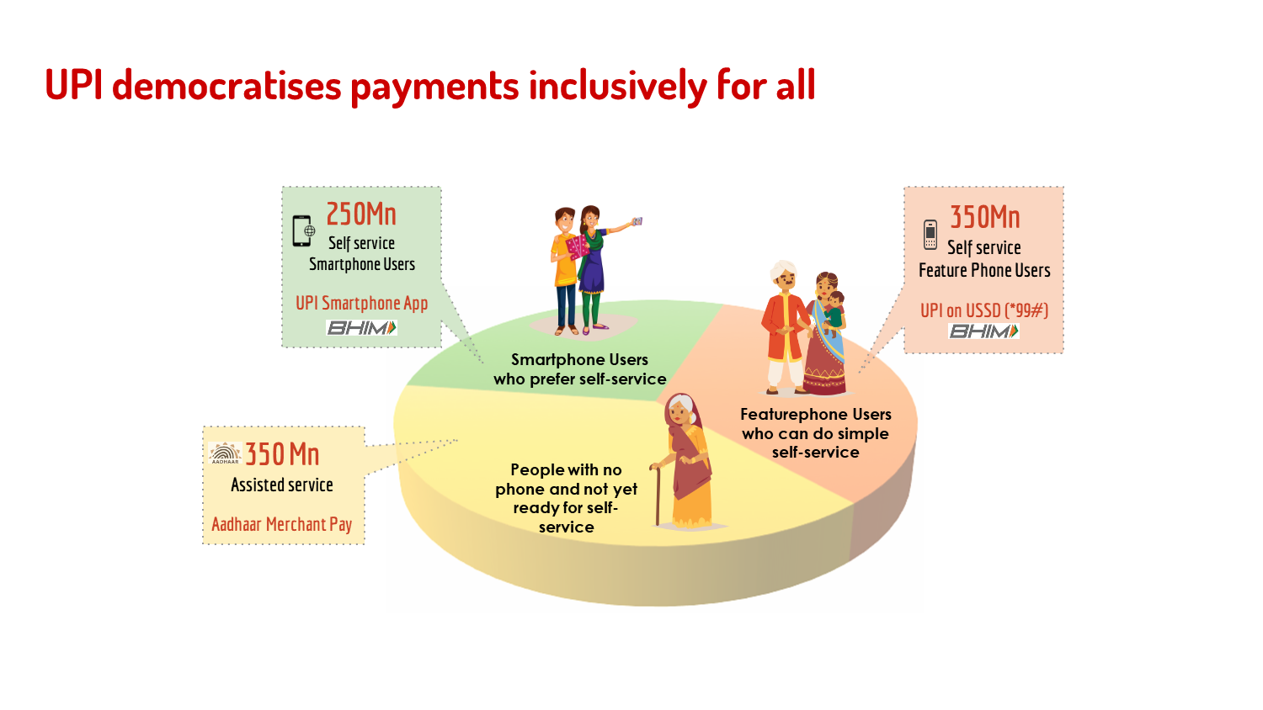

Slide 22
India’s
Digital DNA
Powered at scale by
India Stack
PAPERLESS LAYER
Online electronic signature service & a digital locker for documents
PAYMENTS LAYER
Game changing electronic payment systems and
transition to cashless
AUTH LAYER
Rapidly growing base of paperless systems with billions of artifacts
IDENTITY LAYER
A unique digital biometric identity with open access of nearly a Billion users

Slide 23
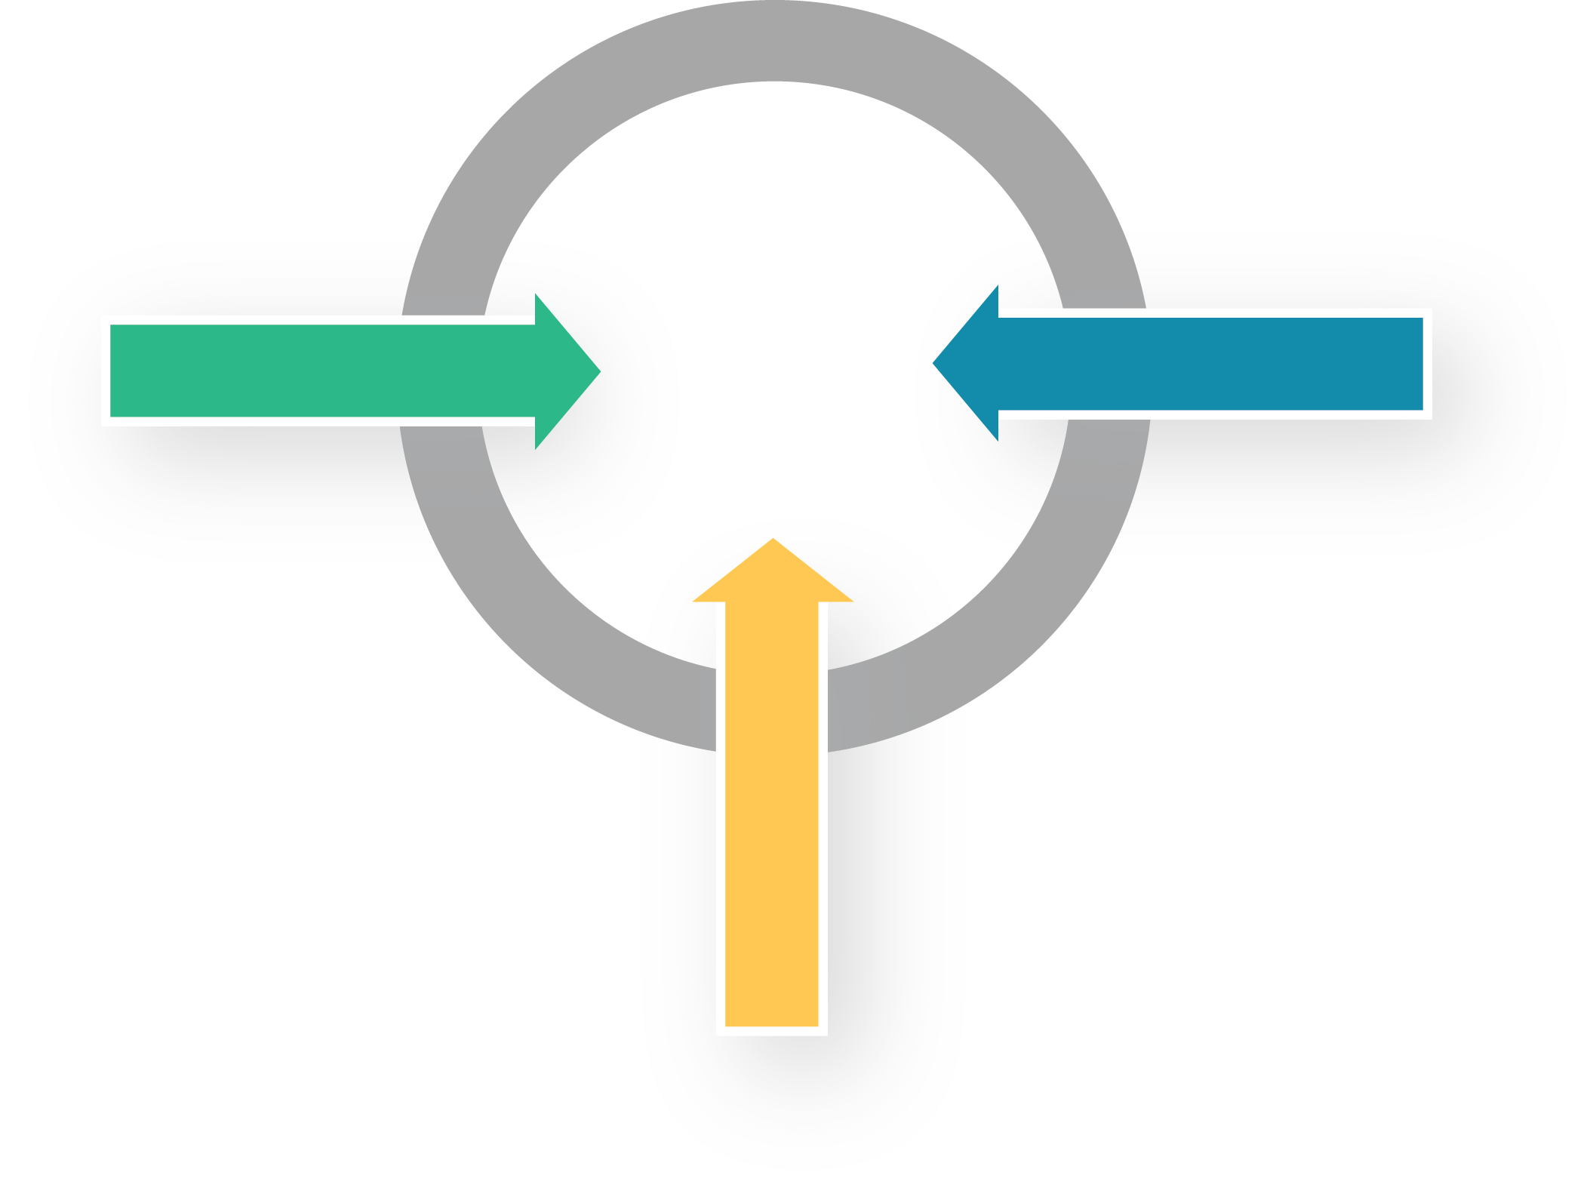





Digital Locker - eliminating paper!
Issues
Documents Digitally
Accesses Documents Online
Machine-readable documents
Digitally protected
2.3 Bn documents
issued
Multi-provider Digital Locker Ecosystem
Issuer
Requestor
Approves
Access
Users
No Physical Papers
No Fake Documents
Source: https://digilocker.gov.in

Slide 24
CONSENT LAYER
Provides a modern privacy-enhancing data sharing framework based on electronic consent
India’s
Digital DNA
Powered at scale by
India Stack
PAPERLESS LAYER
Online electronic signature service & a digital locker for documents
PAYMENTS LAYER
Game changing electronic payment systems and
transition to cashless
AUTH LAYER
Rapidly growing base of paperless systems with billions of artifacts
IDENTITY LAYER
A unique digital biometric identity with open access of nearly a Billion users

Slide 25


A new consent based Data Empowerment approach!
Electronic Consent Artefact
Authorization via 2-fa
Data Access Notifications
Data Providers
Data Consumers
Consent to share data
DP #1
Consent Collector
DC #1
Request for Data
Request for Data
DP #2
DC #2
DP #3
E2E Encrypted Data Flow
based on User Consent
DC #3
DP #N
DC #N
Registry

Slide 26





The Account Aggregator
will facilitate consented sharing of financial information in real-time
Request for Data
Electronic Consent Artefact
Consent to Share
Encrypted Data Flow
Data Access Notifications
Financial Information Providers
Financial Information Users
Consent to share data
Bank
Flow-Based Credit
Financial Data Access Fiduciary
(NBFC Account
Aggregator)
Mutual Fund House
Personal Finance Management
Request for Data
Insurance Provider
Wealth Management
Tax / GST
Platform
Robo Advisors
E2E Encrypted Data Flow
based on User Consent

Slide 27
3.5 B
Digital Docs
33 M
e-Signatures
India Stack is gaining acceptance.
Used by 56 ministries in the centre and all 29 states in delivery of over 434 schemes totalling $70 B in direct transfers
Saved the govt an estimated $13 B in leakages so far
Significant benefits to the private sector
PAPERLESS LAYER
PAYMENTS LAYER
799 M (monthly)
900 M (monthly)
AUTH LAYER
IDENTITY LAYER
1.23 B
Digital Identity Holders

Slide 28




Going Digital at scale accelerates development
Inclusion & Access
Critical products and services are designed to scale
Friction Reduction
Reduces cost of doing business, and expands markets
Increased Trust
Digital & portable attestations, verifiable claims

Slide 29
29
1
2
India achieved this by building Foundational Digital platforms. Paperless, cashless, presenceless, and with electronic consent
The approach is now moving to all sectors!
Platforms give rise to more platforms
Notes:
3 reasons : Consumer side, indians are going digital.
Businesses are becoming tax compliant, friendlier policies.

Slide 30
India Stack gave rise to domain specific platforms
National Health Stack
Bharat Bill Payment System
National Teacher Platform
Electronic Toll Collection - FasTag
Digital Sky
Goods & Services Tax Network
India Stack
JAM

Slide 31
A repository of matched invoices!
Machine-readable matched invoices
API-driven platform for tax filing, invoice upload
10 Million+ businesses enrolled
1 Billion+ invoice lines per month
$12 Billion+ (INR 90K Cr) monthly collection
Goods & Services Tax Network
Source: public data on GST

Slide 32
An ID + wallet for every vehicle!
Unique Vehicle ID and linked prepaid wallet
API based platform for authentication & payment
2.5 Million+ tags issued so far
Live in 375+ toll plazas collecting 24+% of total toll
17 Million+ transactions a month (within a year)
Mandated for every vehicle from Dec '17
National Electronic Toll Collection - FasTag
Source: https://www.npci.org.in/netc-adding-speed-india’s-highway-network

Slide 33

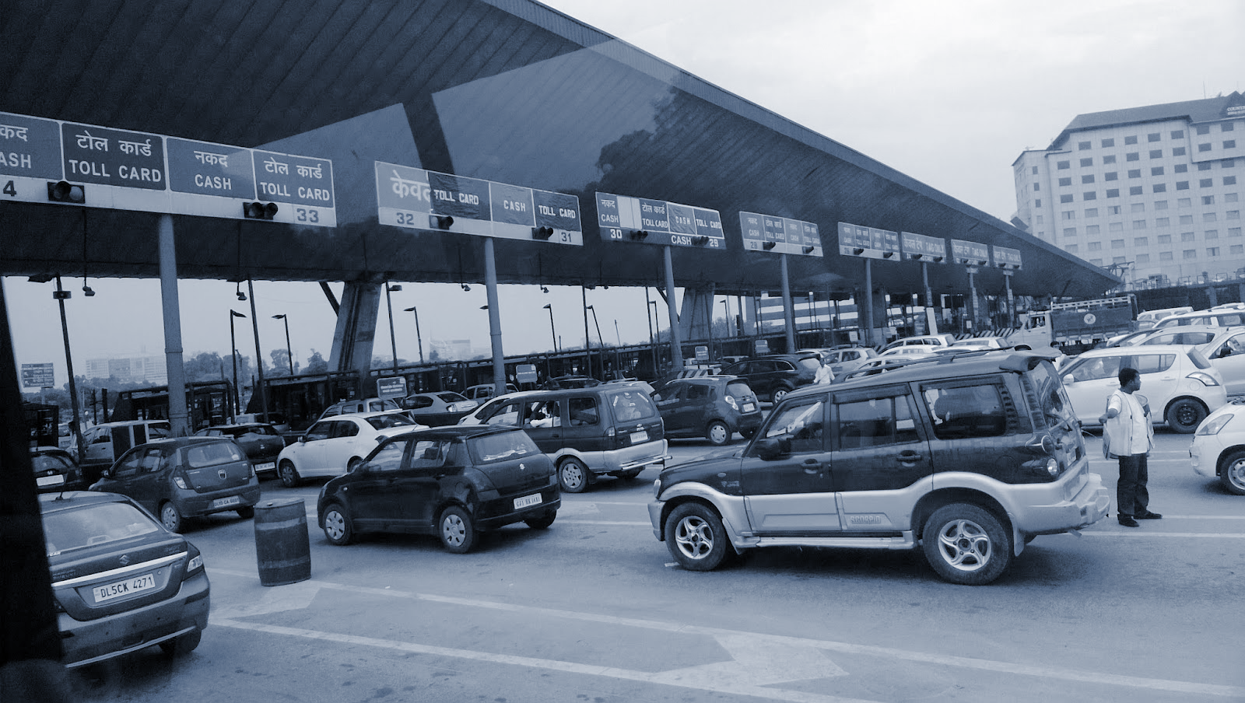
Electronic Toll Collection
Interoperable RFID tag and API specifications
Works across 350+ toll booths on national highways
All vehicle classes, ~60 Million, supported
4 Large banks ready to be issuers and acquirers
Built as an Open API platform. In future, can be used for dynamic pricing, congestion pricing, parking apps, etc.
It can also be used to auto link transport manifests for ease cross border movements.
Source: NPCI website and discussions with NPCI

Slide 34
Every Biller on one platform!
Common Bill Collection and Payment Platform
Open APIs for Bill Fetch, Payment Messaging
Generates data even for cash payments!
1 Billion bills paid every month in India!!
Bharat Bill Payment System

Slide 35
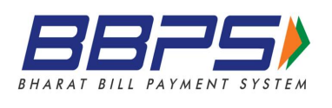
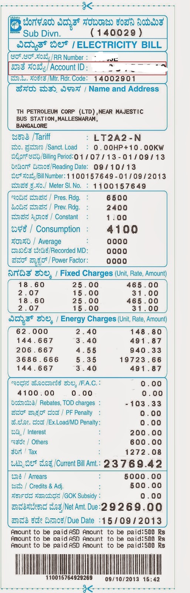
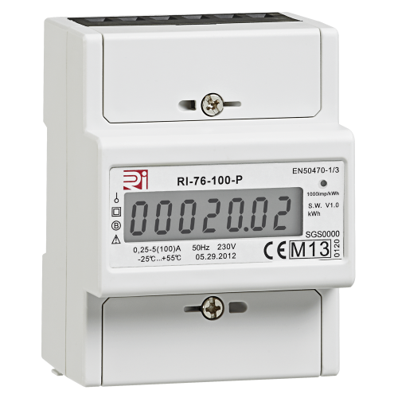
Bharat Bill Payment System
API based platform allowing innovation on delivery models
~1 Billion
Bills per month
~250 Billion INR monthly payments
Ecosystem incentives aligned for rapid adoption
Multi-channel (web, mobile, offline, etc) with multi payment methods (card, cash, UPI, etc)
Unbundling bills, access, payments and rebundling for any-to-any
Bills can go into Digital Locker which can then be shared with consent for a use (e.g. loan)
Source: Public data and NPCI website

Slide 36
Digital infrastructure for health!
A set of digital infrastructures such as Registries, Universal coverage, PHR, National Analytics, etc.
Registries with Open API for e-verification of health providers
Federated PHR to empower everyone
Universal coverage platform for 400 Million+ people!
National Health Stack

Slide 37
National platform for teachers and learners!
An API driven learning platform
Empowering 10 million teachers and 200 million children across 26 states to access more content
Built on open source platform sunbird.org
DIKSHA

Slide 38
Easy permissions to fly from government!
Drone stack to open up future transportation
API based Registry for drones, operators, & pilots
APIs for digital leasing and easy access
Secure hardware based controls for lease enforcing
No permission, No take-off!
Digital Sky

Slide 39
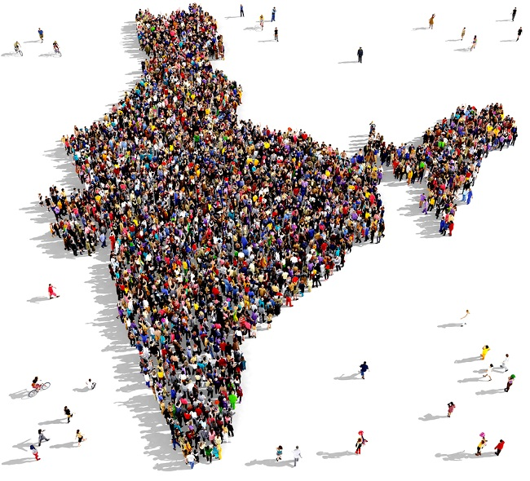
India’s approach to digital infrastructure will help us leapfrog our most important societal problems

Slide 40
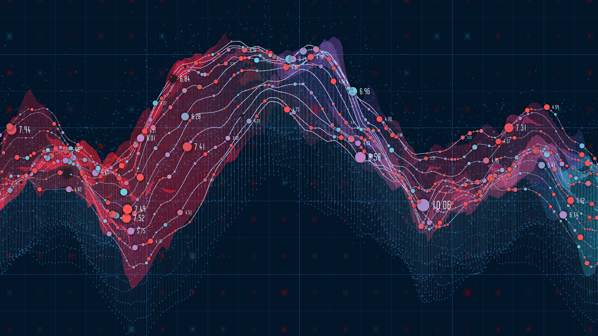
Thank You

