Slide 1


Cybersecurity development Areas of action - an overview
Farid Nakhli
Programme Officer, ITU Regional Office for CIS

Slide 2
BDT Cybersecurity Mandate
Enhancing security and building confidence in the use of ICTs is one of the priority domains for Objective 2 of the Buenos Aires Action Plan adopted at the 2017 World Telecommunication Development Conference. ​
ITU Plenipotentiary Conference (PP):
Resolution 130 (Rev. Dubai 2018) "Strengthening the role of ITU in building confidence and security in the use of information and communication technologies"
Resolution 174 (Busan 2014) "ITU's role with regard to international public policy issues relating to the risk of illicit use of information and communication technologies"
Resolution 179 (Rev. Dubai 2018) "ITU's role in child online protection"
ITU World Telecommunication Development Conference (WTDC):
Resolution 45​ (Dubai 2014) "Mechanisms for enhancing cooperation on cybersecurity, including countering and combating spam“
Resolution 67 (Buenos Aires 2017) "The role of the ITU Telecommunication Development Sector in child online protection"
Resolution 69 (Buenos Aires 2017) "Facilitating creation of national computer incident response teams, particularly for developing countries, and cooperation between them"
ITU World Telecommunication Standardization Assembly (WTSA):
Resolution 50 (Hammamet 2016) "Cybersecurity“
Resolution 52 (Hammamet 2016) "Countering and combating spam“
Resolution 58 (Dubai 2012) "Encourage the creation of national computer incident response teams, particularly for developing countries"
Related Study Group :
​ITU-D STUDY GROUP 2 (2018 - 2021): Question 3/2: "Securing information and communication networks: Best practices for developing a culture of cybersecurity"
Notes:
PREVIOUS Related Study Groups you may wish to add as well:
​​​ITU-T Study Group 17: ​​Security​
ITU-D Study Group 2 Question 3: Securing information and communication networks​

Slide 3
Expected Results – Outlined @ WTDC 2017
Objective 2: Modern and secure telecommunication/ICT Infrastructure: Foster the development of infrastructure and services, including building confidence and security in the use of telecommunications/ICTs
Outcomes 2.2: Strengthened capacity of Member States to effectively share information, find solutions, and respond to threats to cybersecurity, and to develop and implement national strategies and capabilities, including capacity building, encouraging national, regional and international cooperation towards enhanced engagement among Member States and relevant players
Output 2.2: Products and services for building confidence and security in the use of telecommunications/ICTs, such as reports and publications, and for contributing to the implementation of national and global initiatives
Expected Key Performance Indicators:
Number of cybersecurity national strategies implemented in countries that BDT contributed to develop
Number of CERTs that BDT has contributed to establish
Number of countries where BDT provided technical assistance and improved cybersecurity capability and awareness
Number of cyber attacks repelled by CERTs established with the support of BDT

Slide 4
Implementation Mechanisms
Project Implementations
Technical Assistance
Capacity Development
Information Sharing
Partnership Development
Product Development

Slide 5
BDT Cybersecurity
Services Focus Areas

Slide 6
Cybersecurity Services Catalogue
National Cybersecurity Strategy Development
National Cybersecurity Assessment
National Cybersecurity Assistance
Global, Regional and National events
Global Cybersecurity Index
Engagement and awareness
Computer Incident Response Team (CIRT) Program
CIRT Readiness Assessment
CIRT Design
Information sharing
High-Level Cybersecurity Simulations
Partnership
Development
Critical Infrastructure Protection Assistance
Technical Assistance
CIRT Establishment
CIRT Enhancement
Human Capacity Development
Curricula and Training Programs
Bespoke Training
Institutional Capacity Development
Regional Cyberdrills
National Cyberdrills
Good Practices
Study Groups
Information Exchange Tools and Techniques
Publications
ITU News Platform
Service areas
CAPACITY DEVELOPMENT
Services

Slide 7
Engagement and Awareness
Services
Global, Regional and National events
Global Cybersecurity Index
High-Level Cybersecurity Simulations
Partnership
Development
Data Collection
Research and Analysis
Reporting
Organizing
Co-Organizing
Contributing
Management “Table-Top” Exercises
Capacity Building workshops for Management
Implementation
Awareness
Capacity Development
Data Verification

Slide 8
National Cybersecurity Assistance
Services
National Cybersecurity Strategy Development
National Cybersecurity Assessment
Technical Assistance
Critical Infrastructure Protection - Advisory
Information Collection and Research
On-Site and Off-site Verification
Analysis and Reporting
Information Collection and Research
Cybersecurity Related Technical Support
Technical Advisory Assistance
Technical Advisory
Expert In-Country Assistance
Capacity Development on CIP Coordination
Capacity Development Workshop & Interviews
On-Site and Off-site Verification
Strategy Drafting or Review Workshop
Analysis and Reporting
Tools Use Training and Skills Development

Slide 9
Computer Incident Response Team (CIRT) Program
Services
CIRT Design
CIRT Readiness Assessment
CIRT Implementation
CIRT Enhancement
Research and Analysis
Analysis and Reporting
CIRT Readiness Assessment Report - Review
Project Planning
Products and Services Selection
Project Planning
Project Funding
Capacity Development Workshop & Interviews
Information Analysis and Design Drafting
Design Document and other related documentation
Project Funding
Questionnaire Development & Data Collection
Capacity Development Workshop & Interviews
Implementation, Monitoring and Evaluation
Products and Services Selection
Implementation, Monitoring and Evaluation

Slide 10
Human and Institutional Capacity Development
Services
Institutional Capacity Development
Regional Cyberdrills
National Cyberdrills
Human Capacity Development
Curricula and Training Program Development
Bespoke Training Development and Delivery

Slide 11
Information Sharing
Services
Information Exchange Tools and Techniques
Publications
ITU News Platform
Academia Members
The Honeypot Research Network (HORNET)
Guide to Develop National Cybersecurity Strategy
Reports
News Articles
Blogs
Information Analysis and Design Drafting
Design Documents and other related documentation
Global Cybersecurity Index (GCI) Report
Member States
Sector Members
Videos
Good Practices
Study Group Question
ITU
Other published materials

Slide 12
Global Cybersecurity Index

Slide 13


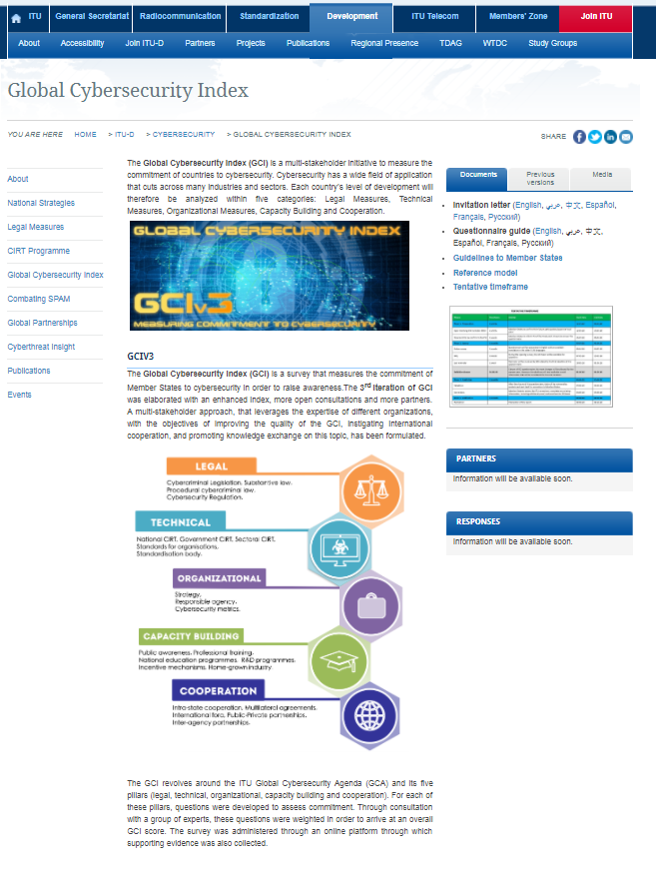
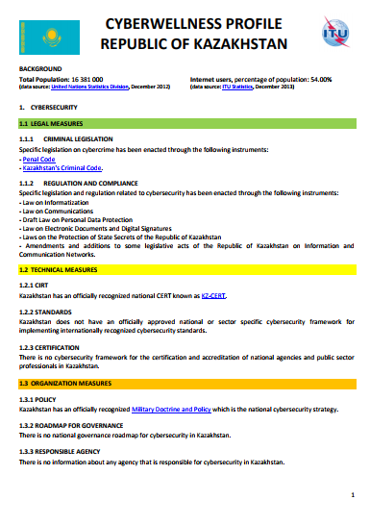

Global Cybersecurity Index - Background
GCIv1 – the 1st iteration of the GCI has started in 2013-2014 period -105 countries responded
GCIv2 – the 2nd iteration covered 2016-2017 period – 134 countries responded
GCIv3 – 3rd iteration soon to be published – 155 countries responded
All iterations include primary research in order to provide global coverage of the 194 Member States

Slide 14

Global Cybersecurity Index - Goals
Help countries identify areas for improvement
Motivate action to improve relative GCI rankings
Raise the level of cybersecurity worldwide
Help to identify and promote best practices
Foster a global culture of cybersecurity

Slide 15
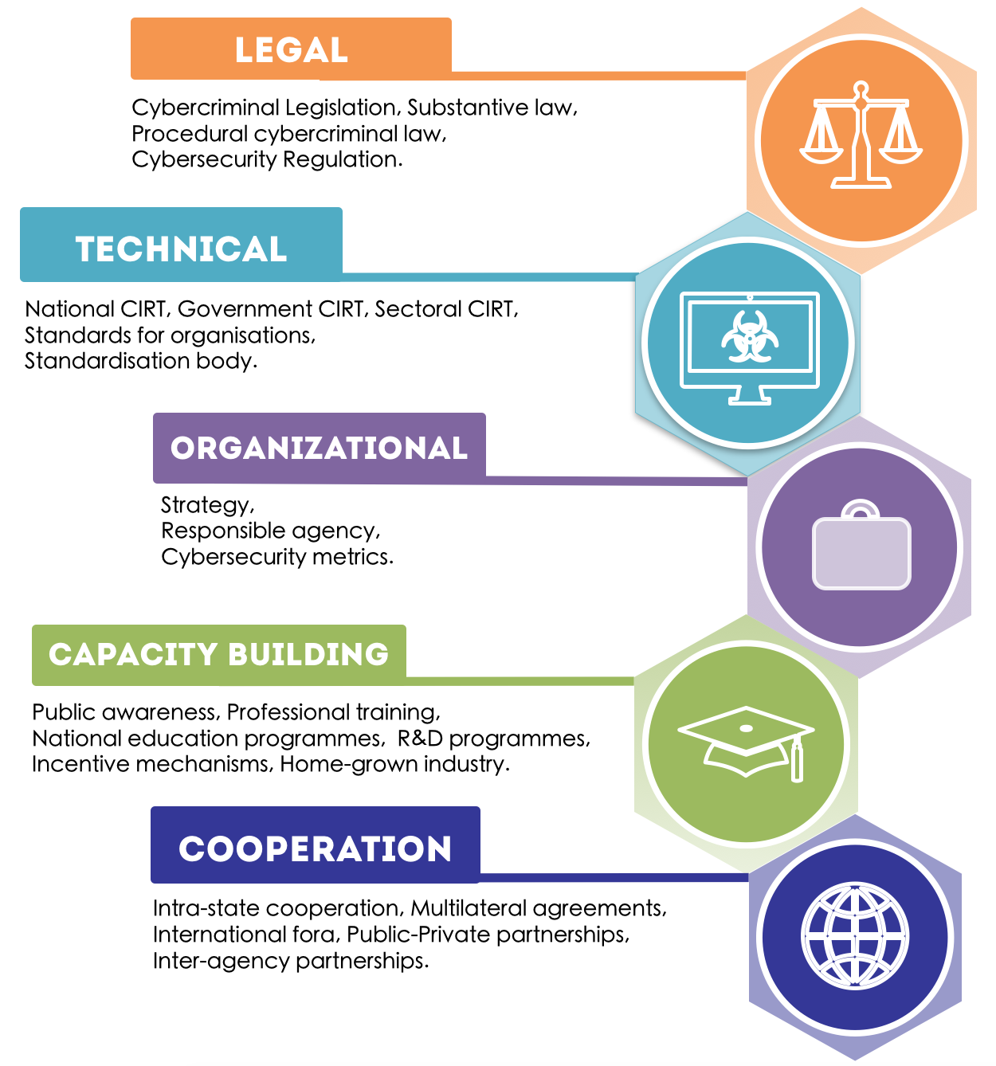
Global Cybersecurity Index
The GCIv3 includes 25 indicators and 50 questions. The indicators used to calculate the GCI were selected on the basis of the following criteria:
Relevance to the five GCA (Global Cybersecurity Agenda) pillars and in contributing towards the main GCI objectives and conceptual framework;
Data availability and quality;
Possibility of cross verification through secondary data.

Slide 16
Global Cybersecurity Index - Phases
Preparation phase
Start phase
Data collection phase
Verification Phase
Analysis Phase
Report writing and publication Phase
Preparation phase
  Elaboration of the survey in collaboration with experts an partners
  Development of online survey system
  Preparation of supporting documentation (guides, conceptual framework, letters etc.)
  Announcement on the ITU website
Start phase
  Informing/inviting Member States via official letter from the BDT Director to Administrations (Responsible Ministry, organization, agency…)
  Collection of contact details of Focal Point(s) assigned by each Administration
  Contacting FPs and providing access to the online survey, together with all necessary documents and instructions
  Technical Support
Data collection phase
  Filling the questionnaire (FPs provide data, links, supporting documents etc.)
  Collection of data from open sources for non-respondents (ITU helps Member States to appear in the Report)
Verification Phase
  ITU specialists verify and all provided data and contact FPs for more details if needed.
  ITU shares the verified data with FPs
Analysis Phase
  Analysis of all collected data (for respondents and non-respondents).
  Ranking. Preparation of comparison charts, maps, tables and other statistical elements.
  Illustrative practices extraction.
Report writing and publication Phase
  Elaboration of the GCI Report
  Publication on the ITU website and printing
  Official launch and informing Member States
  Follow-up

Slide 17
National Cybersecurity Assistance

Slide 18


National Cybersecurity Strategy (NCS)
This Guide has primarily been structured as a resource to help government stakeholders in preparing and reviewing their National Cybersecurity Strategy.

Slide 19

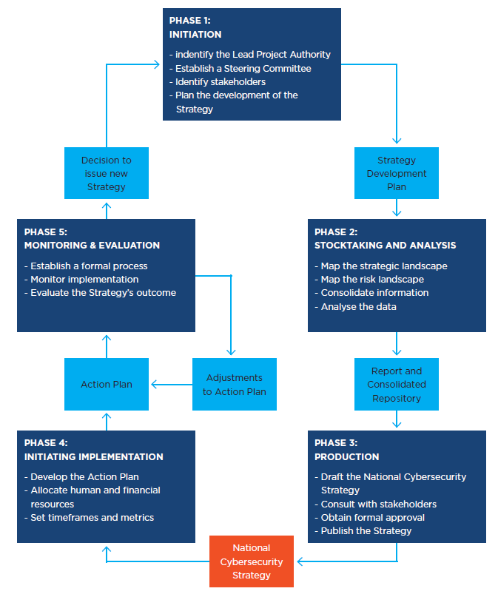
National Cybersecurity Strategy (NCS) Lifecycle
Phase I – Initiation
Phase II - Stocktaking and analysis
Phase III – Production
Phase IV - Initiating and implementation
Phase V - Monitoring & evaluation

Slide 20
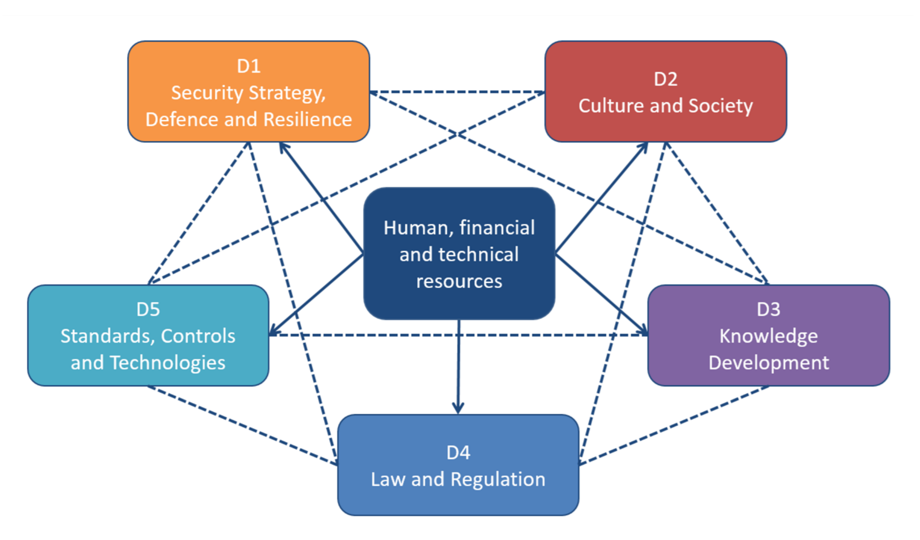

Cybersecurity Capacity Maturity Model Assessments

Slide 21
CIRT Framework

Slide 22

CIRT Development Framework
ENHANCEMENT
ESTABLISHMENT
DESIGN
ASSESSMENT
Focused on Incident Responses capabilities with National responsibilities
Aligned with the FIRST Service Framework

Slide 23
CIRT Assessment
Assessment Service
Description | Review the current incident response capabilities present at the national level
Activities | Administering CIRT questionnaire Analyzing response/s Performing on-site visit for review and finalization On-site workshop
Key Deliverables | Assessment report with basic recommendations
Modality | Off-site and On-site
Costs | Covered by ITU or donor

Slide 24
CIRT Design
Design Service
Description | Develop a blueprint of the National CIRT project, with the related implementation processes
Activities | Defining of CIRT positioning Identify CIRT services required Identify processes and related workflows Identify policies and procedures required (draft) Relationships with constituency and communication strategy Define technology requirements Define premises required Identify HR skills required
Key Deliverables | CIRT design document and implementation plan
Modality | Off-site and On-site
Costs | Covered by the beneficiary Member State or donor

Slide 25
CIRT Establishment
Establishment Service
Description | Execute the project as agreed with the Member States and based on the outcomes of the Design Service’s deliverables
Activities | Capabilities development (human and technological) Hardware and software acquisition Capabilities deployment and testing Operations training Customization, fine tuning and training Handover and closure
Key Deliverables | SOPs Operating manuals Training material Tools
Modality | Off-site and On-site
Costs | Covered by the beneficiary Member State or donor
Typical basic services that a National CIRT may provide to its constituents:
Incident handling
Incident analysis
Outreach and communication

Slide 26
CIRT Enhancement
Enhancement Services
Description | Enhance capabilities and services of the National CIRT
Activities | Evaluation and analysis of the quality for the current capabilities and services Define the required enhancements Additional capabilities deployment and testing Enhanced services - operations training Customization, fine tuning and training Handover and closure
Key Deliverables | Additional SOPs Additional operating manuals Additional training materials Additional tools
Modality | Off-site and On-site
Costs | Covered by the beneficiary Member State or donor
Typical enhanced services that a National CIRT may provide to its constituents:
Incident handling
Incident analysis
Outreach and communication
Analysis (Artifact, media)
Situational Awareness (Sensor operation, fusion and correlation)

Slide 27
Notion of building blocks
A building block is an atomic element (piece of HW, document, training course, etc.) that can be used to produce a deliverable
Building blocks are cross cutting to all processes used to provide assistance as well as to the services that the CIRT will provide to the constituency
Interchangeable, modular, designed to be integrated
Something else?

Slide 28
Notion of building blocks
A building block is an atomic element (piece of HW, document, training course, etc.) that can be used to produce a deliverable
Building blocks are cross cutting to all processes used to provide assistance as well as to the services that the CIRT will provide to the constituency
Interchangeable, modular, designed to be integrated
Something else?

Slide 29
Typology of Building Blocks
HW | Appliances Network devices Desktops, laptops Cables
SW | RTIR Tools for malware analysis Office automation tools
Documentation | Policies (internal security policy, data and incident classification, org charts, job profiles) Templates, manuals, communication material
Awareness and training | Presentations Books Training lab Manuals Communication material
Community and stakeholders engagement | FIRST Membership Outreach plan Announcement plan
HW
SW
Community and Stakeholders engagement
Awareness and
Training
Documentation

Slide 30
Typology of Building Blocks
HW | Appliances Network devices Desktops, laptops Cables
SW | RTIR Tools for malware analysis Office automation tools
Documentation | Policies (Internal security policy, data and incident classification, org charts, job profiles) Templates, manuals, communication material
Awareness and training | Presentations Books Training lab Manuals Communication material
Community and stakeholders engagement | FIRST Membership Outreach plan Announcement plan
Documentation
Awareness and
Training
SW
HW
Community and Stakeholders engagement

Slide 31
ITU CIRT Framework applied
ITU CIRT Framework
Building Blocks
Deliverables
Services/Functions
FIRST Framework
To build
Aligned with
Makes use
To implement

Slide 32
CIRT Basic Services Portfolio
Effective incident handling capability
Provide services to reduce the vulnerability of networks to cyber–attacks
Provide services to support an effective response to cyber–attacks

Slide 33
The Basic Services Offered by a National CIRT
National CIRT
Incident Response Center
Consulting and Technical Assistance Department
Awareness and Communication Department
SERVICE AREA
INCIDENT MANAGEMENT
ANALYSIS
SITUAITON AWARENESS
INFORMATION ASSURANCE
OUREACH AND COMMUNICATION
Incident handling
Incident analysis
Incident mitigation and recovery
Artifact analysis
Development and curation of security intelligence
Risk Management
Security awareness raising
Knowledge sharing and publications dissemination
Service

Slide 34
CIRT Services (FIRST)
Incident validation and classification
Incident tracking
Information collection
Coordination and reporting
Incident handling
Impact analysis
Mitigation analysis
Recovery analysis
Incident analysis
INCIDENT MANAGEMENT
Containment
Restore confidentiality, integrity, availability
Incident mitigation and recovery
Surface analysis
Reverse engineering
Run time analysis
Comparative analysis
Artifact analysis
ANALYSIS
National CIRT
Source identification and inventory
Source content collection and cataloging
Information sharing
Development and curation of security intelligence
SITUATIONAL AWARENESS
Risk assessment
Risk assessment advice
Risk management
INFORMATION ASSURANCE
Technical security support
 | Service Area
 | Service
 | Function
Public service announcements
Publication/dissemination of information
Security awareness raising
OUTREACH / COMMUNICATION
Knowledge sharing and publications dissemination

Slide 35
ITU CIRT Framework Activities

Slide 36
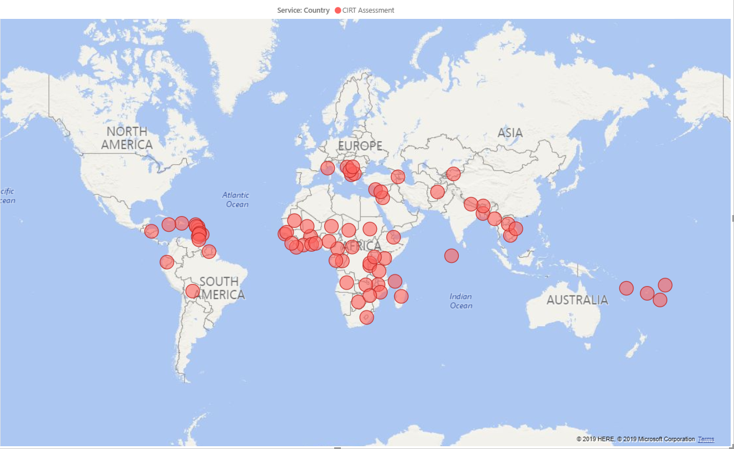
75 CIRT READINESS ASSESSMENTS

Slide 37
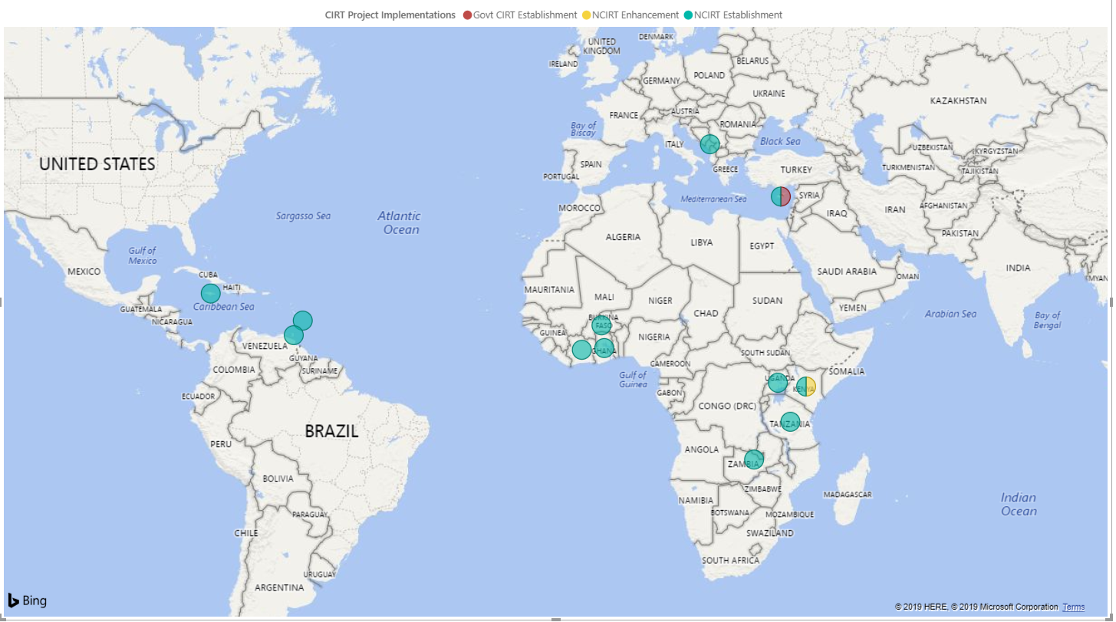
Establishment National CIRT
Establishment Govt. CIRT
Enhancement National CIRT
13 CIRT ESTABLISHMENTS + 1 CIRT ENHANCEMENT

Slide 38
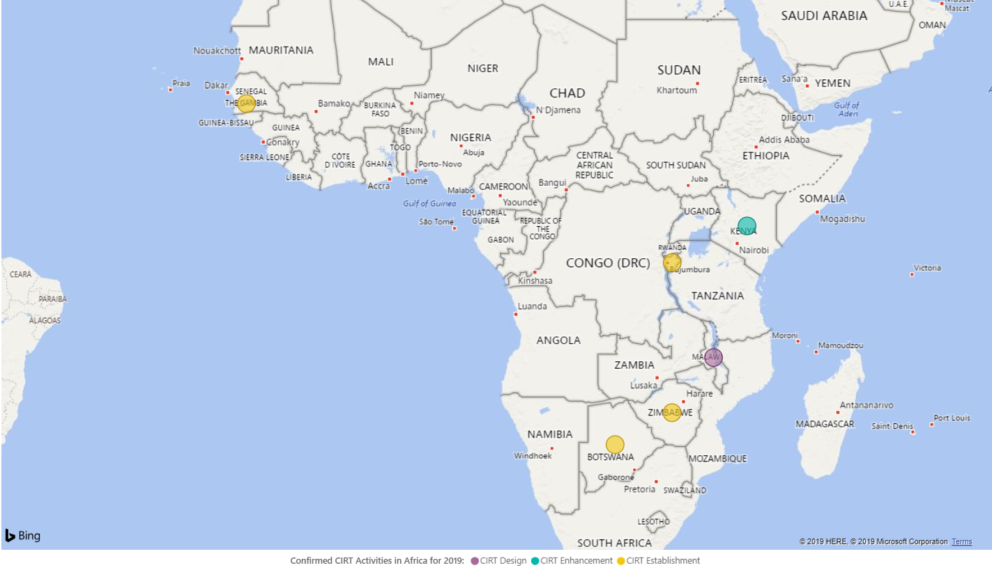
Establishment National CIRT
Design National CIRT
Enhancement National CIRT
2019 CIRT ACTIVITIES IN AFRICA REGION

Slide 39
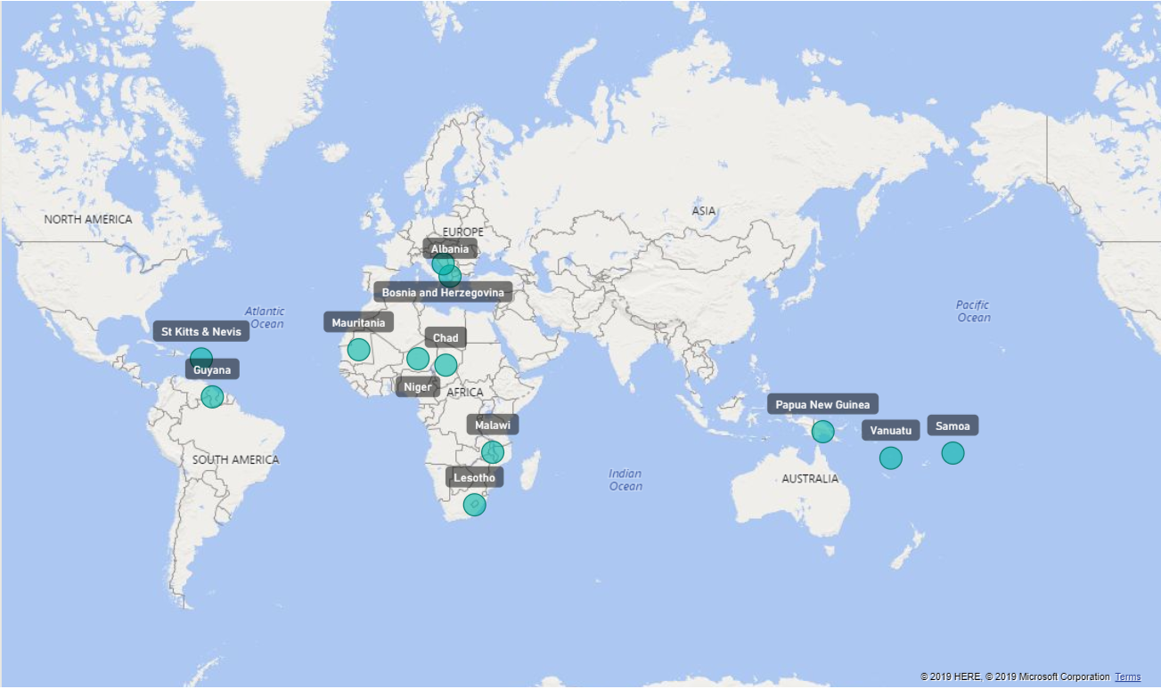
National CIRT Establishment – Interests Around the World

Slide 40
Cyberdrills

Slide 41

Regional Cyberdrills -Objectives
1
Enhancing cybersecurity capacity and capabilities through regional collaborations and cooperation;
2
Enhancing the awareness and the capability of countries to participate and to contribute to the development and deployment of a strategy of defeating a cyber threat;
3
Strengthening international cooperation between Member States to ensure continued collective efforts against cyber threats;
4
Enhancing Member States’ and incident response capabilities and communication;
5
Assisting Member States to develop and implement operational procedures to respond better to various cyber incidents, identify improvements for future planning CIRT processes and operational procedures

Slide 42
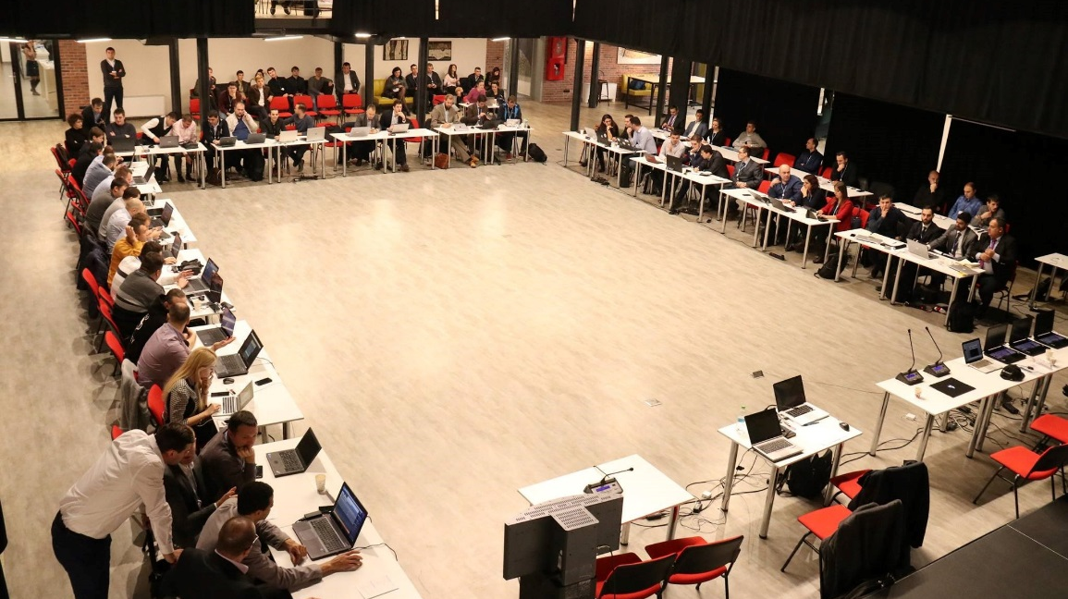
Regional Cyberdrills - Programme
1
Days 1 and 2 are dedicated to the organization of capacity building sessions, case studies or other themes-related training requirements, as well as COP-related issues, etc.
2
Day 3 is a conference day that includes presentations and panel discussions on current issues, latest assessment and current and emerging trends in cybersecurity threats and solutions.
3
Days 4 and 5 are structured around scenarios that consist of several incidents involving the most common types of attacks and possible resolutions.

Slide 43
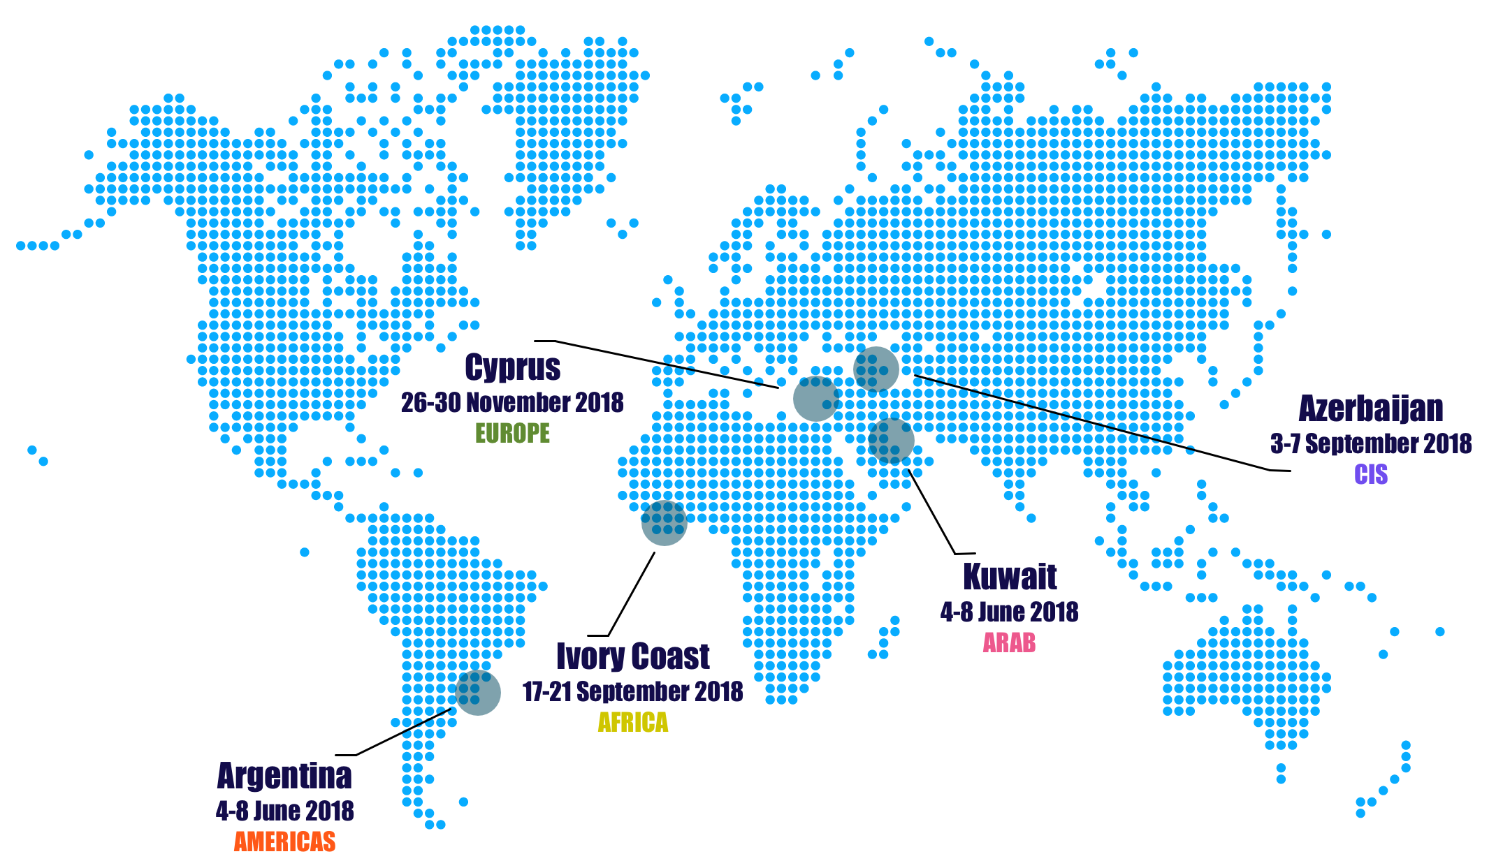
CYBERDRILLS 2018
21-25 October 2018
Notes:
Some are tentative dates

Slide 44
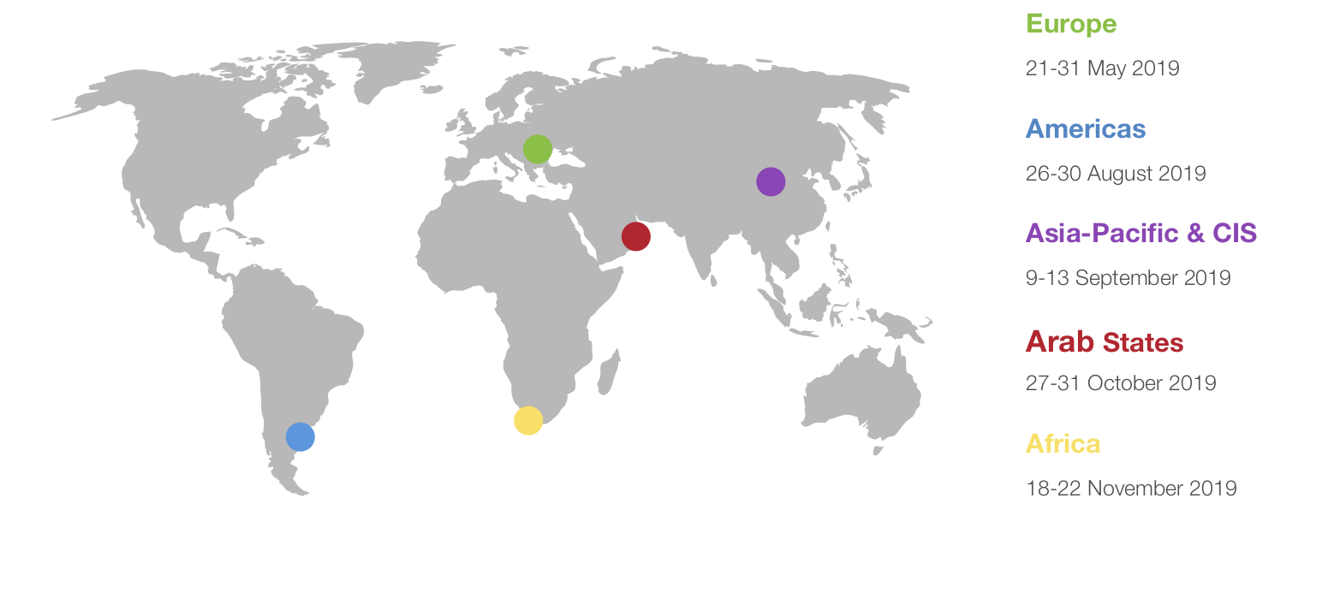
CYBERDRILLS 2019
Notes:
Some are tentative dates

Slide 45

















Cyberdrills
SOME OF ORGANIZATIONS WE WORK WITH

Slide 46
Human Capacity Development

Slide 47
Cybersecurity Training Catalogue
Training Roadmap
Identify niche trainings
Identify suitable training partners
Prepare training descriptions based on standards
Finalizing training catalogue
Delivery – ITU Academy & CYB Projects
Evaluate current trainings
Based on ITU Academy standards
Training courses and certification programs
Notes:
Training roadmap consists of all trainings from basic to expert and certification.
Will look at the current offerings and what needs to be done in the future to identify the gaps
Identify key niche trainings that is not available widely
Identify the suitable training partners
Prepare the training catalog

Slide 48
The Honeypot Research Network (HORNET)

Slide 49
Cyber Threat Intelligence –
HORNET
The main functions of the HORNET platform are:
Enable countries to detect, recognize, and prevent attacks that target their cyberspace.
Help the countries to strengthen the security monitoring of their cyberspace.
Facilitate communication and improve collaboration between national CIRTs
Play the role of a data sharing platform between National CIRTs

Slide 50
Our Approach

Slide 51
Capacity Development
Our Approach
Awareness
Assessment
Design
Strategy
Roadmap
Implementation
Evaluation
Monitoring
Assessment
Feasibility Study
Readiness
Skills
Policy
Regulation
Needs Means and Ways

Slide 52
Capacity Development
Our Approach
Awareness
Assessment
Design
Strategy
Roadmap
Implementation
Evaluation
Monitoring
Assessment
Feasibility Study
Readiness
Skills
Policy
Regulation
Needs Means and Ways

Slide 53
Monitoring and Evaluation ➔ Enhancement
Capacity Development
Lessons Learnt
Enhance Future Work
Our Approach
Awareness
Assessment
Design
Strategy
Roadmap
Implementation
Evaluation
Monitoring
Assessment
Feasibility Study
Readiness
Skills
Policy
Regulation
Needs Means and Ways

Slide 54
Capacity Development
Our Approach
Awareness
Assessment
Design
Strategy
Roadmap
Implementation
Evaluation
Monitoring
Enhancements
Assessment
Feasibility Study
Readiness
Skills
Policy
Regulation
Needs Means and Ways

Slide 55
Enhancements in our processes ➔ Improve Quality
Improve
Quality
Scale-Up
Bring More Value
Enhance
Sustainability
Result Oriented Approach
Deliver Positive Impact
Continuous Improvement
Products and Services

Slide 56

Who we work with?
Member States
Partner Organizations
Private Sector Members
Academia Sector Members
Independent Experts

Slide 57

SOME OF THE ORGANIZATIONS WE WORK WITH ➔

Slide 58







































Slide 59
Thank you for your attention
Farid Nakhli,
Programme Officer
ITU Regional Office for CIS
farid.nakhli@itu.int

