Slide 1

Outcomes of the 3rd Annual Spectrum Management Conference for CIS and Central and Eastern Europe
(Minsk, Belarus, 8-11 May 2019)
Farid Nakhli, Programme Officer, ITU Regional Office for CIS

Slide 2
Overview
IMT standardization in the ITU-R
WRC-19 preparation
3rd Annual Spectrum Management Conference for CIS and Central and Eastern Europe
  Overview
  Regional organizations: RCC, CEPT and APT
  Country cases: UK, Russia, Lithuania, Kyrgyzstan, Romania
  Industry: GSMA, GSA, ESOA

Slide 3
IMT standardization in the ITU-R

Slide 4
IMT standardization in the ITU-R
IMT standards
IMT concept
Spectrum for IMT
Spectrum allocation
Dissemination of information
Development of recommendations and reports
EMC
Country cases
Seminars and conferences
Identification of IMT bands
Technical requirements
Assessment of technologies
IMT standards

Slide 5
ITU standards for IMT
International Mobile Telecommunications
IMT
IMT 2000
Rec. ITU-R M.1457-10
1- IMT-2000 CDMA Direct Spread
2– IMT-2000 CDMA Multi-Carrier
3– IMT-2000 CDMA TDD
4– IMT-2000 TDMA Single-Carrier
5– IMT-2000 FDMA/TDMA
6– IMT-2000 OFDMA TDD WMAN
IMT Advanced
Rec. ITU-R M.2012
1- LTE-Advanced
2- WirelessMAN-Advanced
IMT 2020
Vision: Rep. ITU-R M.2083

Slide 6
IMT-2020 standardization
Detailed studies of IMT-2020 (5G) are ongoing in ITU-R Study Groups, mainly in WP 5D
ITU published:
  IMT Vision – Framework and overall objectives of the future development of IMT for 2020 and beyond (M.2083)
  Minimum requirements related to technical performance for IMT-2020 radio interface(s) (M.2410)
2018-July 2019 -> time frame to present candidate radio interface technologies for IMT-2020 to be evaluated by independent experts
October 2019 -> consolidation of evaluations in WP 5D, consensus seeking and decision making
2020 -> detailed specification for IMT-2020
2017-2020 technical and market tests of 5G technologies

Slide 7
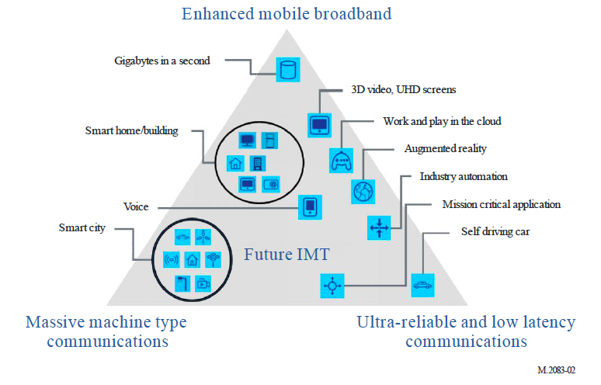
Usage scenarios of IMT for 2020 and beyond

Slide 8
Minimum technical performance requirements
Peak data rate: downlink is 20 Gbit/s and uplink is 10 Gbit/s
Peak spectral efficiency: downlink is 30 bit/s/Hz and uplink is 15 bit/s/Hz
User experienced data rate: downlink is 100 Mbit/s and uplink is 50 Mbit/s
User plane latency: 4 ms for eMBB and 1 ms for URLLC
Mobility: up to 500 km/h
Density: 1 million devices per square kilometer

Slide 9
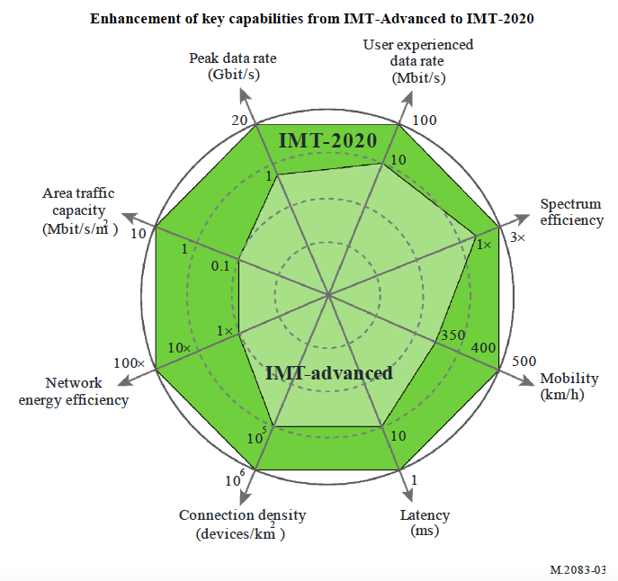
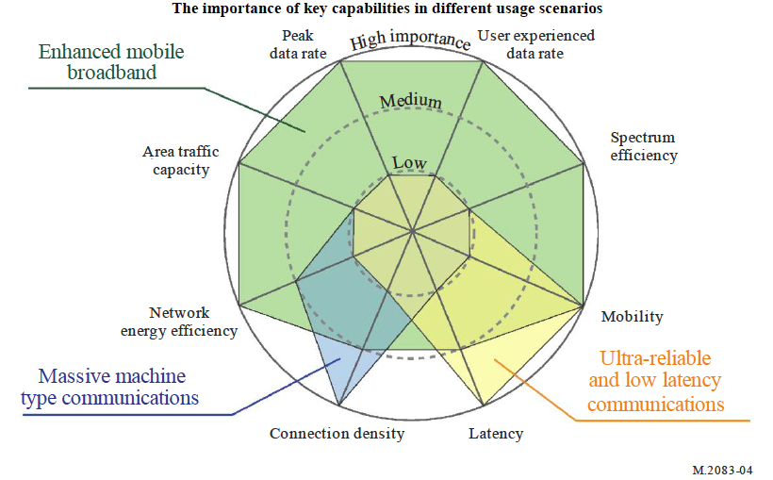
IMT-Advanced vs IMT-2020

Slide 10
WRC-19 preparation

Slide 11


WRC-19

Slide 12
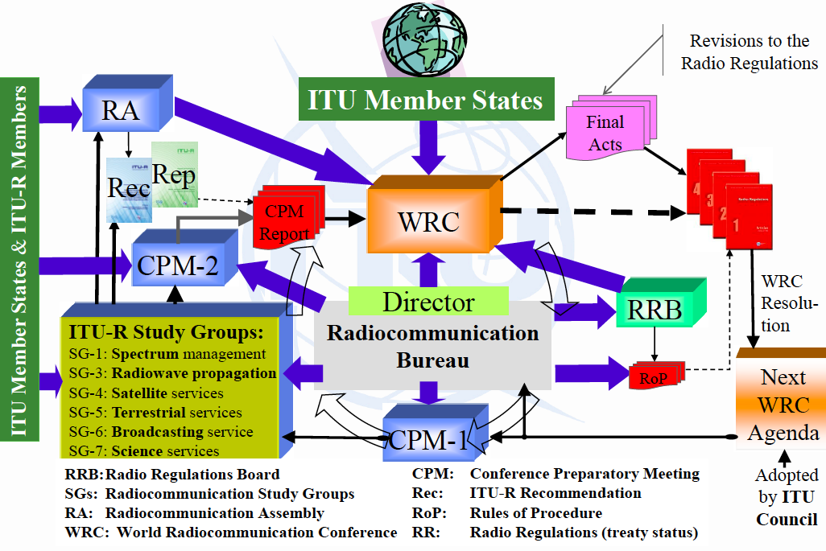
WRC cycle

Slide 13
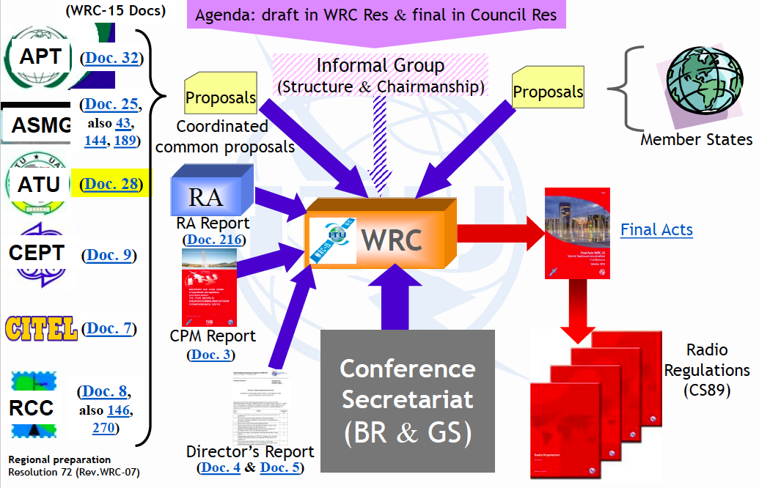
Overview of preparations

Slide 14
3rd Annual Spectrum Management Conference for CIS and Central and Eastern Europe

Slide 15
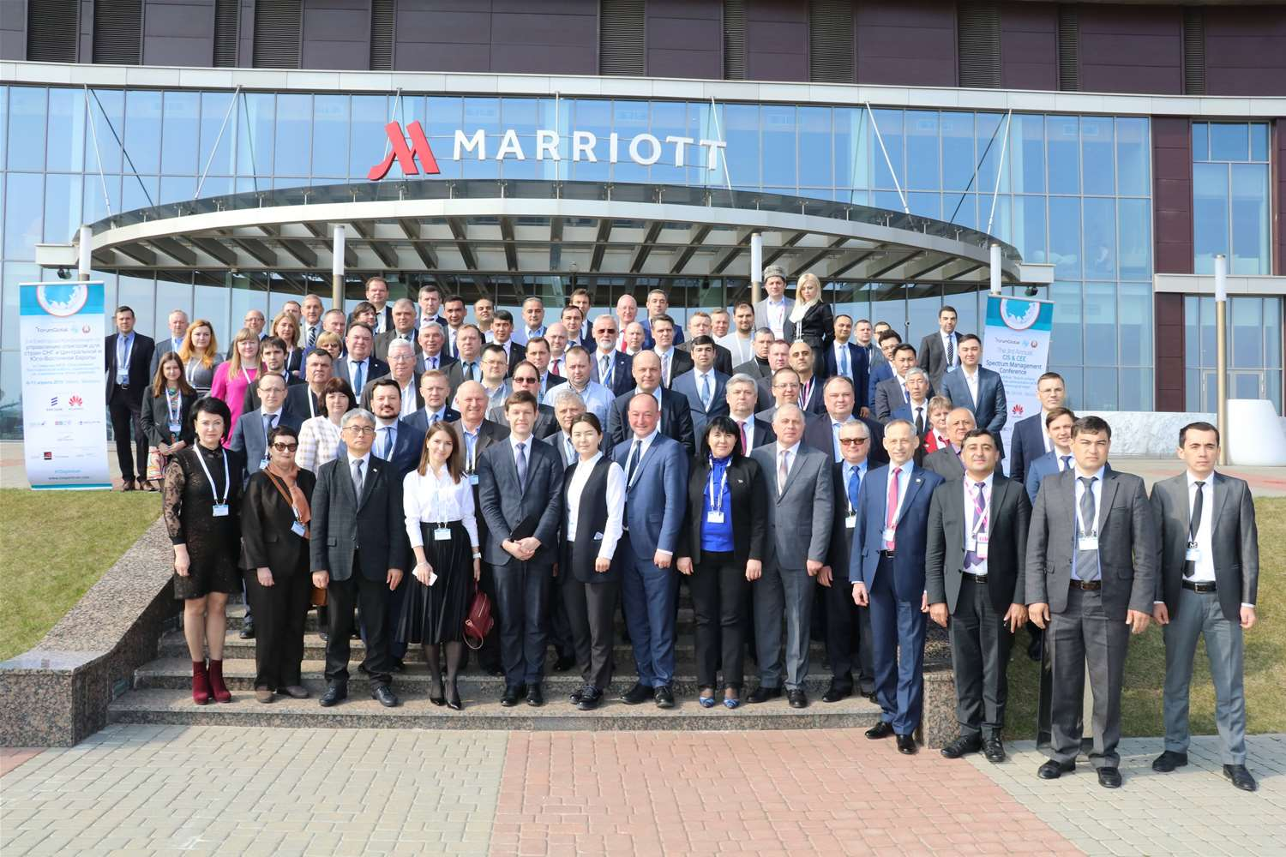
3rd Annual Spectrum Management Conference for CIS and CEE

Slide 16


3rd Annual Spectrum Management Conference for CIS and CEE
Venue and date: Minsk, Belarus, 8-11 April 2019
Organizers: ITU and Forum Global
Host: Ministry of Communication and Informatization of the Republic of Belarus
Participation: over 200 delegates from 30 countries, including representatives of ITU, RCC, CEPT and APT

Slide 17
3rd Annual Spectrum Management Conference for CIS and CEE
Issues discussed:
efficient spectrum usage and further development of terrestrial and satellite radiocommunication in light of WRC-19 preparation
activities of the ITU Radio Regulation Board dedicated to regulation and usage of radiocommunication systems
activities of the ITU Radiocommunication Bureau dedicated to ensuring interference free communication
ITU standards and their application in broadband digital radio systems of different services, including issues of harmonization
use cases of spectrum usage at national, regional and global levels
spectrum for perspective radiocommunication systems and technologies (5G, IMT-2020, high-throughput satellite systems, intelligent transport systems, Internet of Things etc.)

Slide 18
3rd Annual Spectrum Management Conference for CIS and CEE
Issues discussed:
5G rollout approaches taking into account regional specifics
spectrum for systems and radio technologies of future smart cities
spectrum usage by public security and emergency systems
new technologies of radiocommunication systems control
approaches, indicators and criteria to assess efficiency of spectrum usage
studies on how emission associated with 5G rollout influences humans
ITU-R outcomes related to WRC preparation (WRC-19 CPM Report)

Slide 19


Positions of regional organizations – RCC presented by
Sergey Pastukh, Vice-Chairman RCC WG on WRC-19

Slide 20
1.13. To consider identification of bands for future development of IMT, including possible additional allocations to the MS on a primary basis
The RCC Administrations consider that when developing technical conditions and regulatory provisions for the allocation of frequency bands to the MS and their identification for IMT it is necessary to ensure protection of other services having allocation in the considered and adjacent frequency bands taking into account the need in their development, first of all for existing systems or those planned to be used by RCC Administrations.
The RCC Administrations do not oppose the allocation of the frequency band 24.25-25.25 GHz to mobile, excluding aeronautical mobile, service on a primary global basis, as well as the identification of the frequency band 24.25-27.5 GHz for IMT within land mobile service subject to incorporating the conditions in the Radio Regulations for IMT stations to protect:
  space stations in the Earth exploration-satellite service (EESS) (passive) in the frequency bands 23.6-24 GHz, 50.2-50.4 GHz and 52.6-54.25 GHz from unwanted emissions of IMT stations;
  space stations in the fixed-satellite service and inter-satellite service.

Slide 21
1.13. To consider identification of bands for future development of IMT, including possible additional allocations to the MS on a primary basis
In order to ensure this protection it is necessary to limit the emission from IMT base stations in upper hemisphere, as well as to limit unwanted emissions of IMT stations in frequency bands 23.6−24.0 GHz, 50.2−50.4 GHz and 52.6−54.25 GHz allocated to EESS (passive).
The RCC Administrations oppose allocation of the frequency band 31.8-33.4 GHz to mobile service on a primary basis and identification of the frequency bands 31.8-33.4 GHz and 42.5-43.5 GHz, 71−76 GHz and 81−86 GHz for IMT systems, as the results of ITU-R studies in these bands have concluded that IMT systems are incompatible with the stations of the incumbent services.
The RCC Administrations do not support the identification of the frequency bands 45.5−47.0 GHz and 66−71 GHz for IMT systems until ITU-R concludes the compatibility studies with existing primary radio services.
Position of the RCC Administrations on frequency bands 37.0−40.5 GHz, 40.5−42.5 GHz, 47.0−50.2 GHz and 50.4−52.6 GHz will be determined taking into account the need to protect both passive and active services.
The RCC Administrations oppose the consideration of frequency bands not specified in Resolution 238 (WRC-19) for IMT systems in this WRC-19 agenda item.

Slide 22
9.1.1. Implementation of IMT in the bands 1885-2025 MHz and 2110-2200 MHz
To facilitate compatibility between IMT terrestrial component (in mobile service) and IMT satellite component (in mobile-satellite service) in the frequency bands 1980-2010 MHz and 2170-2200 MHz, the RCC Administrations support approval of relevant ITU-R Recommendations and Reports and also relevant RR provisions facilitating such compatibility.
The RCC Administrations are of view that compatibility between IMT terrestrial component (in mobile service) and IMT satellite component (in mobile-satellite service) may be achieved through application of existing provisions of RR Article 9 and introduction of appropriate modifications to RR Appendices 5 and 7 to identify coordination thresholds between stations in mobile and mobile-satellite services in the frequency bands under consideration.
The RCC Administrations support adoption of relevant modifications of RR Appendices 5 and 7, based on the materials of Report ITU-R M.2292.

Slide 23
9.1.2. Compatibility of IMT and BSS (sound) in the band 1452-1492 MHz in Regions 1 and 3
The RCC Administrations do not oppose the development of relevant regulatory and technical conditions in order to provide compatibility between IMT and broadcasting-satellite service (sound) in the frequency band 1452-1492 MHz in Region 1 and these conditions shall only be applied in the territory of countries where this band is identified for IMT.
The RCC Administrations consider that technical conditions and regulatory provisions developed under this issue shall also take into account the need to protect aeronautical telemetry systems in aeronautical mobile service.

Slide 24


Positions of regional organizations – CEPT presented by
Alexandre Kholod, Vice-Chairman ECC CPG

Slide 25
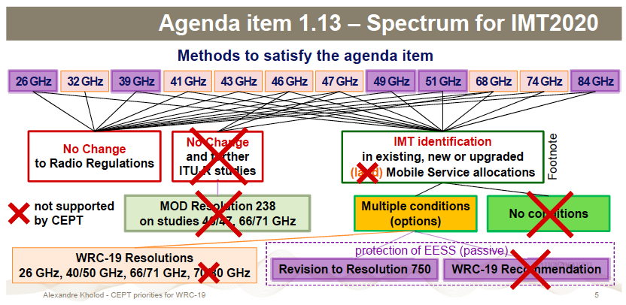
Positions of regional organizations – CEPT

Slide 26
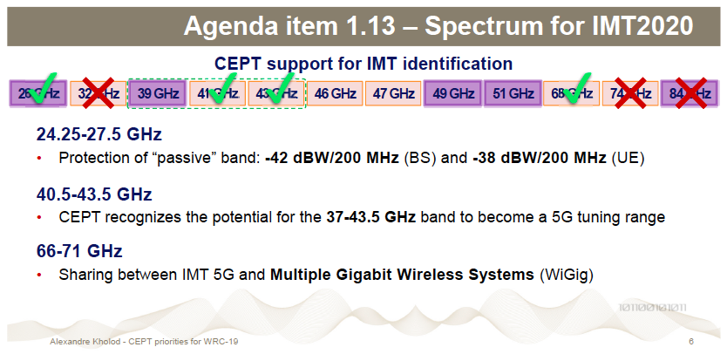
Positions of regional organizations – CEPT

Slide 27


Positions of regional organizations – APT presented by
Kyu-Jin Wee, Chairman APG

Slide 28
Agenda Item 1.13 (IMT)
APT Preliminary View supports
  24.25-27.5 GHz and to revise Table 1-1 of Resolution 750 (Rev.WRC-15), but the unwanted emission level was not agreed
  NOC for 31.8-33.4 GHz
  37-40.5 GHz, 40.5-42.5 GHz and 42.5-43.5 GHz, or portions thereof, for IMT
Issues for Consideration at Next APG Meeting
  Unwanted emission level to protect EESS(P)
Definition of TRP in Radio Regulations
  APG Task Force on TRP will discuss TRP
Protection of FSS
  In Band power limits and some operational condition
  Article 21.5, the value of +10dBW was introduced in the Second Space Conference in 1971
IMT in Mobile Service(MS) or in Land Mobile Service(LMS)?
  APG has not received views to support LMS

Slide 29


Country case – United Kingdom presented by
Chris Woolford, Director, International Spectrum Policy, Ofcom

Slide 30
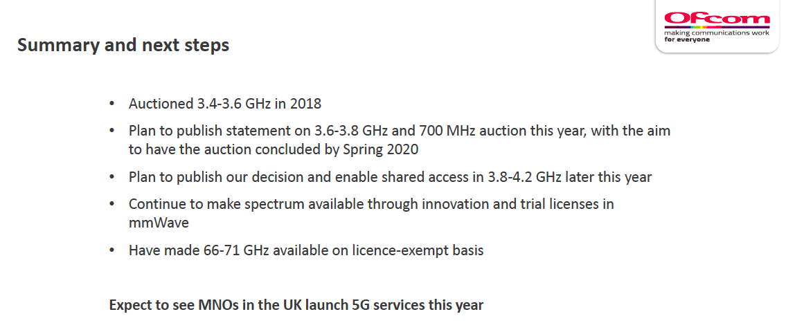
Country case – United Kingdom

Slide 31


Country case – Russia presented by
Valery Tikhvinskiy, Deputy General Director on Innovation Technologies, JSC National Research Institute of Technologies and Communications (NIITC)

Slide 32
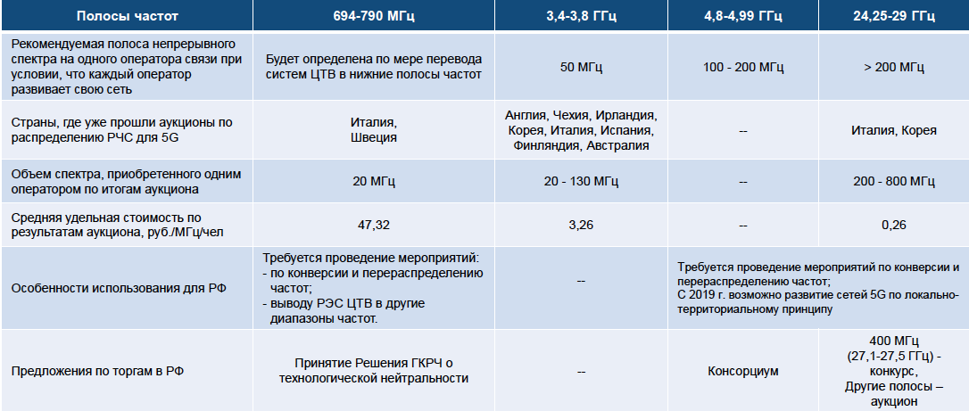
Frequencies for IMT-2020/5G

Slide 33
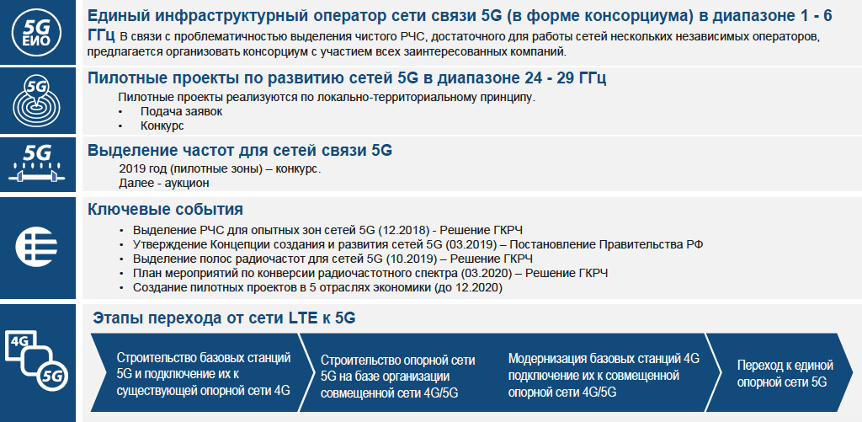
5G rollout concept

Slide 34


Country case – Lithuania presented by
Mindaugas Žilinskas, Deputy Director, Communications Regulatory Authority

Slide 35
Country case – Lithuania
to speed up coordination of frequencies with neighboring countries and to conclude cross border coordination agreements for the 5G pioneer bands at first
to start preparation of auction conditions in 5G pioneer band: 700 MHz, 3400-3800 MHz and 26,5-27,5 GHz
to relocate television in 700 MHz band, currently used radio relay links in the bands 3600- 3800 MHz and 26.5-27.5 GHz to other frequency bands

Slide 36


Country case – Kyrgyzstan presented by
Zamir Mabetaliev, Deputy Director, State Agency of Communication

Slide 37
Country case – Kyrgyzstan
Since 2017 commercially attractive spectrum is being distributed through auctions
Latest decisions were to put 470-694 MHz and bands in 2.3 GHz to 6 GHz range for auction
Spectrum in 694-790 MHz is allocated to radio broadcasting and mobile services on a primary basis
In 2018 Administration of Kyrgyzstan decided to reserve available spectrum in 694-790 MHz, 3600-3640 MHz and 3680-3800 MHz until the end of WRC-19 for prospective use for 5G
Administration of Kyrgyzstan started to free 694-790 MHz band from radio broadcasting service

Slide 38


Country case – Romania presented by
Inga Popovici, Legal adviser, National Authority for Management and Regulation in Communications of Romania (ANCOM)

Slide 39
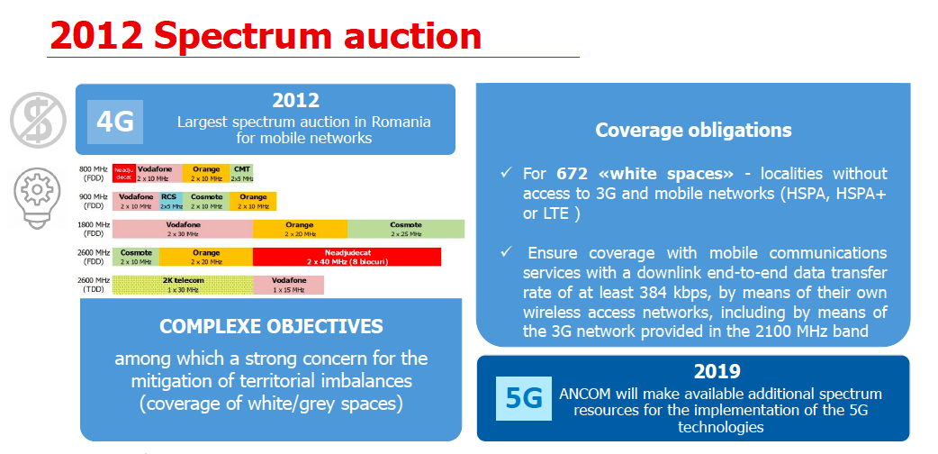
Country case – Romania

Slide 40


Industry – GSMA presented by
Konstantin Savin, Senior Technology Manager

Slide 41
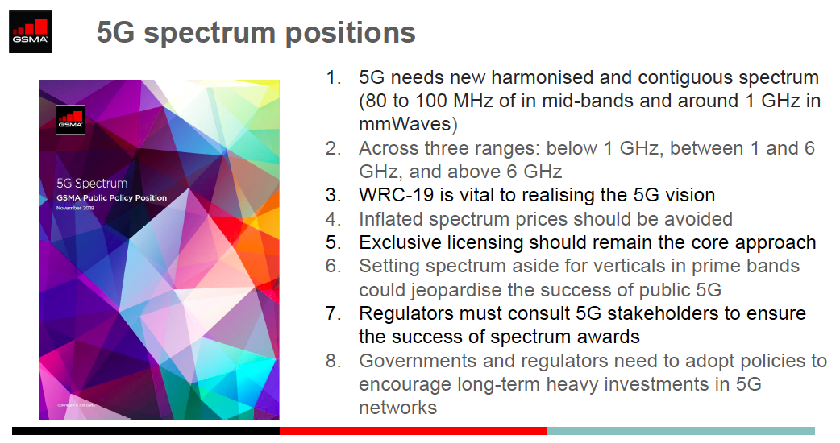
Industry – GSMA

Slide 42
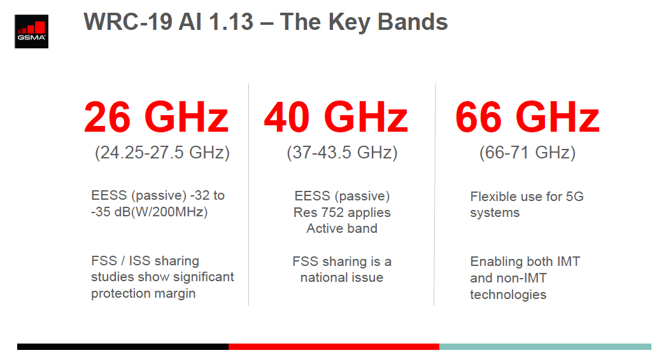
Industry – GSMA

Slide 43
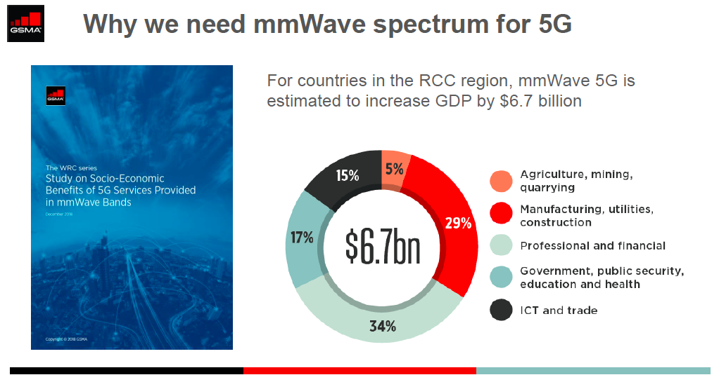
Industry – GSMA

Slide 44


Industry – GSA presented by
Dmitry Laryushin, Lead coordinator CIS region

Slide 45
Industry – GSA
WRC-19 agenda item 1.13: Consider identifying for IMT the 24.25-27.5 GHz and 37-43.5 GHz frequency ranges at WRC-19
  Protection of incumbent services is important
  However, adopting overly restrictive measures would prevent the use of spectrum in an efficient manner
Other WRC-19 agenda items: Any WRC-19 decisions on agenda items 1.5 and 1.14 should ensure protection of IMT/Mobile Services
Help us realize the 2025 vision - governments are encouraged to make spectrum available for 5G NR within the low, mid and high ranges, by 2020, with the appropriate amount of contiguous spectrum per network, as well as provide regulatory conditions that facilitate cost-effective 5G usage in a timely manner

Slide 46


Industry – ESOA presented by
Ivan Zaitsev, Global Spectrum & Policy Regulator

Slide 47
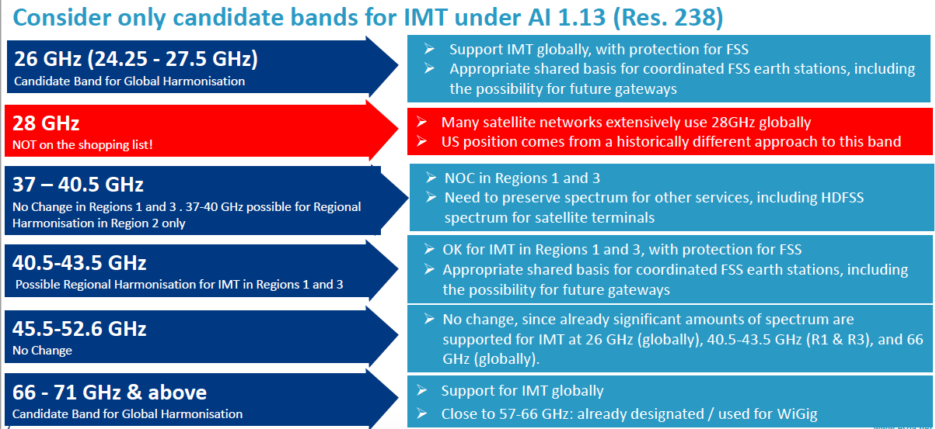
Industry – ESOA

Slide 48
3rd Annual Spectrum Management Conference for CIS and CEE
The conference participants noted:
complex approach used to discuss considered issues with involvement of wide range of experts
high scientific and technical level and practical value of presentations and discussions
that spectrum provision is one of key aspects of ICT infrastructure for digital economy and contributes to the implementation of the UN Sustainable Development Goals
when implementing new technologies and systems one needs to consider protection of existing systems
need to implement radio technologies that enable development of 5G/IMT-2020, IoT/M2M and ITS, taking into account the need to harmonize spectrum and ensure cross-border coordination

Slide 49
3rd Annual Spectrum Management Conference for CIS and CEE
The conference participants noted:
that harmonious development of new radio technologies is only possible when there is balance of interests between ensuring required quality of digital services provided to citizens and economic efficiency
need to continue to develop methods and criteria of integral assessment of efficiency of spectrum usage
that it is reasonable and practically valuable to organize conferences and other events dedicated to usage of spectrum and satellite orbits by radiocommunication systems
that this conference was relevant and timely, and its outcomes can be used by expert in their professional activities, including preparation to WRC and other ITU forums

Slide 50
Thank you for your attention
Farid Nakhli,
Programme Officer
ITU Regional Office for CIS
farid.nakhli@itu.int

