Slide 1
Standardization of Broadband Access and
IMT-2020/5G transport support in ITU-T SG15
ITU/TSB
Hiroshi OTA

Slide 2
ITU-T SG15 - mandate
  ITU-T SG15 is responsible for the development of standards on:
  optical transport network
  access network
  home network and power utility network infrastructures
  equipment
systems
  maintenance
optical fibres and cables and their related installation
  instrumentation
  and measurement techniques
  management
  control plane technologies
  test
  to enable the evolution toward intelligent transport networks, including the support of smart-grid applications.

Slide 3
Broadband access – optical fiber or copper?
Q2/15: Optical systems for fibre access networks
  PON (Passive Optical Network)
Q4/15: Broadband access over metallic conductors
  xDSL (ADSL, VDSL)
  FTTDp (G.fast, G.mgfast)

Slide 4
Optical access

Slide 5
What is PON?
Passive Optical Network (PON) system
  A point-to-multipoint optical communication system.
  The most popular system to realize Fiber To The Home (FTTH) in the world.
Multiple (e.g. 16 to 128) ONUs communicate with an OLT via optical splitter(s).
Central office
ONU1
TDMA
ONU2
OLT
…
Reference point
Optical splitter
ONU n
OLT: Optical Line Terminal, ONU: Optical Network Unit
TDMA: Time Division Multiple Access
Reference point

Slide 6
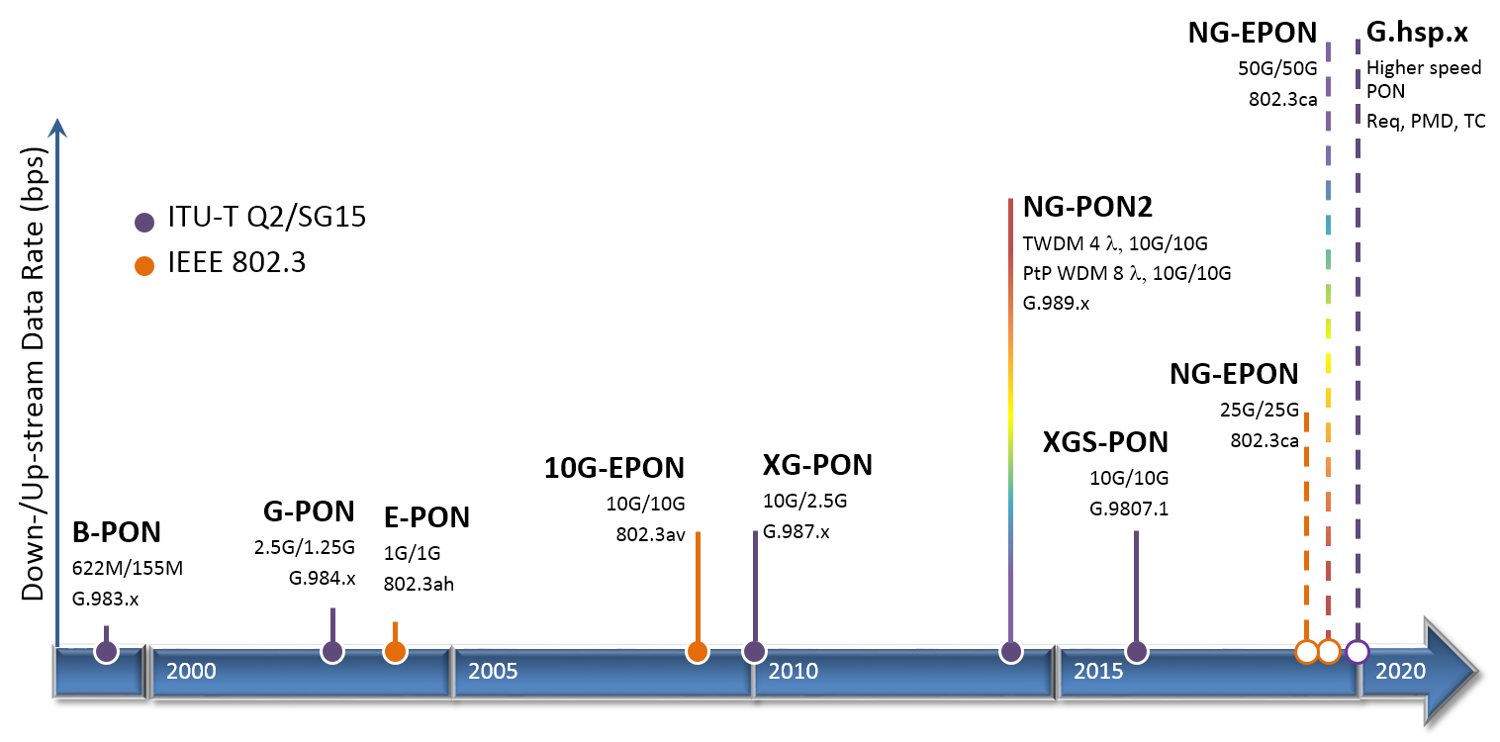
Recent progress in PON standards

Slide 7
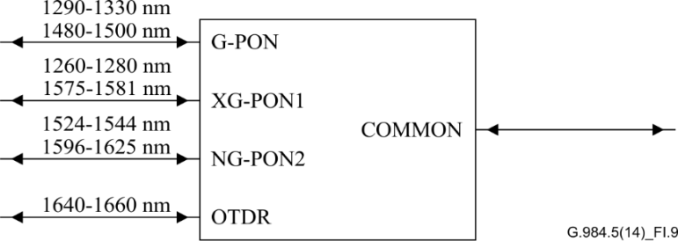
Coexistence of ITU PON Technologies using WDM
XGS-PON
XGS-PON
OLT
G.652 Fiber
CE
1xN
G-PON
1577/1270 nm*
CE** (Co-Existence Element)
NG-PON2
Example of a type of Coexistence Element defined in Appendix I of G.984.5
1490/1310 nm*
G-PON
OLT
1600/1544 nm*
NG-PON2
OLT
*Downstream and Upstream Center Wavelengths (nm)
**Co-existence Element has been defined in ITU-T G.984.5 Amendment 1 along with additional Coexistence solutions

Slide 8
Metallic access

Slide 9








Overview of Access Network Solutions with metallic cables
CO
ADSL2plus
Long (<6000m)
CPE
CPE
≤25 Mbit/s
CPE
VDSL2
Short
CPE
≤150 Mbit/s (17a)
≤400 Mbit/s (35b)
CPE
(<2500m)
G.fast and MGfast fill an access technology gap
Huge gap 100 Mbit/s ➔ multi Gbit/s
Fiber may not always be possible into the home/apartment
G.fast and G.mgfast support FTTdp and FTTB architectures.
G.fast
CPE
≤ 1..2 Gbit/s
Very short TP or coax (<400m)
MGfast
CPE
≤ 5..10 Gbit/s
No drilling
No digging (<100m TP or coax)
Fiber
Copper

Slide 10

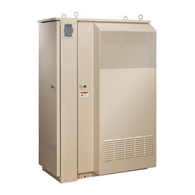

G.fast/FTTdp: Fibre To The distribution point
One FTTdp architecture benefit is that the DPU equipment typically serves 1-20 lines, making it small enough to place on a pole, in a hand-hole or in a small pedestal or in basement
Street Cabinet
Central office
Distribution Point Unit
DPU
DPU backhaul options:
-G-PON, XG-PON1
-EPON, 10GEPON
-Point-to-Point fibre
-bonded VDSL2 copper
Copper drop options:
-G.fast (opt: reverse power)
-VDSL2
-Vectored VDSL2
-IEEE 802.3 BASE-T

Slide 11
Dynamic Time Assignment (i-DTA)
Approved April 2017 as part of G.9701 Annex T/X
  Operation without coordination across lines (i-DTA)
Concepts:
  AN/DPU system monitors up/down throughput needs
  Requests FTU-O to change the TDD up/down ratio
  FTU-O and FTU-R implement the change synchronously and seamlessly
  Up/down ratio between 5/30 and 30/5 with default 7/28
Use case:
  Improve end user experience (QoE) by dynamically allocating the aggregate capacity to the direction that best serves the instantaneous needs of the user’s applications.

Slide 12
Emerging G.mgfast - Multi-Gigabit fast
  G.mgfast is the project defining the MGfast technology
  New project to address functionality beyond G.fast
    Profiles beyond 212 MHz (e.g., 424 MHz and 848 MHz)
    Full-duplex operation (echo cancelled mode)
    Co-exist with G.fast in overlapping frequency bands through mutual vectoring
  Targets
    Aggregate data rates of 5 - 10 Gbit/s over single TP/coax.
    Operation over twisted pair, quad and coaxial cable.
    Consent mid 2019.
  Open points under discussion
    Topologies: (multi?)point-to-(multi?)point
    Advanced coding (e.g., LDPC)
    Multi-stream support for QoS differentiation / 5G slicing
    Convergence of access and in-home networking

Slide 13
PSD Construction Tools
Subcarrier masking
  Eliminates transmission on one or more subcarriers
  A subcarrier mask (SM) is defined as a number of masked frequency bands (start - stop subcarrier index)
Notching of specific frequency bands
  To protect radio services one or more specific frequency bands can be notched
  Notch in the notching mask (NM) in defined start and end subcarrier index
  Within the notched band, all subcarriers shall be turned off and emission shall be at least 20 dB below the limit mask
PSD shaping
  Power spectral density (PSD) shaping allows reduction of the transmit PSD mask in some parts of the spectrum
  PSD shaping mask (PSM) consists of one or more frequency segments. The boundaries of the segments are defined by set breakpoints
  Transceiver shall support at least 32 PSM breakpoints

Slide 14
G.fast Profiles & Limit PSD (ITU-T G.9700)
G.9700 contains the limit mask definitions for the profiles
  106 MHz
  212 MHz
G.9700 provides PSD construction tools (masking, notching, shaping)
2
106
2
212

Slide 15
Transport network support of
IMT-2020/5G

Slide 16
GSTR-TN5G: Transport network support of
IMT-2020/5G (Revised in Oct. 2018)
A reference model of IMT-2020/5G network and a set of deployment scenarios.
Requirements on transport networks in order to support IMT-2020/5G networks
Interfaces between IMT-2020/5G entities and transport networks
Aspects of transport network support include network slicing (data plane and control plane), synchronization, and Control/Management.

Slide 17
Fronthaul
Conventionally, the fronthaul link is between RF and the remaining L1/L2/L3 functions (Option 8 split point)
Option 8 centralizes high layer functions but requires stringent latency and high bandwidth
It is critical to consider tradeoffs between throughput, latency, and functional centralization.
Signal processing chain of 4G and 5G wireless base stations and optional split points
source: 3GPP TR 38.801, “Technical Specification Group Radio Access Network; Study on new radio access technology: Radio access architecture and interfaces”, March 2017

Slide 18




Fronthaul by PON
ONU
FTTCurb/Cab
OLT
ONU
FTTH
Optical splitter
ONU
FTTBuilding
ONU
FTTOffice
OLT
Optical splitter
FTTCell
(Mobile Backhaul/Fronthaul)
ONU

Slide 19
Standards and supplements on PON
Related Recommendations include:
  G.9807 series (XGS PON) – G.9807.1 (10G symmetric PON), G.9807.2 (reach extension)
  G.989 series (NGPON2) - 40-Gigabit-capable passive optical networks (G.989 (Definitions), G.989.1 (General requirements), G.989.2 (Physical layer), G.989.3 (TC layer))
Ongoing work:
  G.suppl.66: 5G wireless fronthaul requirements in a PON context
    Requirements for 5G wireless fronthaul in the setting of optical access networks
    Practical passive optical network solutions

Slide 20
Radio over fiber for 5G fronthaul (ITU-T G.9803)

Slide 21
CPRI over OTN for 5G fronthaul
G Suppl. 56: OTN transport of CPRI signals
  Describes alternatives for mapping and multiplexing CPRI client signals into the optical transport network (OTN)
  Shows examples but does not specify standard methods
  Relates to G.872 (OTN architecture), G.709(.x) series (OTN interfaces), G.798 (OTN equipment) and G.959.1 (OTN physical layer interfaces)

Slide 22
Optical transport network (OTN) beyond 100 Gbit/s
ITU-T G.709: Interfaces for the optical transport network
ITU-T G.709.1: Flexible OTN short-reach interface
ITU-T G.709.2: OTU4 long-reach interface (under approval process)
ITU-T G.709.3: Flexible OTN long-reach interface
G.Sup.5gotn: Application of OTN to 5G transport (new work item)
  Describes how to use the current OTN standards for this application
  Plan to approve it at July 2019 SG15 meeting
G.ctn5g: Characteristics of transport networks to support IMT-2020/5G (new work item)
  Follow-up to GSTR-TN5G: it goes down to the lower level of details
  Plan to approve it at July 2019 SG15 meeting

Slide 23
Wavelength division multiplex (WDM) technologies
ITU-T G.695: Optical interfaces for coarse wavelength division multiplexing applications
ITU-T G.698.4: Multichannel bi-directional DWDM applications with port agnostic single-channel optical interfaces
ITU-T G.959.1: Optical transport networks physical layer interfaces

Slide 24
Frequency synchronization for 5G
Requirements on performance and management of the frequency synchronization are defined in the ITU-T G.826x series
ITU-T G.8265 describes the architecture and requirements for packet-based frequency distribution in telecom networks
ITU-T G.8261 provides the network architecture and requirements related to physical layer-based frequency synchronization
ITU-T G.8262.1 is being developed to define enhanced performance requirements of the physical layer clock, and this clock can be used in supporting a more accurate time synchronization
ITU-T G.8265.1 defines the Precision Time Protocol telecom profile for frequency synchronization

Slide 25
Time synchronization for 5G
Requirements on performance and management of time synchronization are defined in the ITU-T G.827x series
General time synchronization architecture is defined in ITU-T G.8275
Time synchronization requirements and network reference models have been defined by ITU-T G.8271 and ITU-T G.8271.1
Requirements on performance and management of time synchronization are defined in the ITU-T G.827x series
General time synchronization architecture is defined in ITU-T G.8275
ITU-T G.8273.x series of recommendation defines clocks to be used for time synchronization; A new generation of more accurate clocks is being defined addressing the needs of future networks (e.g., Ethernet-based fronthaul)
ITU-T G.8275.1 defines the Precision Time Protocol telecom profile for phase/time synchronization with full timing support from the network; G.8275.2 defines Precision Time Protocol Telecom Profile for time/phase synchronization with partial timing support from the network
Time synchronization requirements and network reference models have been defined by ITU-T G.8271 and ITU-T G.8271.1; New synchronization solutions and network reference models are being developed to allow the distribution of timing with increased accuracy and reliability

Slide 26
Management & Control of Transport Network supporting IMT-2020/5G
GSTR-TN5G (2/2018) focuses on the requirements on transport networks in order to support IMT-2020/5G networks.
  Transport network technologies are those that are in the scope of SG15, including Photonic, OTN, Carrier Ethernet, MPLS-TP and PON, etc.
Q14/15 is responsible to develop the specifications for the management & control of transport network resources, encompassing MCC* requirements, protocol-neutral Information Models (IM) and protocol-specific solutions (Data Model – DM) for common transport functionality, and transport technology-specific functionality (e.g., OTN, Carrier Ethernet, MPLS-TP, Photonic).
  Common: ITU-T G.7710 (Requirements), ITU-T G.7711 (Core IM)
  OTN: ITU-T G.874 (Requirements), ITU-T G.874.1 (Base IM)
  Carrier Ethernet: ITU-T G.8051 (Requirements), ITU-T G.8052 (Base IM), ITU-T G.8052.1 (OAM IM & DM), ITU-T G.8052.2 (Resilience IM & DM)
  MPLS-TP: ITU-T G.8151 (Requirements), ITU-T G.8152 (Base IM)
  Photonic: G.media-mgmt (Requirements and Base IM)
These IM & DM specifications can be used to derive the specific MCC interfaces, such as
  Between transport NEs and SDN controllers, between SDN controllers of adjacent layers, between SDN controllers and Applications, and between SDN controller and administrative role
* MCC – Management-Control Continuum: The concept whereby management and control functions are considered to be a continuum is known as the management-control continuum (MCC)

Slide 27


