Slide 1
Technologies to support
new/future services and applications
ITU/TSB
Hiroshi OTA

Slide 2
Outline
Artificial intelligence (AI)
  General
  AI for health
  AI/machine learning for 5G/IMT-2020
Internet of things (IoT)
Distributed ledger technologies (DLT)
Intelligent transport system (ITS)
Quantum key distribution (QKD)

Slide 3


Slide 4
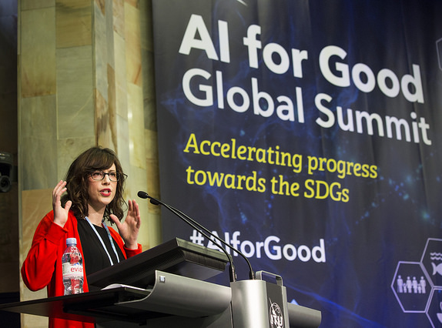

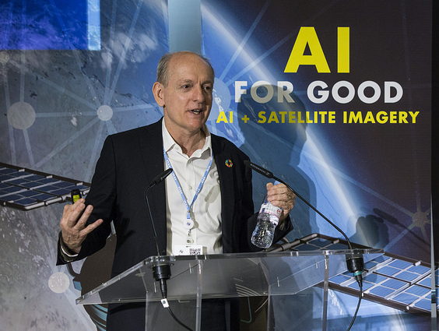
THE SUMMIT
AI for Good Global Summit
The AI for Good Global Summit is THE leading United Nations platform
for global and inclusive dialogue on AI
Hosted each year in Geneva by the ITU in partnership with
UN Sister agencies, XPRIZE Foundation and ACM

Slide 5
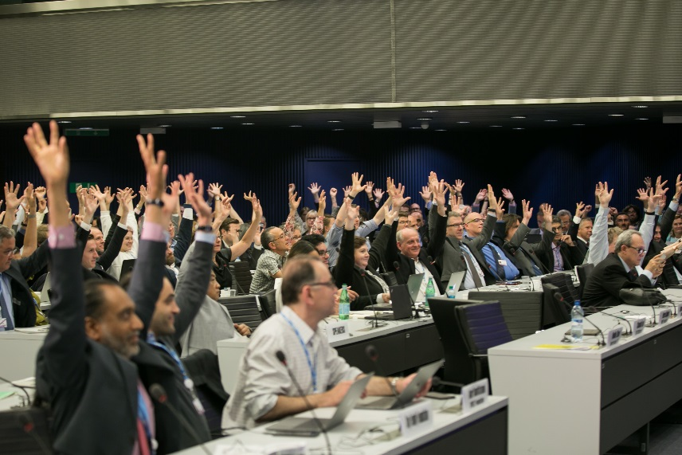
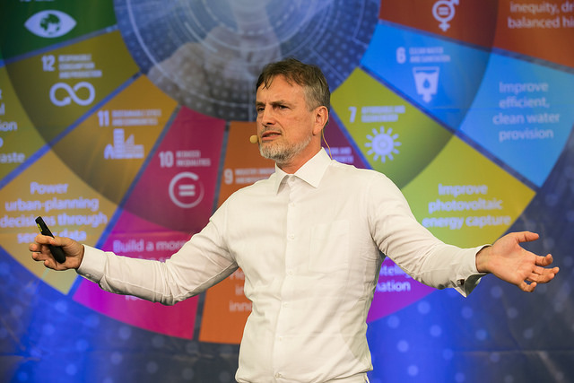


THE GOAL
AI for Good Global Summit
Connect AI innovators with problem owners, to identify
practical applications of AI to accelerate progress towards the
UN Sustainable Development Goals
Ensure trusted, safe and inclusive development of
AI technologies and equitable access to their benefits

Slide 6

Focus Group on AI for Health (FG-AI4H)
ITU-T SG16 in partnership with WHO
Standardized assessment framework for the evaluation of AI-based methods for health, diagnosis, triage or treatment decisions
Evaluation and benchmarking of AI-Health models to enable certification & widespread use
https://www.itu.int/en/ITU-T/focusgroups/ai4h/Pages/default.aspx

Slide 7
Focus Group on AI for Health (FG-AI4H)
Background:
Machine Learning can provide ubiquitous health diagnostics at negligible cost, non-invasive, high frequency - early stage detection can lead to lower cost of treatment and improved treatment outcomes
Machine Learning competitions have elevated AI for health diagnostics to superhuman performance
Medicine regulators (Food and Drug Administration, European Medicine Agency, CFDA, etc.) are equipped to certify tools that aid medics with analyses, not tools that perform analyses
Consequently:
AI for health exists mostly as an academic exercise,
Models are not being certified for professional use
Focus Group Objective:
Provide a trusted benchmark for AI4H, to enable certification by health regulators

Slide 8
Machine Learning & 5G FG
Communication networks not designed to cope
with Big Data and Machine Learning (ML)
Standardization strategies to increase efficiency
and security of 5G systems using ML
Focus Group has developed a functional architecture
based on ML5G uses cases
More info: https://www.itu.int/en/ITU-T/focusgroups/ml5g/Pages/default.aspx

Slide 9
Rec. ITU-T Y.3170 -(formerly Y.qos-ml): Requirements of machine learning based QoS assurance for IMT-2020 network
  This Recommendation describes:
  Overview
  Functional model
  High level requirements
  Functional requirements
  This Recommendation uses machine learning only in the context of QoS assurance. Therefore any other use of machine learning is out of scope of this Recommendation.

Slide 10


ITU-T SG20: IoT and Smart Cities & Communities
Lead Study Group on:
4 Regional Groups
Internet of things (IoT) and its applications
SG20RG-LATAM
SG20RG-ARB
SG20RG-AFR
SG20RG-EECAT
Smart cities and communities, including its e‑services and smart services
Collaboration with other SDOs
Internet of things identification
Joint Coordination Activity on Internet of Things and Smart Cities and Communities (JCA-IoT and SC&C)
For example: OneM2M, ISO, IEC
Notes:
Responsible for studies relating to IoT and its applications, and smart cities and communities (SC&C).
It includes studies relating to Big data aspects of IoT and SC&C, e-services and smart services for SC&C

Slide 11

What is SG20 currently working on:
Smart cities and communities
Open Data in Smart Cities
Use cases, requirements and architectures for Smart cities and communities
Smart Services in rural communities
Disaster notification of the population in smart cities and communities
Smart Tourist destinations
Smart City Infrastructure
Internet of things (IoT)
Drones for IoT
IoT requirements for edge computing
Artificial Intelligence and IoT
Accessibility for IoT
Blockchain and IoT
IoT for developing countries
Intelligent Transport Systems (ITS) based on IoT
Privacy and trust of IoT systems
Interoperability
Edge computing
IoT-devices authentication
Digital twins for IoT
Data management & processing
Data structure and data transfer protocol for automotive emergency response system
Function description and metadata of Spatio-temporal Information Service for SSC
Integrity
Notes:
Challenges
Verticals today (silo structure)
Restricted knowledge
Inefficiency
Fragmented
Security issues
Intelligent Transport Systems (ITS) based on the IoT aim to provide innovative individual, personalized services relating to different modes of transport and traffic management, to enable users to be better informed and to make safer, more coordinated, and "smarter" use of transport networks.
Integrated sensing and management: Integrated sensing & management system(ISMS) for SSC is the system to resolve problems such as security, criminality, pollution, traffic congestion, inadequate infrastructure, response to natural hazards. ISMS for SSC aims at satisfying the high-precision, multi-temporal, and full-range sensing as well as integrated, rapid, and efficient management requirements of urban applications.

Slide 12

ITU-T SG20 last meeting main results
Geneva, Switzerland, 9-18 April 2019
Statistics:
170
Participants
4
Draft Recommendations consented
1
Draft Recommendation determined
1
Supplement agreed
7
New work items
Notes:
The 9 Recommendations consented during the meeting are now approved

Slide 13
ITU-T SG20 Main outcomes
Geneva, Switzerland, 9-18 April 2019
4 draft Recommendations consented
​ ITU-T Rec. | Provisional name | Title | Q
Y.4206 | Y.UCS-reqts | Requirements and capabilities of user-centric work space service | 2/20
Y.4207 | Y.SEM | Requirements and capability framework of Smart Environmental Monitoring | 2/20
Y.4460 | Y.dev-IoT-arch | Architectural reference model of devices for IoT applications | 3/20
Y.4906 | Y.AFDTS | Assessment Framework for digital transformation of sectors in smart cities | 7/20
1 draft Recommendation determined
ITU-T Rec. | Provisional name | ​Title​ | Q
Y.4556 | Y.SC-Residential | Requirements and functional architecture of smart residential community | 4/20

Slide 14
ITU-T SG20 Main outcomes
Geneva, Switzerland, 9-18 April 2019
7 new work items
Question | Working title | Title
1/20 | Y.rrm-data | Requirements and reference model of IoT related data from city infrastructure
3/20 | Y.IoT-AOS-prot | Protocols of supporting autonomic operations in the Internet of things
4/20 | Y.smart-education | Requirements and reference architecture of smart education
4/20 | Y.BC-SON | Framework of blockchain-based self-organization networking in IoT environments
4/20 | Y.IoT-SCS | Requirements and functional architecture for smart construction site services
4/20 | Y.UAV-BSI | Requirements and functional architecture of base station inspection services using unmanned aerial vehicles
4/20 | Y.smoke-detection | Requirements and Functional Architecture of Smart Fire Smoke Detection Service

Slide 15


















United 4 Smart Sustainable Cities (U4SSC)
U4SSC is a United Nations Initiative to achieve
Sustainable Development Goal 11: "Make cities and human settlements inclusive, safe, resilient and sustainable.
Supported by:
Coordinated by:
Notes:
U4SSC is a United Nations Initiative coordinated by ITU and UNECE and supported by other 14 UN agencies to respond to the Sustainable Development Goal 11: "Make cities and human settlements inclusive, safe, resilient and sustainable. The U4SSC was launched in May 2016. It advocates for public policy to encourage the use of ICTs to facilitate and ease the transition to smart sustainable cities.

Slide 16

U4SSC Key performance indicators for Smart Sustainable Cities
To establish the criteria to evaluate ICT´s contributions in making cities smarter and more sustainable, and to provide cities with the means for self-assessments.
Over 50 cities worlwide are already implementing these KPIs
We invite you to implement the U4SSC KPIs in your city
Coming soon: ITU Global Smart Sustainable Cities Index
Notes:
Additionally, the U4SSC developed a set of international key performance indicators (KPIs) for Smart Sustainable Cities (SSC) to establish the criteria to evaluate ICT´s contributions in making cities smarter and more sustainable, and to provide cities with the means for self-assessments in order to achieve the sustainable development goals (SDGs).
This set of KPIs was based on Recommendation ITU-T Y.4903/L.1603. The KPIs were updated with the input received from the 16 UN Agencies members of the U4SSC, cities participating in the Implementation of the KPIs for SSC project and city experts. The list of all the KPIs for SSC along with its collection methodology are contained in this flipbook on Collection Methodology for Key Performance Indicators for Smart Sustainable Cities.
Additionally, over 50 cities worldwide are already implementing these KPIs.

Slide 17



Case Studies on the Implementation of KPIs for SSC
The Case of Dubai
The Case of Singapore
The Case of Moscow
Visit: http://www.itu.int/go/ITU-T-SSC

Slide 18

Blockchain and DLT – ITU portfolio
ITU-T Focus Groups
Pre-standardization
ITU-T Study Groups
Formal standardization
Application of DLT (FG DLT) - identifies use cases, works on terminology, a high-level architecture, an assessment framework, and regulatory aspects
Digital Fiat Currency (FG DFC) - explores blockchain as enabler for CBDC
Data Processing and Management to support IoT and Smart Cities & Communities (FG DPM) - studies use of blockchain in this context
SG13 - Cloud computing requirements for blockchain as a service (BaaS); blockchain in NGNe (2 work items)
SG16 - DLT and e-services (Question 22/16) (6 work items)
SG17 - Security aspects for DLT (Question 14/17: 10 work items)
SG20 - “Blockchain of things” (4 work items)
Open to non-members
ITU members only

Slide 19
Focus Group on Application of DLT (FG DLT) – Overview
Leaders
Structure
Timeline
  WG1: Terms, Definitions, Concepts
  Lifetime from Oct 2017 to Sept 2019
  Geneva, 17-19 October 2017 (ITU)
  Bern, 5-7 February 2018 (Swisscom)
  Geneva, 28-30 May 2018 (ITU)
  Beijing, 9-12 Oct 2018 (CAICT)
  Rio de Janeiro, 14-17 Jan 2019 (BNDES)
  Madrid, 1-4 April 2019 (Alastria)
  Geneva: 29 July-2 August 2019 (ITU)
  Wei Kai
  (CAICT, China)
  WG2: Applications & Services
  WG3: Technology Ref. Framework
  Suzana Maranhão Moreno
  (BNDES, Brazil)
  WG4: Policy Framework
  WG5: Standardization Roadmap

Slide 20
FG DLT – Status of Deliverables
Deliverables (Number, title) |  | Description | Possible Study Group output / comments
D1.1 | Terms and definitions | Harmonization with related terminology from ITU-T SG17, ISO/TC 307, NIST, and others. | Recommendation
D2.1 | DLT use cases | 50+ use cases reviewed, including from finance, healthcare, utilities, telecoms sectors, as well as cross-cutting DLT applications (e.g., identity management, data provenance). | Technical Paper
D3.1 | DLT reference architecture | Includes hierarchical relationships, specific functions and modules. | Recommendation
D3.2 | Overview of existing platforms and mapping to DLT reference architecture | Covers most popular DLT platforms. | Technical Paper
D3.3 | Assessment criteria for DLT platforms | Introduction of 15 DLT platform assessment criteria. | Recommendation
D4.1 | Regulatory framework | Discussion of key DLT features and associated regulatory challenges. Examples of approaches for users, regulators and solution providers to address these challenges. | Technical Paper
Dx.y | Outlook on future DLT | Introduction of emerging concepts related to DLT. | Technical Paper

Slide 21
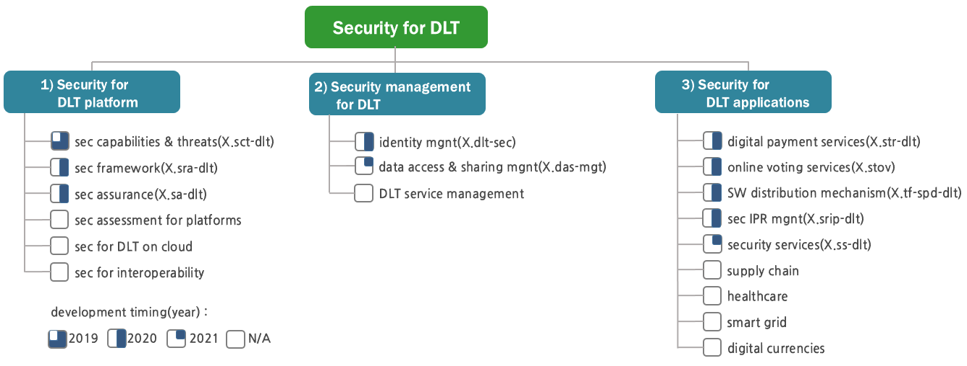
ITU-T Study Group 17 – Security aspects for DLT
Notes:
X.sra-dlt - Security framework for Distributed Ledger Technology
X.str-dlt - The security threats and requirements for digital payment services based on distributed ledger technology
X.sct-dlt - Security capabilities and threats of Distributed Ledger Technology
X.ss-dlt - Security Services based on Distributed Ledger Technology
X.dlt-sec - Security considerations for using DLT data in Identity Management
X.sa-dlt - Security assurance for Distributed Ledger Technology
X.stov - Security threats to online voting using distributed ledger technology
X.das-mgt - Security framework for the data access and sharing management system based on the distributed ledger technology
X.tf-spd-dlt - Technical framework for secure software programme distribution mechanism based on distributed ledger technology
X.srip-dlt - Security requirements for intellectual property management based on distributed ledger technology

Slide 22
Standardization on Intelligent Transport Systems (ITS): Multiple Study Group approach
Radiocommunication Sector (ITU-R)
Working Party 5A (spectrum allocation & harmonization, automotive radar)
Telecommunication Standardization Sector (ITU-T)
Study Group 17 : ITS and automotive cybersecurity (remote SW update)
Study Group 12 : Quality of Service of speech and audio in vehicles
Study Group 2 : Numbering for In Car Emergency Communication (ICEC)
Study Group 20 : ITS and Internet of Things and Smart Cities
Study Group 16 : Vehicle gateway and in car multimedia platforms
  ITU-T Focus Group on Vehicular Multimedia (FG-VM)

Slide 23
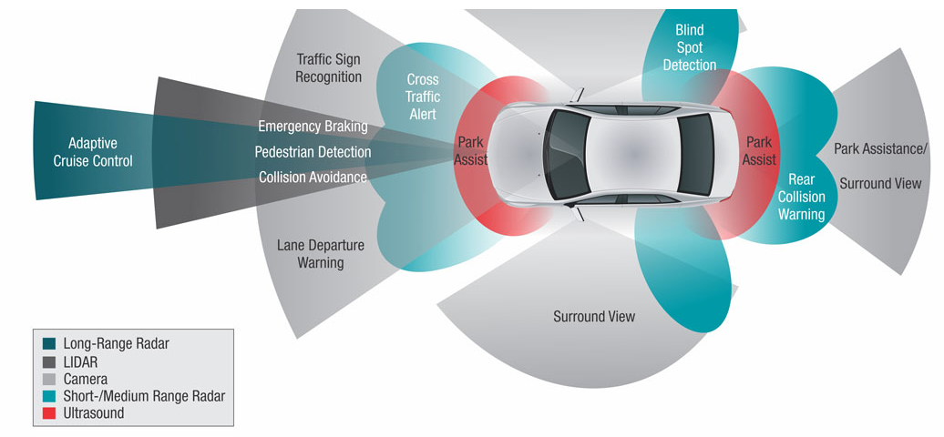
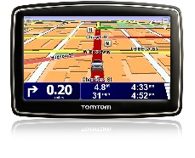
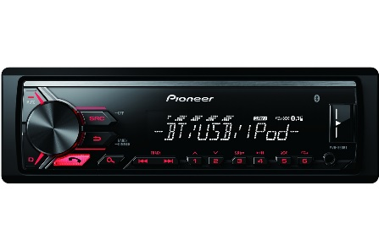


ITU allocates spectrum for vehicles
GPS
Car Radio
Mobile communication and Internet access

Slide 24
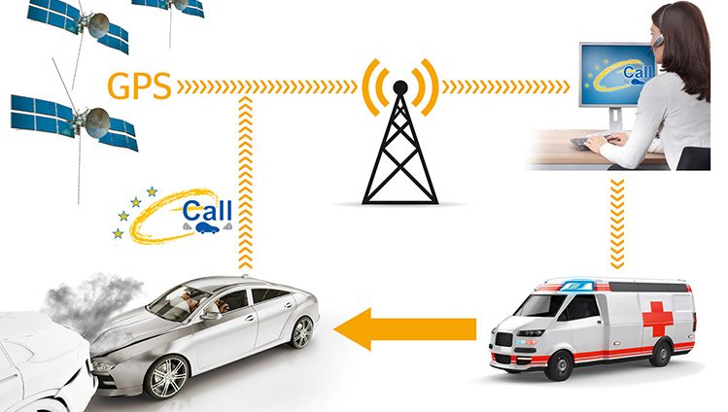
ITU-T SG12: ITU standards make e-calls intelligible
Source: Continental - Automatic Emergency Call
ITU-T P.1140: Speech communication requirements for emergency calls originating from vehicles
Referenced in new UN regulation on automatic emergency call system for road traffic accidents (UNECE WP.29)

Slide 25
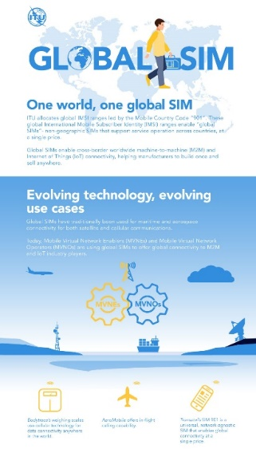
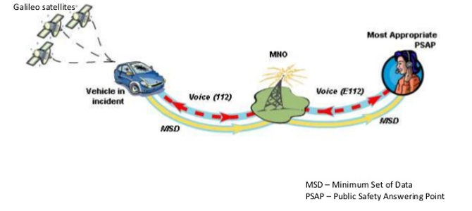
ITU-T SG2: Numbering for in Car Emergency Communication (ICEC) calls
Global numbering resources used for ICEC calls are under consideration

Slide 26
ITU-T SG20 - Develops international standards to enable the coordinated development of IoT technologies in smart cities, including related big data
Completed standards work
ITU-T Y.4116: Requirements of transportation safety services including use cases and service scenarios.
ITU-T Y.4119: Requirements and capability framework for IoT-based automotive emergency response system
Ongoing standards work
Y.IoT-ITS-framework: Framework of Cooperative ITS based on the IoT
Y.IoT-UAS-Reqts: Use cases, requirements and capabilities of unmanned aircraft systems for IoT
Y.AERS-msp: Minimum set of data structure for automotive emergency response system
Y.AERS-mtp: Minimum set of data transfer protocol for automotive emergency response system
Y.TPS-afw: Architectural framework for providing transportation safety service
Y.NDA-arch: Functional architecture of network-based driving assistance for autonomous vehicles
Notes:
1. 1.7 Mb data generated per second per person
Speaker note: If this were 2020, by the time I have finished presentation this room will have generated roughly 40 million Mbs of data!
2. 2020 will ship 235 million wearables.
Speaker note: That’s equal to all of North Africa wearing wearables
3. 6$ trillion IoT market
Speaker note: Approaching 2020 we are now beyond the hype phase
Closing message: Think about what this means for your networks, data-centers, future investments in infrastructure and new business models…

Slide 27
Focus Group on “Vehicular Multimedia” (FG-VM)
Vehicular multimedia system
4th screen after TV, PC & Mobile Phone
3rd infotainment space after home, office
Aim of FG-VM
Integration of Terrestrial and Satellite networks
Integration of Broadcasting and Internet services
Reduce costs using converged networking
Provide wide area coverage
Challenges
Integration and compatibility with mobile communication: 3, 4, 5G and beyond
Software protocols and hardware specifications standardization and adoption
Harmonization of Transport regulations
Involve international experts and stakeholders
For more information: https://itu.int/en/ITU-T/focusgroups/vm
Contact: ​​tsbfgvm@itu.int

Slide 28
Focus Group on Vehicular Multimedia (FG-VM) – future meetings
The following meetings are planned:
4th FG-VM Meeting (16-17 May 2019, e-meeting)
5th FG-VM Meeting (11-12 July 2019, Changchun, China)
6th FG-VM Meeting (11-12 September 2019, Budapest, Hungary​, TBC)
For more information: https://itu.int/en/ITU-T/focusgroups/vm
Contact: ​​tsbfgvm@itu.int

Slide 29
Quantum Key Distribution (QKD) – ITU-T SG17: Secutiry aspects
Current work items:
X.sec-QKDN-ov - Security requirements for quantum key distribution networks – overview
X.cf-QKDN - Use of cryptographic functions on a key generated in Quantum Key Distribution networks
X.sec-QKDN-km - Security requirements for quantum key distribution networks - key management
TR.sec-qkd - Technical report on security framework for quantum key distribution in telecom network

Slide 30
Quantum Key Distribution (QKD) – ITU-T SG13: Network aspects
Current work items:
Y.QKDN_FR - Framework for Networks to supporting Quantum Key Distribution
Y.QKDN_Arch - Functional architecture of the Quantum Key Distribution network
Y.QKDN_KM - Key management for Quantum Key Distribution network

Slide 31




Slide 32
Backup

Slide 33
SG17: X.sec-QKDN-ov - Security requirements for quantum key distribution networks - overview
General security requirements on Quantum Key Distribution (QKD) networks;
Security requirements for QKD networks on
  key management;
  core quantum key relaying functions;
Threats and Security functions for communications between
  QKD systems and applications (cryptographic applications)
  QKD systems and management & monitoring systems

Slide 34
SG17: X.cf-QKDN - Use of cryptographic functions on a key generated in Quantum Key Distribution networks
Aims to add specifications for QKD to existing cryptographic standards to make QKD systems approvable
Focuses on making the keys generated and distributed by a QKD system approvable based on these existing standards

Slide 35
SG17: X.sec-QKDN-km - Security requirements for quantum key distribution networks - key management
Provides help for design, implementation, and operation of key management of QKD network with approved security
Analysis of security issues on a QKD network
Security requirements on a QKD network
Methods and technical specifications of key management to meet these security requirements
Note: Basic functions of a QKD network including key management functions relevant to this Recommendations are given in the Draft Recommendation ITU-T Y.QKDN_FR ""Framework for Networks to supporting Quantum Key Distribution"" in SG13.

Slide 36
SG17: TR.sec-qkd - Technical report on security framework for quantum key distribution in telecom network
Provides security framework of quantum key distribution
Introduction to the QKD network
General architecture for security functions of QKD in telecom network
Threats and security functions for communications between the QKD systems and other entities.

Slide 37
SG13: Y.QKDN_FR - Framework for Networks to supporting Quantum Key Distribution
Describes the framework for Networks to support Quantum Key Distribution (QKD), which addresses architectural network aspects to help the implementation of QKD technologies on user network including:
QKD technologies
Relationship between user network and QKD technologies
Integrated network
Network requirements to support QKD technologies and QKD network
General structure of QKD network
Basic functions of QKD network
Overall service procedure in the layered model

Slide 38
SG13: Y.QKDN_Arch - Functional architecture of the Quantum Key Distribution network
  Provides functional architectures of the Quantum Key Distribution (QKD) network including:
The reference model
Functional elements and reference points
Deployment model
Overall operational procedures
NOTE – This Recommendation addresses the architecture of the QKD network based on the general structure defined in [ITU-T Y.QKDN_FR] as a foundation for further QKD network studies.

Slide 39
SG13: Y.QKDN_KM - Key management for Quantum Key Distribution network
  Describes key management for Quantum Key Distribution (QKD) network including:
Requirements
Functional elements
Procedures
Key formats (key data and meta-data)
Refers the overall structure and basic architecture of QKD network that are defined in Y.QKDN_FR.

