Slide 1
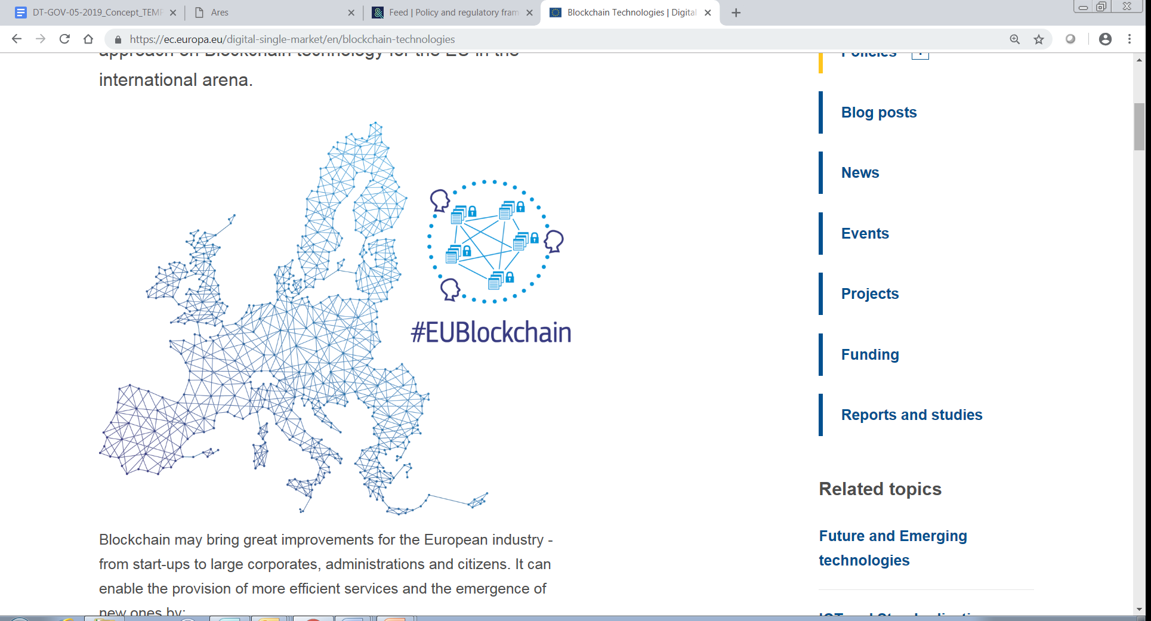
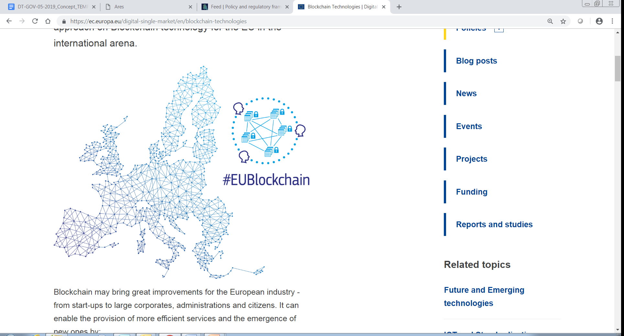
Blockchain: EU strategy and key objectives
ITU workshop,
KIEV, Ukraine
16th May 2019
Massimiliano Dragoni
Digital Innovation and Blockchain Unit Digital Single Market – DG CONNECT
EUROPEAN COMMISSION

Slide 2

Why Blockchain?
New paradigms and collaborative models in the digital economy (more trust)
Transformative capacities (e.g. disintermediation, tokenisation)
Potential alternative model to dominant platforms (decentralisation)
Higher quality and efficiency (e.g. data integrity, traceability)
New opportunities that Europe must seize NOW
Role for public bodies and the private sector

Slide 3
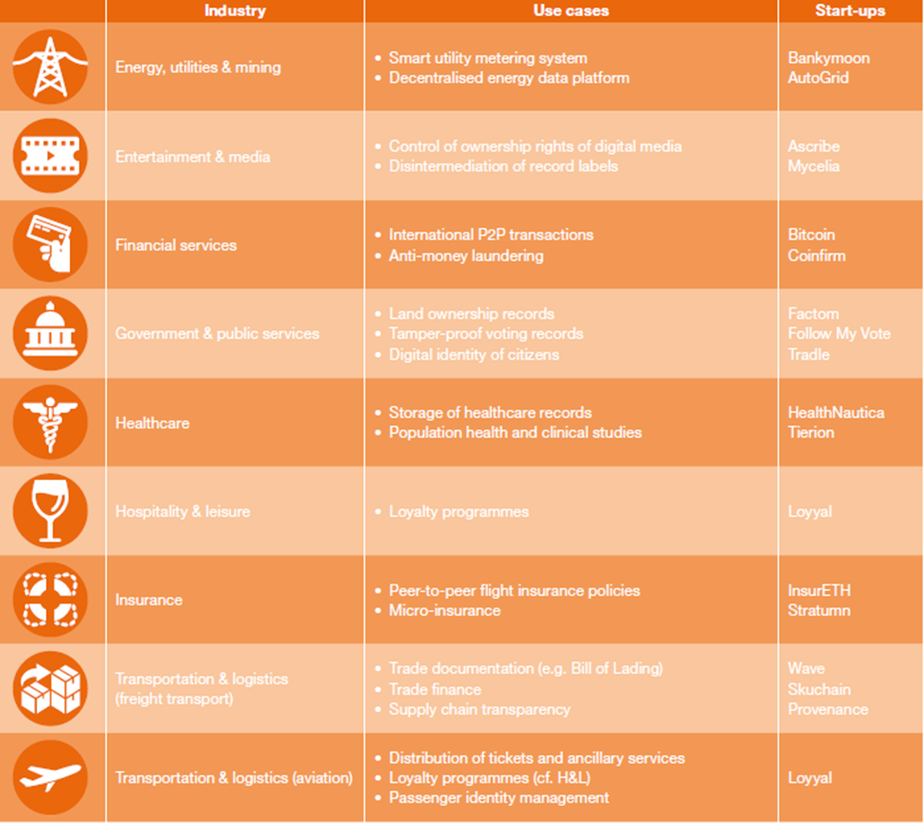

From high potential to operations and successful uses
Major actors from various industrial sectors engaged in projects (users / suppliers)
Vibrant start-up communities
Value for citizens
High interest in governments - EU (EC/EP/ECA), national, local
Map of existing initiatives
EU regulatory framework

Slide 4
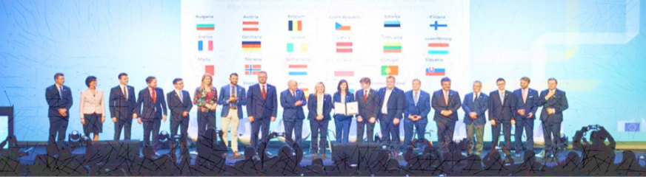
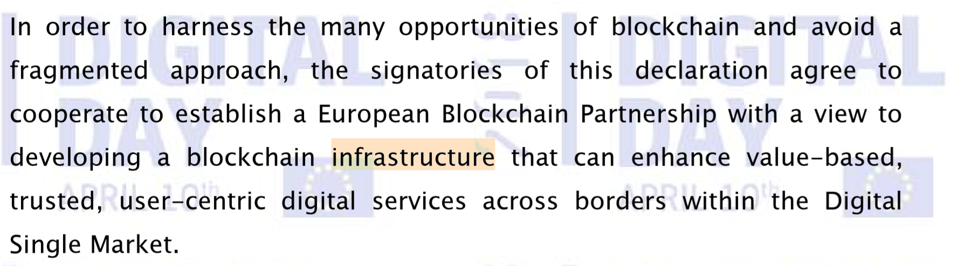
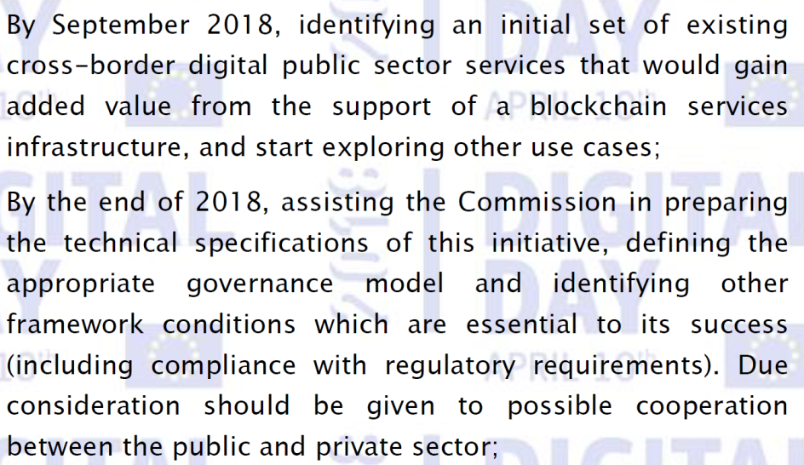
Focus EBP
Policy engagement
The European Blockchain Partnership
MANDATE OF THE EUROPEAN BLOCKCHAIN PARTNERSHIP
JOINT DECLARATION 10th OF APRIL 2018
SIGNATORIES AGREE TO ENGAGE IN COOPERATION TO ESTABLISH A EUROPEAN BLOCKCHAIN SERVICES INFRASTRUCTURE [EBSI]
3 DELIVERABLES BY END OF 2018
Use-cases cross border digital public sector services
Functionalities and architecture of the EBSI
Governance Model

Slide 5

Policy engagement:
EU with MS / EEA
European Blockchain Partnership
29 countries, including Norway and Liechtenstein, to cooperate towards a European blockchain Services Infrastructure (EBSI): focus on cross border public services first
  Uses cases identified (Common registers / excise exchange in Europe, Notarisation of documents; Diplomas)
  European Self Sovereign Identity – eSSIF / eIDAS
  Infrastructure (Guiding principles addressed by EBP)
What was achieved
  From 22 to 29 members
  Agreement on 3 deliverables
  Implementation through CEF in
  2019-2020
Continue exchange of experiences, dialogue on regulatory/legal aspects
Notes:
strengthen cooperation in the development of a European Public Blockchain Infrastructure that can enhance value-based, trusted, user-centric digital services of public interest across-borders

Slide 6






EBP Governance
Roadmap 2019
EUROPEAN BLOCKCHAIN PARTNERSHIP
EBP POLICY GROUP
EBSI TECHNICAL GROUP
EBSI FOCUS
EBSI USER GROUPS
SUPPORT EBSI DEVELOPMENT
IDENTIFICATION AND SELECTION OF NEW USE CASES
ALIGNMENT OF EBSI PRIORITIES WITH POLICY PRIORITIES
POLICY FOCUS
NOTARISATION U-G
DEFINE POLICY AGENDA ON DLT
IDENTIFY POLICY AND REGULATORY AREAS THAT ARE CRITICAL FOR BLOCKCHAIN TECHNOLOGY DEPLOYMENT. E.G. SMART CONTRACTS
AGREE ON REPRESENTATION AND PARTICIPATION AT THE INATBA GLOBAL REGULATORY DIALOGUES INITIATIVE
DIPLOMAS U-G
CARRY-OUT A SURVEY ON BLOCKCHAIN AND FUTURE DIGITAL SERVICES OF PUBLIC INTEREST (FEED INTO DEP)
CREATE AN OVERVIEW OF EU, NATIONAL AND GLOBAL DEVELOPMENTS RELATED TO – 1. BLOCKCHAIN AND HIGH PERFORMANCE COMPUTING
2. BLOCKCHAIN AND ARTIFICIAL INTELLIGENCE
3. BLOCKCHAIN AND SKILLS GAPS FOR SERVICES OF PUBLIC INTEREST
4. OTHERS
ESSIF U-G
TAXATION – IOSS U-G*
INPUT INTO GLOBAL REGULATORY DIALOGUES (WITH INABTA)
TO BE LAUNCHED BY OCCASION OF THE WORLD BLOCKCHAIN CONGRESS (FALL 2019)
OTHERS…

Slide 7
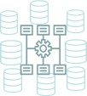

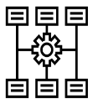

EUROPEAN BLOCKCHAIN SERVICES INFRASTRUCTURE (EBSI) Development
EBSI Roadmap
Implementation
2019
2020
2021
TRACK 1
DEFINED TECHNICAL SPECIFICATIONS
INFRASTRUCTURE
CHARACTERISTICS AND ARCHITECTURE OF EBSI
CONSTRUCTION OF EBSI v1
MEMBER STATES INTEGRATION
TRANSITION TO PRODUCTION
Deployment package
Common API
Functional modules
TECHNICAL AND
USER GROUPS
TRACK 2
CENTRAL SERVICES GO LIVE
LAUNCH OF EBSI TESTING PLATFORM
CONSTRUCTION OF EBSI v2
PREPARATION OF EBSI v2
Review of EBSI V1
Development of additional Technical Specifications
Q2 and Q3 2019
Q4 2019 to Q3 2020
Q3 2020 to Q1 2021
Q4 2020 to Q2 2021

Slide 8
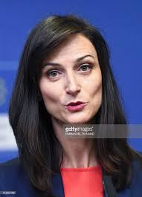
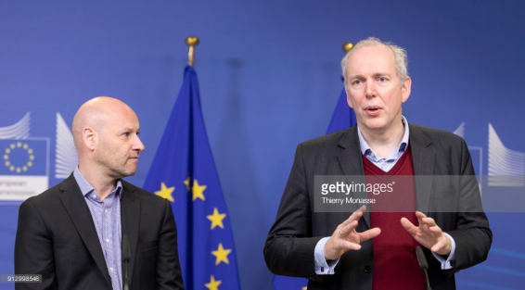
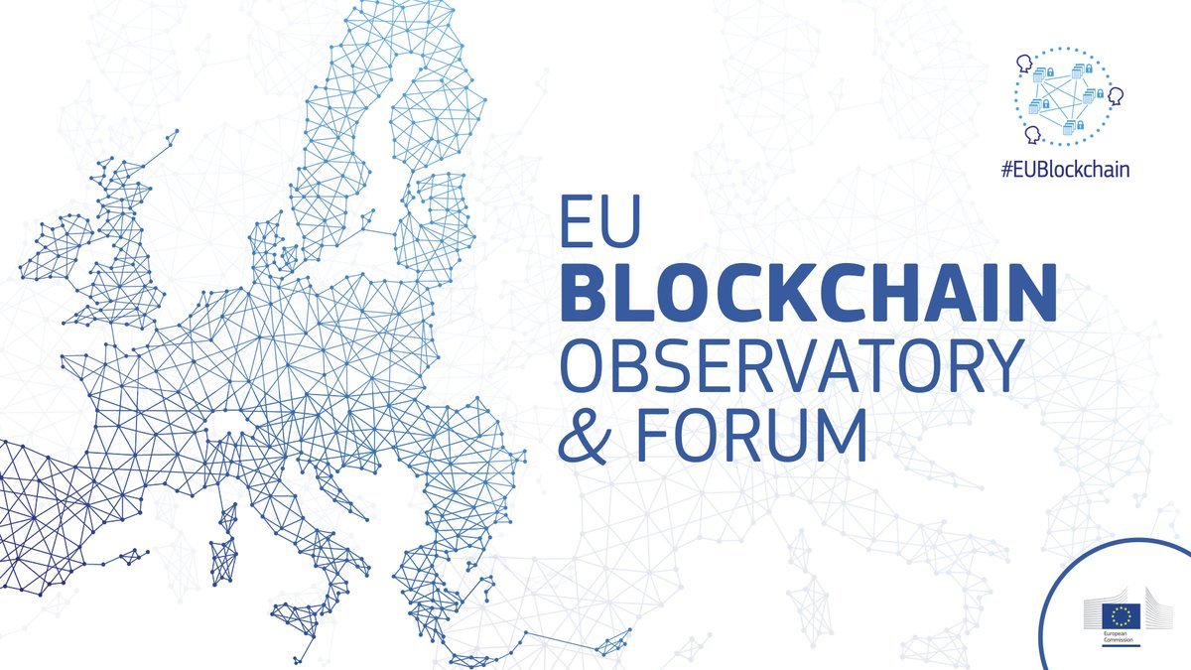
An Observatory and a Forum, an online and offline community, a map of 630+ projects, workshops organised, reports prepared, available trainings
EU Blockchain Observatory and Forum
Stakeholders engagement

Slide 9
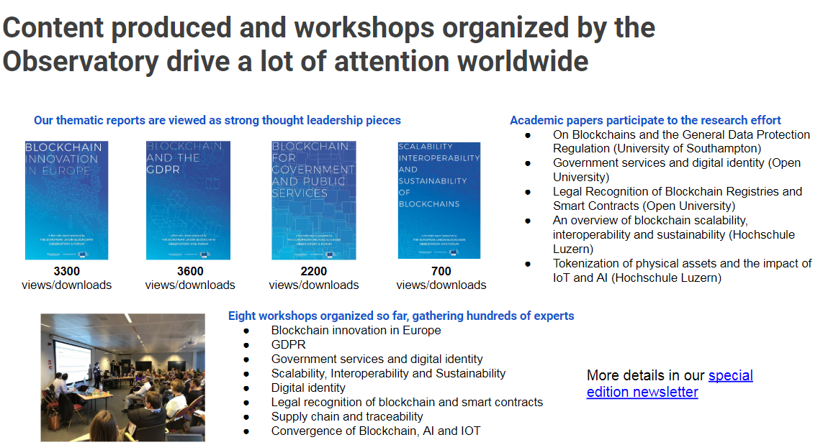
EU Blockchain Observatory and Forum
Achievements

Slide 10
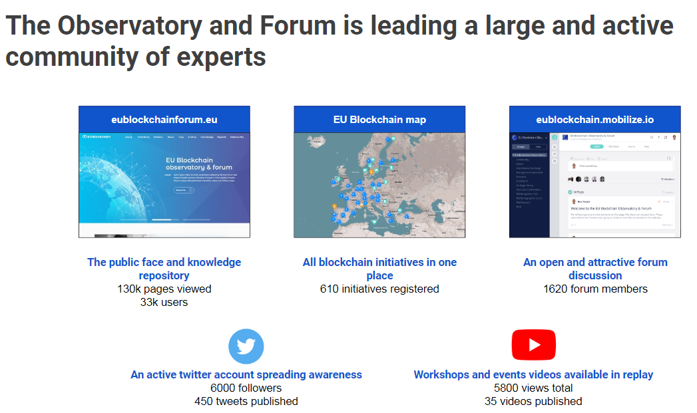
EU Blockchain Observatory and Forum
Achievements

Slide 11
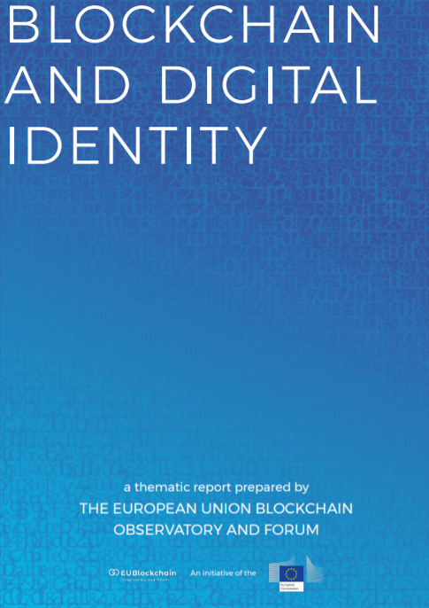
Focus
Digital identity
ID has become multiple and multifaceted
Today ID is centralised and fragmented (siloed and monopoles)
ID in a digital world needs digital proofs and credentials
Digital identity: atomic and cumulative (growing and evolving data points in digital realm)
Self-Sovereign Identity may offer user-owned decentralised digital identities
Assessing possible anchoring with eIDAS
Through the EBSI – EU Self-Sovreign Identity Use Case (implementation)
Blockchain

Slide 12
Focus – Decentralised
digital identity
"Decentralised identities are digital identities that are created by an individual and remain under his or her control. By attaching trusted information (credentials) from authoritative sources to these identities, the individual can create trust in the claims he or she makes about his or her identity, while still maintaining that control".

Slide 13
Considerations
ESSN
European Social Security Number to provide a unique identifier for each EU citizen to interact with social security administrations and institutions.
Self Sovereign Identity to provide citizens with a unique identifier handled by users through their private/public encryption keys, decentralised fashion, digital by default (linked to verified eIDAS accounts with proper level of assurance?)
Unique identifier is good to attach all our attributes, including social security ones (centrally / decentralised managed?)

Slide 14
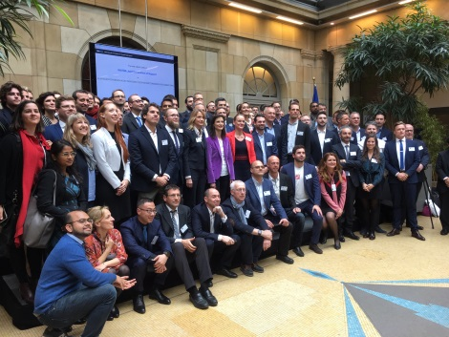
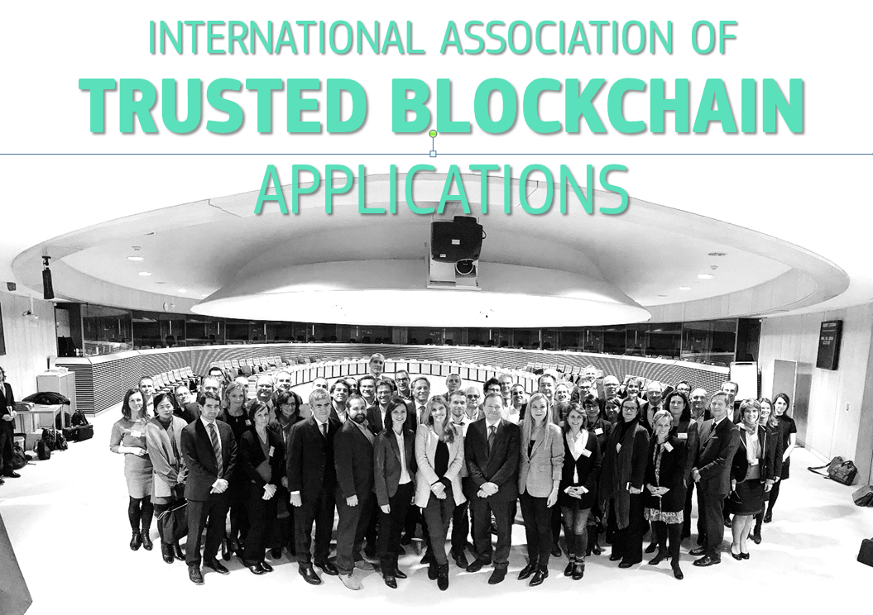
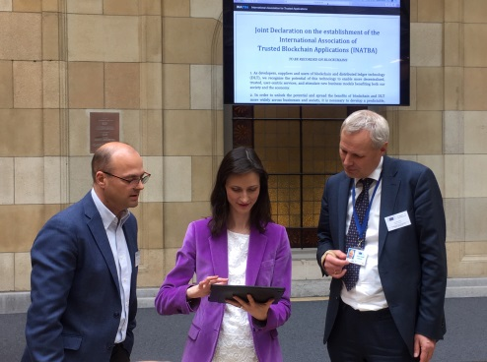
INATBA
Industry engagement

Slide 15

Focus INATBA
Its mandate
The INternational Association for Trusted Blockchain Applications is an open and inclusive multi-stakeholders organisation, created in Europe, Brussels, bringing together all stakeholders committed to promote interoperability, transparent governance, legal certainty and trust in services enabled by blockchain and DLT, worldwide, through continued collaboration and openness.
INATBA is bringing together members to develop open, transparent & inclusive governance model; Interoperability of DLT/Blockchains; Sector-specific specifications & promote convergence of policy by establishing regulatory dialogues between industry&public authorities at global level.
1st World Blockchain Congress, Malaga, 11-13 November 2019

Slide 16
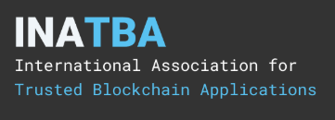
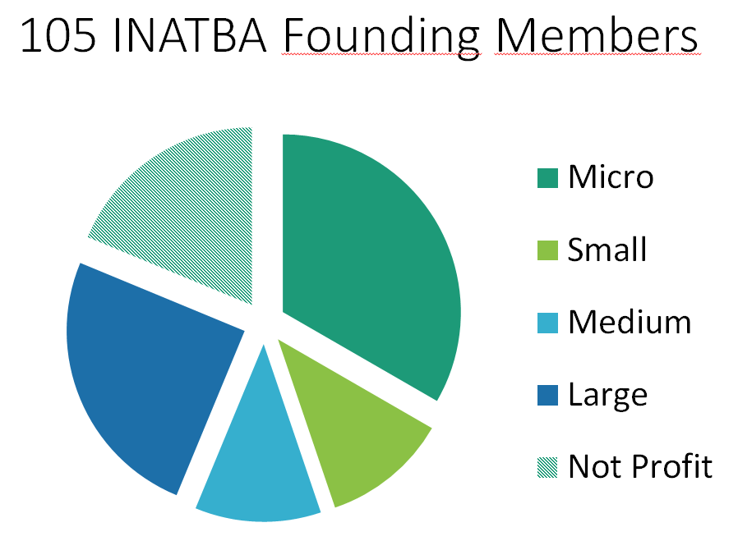
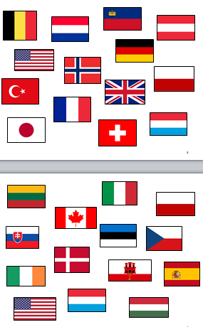

Focus INTBA
Establishment
105 founding members on 6th March 2019
300+ requests for membership
Over 4 continents
ICANN-style ambitions
Official launch on 3rd April in Brussels
INATBA Declaration hashed on blockchains
More info https://www.inatba.org/

Slide 17

Legal framework
Smart Contracts : Is the current legal framework sufficiently clear to ensure the enforceability of smart contracts and clarify jurisdiciton in case of legal disputes?
Tokenisation : Is the current legal framework appropriate for issuing and trading tokens (i.e.: crypto assets), when they are not considered as financial instruments ?
=> EU Blockchain Observatory WG "Legal"
=> Opinion EBA, ESMA Jan 2019 (gap analysis)
=> Study EU Commission 2019

Slide 18
The way forward
European strategic leadership in MFF 2021-2027, while continue funding R&I through existing EU programmes;
Address regulatory aspects to exploit DSM
Build EBSI with practical cross-border use cases
Promote public-private cooperation with INATBA
Engage in international outreach
Work on Standardisation (ISO TC 307), Interoperability
Prepare investment fund in "AI and blockchain"
Education and skills development

Slide 19

AN AMBITIOUS EU BLOCKCHAIN STRATEGY
EU Strategy
Blockchain holistic approach
ESTABLISHING GLOBAL LEADERSHIP IN BLOCKCHAIN AND DISTRIBUTED LEDGER TECHNOLOGIES
JOINED-UP POLITICAL VISION (EU-MS)
JOINT DECLARATION ON THE ESTABLISHMENT OF THE EUROPEAN BLOCKCHAIN PARTNERSHIP [EBP] AND THE DEVELOPMENT OF THE EUROPEAN BLOCKCHAIN SERVICES INFRASTRUCTURE [EBSI] FOR CROSS-BORDER DIGITAL SERVICES OF PUBLIC INTEREST
PUBLIC-PRIVATE PARTNERSHIP
SUPPORTING THE CREATION OF THE INTERNATIONAL ASSOCIATION OF TRUSTED BLOCKCHAIN APPLICATIONS [INATBA]; A MULTISTAKEHOLDER ORGANISATION TO PROMOTE TRUST AND INTEROPERABILITY AT GLOBAL LEVEL
CONNECTING GLOBAL and EUROPEAN EXPERTISE
THE EU BLOCKCHAIN OBSERVATORY AND FORUM BRINGS TOGETHER THE LEADING GLOBAL EXPERTS TO IDENTIFY OBSTACLES, INCENTIVES AND PRACTICAL SOLUTIONS TO PROMOTE BLOCKCHAIN UPTAKE.
INVESTING IN EU RESEARCH, INNOVATION AND START-UPS
THROUGH THE CONNECTING EUROPE FACILITY AND H2020 PROGRAMMES, THE EU IS CO-INVESTING IN THE MOST ADVANCED DIGITAL INFRASTRUCTURE AND THE MOST INNOVATIVE EU START-UPS
NEW EU INVESTMENT SCHEME FOR AI AND BLOCKCHAIN + SUPPORT PROGRAMME
PROMOTING AN ENABLING DSM LEGAL FRAMEWORK, INTEROPERABLE STANDARDS and SKILLS DEVELOPMENT

Slide 20
Next steps
How to engage?
INATBA : solicit your stakeholders to become members; discuss interest for regulatory dialogues in the World Blockchain Congress
EU Blockchain Observatory and Forum: dedicated meetings with DGs, engage in the next workshops (slide) and reports
EU Blockchain Partnership: identify promising use cases to be sumbitted in 2019 (second wave); engage in more technical discussions on existing use cases and deployment; regulatory barriers and legal certainty framework.
Research and innovation activities: continue mapping EU-funded projects – many DGs contributions still missing!Priorities for the next MFF.
Exploring areas of legal uncertainty and regulatory framework e.g. smart contracts and tokenisation: EU study DG CNECT SMART 2018/0038

Slide 21
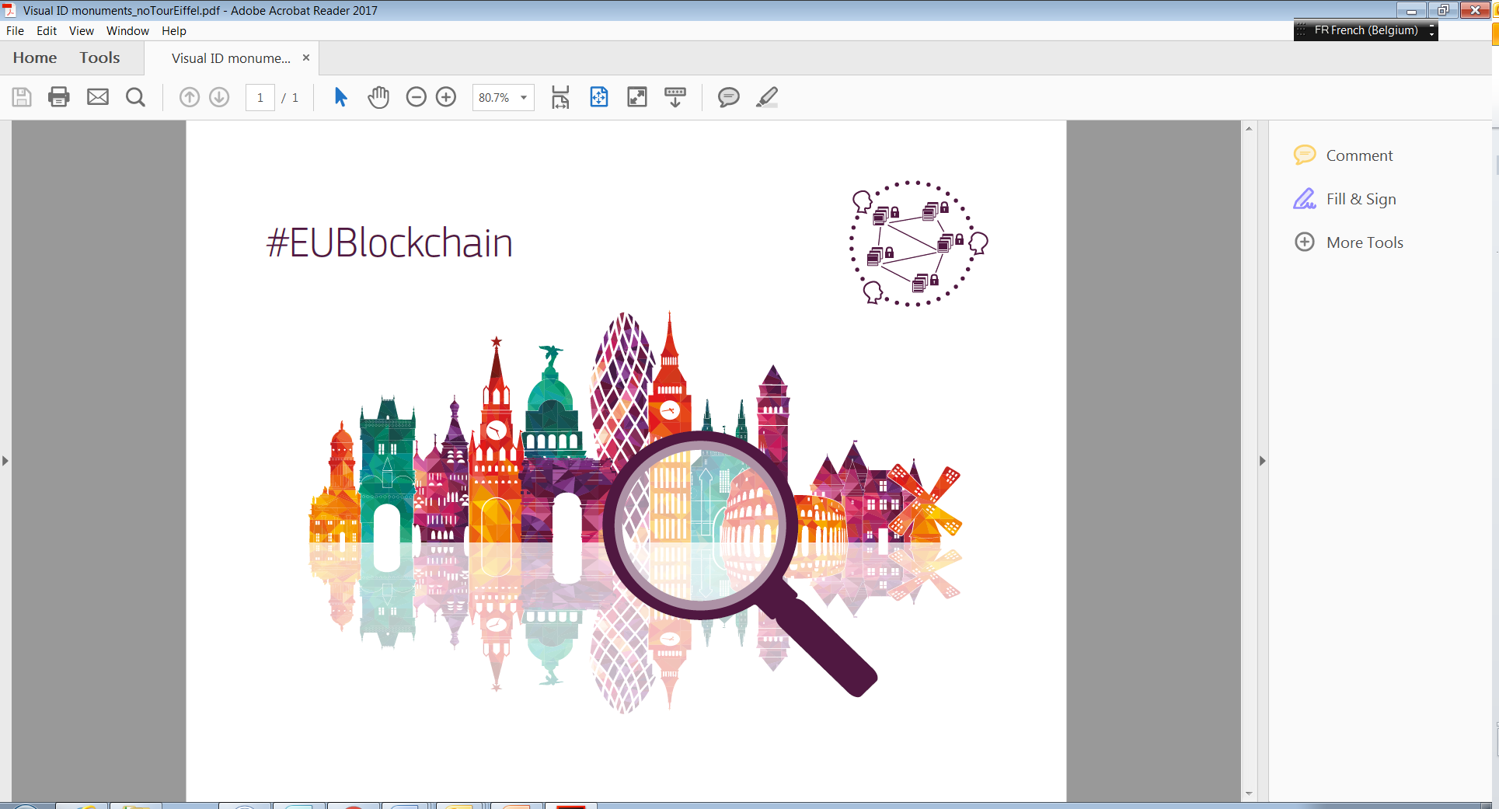
Thank you!
CNECT EU Blockchain
@EUBlockchain

