Slide 1
We exist to protect your world.
Vitalii Voropai
IBM Security CTP, CIS Countries

Slide 3
1959
Вычислительные мощности

Slide 4
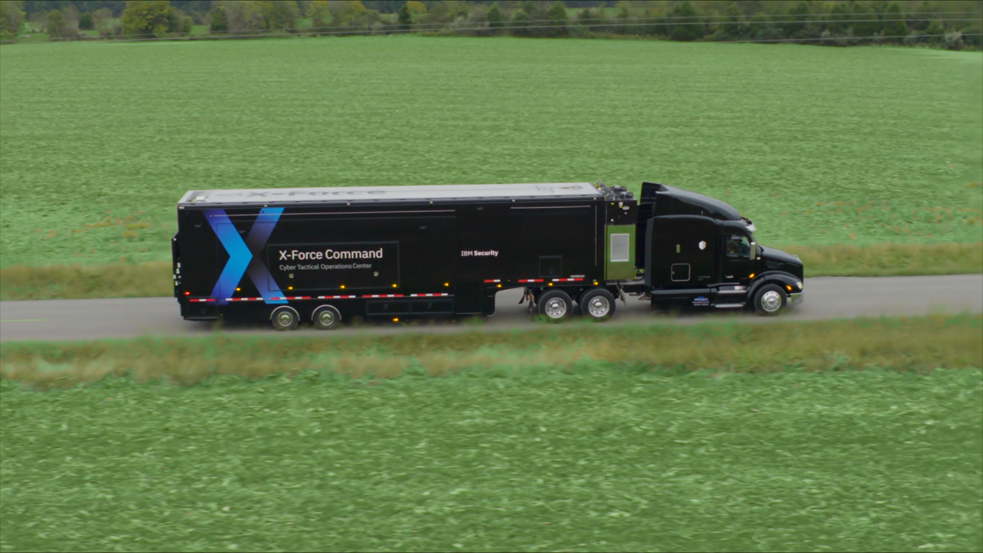
2018
Безопасность

Slide 5


8,000+ сотрудников
17,500+ клиентов
133 страны
3,500+ патентов
Самый крупный Security Стартап
Notes:
<Presenter: This is an embedded video of the world. If in slideshow mode you have problems playing, download the video file to your hard drive and try again: https://ibm.box.com/s/gh5bofouefzi8vs009bujsfrivddaxl6 >
Point-product technologies and linear-driven security strategies are no longer enough amidst the challenges of today’s highly interconnected technology innovations.
Gartner predicts there will be 20.8 billion by 2020. <Source: 2015 Gartner Press Release>
…and cybercriminals’ targets are now bigger and their rewards greater as they fine-tune efforts to obtain and leverage higher-value data than in years past. The demand for leaked data is trending toward higher-value records such as health-related personally identifiable information (PII) and other highly sensitive data, with less emphasis on the emails, passwords and even credit card data that were the targets of years past. This PII can be used for social engineering to gain access to valuable financial targets. We see this in both the breach trends and the evolution of malware to target high value bank accounts.
<click>In fact, Juniper Research forecasts that the number of personal data records stolen by cybercriminals will reach 5 billion in 2020.
<click>Costing global business over $8 Trillion over the next 5 Years. <Source: https://www.juniperresearch.com/press/press-releases/cybercrime-to-cost-global-business-over-$8-trn>
<click>
These challenges put added strain on organizations that are also faced with…
Compliance mandates – Adapting to a threat-aware, risk-based approach versus a compliance-based, box-checking approach is critical amidst the ever-changing regulatory mandates affecting organizations. GDPR for example, the new data protection framework that takes effect across Europe starting May 2018. GDPR doesn’t just impact European companies, any organization that stores, accesses, processes or uses EU residents’ personal data is subject to the regulation. Fines for violations have the potential to reach the billions for large, global companies — anywhere from 2 to 4 percent of a company’s gross revenue.
<Source: 2017 SecurityIntelligence.com Article: https://securityintelligence.com/prepared-for-the-general-data-protection-regulation-gdpr-top-10-findings-from-hurwitz-associates-survey/>
<click>All of this is compounded by the fact that we barely have the manpower to address these concerns. Experts predict that the growing gap between available qualified cybersecurity professionals and unfulfilled positions will reach 1.8 million by 2022.
<Source: Frost & Sullivan 2017 Study: https://iamcybersafe.org/wp-content/uploads/2017/03/WomensReport.pdf>
<click>And with our own experts are seeing as many as 85 tools from 45 different vendors being used by our customers; its no wonder security professionals are overwhelmed.
Security needs to become agile so that it moves, adapts, and scales along with the business.

Slide 6

Notes:
To begin, I want you to imagine for a moment that you are on the operating table. You’re about to undergo a critical procedure … life or death … a procedure that must go perfectly in order for you to survive. There’s a team of five highly skilled surgeons performing the operation, and it’s taking place in one of the most renowned medical facilities in the world.
But now, I want you to image that instead of five surgeons in the operating room …

Slide 7

Notes:
… there are only two.
And instead of being able to clearly see everything before them …

Slide 8

Notes:
… they’re blindfolded … unable to see anything at all. Getting a little nervous?
Now I want you to imagine that these two blindfolded surgeons are not just operating on you …

Slide 9


















Notes:
… but instead they are performing critical surgeries on hundreds, thousands, even tens of thousands of other patients at exactly the same time.
Oh, and did I mention that that while all of this is happening …

Slide 10
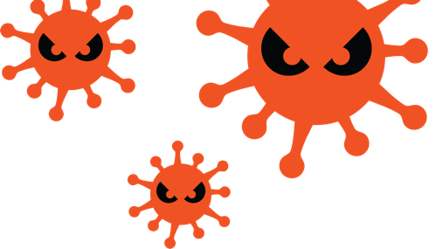
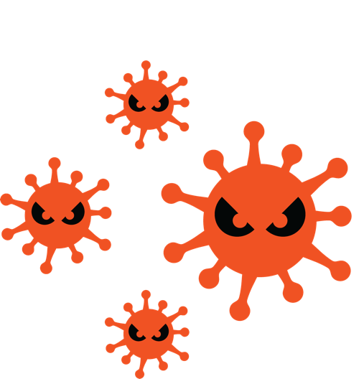
Notes:
… the hospital is being moved out from underneath of them?
And finally, for good measure …

Slide 11
Notes:
… let’s go ahead and introduce a never-before-seen superbug into the operating room.
I think we can all agree that this nightmarish scenario is one that would simply never be tolerated. We would never allow a situation in which those we entrust with our safety and well being are diminished, impaired, overwhelmed, distracted and overrun. Would we?

Slide 12

Мы часто обсуждаем
Нам нужны новые контроли
Нам не хватает сотрудников
Как нам защищать IoT?
Мы уходим в облако
Что делать с регулятором?
Notes:
Top challenges we see our clients facing today include outdated tools, skills, advanced attacks, cloud security, data privacy and regulatory compliance. What are some of your top concerns?
<Presenter: See Industry challenges module for challenges that are more specific for your target audience.>

Slide 13
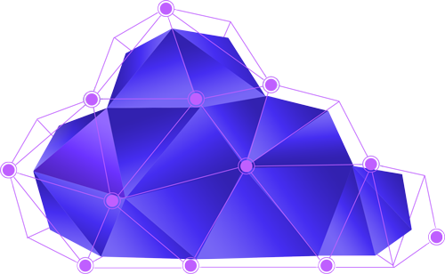
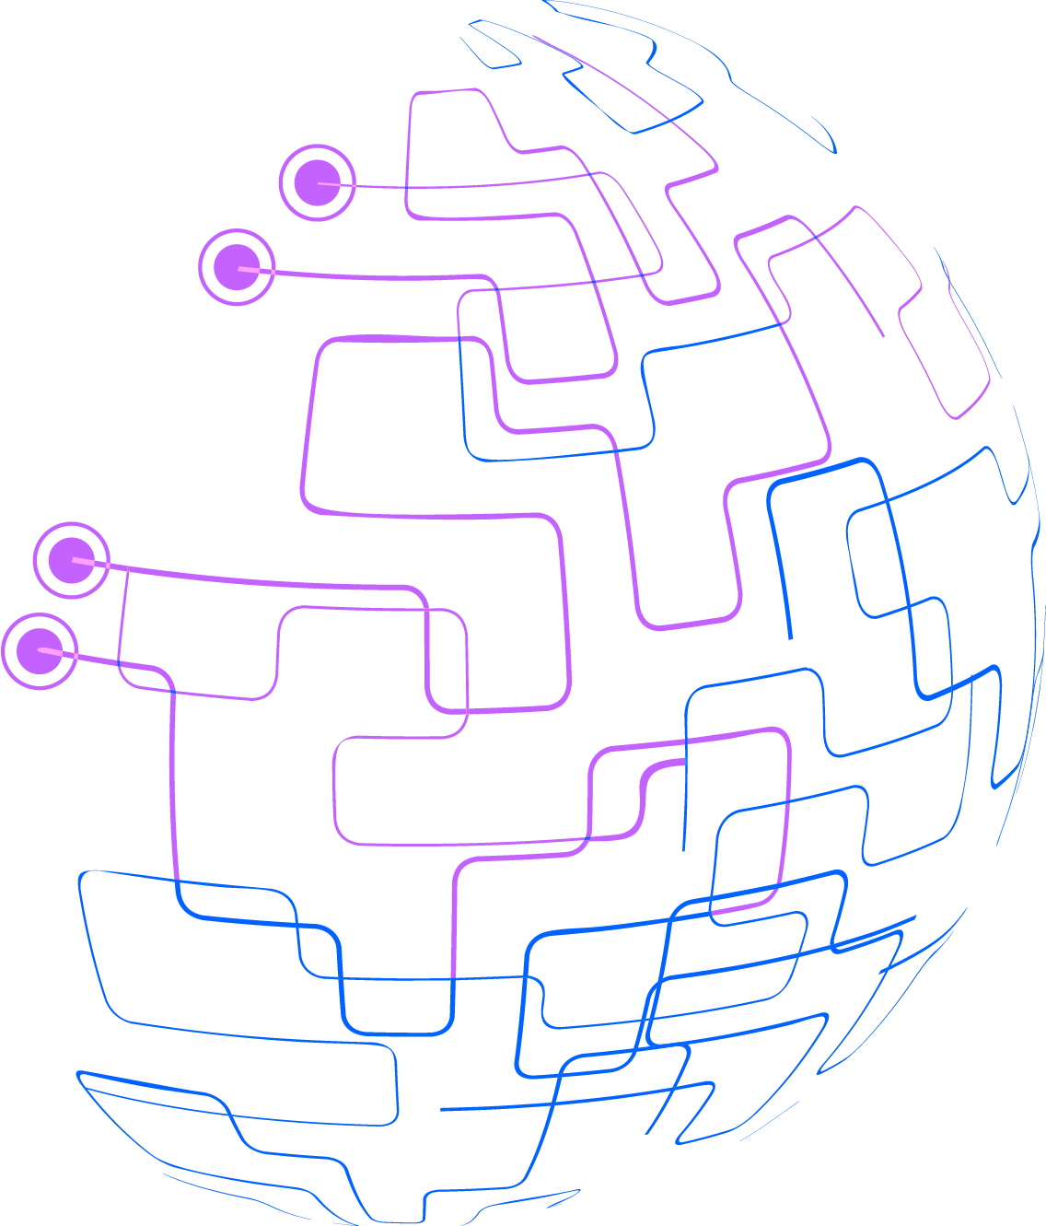

Будущее и настоящее.
2019+
Connected security
До 2013
2013-2018
AI, ML
DATA
APPS
IDENTITY
& ACCESS
SECURITY
INTELLIGENCE
MOBILE
ADVANCED
FRAUD
ENDPOINT
NETWORK
THREAT
INTEL

Slide 14
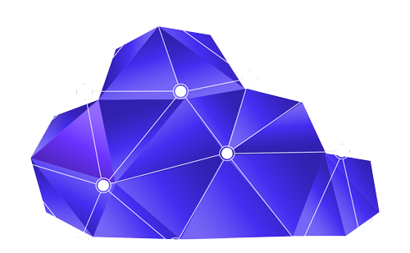
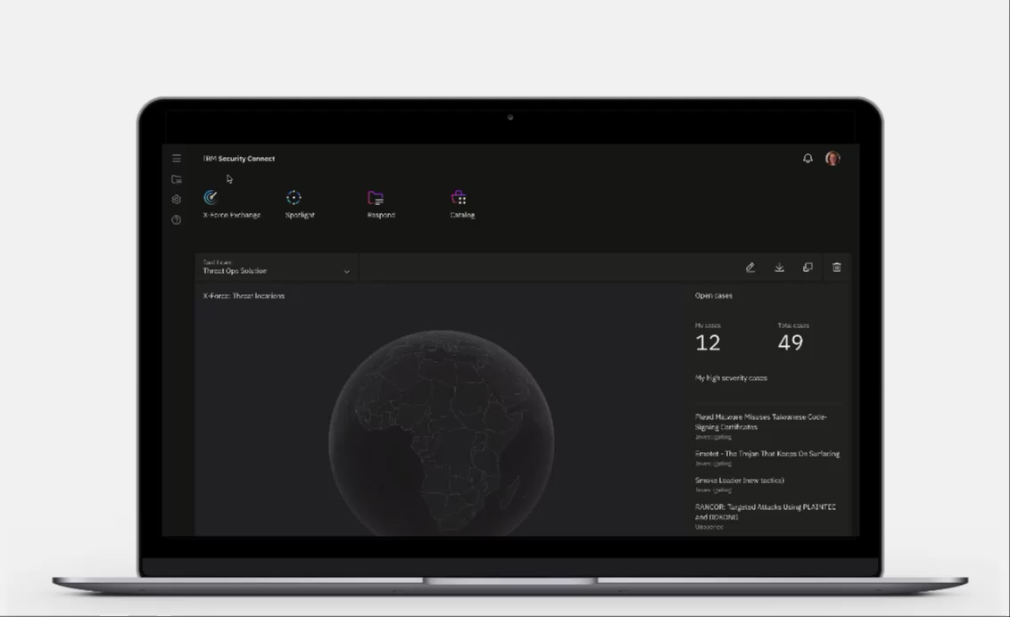

Connected Security
IBM Security Connect
Экосистема
Простота
Приложения
Обмен данными
Blockchain for security
IBM Security / © 2019 IBM Corporation
Notes:
Moment Sridhar take stage, but to help set context
Goal of Connect two fold | Change clients consume and freedom to compose | Move from solution to solution w/o complex
Will be hub for Threat Intelligence | Collaboration | Cloud-based AI | Extend value of existing IBM and 3rd party | On prem or in cloud
We not just aiming for this to be IBM Security’s new platform, we want it to become the industry’s new platform.

Slide 15
IBM Security Connect

Slide 19



Обнаружить
Notes:
Data, data, everywhere, but not a clear insight in sight.
Trapped by too much info and not enough resources to parse it down to palatable bites.
82% - Insider and privilege misuse breaches that took months, or even years, to be discovered.

Slide 20
IBM Security Qradar
Журналы^{Unlim*}
Сеть
Уязвимости
Топология
Активы
Пользователи
  IBM Watson
  Qradar UBA
  DNS Analyzer
  OpenVas
  Qlean
  Assistant
  IBM Resilient
  IBM i2
Notes:
DSAT VP
CLEARLY VISUALIZE:
According to Cisco research, organizations report that 44% percent of alerts go uninvestigated, and of the alerts that are true positives, 54% are never remediated. Despite their best efforts, teams just can’t keep up. This problem is becoming so serious that over one third of cybersecurity professionals rate the inability to keep up with alerts as their single greatest challenges incident response challenge.
IBM QRadar Security Intelligence Platform: How does Qradar (or any good SIEM) best see into data sources for threat information
IBM Security Intelligence Operations and Consulting Services
IBM Managed Security Information and Event Management (SIEM)
QUESTION: Who is running multiple SIEMs. Why? Do you still think you’re seeing it all?
INTELLIGENTLY UNCOVER
Two questions to answer here: 1. How does Advisor help uncover more threats with it’s AI awesomeness of scouring unstructured data. 2. Looking inside the perimeter for APTs and other chained attacks.
IBM QRadar Advisor with Watson
IBM QRadar User Behavior Analytics
IBM Managed Detection and Response
QUESTION: Are you seeing insider risky behavior? APTs are on the rise and often start with jacked credentials. What about threat intelligence that doesn’t come from a neat and tidy structured data feed. How quickly are you seeing threats and responding?
SEAMLESSLY STOP
Heavy services play here, while we know Qradar is the end all be all of integrations, slow your roll, push services help here. That mid-market convo we discussed on our first call.
Who is doing all they can to manage access and see insider behavior? The best bet to slowing down the APT deluge from multi-pronged attacks. This is also a bleed-in point to Orchestrate Incident Response.
IBM X-Force Incident Response Intelligence Services (IRIS)
IBM Security Access Manager
IBM Identity Governance and Intelligence

Slide 21




IBM Watson for CyberSecurity
Человеческая экспертиза
АНАЛИТИКИ ИБ
Здравый смысл
Мораль
Сострадание
Абстракции
Дилеммы
Обобщения
IBM Watson
Анализ неструктурированных данных
Натуральный язык
Вопросы и ответы
Машинное обучение
Устранение человеческого фактора
Аналитика по компромиссам
Аналитика ИБ
Корреляция данных
Идентификация паттернов
Детектирование аномалий
Приоретизация
Визуализация данных
Рабочие процессы
АНАЛИТИКА ИБ
ПОНИМАНИЕ| МОТИВАЦИЯ | ОБУЦЕНИЕ
КОГНИТИВНАЯ ИБ

Slide 22
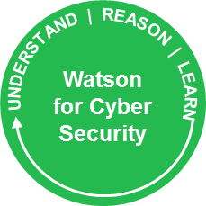
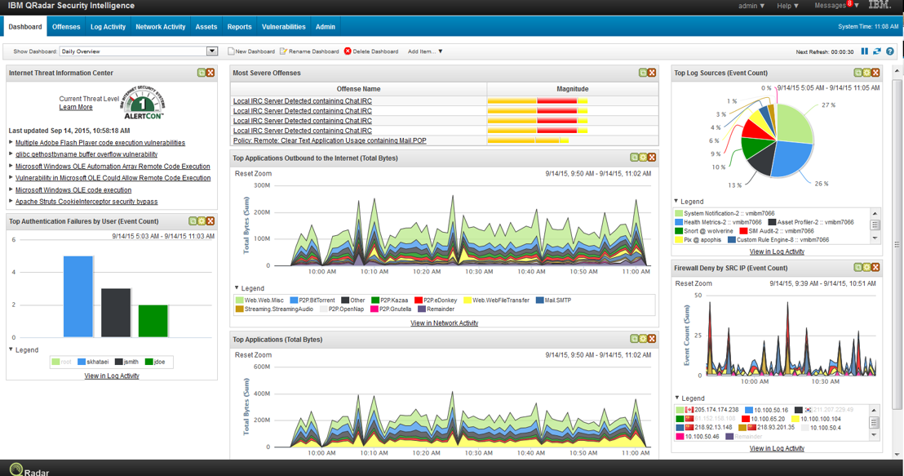
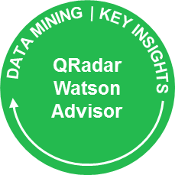
QRadar Advisor
6. Обогащение
5. Результаты
4. Сопоставление
Устройства
Графы
1. Offenses
Взаимосвязи
QRadar
Контекст
2. Собирает данные для расследования
3. Анализ

Slide 23
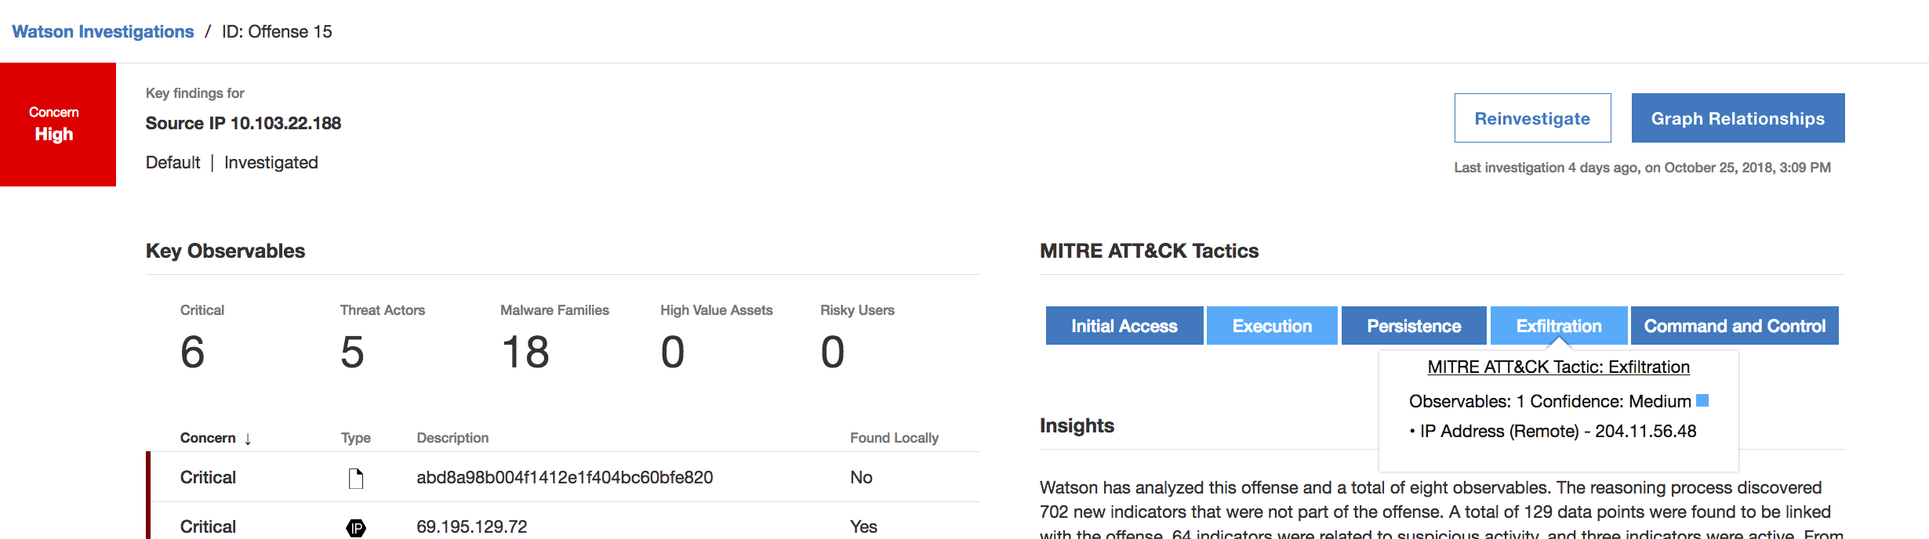
QRAW 2.0 и MITRE ATT&CK
Offense
Расследование

Slide 24
QRAW 2.0 и MITRE ATT&CK

Slide 25


Правильно среагировать
Notes:
77% of orgs don’t have a response plan. 57% say time to respond to events has increased YoY/. 40x faster responses with intelligent orchestration.
Increased complexity of attacks and security tools is causing Analysts to be bogged down by baby sitting false positives. (Good place to harken back to initial New Rules, not tools mantra).

Slide 26
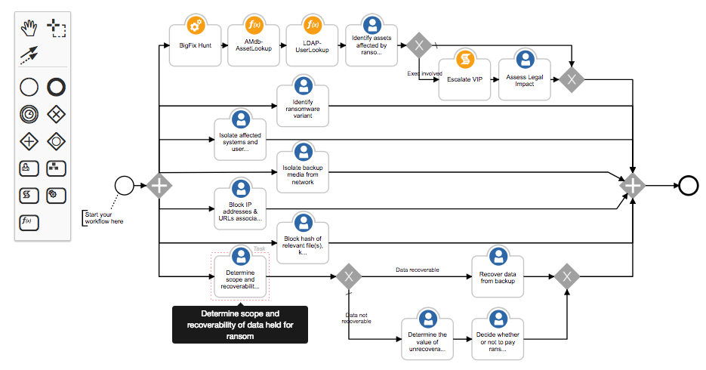
Intelligent Orchestration with Automation
Автоматизация рутинных задач для ускорения процесса
Принятие решения на ключевых этапах
Люди, процессы и технологии

Slide 27
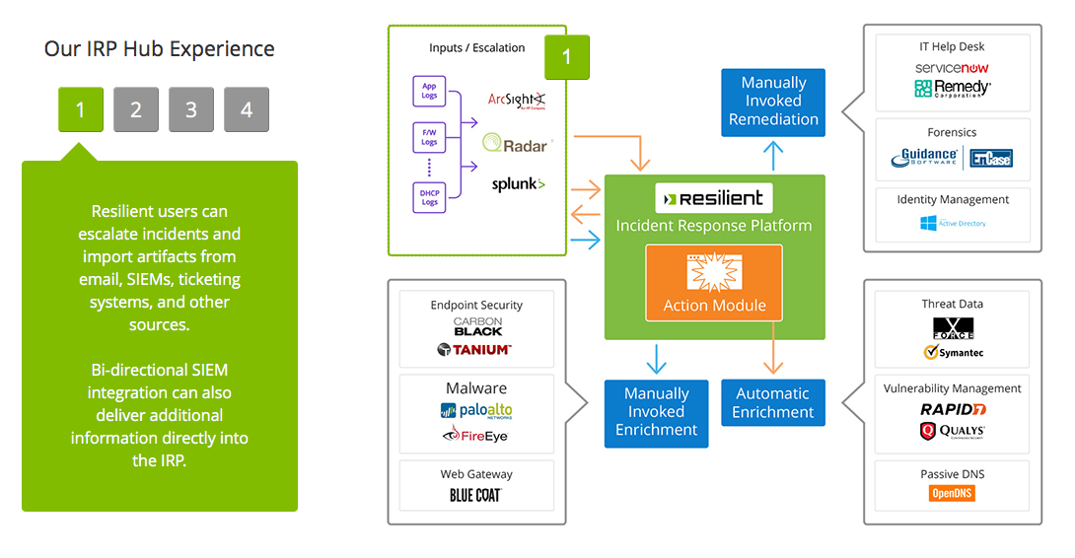
Интеграция Resilient с другими решениями
Ручное исправление
Пользователи Resilient могут эскалировать инциденты и импортировать артифакты из email, SIEM, ticketing systems и других источников.
Двунаправленная интеграция с SIEM может также предоставлять дополнительную информацию прямо
в IRP.
Ручное обогащение
Автоматическое обогащение

Slide 31


Среагировать
Описание и автоматизация
400 часов в год
В 40 раз быстрее
Обмен опытом и использование AI
Notes:
Orchestrate and automate:
Resilient helps alleviate the skills gap by allowing analysts to focus energy on investigation and response – rather than pivoting between tools and repeating basic steps – by automating triage and enrichment tasks.
Freeing SOC staff to focus on more strategic priorities.
IBM Resilient Incident Response Platform
Resilient Dynamic Playbooks
QUESTION: What’s your biggest incident response challenge? Well documented processes, people,
Fully integrate human and AI
Resilient helps enable SOC Managers to increase and measure SOC productivity by integrating with existing security tools. Teams can enforce SLAs and help ensure that the right analyst is working on the right tasks with the right tools.
IBM QRadar Security Intelligence Platform
IBM QRadar Advisor with Watson
IBM QRadar User Behavior Analytics
Refine IR processes and procedures
Resilient helps enable SOC Managers to increase and measure SOC productivity by integrating with existing security tools. Teams can enforce SLAs and help ensure that the right analyst is working on the right tasks with the right tools.
Also, seek expert advice since your problems might be broader in scope than originally suspected.
IBM X-Force Incident Response Intelligence Services (IRIS)
IBM Managed Detection and Response
IBM Managed Security Information and Event Management (SIEM)

Slide 32


Slide 33


Понять суть угрозы
Master Threat Hunting
Notes:
The greatest threats to an organization come from the most unsuspecting places.
The reality of Advanced Persistent Threats is that they’re serving as the brunt of the damage experienced by companies today. 80% of the epic breaches
that have made the news in recent years came from the 20% of threats unseen by traditional systems. They were multi-step attacks as opposed to brute for entry, they required detectives to ferret them out- not security guards.
QUESTION: Do you feel like you're hunting threats or reacting to them?

Slide 34

Master Threat Hunting
Что произошло?
Что может произойти?
Гипотезы
Notes:
Is Threat Hunting art or science? The answer is simply that you get better results from the marriage of the two.
QUESTION: Who knows the Golden Ratio? From Davinci to Dali, when creating the most aesthetically pleasing images, a mathematical pattern was discovered – a balance to the scene based on mathematical patterns. We also see the ratio in our favorite nature items from flowers to bee hives.
Threat Hunting is art and science. Tools are useless without the skills to use them, as millions of people have shown at Painting and Wine evenings. Likewise, if Norman Rockwell did finger painting – he probably wouldn’t have been noted as The American artist of the 20th century.
Science
Manage a deluge of data. Find the right data. Correlate with i2.
IBM i2
IBM QRadar Security Intelligence Platform
IBM QRadar Advisor with Watson
IBM QRadar User Behavior Analytics
Art
Knows what data to pull based on intuition. Successful correlation is incumbent on domain knowledge of what to deliver. One false premise can eschew results to a ghost hunt.
IBM X-Force Incident Response Intelligence Services (IRIS)
IBM Managed Detection and Response
IBM Managed Security Information and Event Management (SIEM)
QUESTION: What is your greatest challenge Threat Hunting right now? Art (the people and skills) or Science (the tools)?

Slide 35
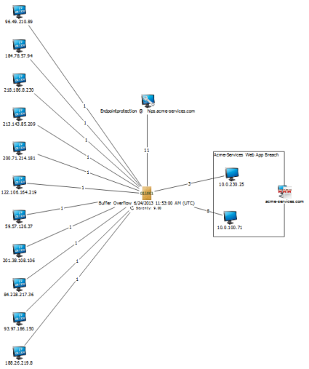
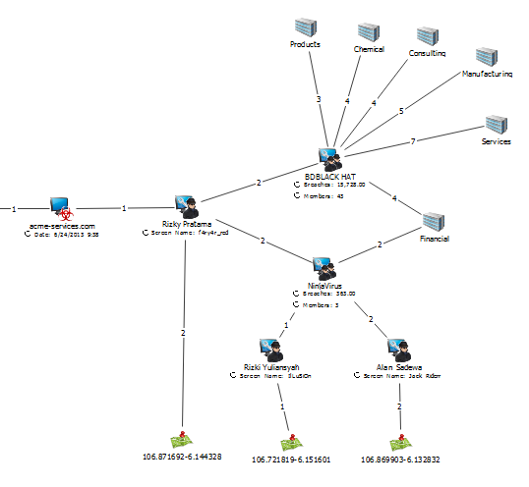
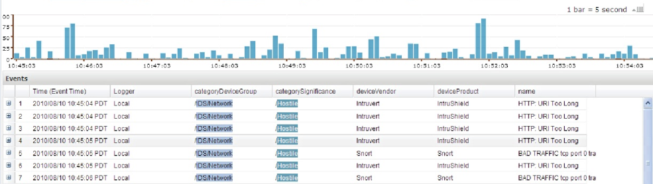






Да кому мы вообще нужны?
So what?
Notes:
35
This is an example of what a Cyber Investigation chart may look like.
The left hand side information for the Breach indication box, is all collected from an environments SIEM – presented in a new simply understandable way. No more looking at a network map to view activity – now it is broken down to a simple Source to Event to Target pattern, making it very easy to read.
All data to the right of the Breach indication box is collected OSINT data. Breach claims are collected from attacker forums, and dump sites such as Pastebin. Attacker and Team data is collected from sources like Social Media communications, and data dumps with signatures. Industry data comes from sites such as Alexa, comparing known historical target domains of the Teams with result from Alexa queries.

Slide 36
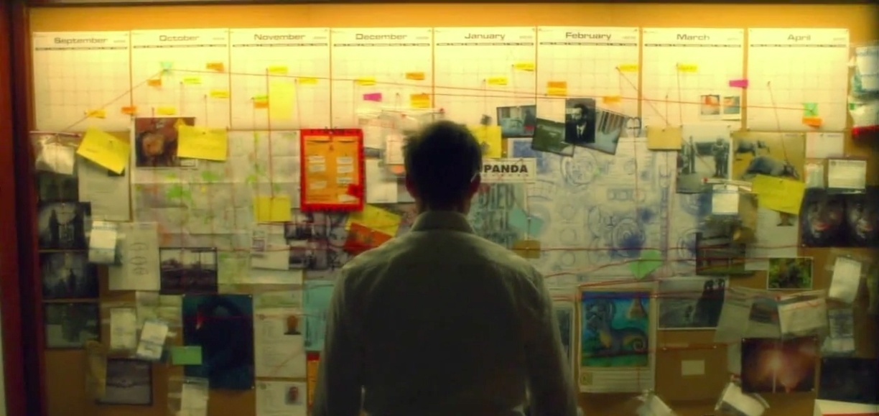

Slide 37

IBM Security
Обнаружить
Среагировать
Понять суть
Notes:
A modern security operations center (SOC) is proactively planned, not reactively pieced together. It detects, investigates and stops threats before they become costly data breaches.
Technology is only one piece of the program. Plan, instead of react. Ensure that people and processes are in harmonic orchestration with the feeds of security data. Arm your SOC to proactively hunt out new dangers with a daily diligence.
Detect and Stop Advanced Threats
Orchestrate Incident Response
Master threat Hunting

