Slide 1
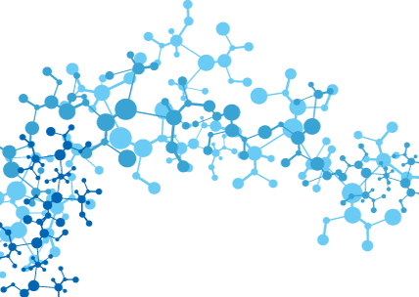
AI technologies in digital future
Mykyta Klymenko
Institute of AI problems
MES and NAS of Ukraine

Slide 2
Report plan
Current AI research directions
Main definitions, AI classification
Overview of actual developments in the AI field
Prerequisites for transition to a new stage of AI
Future AI application possibilities

Slide 3
AI nowadays

Slide 4
Current AI research directions
Thought processes modeling
Knowledge representation and applying of it
Natural language processing
Robotics
Machine creativity
Machine learning

Slide 5
Artificial intelligence
is an algorithm of creative tasks fulfillment, formed by the artificial consciousness
According to the decision of the First International Conference «Artificial Intelligence – 2000» and the Tenth Conference «Artificial Intelligence – 2010»

Slide 6
AI levels
Artificial narrow intelligence (ANI)
Artificial general intelligence (AGI)
Artificial superintelligence (ASI)

Slide 7
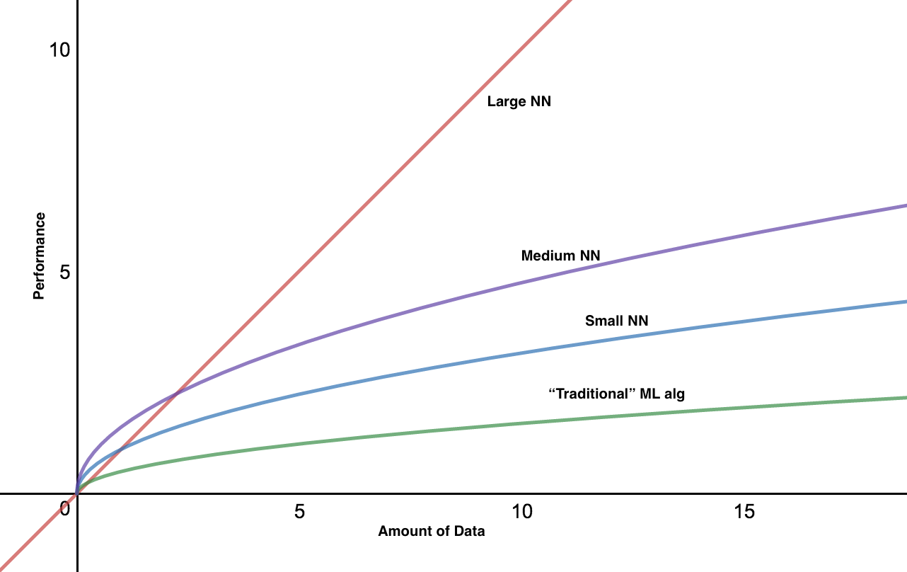
Data became the key to AI

Slide 8
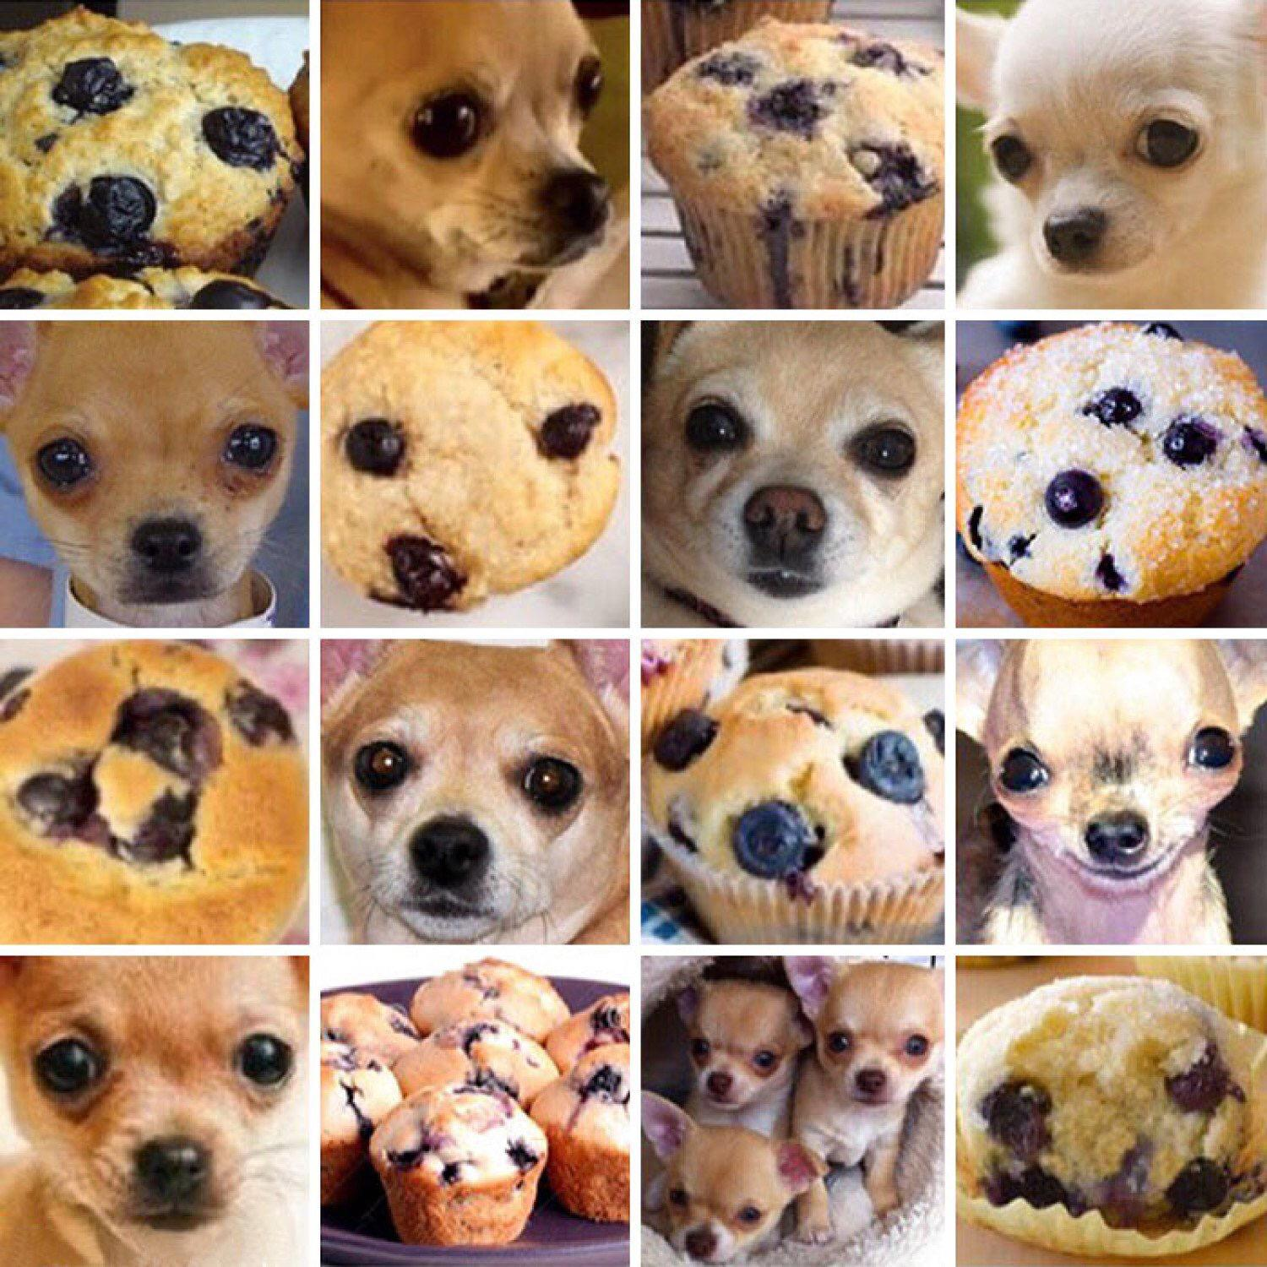
Weaknesses of machine learning

Slide 9
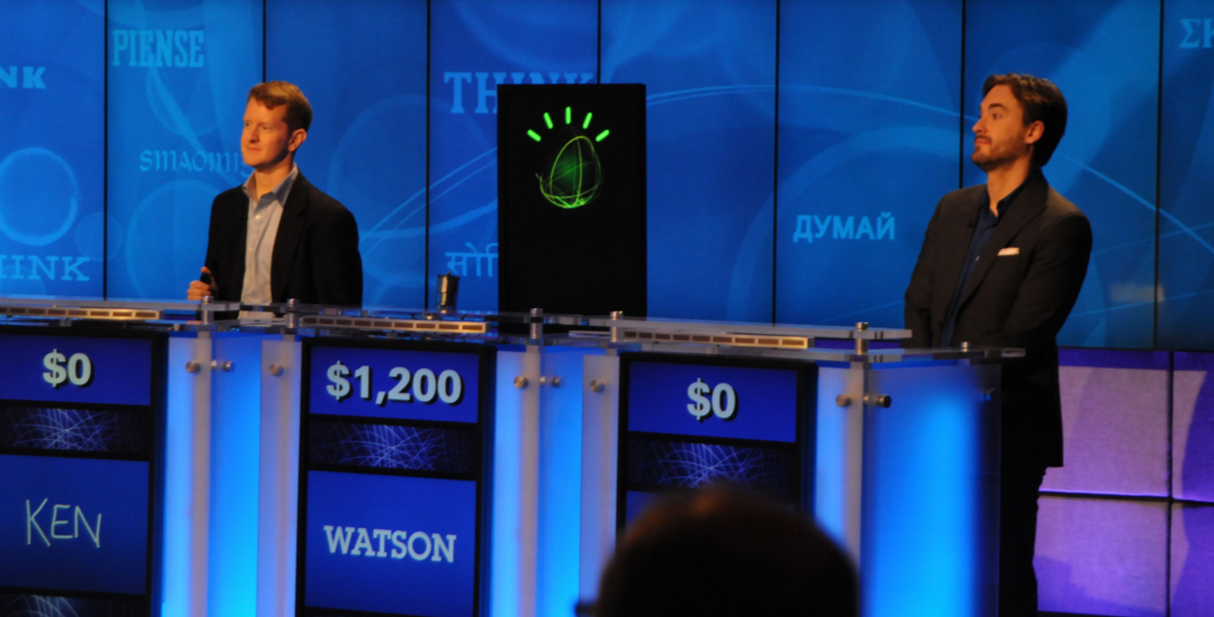
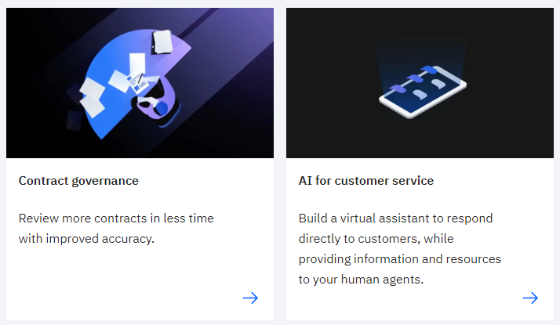
The state-of-the-art machine learning examples
IBM Watson
2011 – demo
2019 – use cases

Slide 10
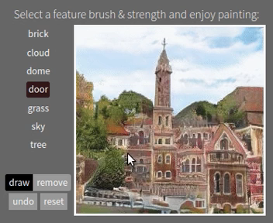
The state-of-the-art machine learning examples
MIT GAN
Generative adversarial networks

Slide 11
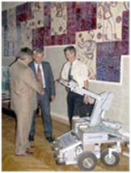
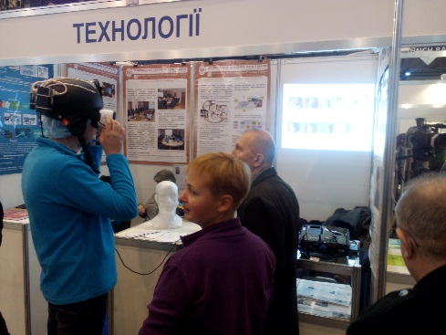
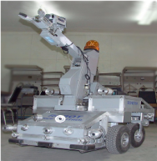
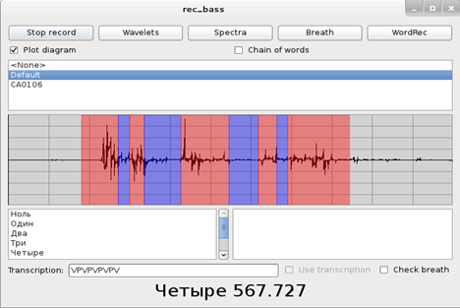
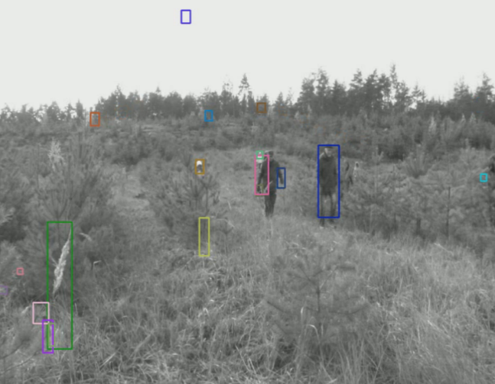
Institute of artificial intelligence problems
MES and NAS of Ukraine

Slide 12
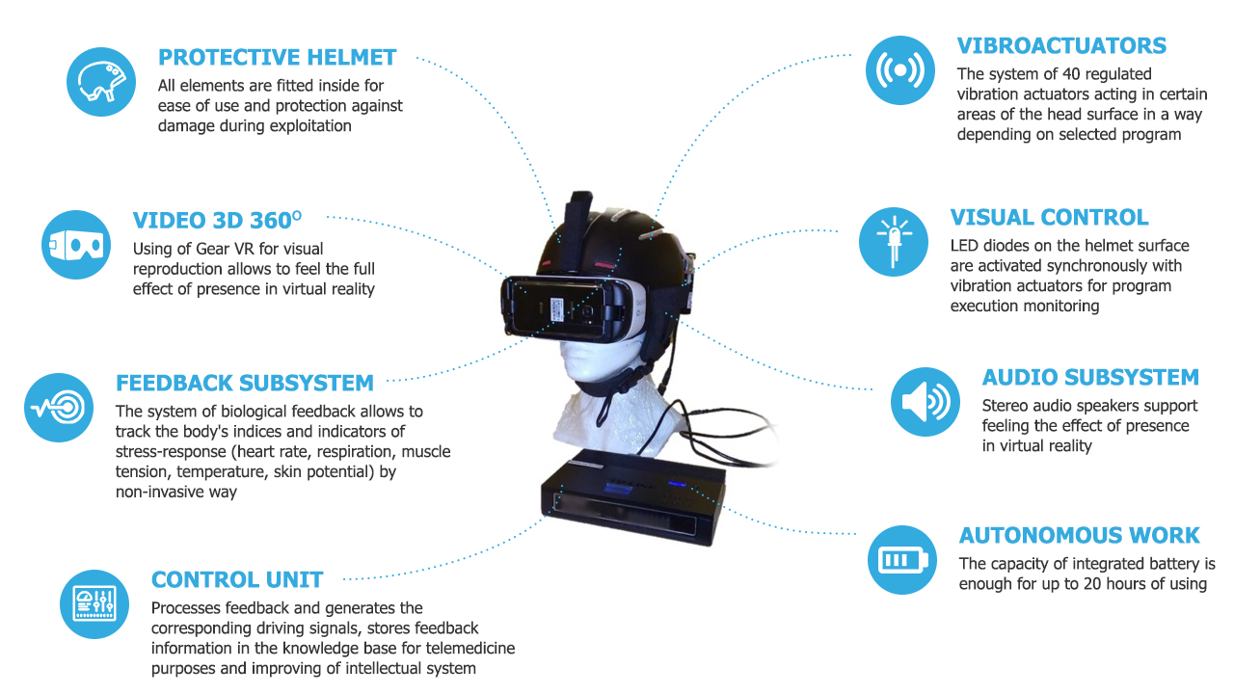
Institute of artificial intelligence problems
MES and NAS of Ukraine
Intelligent Helmet for psycho-physiological correction

Slide 13
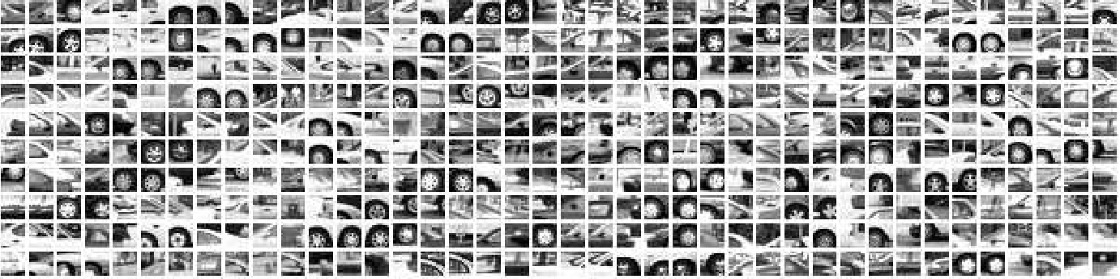
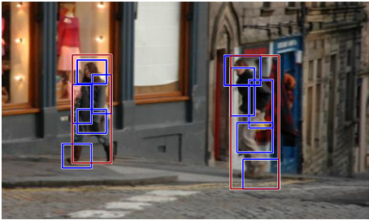
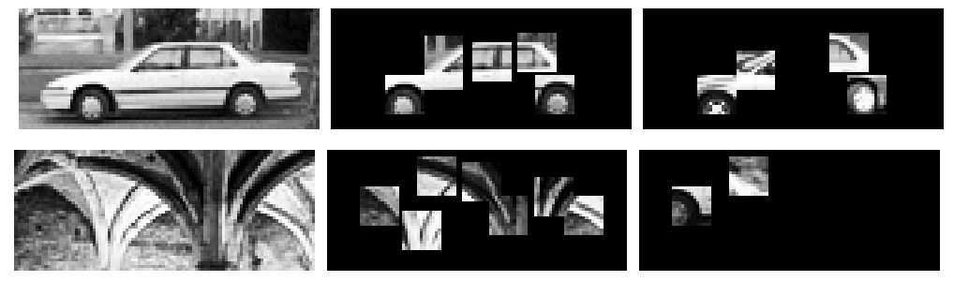
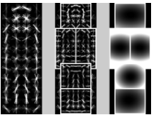
Institute of artificial intelligence problems
MES and NAS of Ukraine
Target objects detecting and tracking in video stream

Slide 14
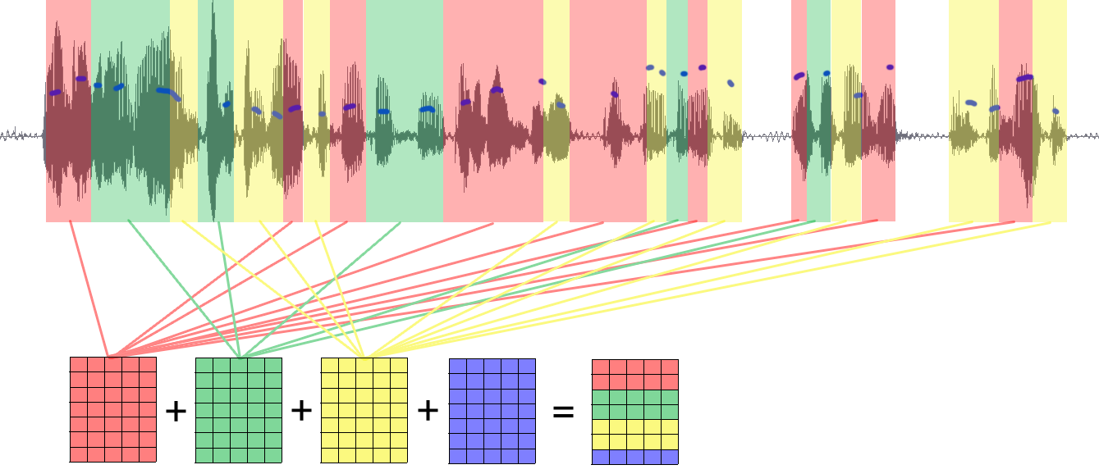
Institute of artificial intelligence problems
MES and NAS of Ukraine
The method of emotion recognition by voice
Recognised emotions:
Interest
Joy
Anger
Fear
Guilt
Suffering
Application possibilities:
Marketing research Patient monitoring Public safety

Slide 15
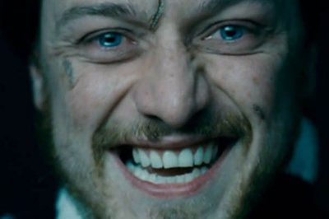
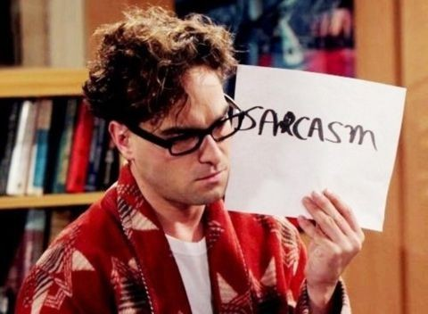
Institute of artificial intelligence problems
MES and NAS of Ukraine
The method of emotion recognition by voice
Unsolved problems:
Mixed emotions
(simultaneous demonstration)
Dependence on speech context
(semantic analysis)

Slide 16
AI application possibilities (ASI)
Perception based machine learning
Social data processing
NeuroNet
Noosphere

Slide 17

Thank you for your attention!
Institute of artificial intelligence problems
MES and NAS of Ukraine
http://ipai.net.ua
ipai.kiev@gmail.com

