Slide 1

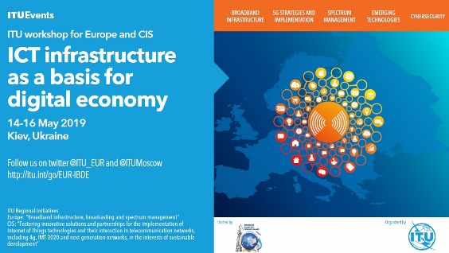
5G Implementation in
Europe: Opportunities and Challenges
Jaroslaw K. PONDER
Head of ITU Office for Europe
@ITU_EUR | EURregion@itu.int
14 May 2019 | Kyiv, Ukraine

Slide 2




ITU at a glance
ITU is the United Nations specialized agency for information and communication technologies (ICTs)
193 | 550 | 140 | 170
MEMBER STATES | SECTOR MEMBERS | ACADEMIA MEMBERS | ASSOCIATES
ITU allocates the global radio spectrum and satellite orbit resources, develops the technical standards that ensure networks and technologies seamlessly interconnect, and strives to improve access to ICTs to underserved communities worldwide
PROMOTING GLOBAL COLLABORATION FOR A CONNECTED WORLD
Notes:
Our role is to facilitate peaceful relations, international cooperation between peoples, and economic and social development by means of efficient telecommunications services.
Each sector has separate mandate, but all work cohesively towards connecting the world

Slide 3

ITU at a glance
03
What we do
ITU Radiocommunication
Coordinating radio-frequency spectrum and assigning orbital slots for satellites
3
ITU Standardization
Sectors
Establishing global standards
‘Committed to
Connecting the World’
ITU Development
Bridging the digital divide

Slide 4
IMT-2000, IMT-Advanced & IMT-2020
TOWARDS IMT-2020 and Beyond
All of today’s 3G and 4G mobile broadband systems are based on the ITU’s IMT standards
IMT provides the global platform on which to build the next generations of mobile broadband connectivity
ITU established the detailed specifications for IMT-2000 and the first 3G deployments commenced around the year 2000
In January 2012, ITU defined the next big leap forward with 4G wireless cellular technology –IMT-Advanced –and this is now being progressively deployed worldwide
The detailed investigation of the key elements of IMT-2020 is well underway, using the partnership ITU has with the mobile broadband industry and the wide range of stakeholders in the 5G community

Slide 5
Evolution of mobile networks
 | 1G | 2G | 3G | 4G | 5G
Approximate deployment date | 1980s | 1990s | 2000s | 2010s | 2020s
Theoretical download speed | 2kbit/s | 384kbit/s | 56Mbit/s | 1Gbit/s | 10Gbit/s
Latency | N/A | 629 ms | 212 ms | 60-98 ms | < 1 ms

Slide 6
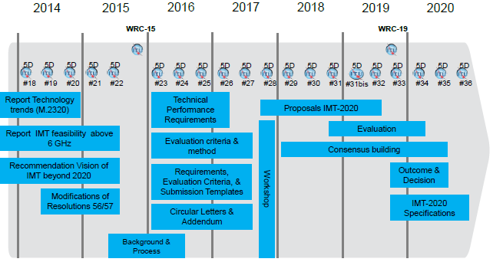
ITU-R IMT-2020 => Detailed timeline and process

Slide 7
Spectrum
Implementation of 5G in Europe / European 5G Observatory
5G pioneer bands identified in Europe (700 MHz, 3.6 GHz and 26 GHz)
Common roadmap for the availability of spectrum adopted by Member States
Consultations on spectrum assignments launched by Member States
  Denmark 700 MHz & 900 MHz & 2300 MHz, Germany 2 & 3.6 GHz, France 3.5 GHz & 26GHz, Lithuania 3.5 GHz, Luxemburg 700 MHz & 26 GHz, Malta &00MHz, Poland 700 MHz & 3.5 GHz & 26 GHz, Portugal 700 MHz, Romania 700 MHz, Slovakia 26 GHz, Slovenia, Sweden 26 GHz, UK 26 GHz
2.5 GHz spectrum assigned in 7 MSs
  Czech Rep., Hungary, Ireland, Latvia, Slovakia, Spain, UK
3.5 GHz auctions scheduled for Q4 2018 in 4 MSs
  Austria, Finland, Italy, Sweden
700 MHz spectrum already assigned in
  Finland, France, Germany and Sweden

Slide 8
After WRC-15 spectrum for IMT
Band (MHz) | Footnotes identifying the band for IMT |  |  | Bandwidth
 | Region 1 or parts thereof | Region 2 or parts thereof | Region 3 or parts thereof
450-470 | 5.286AA |  |  | 20
470-698 | - | 5.295, 5.308A | 5.296A | 228
694/698-960 | 5.317A | 5.317A | 5.313A, 5.317A | 262
1 427-1 518 | 5.341A, 5.346 | 5.341B | 5.341C, 5.346A | 91
1 710-2 025 | 5.384A, 5.388 |  |  | 315
2 110-2 200 | 5.388 |  |  | 90
2 300-2 400 | 5.384A |  |  | 100
2 500-2 690 | 5.384A |  |  | 190
3 300-3 400 | 5.429B | 5.429D | 5.429F | 100
3 400-3 600 | 5.430A | 5.431B | 5.432A, 5.432B, 5.433A | 200
3 600-3 700 | - | 5.434 | - | 100
4 800-4 990 | - | 5.441A | 5.441B | 190
Total Bandwidth | 1,886 (Regional allocations vary and totals can be different for a specific region)

Slide 9
New spectrum bands under study for WRC-19
Existing mobile allocation | No global mobile allocation
24.25 – 27.5 GHz | 31.8 – 33.4 GHz
37 – 40.5 GHz | 40.5 – 42.5 GHz
42.5 – 43.5 GHz
45.5 – 47 GHz | 47 – 47.2 GHz
47.2 – 50.2 GHz
50.4 GHz – 52.6 GHz
66 – 76 GHz
81 – 86 GHz

Slide 10
ITU-R IMT-2020 Vision => 5G Capability

Slide 11
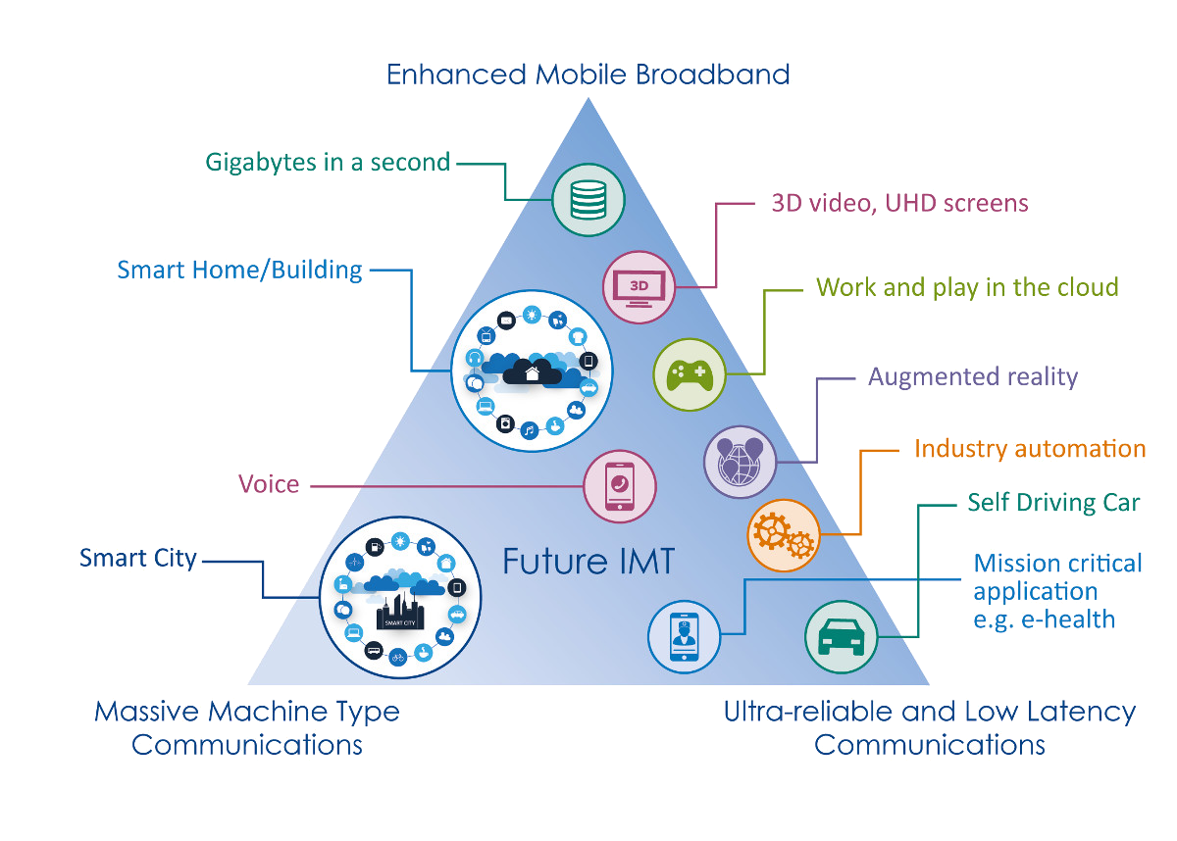
5G Usage scenarios
Notes:
Three main usage scenarios for IMT-2020 have been identified in Recommendation ITU-R M.2083, “IMT Vision – Framework and overall objectives of the future development of IMT for 2020 and beyond,” which are enhanced mobile broadband, ultra-reliable and low latency communications, and massive machine-type communications. Additional use cases are expected to emerge, which are currently not foreseen. For future IMT, flexibility will be necessary to adapt to new use cases that come with a widely varying range of requirements.
IMT-2020 will encompass a large number of different features. Depending on the circumstances and the different needs in different countries, future IMT systems should be designed in a highly modular manner so that not all features have to be implemented in all networks.
This figure illustrates some examples of envisioned usage scenarios for IMT-2020.

Slide 12
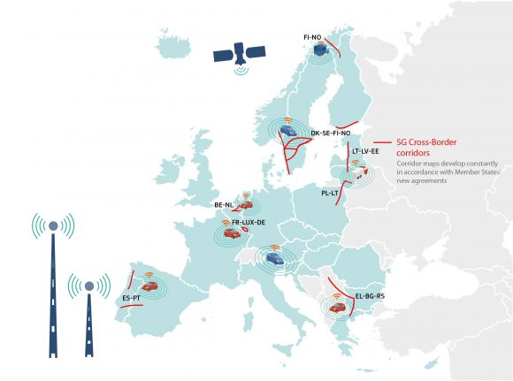
5G Trials
Implementation of 5G in Europe / European 5G Observatory
100 plus pre-commercial 5G trials and pilots launched in Europe as part of the industry’s 5G trial roadmap
20 Trial Cities appointed: Amsterdam, Aveiro, Barcelona, Bari, Berlin, Bristol, Espoo, Ghent, L’Aquila, London, Madrid, Malaga, Matera, Milan, Oulu, Patras, Prato, Stockholm, Tallinn and Turin
10 digital cross-border corridors established inter alia accommodating live testing of 5G for Cooperative Connected and Automated Mobility
5 September 2018: Poland and Lithuania signed a letter of intent to cooperate on technical, legal and policy of the cross-border CAM corridor 'via Baltica - South' (linking Warsaw, Kaunas, and Vilnius).
28 September: Latvia, Lithuania and Estonia signed a memorandum of understanding for the 'Via Baltica - North' initiative to develop an experimental 5G cross-border corridor where self-driving vehicles can be tested.

Slide 13
5G Coverage, Roadmaps and National Plans
Implementation of 5G in Europe / European 5G Observatory
Eight Member States have published national 5G roadmaps
  Austria, France, Germany, Luxemburg, Netherlands, Spain, Sweden, and UK
  Denmark, Poland, Others in the process of development
National calendars for key milestones set by the government
Measures to stimulate investments in 5G infrastructures such as reducing the cost of deploying small cells, wide ranging support to 5G trials
Promoting partnerships between the telecom sector and vertical industries
Foster public services as lead user for early 5G deployment
European Instruments
  Digital Single Market Strategy
  European Electronic Code
  5G Action Plan

Slide 14

Challenges in Implementation of 5G in Europe
Small cell deployment
  Local permitting and planning process
  Lengthy engagement and procurement exercises
  High fees and charges to access street furniture (and the access itself)
  Levels of Electromagnetic Fields
    Italy, Poland, Russia, Switzerland
    Belgium and Paris
Fiber backhaul
Spectrum
Investment

Slide 15


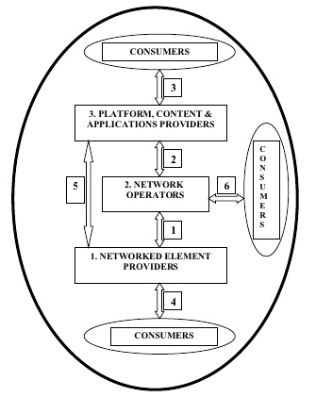


Collaboration on EMF
ICT Ecosystem
Notes:
As an independent organization, the International Commission on Non-Ionizing Radiation Protection (ICNIRP) provides scientific advice and guidance on the health and environmental effects of non-ionizing radiation (NIR) to protect people and the environment from detrimental NIR exposure. ICNIRP is constituted of a Commission of up to 14 members. Commision: Chair, Vice-Chair and up to 12 members constitute the Commission. Scientific Expert Group (SEG): 25 External scientists support ICNIRP’s work with further expertise.
ICNIRP’s current guidelines for the high-frequency (100 kHz – 300 GHz) portion of the electromagnetic spectrum were published in 1998. Given the large body of relevant research that has been generated since those 1998 guidelines, ICNIRP is now revising the guidelines to incorporate this literature. Currently it is work in progress.
At the end of 2018, ICNIRP is expected to open a public consultation on the new guidelines on RF EMF limits: https://www.icnirp.org/en/activities/news/news-article/revision-of-hf-guidelines-2017.html
ITU is closely collaborating with WHO and participates regularly in WHO meetings on EMF.
International Advisory Committee for NIR Protection in Slovenia. 20-22 June 2018 in Slovenia.
Exposure limits are under WHO responsibility.
WHO recommends the use of the ICNIRP exposure limits. http://www.who.int/peh-emf/standards/en/ :
The exposure limits for EMF fields developed by the International Commission on Non-Ionizing Radiation Protection (ICNIRP) - a non-governmental organization formally recognised by WHO, were developed following reviews of all the peer-reviewed scientific literature, including thermal and non-thermal effects. The standards are based on evaluations of biological effects that have been established to have health consequences. The main conclusion from the WHO reviews is that EMF exposures below the limits recommended in the ICNIRP international guidelines do not appear to have any known consequence on health.
Because disparities in EMF standards around the world has caused increasing public anxiety about EMF exposures from the introduction of new technologies, WHO and ITU are working together to develop standards that can respond to this challenge.
WHO:

Slide 16




ITU Mandate on EMF
ITU PP Resolution 176 - "Human exposure to and measurement of electromagnetic fields" (Dubai, 2018)
3 SECTORS
STANDARDIZATION
DEVELOPMENT
RADIOCOMMUNICATION
WTSA Resolution 72 - "Measurement concerns related to human exposure to electromagnetic fields" (Rev. Hammamet, 2016)
WTDC Resolution 62 - "Assessment and
measurement of human exposure to electromagnetic fields" (Rev. Buenos Aires, 2017)
ITU-R Question 1/239 (Electromagnetic field measurements to assess human exposure).

Slide 17
Intersectoral Activities
Comments to the new ICNIRP guidelines on “Guidelines for limiting exposure to time-varying electric, magnetic and electromagnetic fields, (100 kHz TO 300 GHz)”. In cooperation with ITU-R and ITU-D experts, and based on the received Contribution from ATDI and Orange Polska and also from the inputs received during the ITU-T SG5 meeting, 32 comments have been included and sent to ICNIRP; see TD696-R1
Mapping of ITU-D/R/T EMF activities to avoid overlap, mainly:
  D: Strategies & Policies concerning human exposure to EMF
  R: EMF measurements from base stations to assess human exposure
  T: Simulation, assessment, 5G

Slide 18






ITU-T Study Group 5: Environment, climate change and circular economy
SG5 is responsible for:
electromagnetic compatibility, lightning protection and electromagnetic effects
ICTs related to the environment, climate change, energy efficiency and clean energy
circular economy, including e‑waste
Studying ICT environmental aspects of electromagnetic phenomena and climate change.
Studies on how to use ICTs to help countries and the ICT sector to adapt to the effects of environmental challenges, including climate change, in line with the Sustainable Development Goals (SDGs).
Safe and reliable use of ICT
9 Questions
4 Regional Groups
Q3/5 - Human exposure to electromagnetic fields (EMFs) from information and communication technologies (ICTs)

Slide 19


Setting Environmental Requirements for 5G
International Standards
Supplements
Technical Reports
ITU-T SG5
Electromagnetic compatibility (EMC)
Electromagnetic fields (EMF)
Resistibility
ITU-T K.Suppl.8
ITU-T K.Suppl.9 - 5G technology and human exposure to RF EMF
ITU-T K.Suppl.14 - RF-EMF exposure limits on 4G and 5G
Draft ITU-T K.Supp-5G_EMF_Compliance
Energy feeding & efficiency
ITU-T K.Suppl.10
ITU-T L. 1220
ITU-T L. Suppl.36
Notes:
WP1/5:
K.Suppl 8, Resistibility analysis of 5G systems
K.Suppl 9, 5G technology and human exposure to RF EMF
K.Suppl 10, Analysis of EMC aspects and definition of requirements for 5G systems
K.Supp-5G_EMF_Compliance: “Electromagnetic field (EMF) compliance assessments for 5G wireless networks”: This supplement provides guidance on the EMF compliance assessment considerations for 5G wireless networks. Given the 5G technical standards are still being finalised and commercial 5G networks are not due to launch until 2019 - 2020, the first version of this supplement focuses on the computational assessment options. Later versions of this supplement will include measurement based assessment methods and case studies of 5G networks when they are launched.
This draft provides a content outline and some preliminary base level text. This draft will be developed in consultation with the 5G equipment manufacturers and operators as the 3GPP technology standards are developed.
The supplement will reference IEC 62232 and IEC TR 62669 which provide assessment methodology and case studies relevant for 5G networks.
WP2/5:
L.1220: Innovative energy storage technology for stationary use - Part 1: Overview of energy storage
TP on Study on methods and metrics to evaluate energy efficiency for future 5G systems
L Suppl. 36: ITU-T L.1310 – Study on methods and metrics to evaluate energy efficiency for future 5G systems
Open new WI in progress
L.5G_powering : Sustainable power feeding solutions for 5G network
L.EE_5G Energy efficiency Metrics and measurement methodology for 5G solutions
L.ENST2battery: Innovative energy storage technology for stationary use - Part 2: Battery
L.ENST3supercap: Innovative energy storage technology for stationary use - Part 3: Supercapacitor technology

Slide 20
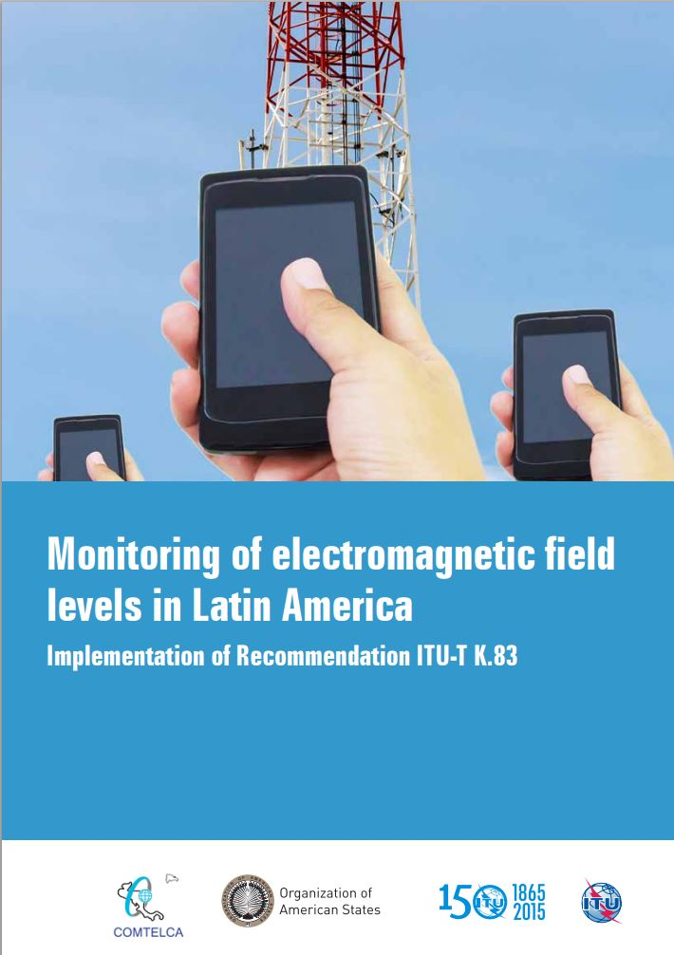
ITU’s contribution to EMF Standards
ITU-T Study Group 5 has an active group of global experts focused on RF EMF
Key activities & study areas
10 Recommendations (Normative International Standards) and 5 Supplements (Non-Normative guides and reports) in force
  ITU-T K.83 on Monitoring of Electromagnetic field levels
Notes:
Recommendation ITU-T K.52 (2000/2014/2018) - Guidance on complying with limits for human exposure to electromagnetic fields – includes „K.52calculator software”
Recommendation ITU-T K.61 (2003/2018) - Guidance on measurement and numerical prediction of electromagnetic fields for compliance with human exposure limits for telecommunication installations
Recommendation ITU-T K.70 (2007/2018) - Mitigation techniques to limit human exposure to EMFs in the vicinity of radiocommunication stations – includes „EMF Estimator software”
Recommendation ITU-T K.83 (2011/2014) - Monitoring of electromagnetic field levels
Recommendation ITU-T K.90 (2012) - Evaluation techniques and working procedures for compliance with exposure limits of network operator personnel to power-frequency electromagnetic fields– includes EMFACDC software
Recommendation ITU-T K.91 (2012/2018) - Guidance for assessment, evaluation and monitoring of human exposure to radio frequency electromagnetic fields – includes “Uncertainty calculator” and “Watt_Guard” software and Supplement “EMF-guide”
Recommendation ITU-T K.100 (2014/2018) - Measurement of radio frequency electromagnetic fields to determine compliance with human exposure limits when a base station is put into service
Recommendation ITU-T K.113 (2015) - Generation of radiofrequency electromagnetic field level maps
Recommendation ITU-T K.121 (2016) - Guidance on the Environmental Management for Electromagnetic Radiation from Radiocommunication Base Stations
Recommendation ITU-T K.122 (2016) - Exposure levels in the close proximity of the radiocommunication antennas

Slide 21
ITU’s contribution to EMF Standards
Recommendation ITU-T K.52 (2000/2014/2018) - Guidance on complying with limits for human exposure to electromagnetic fields – includes „K.52calculator software”
Recommendation ITU-T K.61 (2003/2018) - Guidance on measurement and numerical prediction of electromagnetic fields for compliance with human exposure limits for telecommunication installations
Recommendation ITU-T K.70 (2007/2018) - Mitigation techniques to limit human exposure to EMFs in the vicinity of radiocommunication stations – includes „EMF Estimator software”
Recommendation ITU-T K.83 (2011/2014) - Monitoring of electromagnetic field levels
Recommendation ITU-T K.90 (2012/2017) - Evaluation techniques and working procedures for compliance with exposure limits of network operator personnel to power-frequency electromagnetic fields– includes „EMFACDC” software
Recommendation ITU-T K.91 (2012/2017) - Guidance for assessment, evaluation and monitoring of human exposure to radio frequency electromagnetic fields – includes “Uncertainty calculator” and “Watt_Guard” software, Supplement and mobile App “EMF-guide”, mobile App „EMF Exposure”
Recommendation ITU-T K.100 (2014/2017) - Measurement of RF EMF to determine compliance with human exposure limits when a base station is put into service
Recommendation ITU-T K.113 (2015) - Generation of RF EMF level maps
Notes:
Recommendation ITU-T K.52 (2000/2014/2018) - Guidance on complying with limits for human exposure to electromagnetic fields – includes „K.52calculator software”
Recommendation ITU-T K.61 (2003/2018) - Guidance on measurement and numerical prediction of electromagnetic fields for compliance with human exposure limits for telecommunication installations
Recommendation ITU-T K.70 (2007/2018) - Mitigation techniques to limit human exposure to EMFs in the vicinity of radiocommunication stations – includes „EMF Estimator software”
Recommendation ITU-T K.83 (2011/2014) - Monitoring of electromagnetic field levels
Recommendation ITU-T K.90 (2012) - Evaluation techniques and working procedures for compliance with exposure limits of network operator personnel to power-frequency electromagnetic fields– includes EMFACDC software
Recommendation ITU-T K.91 (2012/2018) - Guidance for assessment, evaluation and monitoring of human exposure to radio frequency electromagnetic fields – includes “Uncertainty calculator” and “Watt_Guard” software and Supplement “EMF-guide”
Recommendation ITU-T K.100 (2014/2018) - Measurement of radio frequency electromagnetic fields to determine compliance with human exposure limits when a base station is put into service
Recommendation ITU-T K.113 (2015) - Generation of radiofrequency electromagnetic field level maps
Recommendation ITU-T K.121 (2016) - Guidance on the Environmental Management for Electromagnetic Radiation from Radiocommunication Base Stations
Recommendation ITU-T K.122 (2016) - Exposure levels in the close proximity of the radiocommunication antennas

Slide 22
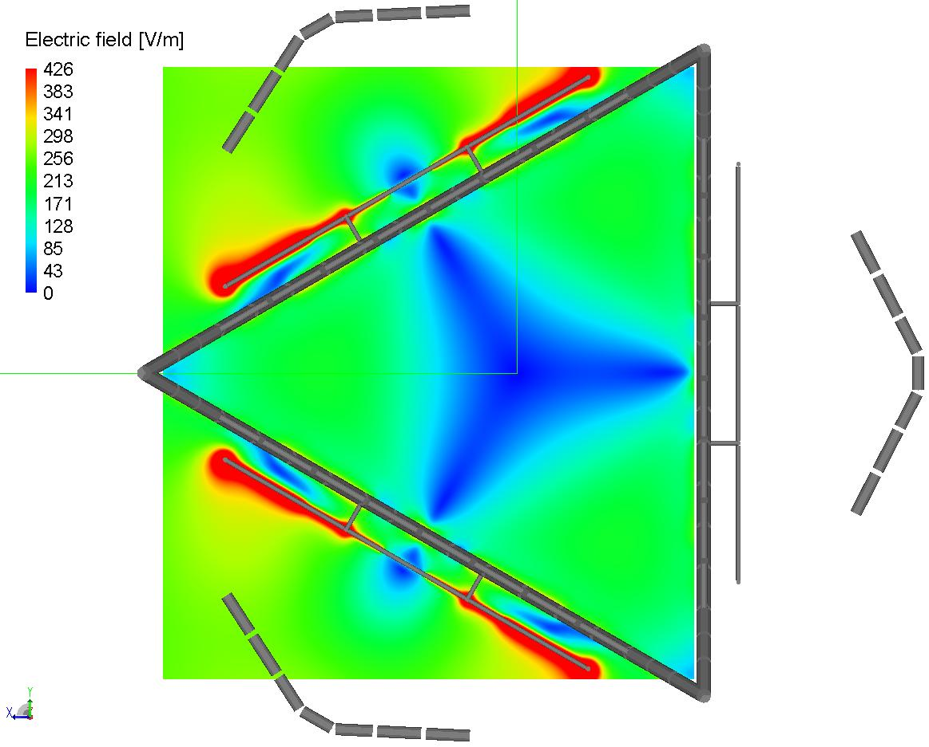
ITU-T Recommendations on EMF assessment
Recommendation ITU-T K.121 (2018) – Guidance on the environmental management for compliance with radio frequency EMF limits for radiocommunication base stations
Recommendation ITU-T K.122 (2016) - Exposure levels in close proximity of radiocommunication antennas

Slide 23

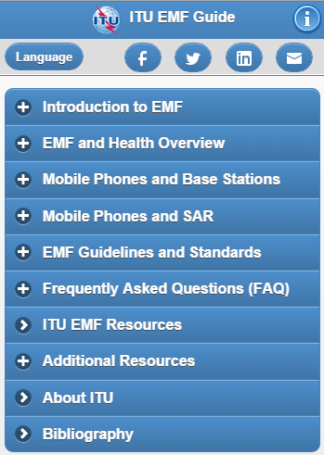
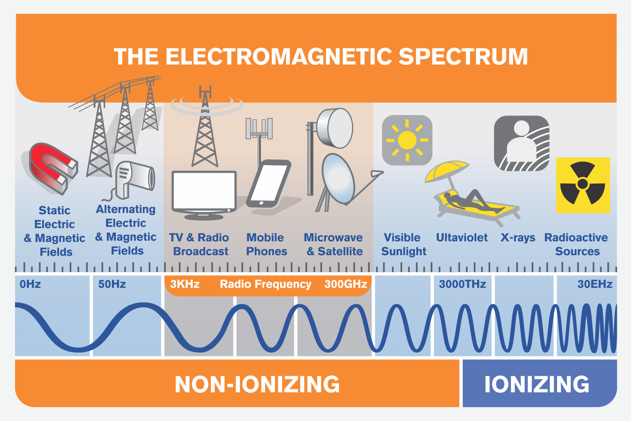



Raising awareness on EMF
Key elements for successful public communications:
  Information easy to understand;
  Open and transparent dialogues;
  Providing stakeholders with trusted sources of information.
ITU’s Public information on EMF:
  ITU EMF Guide – key information source
  EMF Website
  Report on “Monitoring of electromagnetic field levels in Latin America”
  Best practices to reduce exposure from mobile devices
  The EMF Guide mobile app in the 6 UN official languages is available online at http://emfguide.itu.int. It is also available in Malay.

Slide 24
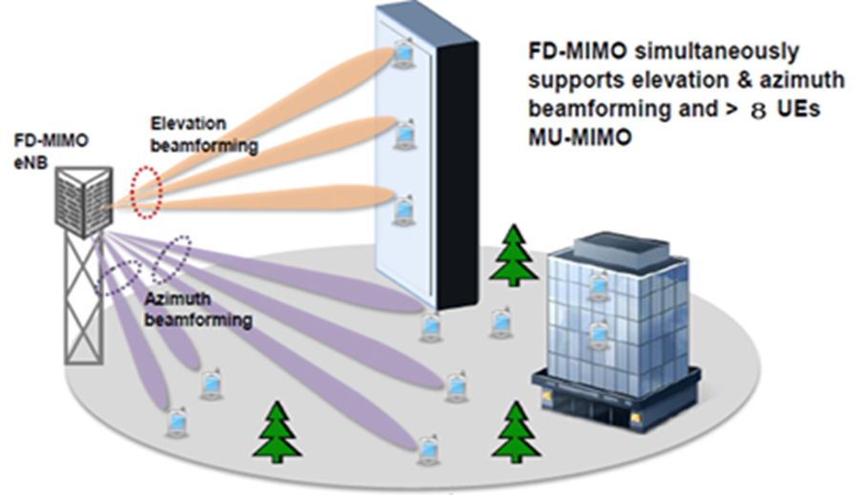
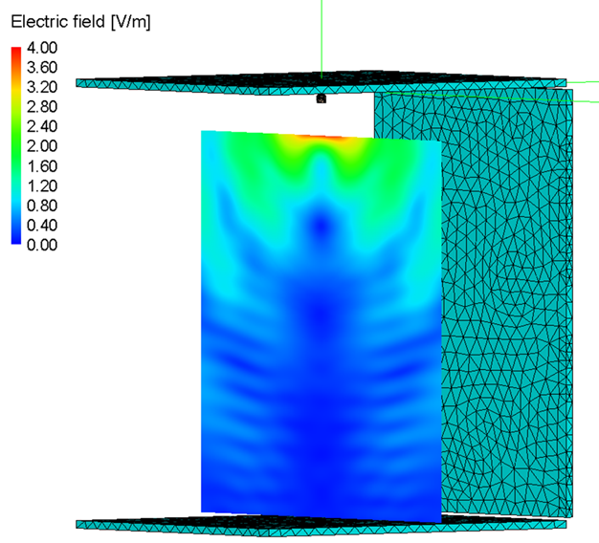
K. Suppl. 9 (11/2017) 5G technology and human exposure to RF EMF
Contains an analysis of the impact of the implementation of 5G mobile systems with respect to exposure level of EMF around radiocommunication infrastructure
Higher frequencies and higher throughput
Smart antennas: will be more efficient which will result in minimized RF-EMF exposure
Small cells: are well suited for coverage extent as well as capacity issues. Better quality and reduced power to and from mobile phones.
Internet of things (IoT): EMF exposure will usually be much lower than from other devices and systems
Notes:
The deployment of 5G will see the evolution and expansion of existing 4G networks and the introduction of new radio access networks in the millimetre wave bands. Because of the use of much higher frequency ranges the number of base stations will substantially increase. These networks will include a range of installations including more small cell deployments and advanced antenna technologies. Massive MIMO antennas will allow to use very narrow beams that will follow the user with impact for the surrounding exposure level different than this from current systems. The number of wireless devices will dramatically increase. New technology allows for use more efficient systems that require lower level of the signals for communication.
Supplement 9 to the ITU-T K-series Recommendations contains an analysis of the impact of the implementation of 5G mobile systems with respect to the exposure level of electromagnetic fields (EMF) around radiocommunication infrastructure.

Slide 25

Two new ITU-T Supplements on EMF
  Supplement ITU-T K.Suppl.13 on Radiofrequency electromagnetic field (RF-EMF) exposure levels from mobile and portable devices during different conditions of use​
  Supplement ITU-T K.Suppl.14 on The impact of RF-EMF exposure limits stricter than the ICNIRP or IEEE guidelines on 4G and 5G mobile network deployment
    Provides an overview of some of the challenges faced by countries, regions and cities which are about to deploy 4G or 5G infrastructures.
    Includes a case study on Poland
    Based on inputs and contributions from, inter alia, Poland, India, Ericsson, Nokia, China Telecom, Huawei, Uganda, Cisco, GSMA and Vodafone, Telstra, Korea, Belgium, etc
Notes:
Supplement ITU-T K.Suppl.13 on Radiofrequency electromagnetic field (RF-EMF) exposure levels from mobile and portable devices during different conditions of use​
This Supplement describes the various factors that determine the level of RF-EMF exposure, as defined by the specific absorption rate (SAR) that is induced in the users of mobile and portable radiocommunication devices. Based on this technical information practical information and guidance is provided for users of mobile devices.
Supplement ITU-T K.Suppl.14 on The impact of RF-EMF exposure limits stricter than the ICNIRP or IEEE guidelines on 4G and 5G mobile network deployment
This Supplement provides an overview of some of the challenges faced by countries, regions and cities which are about to deploy 4G or 5G infrastructures. This Supplement provides information on a simulation on the impact of RF‑EMF limits that was carried out in Poland as an example of a wider phenomenon, which is applicable to several other countries, which have set limits stricter than those contained in the ICNIRP or IEEE guidelines.

Slide 26
ITU-T Supplement 14 of K Series (2018)
An overview of some of the challenges faced by countries, regions and cities which are about to deploy 4G or 5G infrastructures.
Information on a simulation on the impact of RF-EMF limits that was carried out in Poland as an example of a wider phenomenon, which is applicable to several other countries, which have set limits that are stricter than those contained in the ICNIRP or IEEE guidelines.
The results of the simulation indicate that where RF-EMF limits are stricter than ICNIRP or IEEE guidelines,
  the network capacity buildout (both 4G and 5G) might be severely constrained and
  might prevent addressing of the growing data traffic demand and
  might prevent the launching of new services on existing mobile networks.
Two new ITU-T Supplements on EMF

Slide 27
Spectrum cannot be fully deployed
Additional radio frequencies, e.g., 60 MHz (FDD – 2x30 MHz) in the 700 MHz spectrum band, 100 MHz in the
2300 MHz band and 400 MHz in the 3.4-3.8 GHz spectrum range have or will become available for 4G and 5G
mobile communications in the near future. This would double the available spectrum and capacity in mobile
networks for example as shown in Figure 1 for the case of Poland.
However, deploying additional spectrum and consequently increasing the transmitted power, on an existing site increases the EMF exposure and hence the power density levels. In dense urban areas and urban areas [b-BCG], where distances between antennas and people are short already, the strict Polish EMF exposure limits do not allow mobile network operators to use the additional spectrum on most sites. In dense urban areas already some of today's spectrum cannot be used anymore and is wasted.
Two new ITU-T Supplements on EMF
Average spectrum holding (source Office of Electronic Communications, Poland)
Spectrum deployable on average with current and harmonized power density limits (PDLs) (source adapted from Polish mobile network operators [b-BCG])

Slide 28
Technology innovation is restricted
New antenna technologies, such as Massive MIMO and beamforming, or small cells are a key element of future
5G mobile networks. The EMF exposure limits below INCIRP or IEEE guidelines (as shown in the case of Poland),
do not in most cases allow mobile network operators to fully leverage these new technologies.
– Applying beamforming, i.e., further narrowing an antenna beam, would easily exceed the current EMF exposure limits;
– Deploying small cells in hot spot areas will not be feasible as the current EMF exposure limits prevent placing a large number of small cells due to the short distance between antenna and people, see Figure 3.
Both technology examples, beamforming and small cells, would be essential to provide more capacity in dense urban and urban areas.
Two new ITU-T Supplements on EMF
Minimum distance antenna-to-people (source [b-BCG])

Slide 29
Possibility to densify site grid is limited
Densifying the mobile network grid by adding new sites would be the third, but most expensive and time-consuming lever to increase capacity in mobile networks. In order to cope with the data traffic explosion and assuming that spectrum and technology levers cannot be exploited, mobile network operators would have to have 3.5-fold the number of sites in urban areas by 2025 and almost sevenfold the number of sites in dense urban areas by 2025.
Two new ITU-T Supplements on EMF
Site evolution in dense urban and urban areas

Slide 30
Future customer experience will suffer and true 5G is not possible
Given the limitations for deployment of new spectrum, technology and the very restricted growth of a number of sites (Assumption: 20% additional sites compared to the status quo), as a result of the strict EMF exposure limits, the gap between capacity supply and data traffic demand will grow very quickly. Polish data traffic growth with a CAGR of 36% until 2020, 29% until 2025 and 15% until 2030 (24x network data traffic in 2030 versus 2016).
Two new ITU-T Supplements on EMF
Share of unserved data traffic (source [b-BCG])

Slide 31
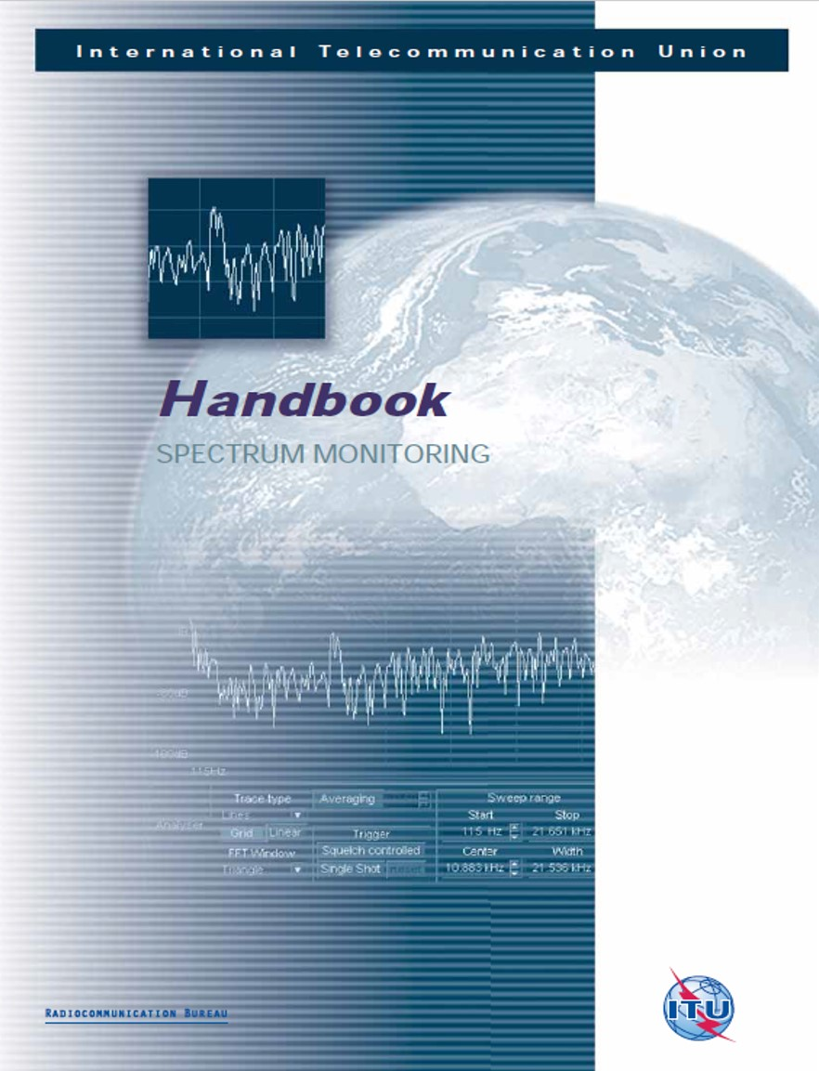
ITU’s worldwide recognized reference on Spectrum Monitoring and related issues
Chapter 5.6 on Non-Ionizing Radiation (NIR) measurements
Explains NIR limits & exposure quotient
Instruments for NIR measurements
- Broadband isotropic probes and meters
- Tri-axis antennas and field strength meters
- Transportable station
- standard field strength measurement equipment
Measurement procedures for different radio services (incl. mobile, broadcasting, etc.)
Reporting methods
Source: ITU-R Handbook on Spectrum Monitoring
www.itu.int/pub/R-HDB-23

Slide 32
On-going ITU-R Studies on EMF measurements to assess human exposure
Work initiated by the ITU Experts Group on Spectrum Monitoring (i.e. ITU-R WP 1C) in response to Question ITU-R 239/1 (2016):
https://www.itu.int/dms_ties/itu-r/md/15/wp1c/c/R15-WP1C-C-0169!N09!MSW-E.docx
What are the measurements techniques to assess the human exposure from wireless installations of all types?
How can measurement results be presented?
Significant progress made in 2017-2018
Studies to be completed by 2019!
Source: Question ITU-R 239-1 - www.itu.int/pub/R-QUE-SG01.239
Work by correspondence and at the next ITU-R WP 1C meeting planned on 28 May - 5 June 2019

Slide 33
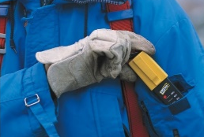
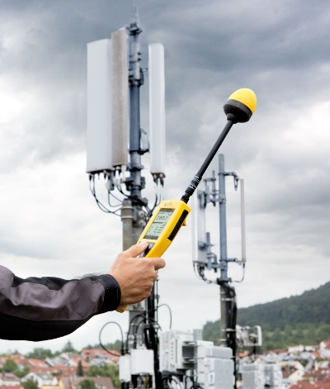

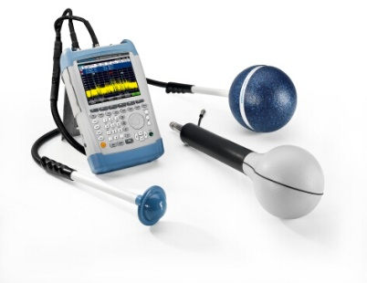
A practical guide for EMF measurements to assess human exposure
Basic knowledge for a successful EMF assessment measurement process
Available types of measurement instruments with specific features for
EMF assessment
- Personal monitor for occupational exposure
- Broadband meters
- Frequency selective meters
Handheld spectrum analyser with isotropic-antennas, 9 kHz to 6 GHz
Frequency selective meter dedicated to EMF, with isotropic-antenna
How to assess the exposure due to specific services
General approach for services where extrapolation is not required
GSM base stations
UMTS base stations
LTE base stations

Slide 34

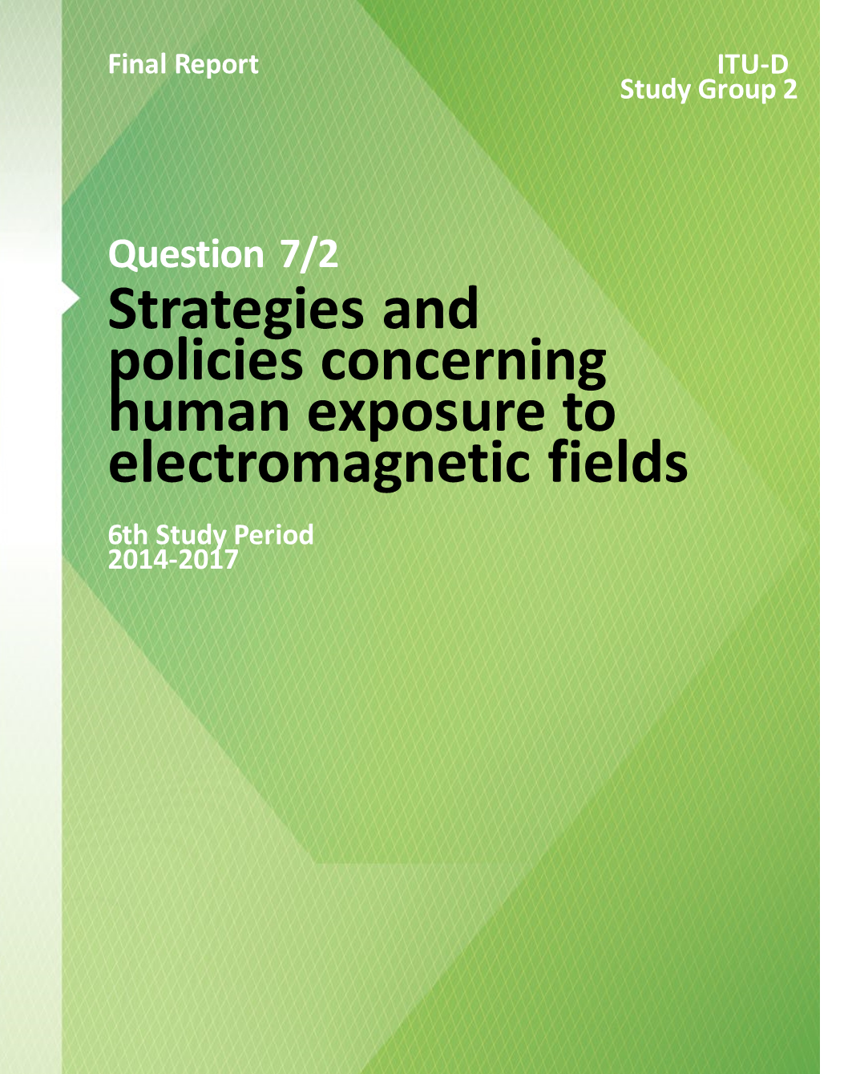
ITU-D Study Group Final Report of Q7/2
 | Question 7/2 – Strategies and policies concerning human exposure to electromagnetic fields
This report collects and disseminates information concerning exposure to Radio Frequency (RF) and Electromagnetic Fields (EMF), in order to assist national Administrations, particularly in developing countries, to develop appropriate national regulations. It is useful for Administrations, in order to listen and respond to the concerns of the public related to radiating antennas.
https://www.itu.int/pub/D-STG-SG02.07.1-2017
Following the 2018 public-consultation (and revision) of the ICNIRP Guidelines the International EMF
limits may change and influence the regulatory framework. New case studies are inserted
Countries changed their exposure limits. The 2018 October Workshop provide significant view. Moreover, there is a lot of ITU activities on EMF and the ITU Plenipotentiary Conference PP-18 Resolution 176 (revision Dubai) may revise the PP-14 held in Busan
ITU-T World Telecommunications Standardisation Assembly 2020 (WTSA-20) may revise WTSA-16 Resolution 72 (Hammamet)
ITU-D World Telecommunications Development Conference 2017 (WTDC-17) held in Buenos Aires, revised WTDC-14 Resolution 62 (Dubai)
Based on the revision of WTDC-14 Resolution 62 ‘Assessment and measurement of human exposure to EMF’ and the revision of Q 7/2 ‘Strategies and policies concerning human exposure to EMF’, this Report updates and revises the Question 7/2 Final Report and provides new material on Policies and Assessments.

Slide 35
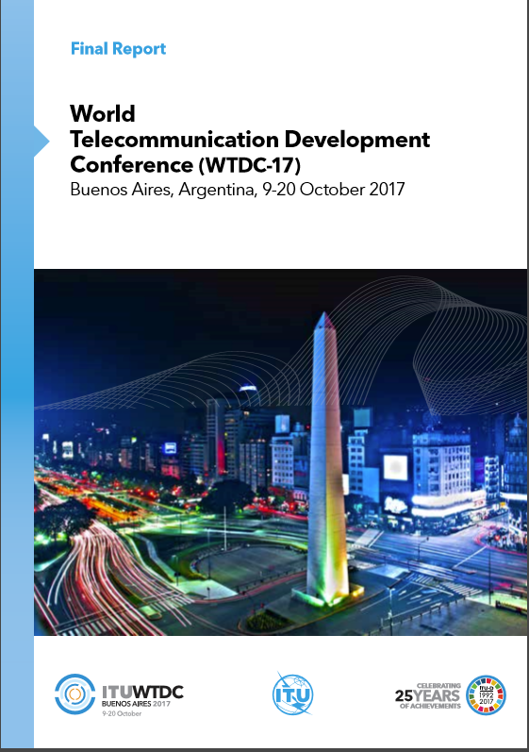
ITU-D Study Question Q7/2
ITU-D SG2 First meeting
9 May 2018: Q7/2
Presented and discussed:
  Work-plan
  Structure of the report, items to study
  Collaboration with other Sectors and Organisations
Meeting report: 2/REP/7-E
  Annex 1: Work-plan
  Annex 2: Draft Table of Content

Slide 36
New Q 7/2 Report ToC
CHAPTER 1 – Introduction
1.1 Background
1.2 Scope of the Report
CHAPTER 2 – ITU Activities
2.1 PP-18 Resolution 176 (revision Dubai)
2.2 WTDC-17 Resolution 62 (Rev. Buenos Aires, 2017)
2.3 ITU-R Radio Assembly 2019, Report SM.[EMF-MON] and deliveries of Question 239/1
2.4 ITU-T WTSA-20 Resolution 72, K. series Recommendations and deliveries of Question 3/5
CHAPTER 3 – Updated international and regional EMF activities and exposure limits
World Health Organization (WHO)
ICNIRP Guidelines and IEEE safety levels
Regional, national and comparative exposure limits
CHAPTER 4 – Policies to limit exposure to radiofrequency fields
4.1 Guidelines for national regulation
4.2 Best Practices of the use of mobile devices for exposure reduction
4.3 EMF exposure of next generation of mobile communications technologies.
4.4 Impact of IMT 2020 (5G) on EMF
4.5 Exposure to other radiators such as Wi-Fi, Bluetooth, wireless connected devices
4.6 EMF risks to animals and plants

Slide 37
New Q 7/2 Report ToC (Cont.)
CHAPTER 5 – National EMF activities on exposure limits
  Legal framework
  Assessment concerns related to human exposure to EMF
  Public Awareness
  Exposure limits nearby sensitive areas such as kindergartens, schools, hospitals
  Maps of calculated field-strength around transmitters
  Presentation of results on the web
5.7 Results of Questionnaire
CHAPTER 6 – Exposure levels from handsets and notebooks
6.1 Human exposure to EMF from base stations versus handsets and notebooks
6.2 Children exposure from handsets
6.3 National SAR measurements
CHAPTER 7 – Comparison of exposure limits in different countries
CHAPTER 8 – Case studies, success stories, and national practices

Slide 38




5G Related ITU Regional Forums, Seminars, Workshops
ITALY, November 2018
UKRAINE, May 2018
HUNGARY, July 2018
LATVIA, July 2018
MONTENEGRO, October 2018
ATHENS, October 2018

Slide 39

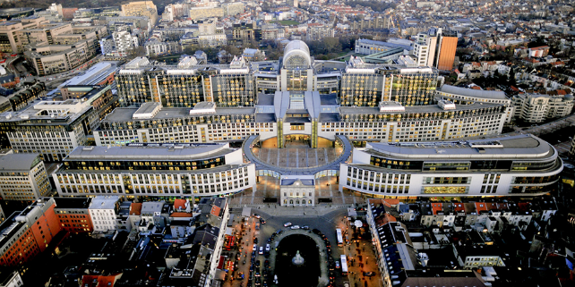
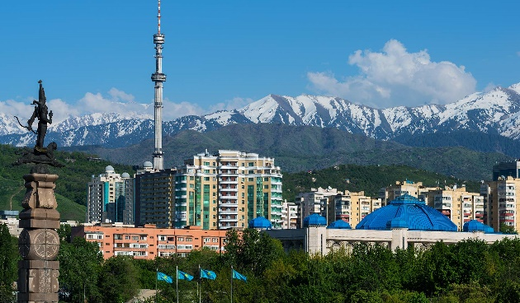
Additional 5G related meetings
5G Related Meeting in the Region
Dec 2018, WARSAW
ITU-T Workshop on “5G, Health and EMF”
5 December 2017, Warsaw, Poland
Contribution to Europe’s 5G Ambition: Investing in 5G Enabler Infrastructure,
20 June 2018, European Parliament, Brussels)
2nd Annual CIS and Central and South-Eastern European Spectrum Management Conference and ITU Regional Workshop “Broadband Development based on 4G and 5G Technologies”
17-20 September 2018, Almaty, Kazakhstan
June 2018, BRUSSELS
Sep 2018, KAZAKHSTAN

Slide 40
5G @ Telecommunication Networks Development, BDT
5G overview
  The role of the ITU
  What is 5G?
  5G use cases
  Socio economic implications of 5G
  Digital divide
5G technology and spectrum requirements
  Radio access networks
  Core networks
  Backhaul
  Fronthaul
  Spectrum for 5G
Key challenges in rolling out 5G
  Small cell deployment challenges
  Fibre backhaul
  Spectrum
  Other factors
What does ‘good’ look like?
  Streamlining small cell deployments
  Policy intervention - fibre and spectrum
  Infrastructure sharing
  Transition to fibre
  Addressing local planning challenges
  Spectrum harmonization
  Spectrum licensing
  5G pilots
Example of costs and investment implications
  Overview
  Methodology
  Scenarios
    Scenario 1 – large densely populated city
    Scenario 2 – small medium density city
  Independent cost estimates
  Investment models
@ITU | September 2018

Slide 41
CONTACT US
ITU OFFICE for EUROPE
eurregion@itu.int
@ITU_EUR
https://www.itu.int/en/ITU-D/Regional-Presence/Europe
Jaroslaw K. PONDER, Head of ITU Office for Europe
jaroslaw.ponder@itu.int

Slide 42
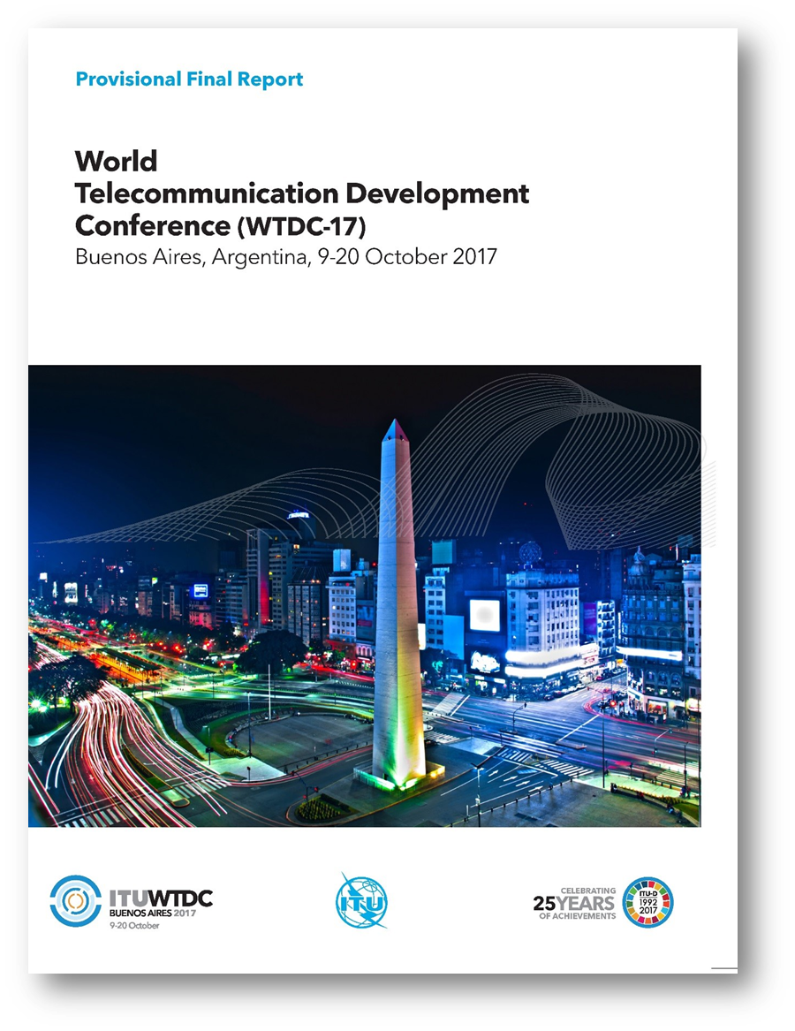
REGIONAL INITIATIVES FOR EUROPE 2018-2021
EUR1: Broadband infrastructure, broadcasting and spectrum management
EUR2: A citizen-centric approach to building services for national administrations
EUR3: Accessibility, affordability and skills development for all to ensure digital inclusion and sustainable development
EUR4: Enhancing trust and confidence in the use of information and communication technologies
EUR5: ICT-centric innovation ecosystems

Slide 43

ITU REGIONAL INITIATIVE for EUROPE on BROADBAND
EUR1: Broadband infrastructure, broadcasting and spectrum management
Objective: To facilitate high-speed connectivity with resilient and synergistic infrastructure development, deployment and sharing, whilst ensuring a trusted and quality user experience.
Expected results: Assistance to the countries in need in the following
Development of plans (national and regional) and feasibility studies for deployment of ubiquitous resilient high-speed connectivity, including 5G/IMT2020 and digital broadcasting deployment, with all relevant components including legislation, standards, organizational set-up, capacity building and cooperation mechanisms, as needed
Sharing of guidelines on collaborative regulation between the telecommunication sector and other synergistic sectors such as energy, railway and transportation
Assessment of dynamics, challenges and opportunities in respect of the roll-out of diverse broadband technologies across Europe in the context of the creation of ubiquitous resilient high-speed broadband infrastructure
Sharing of best practices and case studies in cable TV, digital broadcasting, 5G experience, early use cases and trends in next-generation access network roll-out
Mapping of the ubiquitous infrastructure and services, fostering harmonization of approaches across the region and taking into account infrastructure-sharing approaches applied by countries
Establishment of quality-of-service systems and consumer-protection frameworks
Development of plans for ICT for sustainable energy covering different types of ICT applications and innovations.

Slide 44
5G @ Telecommunication Networks Development, BDT
5G overview
  The role of the ITU
  What is 5G?
  5G use cases
  Socio economic implications of 5G
  Digital divide
5G technology and spectrum requirements
  Radio access networks
  Core networks
  Backhaul
  Fronthaul
  Spectrum for 5G
Key challenges in rolling out 5G
  Small cell deployment challenges
  Fibre backhaul
  Spectrum
  Other factors
What does ‘good’ look like?
  Streamlining small cell deployments
  Policy intervention - fibre and spectrum
  Infrastructure sharing
  Transition to fibre
  Addressing local planning challenges
  Spectrum harmonization
  Spectrum licensing
  5G pilots
Example of costs and investment implications
  Overview
  Methodology
  Scenarios
    Scenario 1 – large densely populated city
    Scenario 2 – small medium density city
  Independent cost estimates
  Investment models
@ITU | September 2018

Slide 45
5G Related ITU Regional Forums, Seminars, Workshops
ITALY, November 2018
UKRAINE, May 2018
HUNGARY, July 2018
LATVIA, July 2018
MONTENEGRO, October 2018
ATHENS, October 2018

Slide 46
Additional 5G related meetings
5G Related Meeting in the Region
Dec 2018, WARSAW
ITU-T Workshop on “5G, Health and EMF”
5 December 2017, Warsaw, Poland
Contribution to Europe’s 5G Ambition: Investing in 5G Enabler Infrastructure,
20 June 2018, European Parliament, Brussels)
2nd Annual CIS and Central and South-Eastern European Spectrum Management Conference and ITU Regional Workshop “Broadband Development based on 4G and 5G Technologies”
17-20 September 2018, Almaty, Kazakhstan
June 2018, BRUSSELS
Sep 2018, KAZAKHSTAN

Slide 47
Fostering 5G Dialogue in Europe in 2019 and beyond…
5G Related ITU Regional Forums, Seminars, Workshops
Report on National Strategies for 5G Implementation and Pilot Projects
Report on Electromagnetic Field Levels and 5G [EMF]
Regional Seminar on Broadband Connectivity [Q2, Albania]
Regional Conference on 5G [Q2/Q3, Poland]
Regional Conference [Serbia]
Expert Meetings [Italy and Poland]
Regional Regulatory Forum [September/October, Budva]
Europe focused enhancement of ITU Interactive Transmission Maps including collection of information from official sources
Twinning programmes within the Europe region and beyond
[offering from Hungary, Italy and Poland]

Slide 48

ITU Centres of Excellence:
Building Human Capacities on 5G
5G Related Training through ITU ACEDEMY
02/04/2018 - 09/04/2018: ITU Centres of Excellence E-Learning course on Wireless Access Technologies to Internet Network
​29/05/2018 - 25/06/2018: ITU Centre of Excellence E-Learning course on Future Broadband Internet Access
15/10/2018 - 16/10/2018: ITU Centres of Excellence Face to Face course on Broadband Access (Hemniz)
25/10/2018 - 26/10/2018: ITU Centres of Excellence Face to Face course on Technical, Business and Regulatory Aspects of 5G Network (Warsaw)

