Slide 1


Ukrainian Numbering, Naming and Addressing Operation Center
State University of Telecommunications
Functionality and identity management in 5G/LTE and IoT networks
Yuri Kargapolov
CEO UNAOC, Consortium,
State University of Telecommunications
ceo@num.net.ua
http://num.net.ua
ITU Workshop for Europe and CIS on ICT Infrastructure as a Basis for Digital Economy
Kiev,
May 14-16, 2019

Slide 2
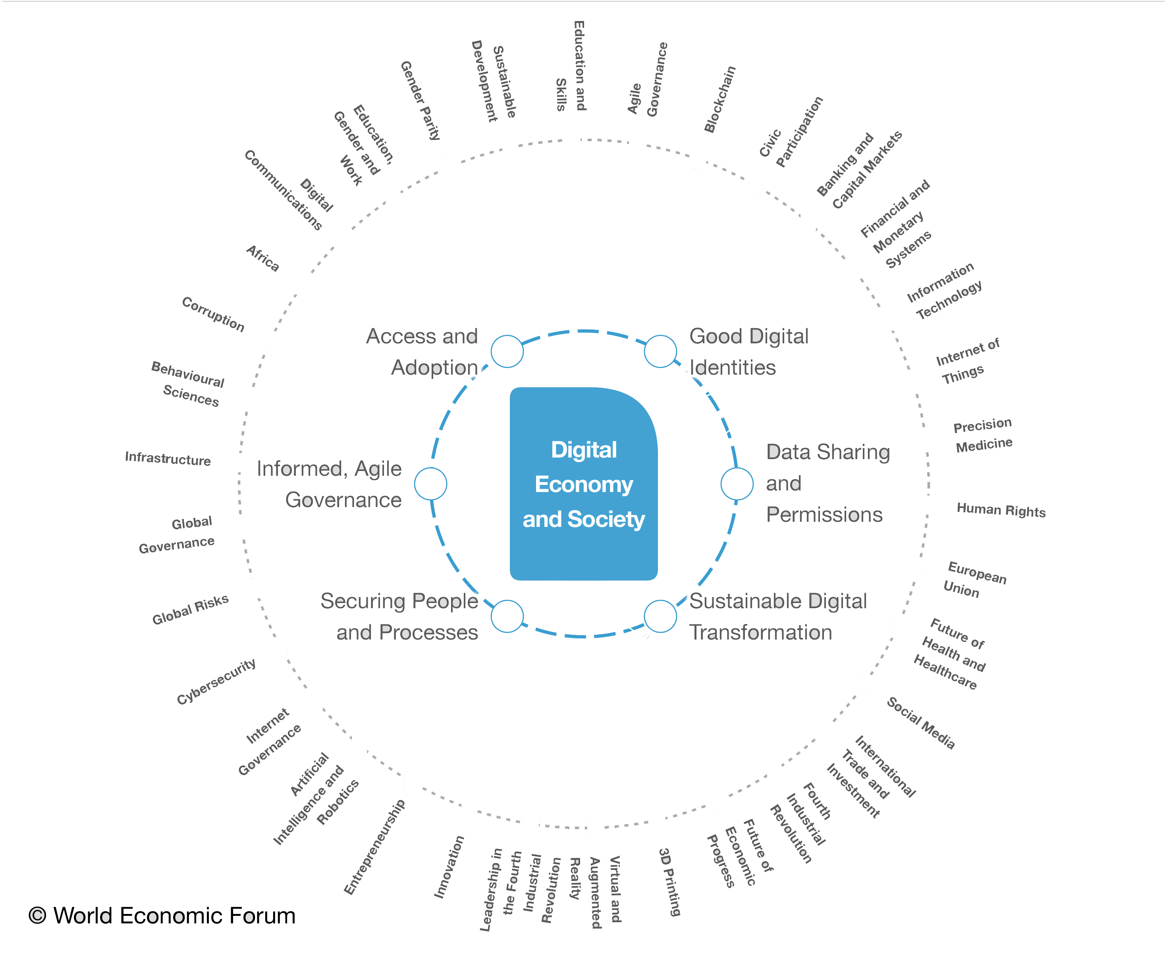
Digital Economy
Infrastructure
Legislative and regulatory environment
Personnel and Education
Digital healthcare
Information Security
Agile Governance
Smart city and village
Science and Research

Slide 3
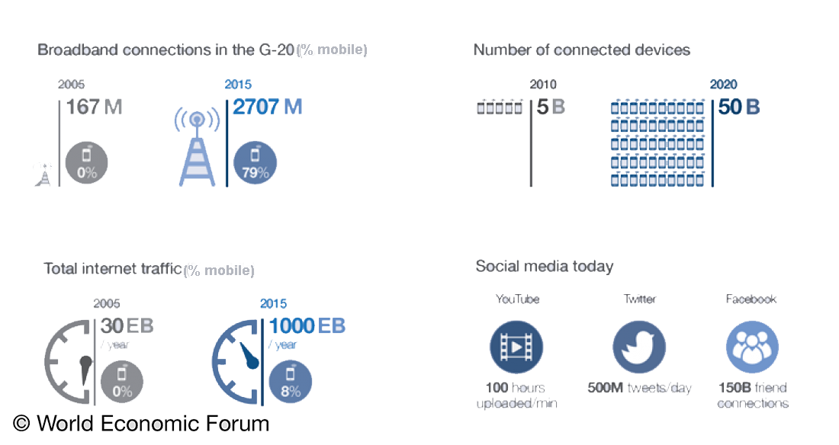
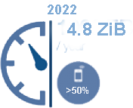
Demands on Digital Infrastructure Exploding
Cisco Visual Networking Index: Forecast and Trends, 2017–2022

Slide 4
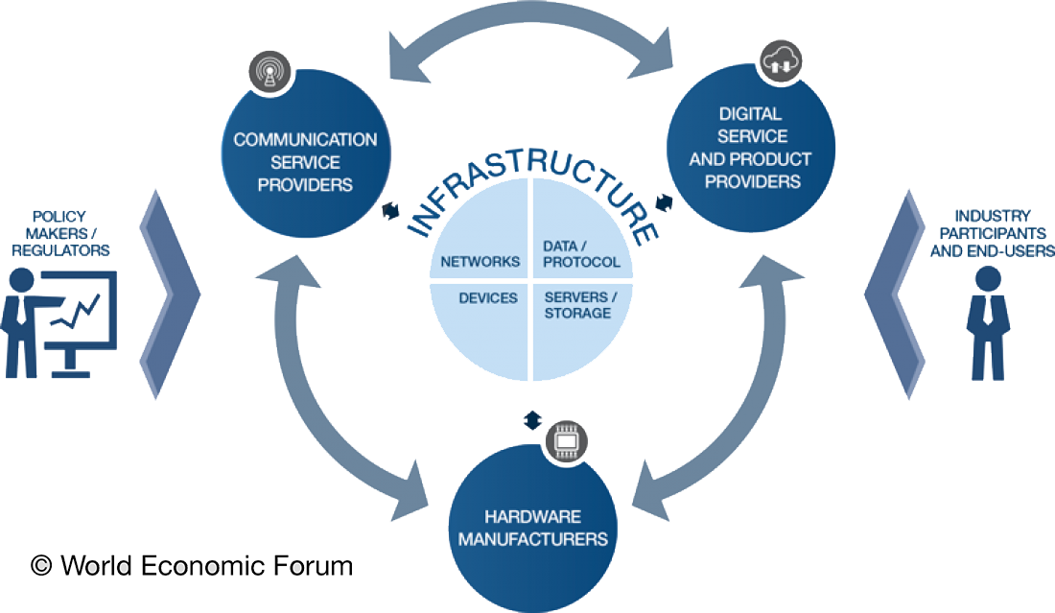
Infrastructure
Data processing, analysis & harmonization, business logic
Aggregation, filtering,
data transmission
Identity Management?
Data gathering
Software application, data storage, governance

Slide 5
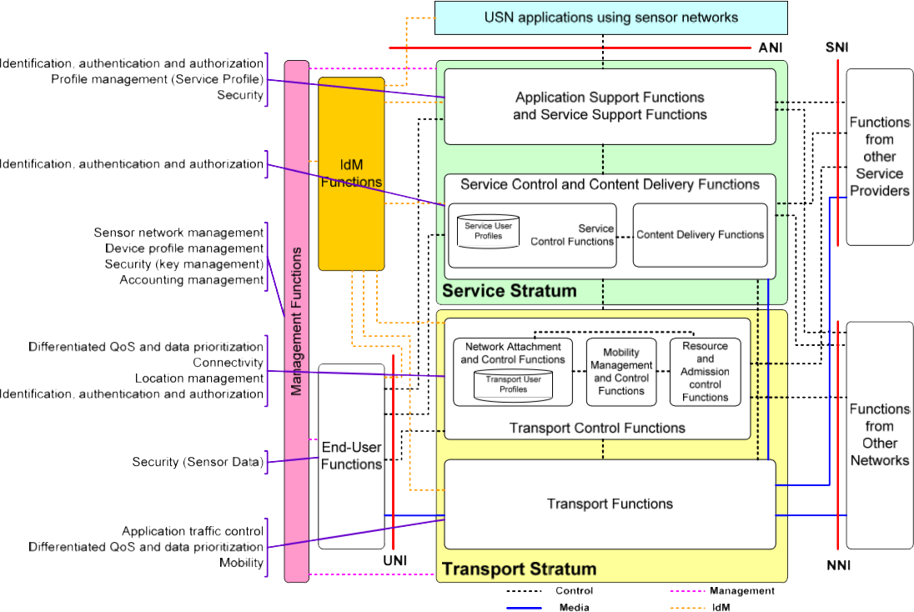
Overall functional architecture model
Y.2026 (12)
Functional requirements and architecture of the next generation network for support of ubiquitous sensor network applications and services
ANI | Application Network Interface
USN | Ubiquitous Sensor Network
UNI | User network interface
SNI | Service node interface
NNI | Network-to-network interface
IdM | ID Management
IdM

Slide 6
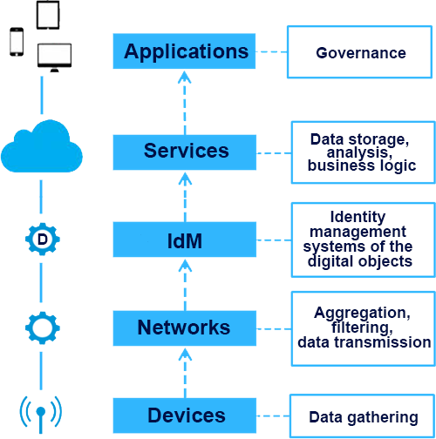
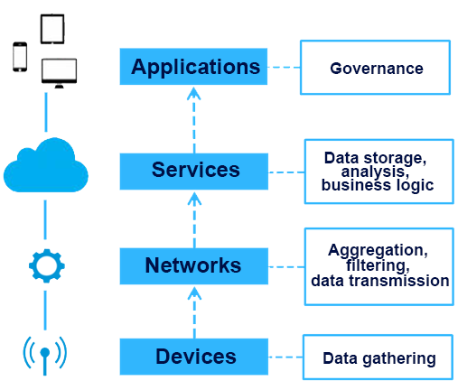



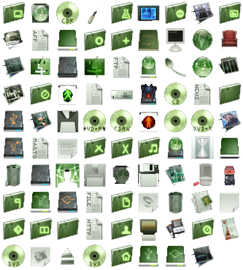
Place IdM in the general architecture
Multiple identifiers harmonization system
What is a basic ID?
If a basic ID is missing
and there are complex
IDs in the combination
Where is IdM place ?
ID = MSISDN

Slide 7
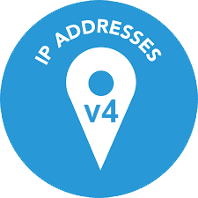




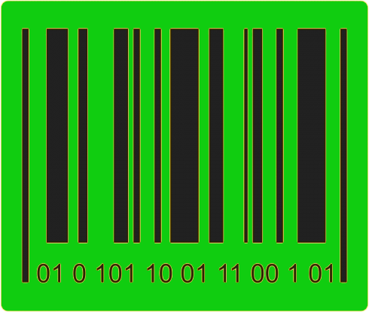


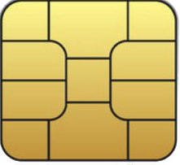

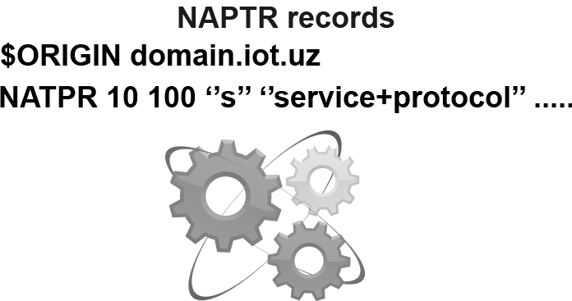

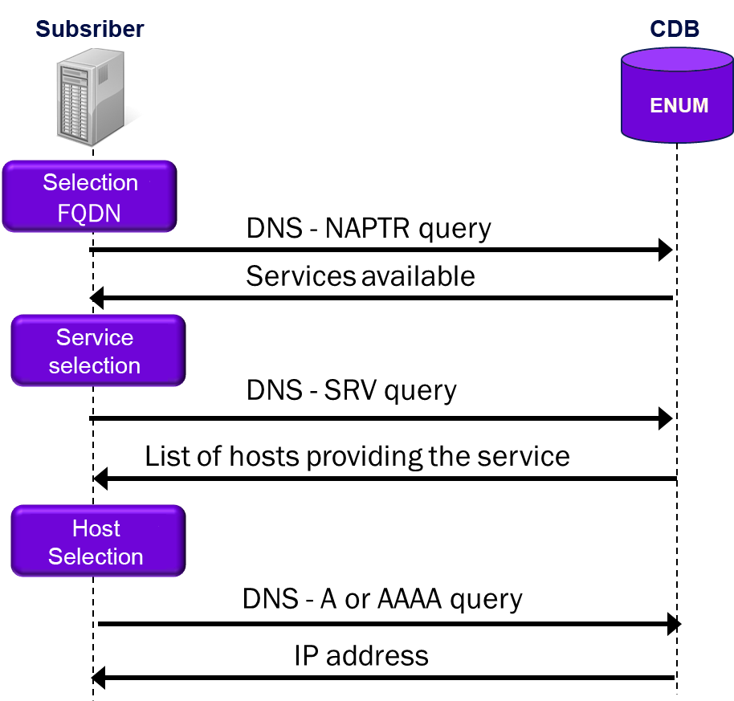


How does this work?
MSISDN
Example on the transport system

Slide 8





Functionality of the IdM systems for Transport Systems
here & now
any user
at any time
in any place
with any own identifier (s)
with own device (s)
in the network of any chosen operator
can get any services
Check-in
Rescues
Tracking
Booking
Security
e-commerce

Slide 9
IdM & ENUM/DNS security
DNS Server of Service
Subscriber B
Response on Service
Web resource
Response on Service
Response on Service
service:<local-part>@<domain-part>
Query on Service:
<number>.0.8.3.e164.arpa
Proxy/DNS
Server of Service
on <domain-part>
Subscriber A
Query on Service
Proxy Server of Service
Notes:
Because the proposed solution will use the DNS technologies, the security issue must be one of main
The current situation is unsatisfactory. We still don't have the relevant the DNS security support solutions for IoT as well as fro DNS technilogies in general
The red zones are reflected the real threats in standard scheme of DNS resolving

Slide 10
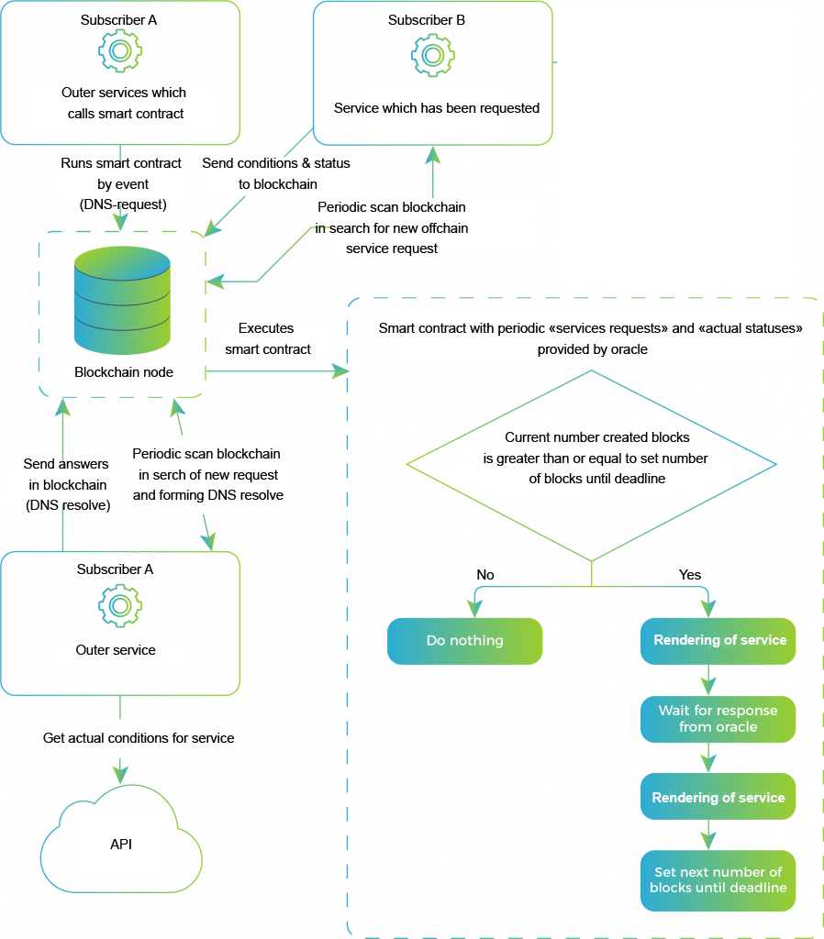
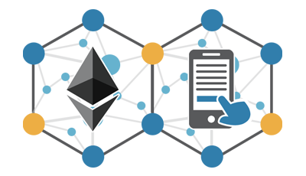
IdM/Blockchain + SC and security
IdM & ENUM/DNS security ?????
Notes:
Today, we sure, there is only one way solutions of security issue for the DNS-technology, it’s application of the blockchain technology

Slide 11
Generations of the IdM systems
Only the basic function of the IdM (i.e. MNP or IMEI) and the supporting portability, fight against counterfeiting, smuggling, fraud, fishing etc.
There are advanced functions for processing complex transactions (npdi, dynamic number portability correction) within mobile and fixed networks, roaming and geolocation, support for non-geographic and nomadic numbers
Creation of a unified and integrated data environment and decision-making policy using prediction algorithms, support for all types of subscriber's IDs at any time and in any place, including personalization of subscriber services
Formation of the basis of a convergent environment in which any user at any time, in any place, using any own ID (s) and own device (s), can receive from any chosen operator the necessary service “here and now” …. on the ENUM platform
1G
2G
3G

Slide 12
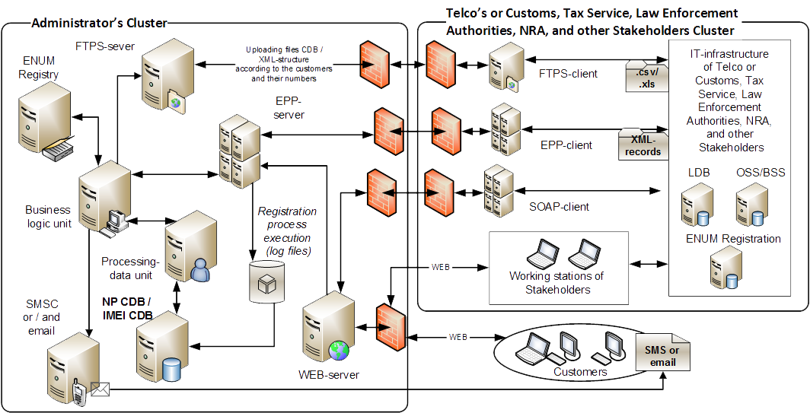
ENUM
Registrants

Slide 13
Ukrainian Numbering, Naming and Addressing Operation Center
State University of Telecommunications
Thanks!
Questions?
Yuri Kargapolov
CEO
CEO UNAOC, Consortium,
State University of Telecommunications
ceo@num.net.ua
http://num.net.ua
UNOC
2016, UNOC ©

