Slide 1


«Methods of creating management of infocommunication networks in emergency systems during the digital transformation of the state»
Andrii Zakharzhevskyi
Candidate of Technical Sciences (Ph. D.), Doctoral student
of the State University of Telecommunications
Kyiv - 2021

Slide 2
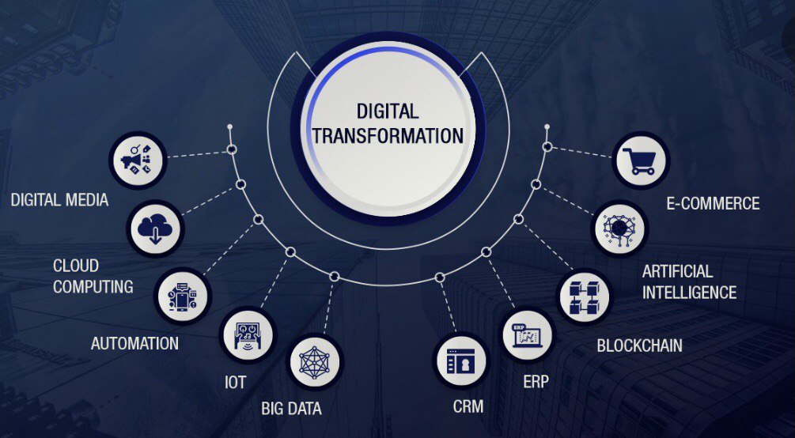

Slide 3
Emergency - violation of normal living conditions and activities of people on objects or territories, caused by an accident, catastrophe, epidemic, natural disaster, epizootic, large fire, use of means of destruction that have caused or may lead to human and material losses
Emergency situation
Natural nature
Man-made nature
Unconstitutional orientation
Military nature

Slide 4
,
SIGNS OF EMERGENCY SITUATIONS
Violation of ecological balance
Danger to life and health of many people
Complete or partial cessation of IT-activities
Material and economic damage

Slide 5
EMERGENCY SITUATIONS ON THE TERRITORY OF THE STATE
Classification of emergencies
On a sectoral basis
In the field of origin
On the scale of possible consequences
National level
In the construction
Man-made
Regional level
In production
Natural
Local level
Transport
Socio-political nature
Objective level
In agriculture
Military nature
military nature

Slide 6
GLOBAL INFORMATION INFRASTRUCTURE
Emergency management system
Service 1
Service
N
Service
2
Subscriber A
Subscriber B
Subscriber information terminal
Subscriber information terminal
Transport communication network
Information component
Telecommunication component
Information component
Infocommunication component

Slide 7
FACTORS AFFECTING THE CREATION OF THE NETWORK OF THE FUTURE DIGITAL TRANSFORMATION OF THE STATE
Service
factor
Data
factor
Full range of infocommunication services
Functional flexibility
Access to information
Resource virtualization
Identification
Centralized network management
Mobility
Reliability and security
Reduction of energy consumption
Versatility of services
Optimization
Economic incentives
Environmental factor
Socio-economic factor

Slide 8
"FIND-CONNECT-PERFORM" PARADIGM IN EMERGENCY SITUATIONS
CONSUMER SERVICE
CONNECT
SYSTEM REGISTER
Identify
SERVICE PROVIDER
Record the provision of the service

Slide 9
NETWORK MANAGEMENT ARCHITECTURE IN EMERGENCY SITUATIONS DIGITAL TRANSFORMATION OF THE STATE
The evolution of life
system cycle
Business process management
Security aspects
Functional management model
Information management model
Physical management model

Slide 10
SERVICE-ORIENTED ARCHITECTURE FOR DIGITAL TRANSFORMATION
Subscriber interface (Initiator of service request and recipient of service)
Message routing
Message conversion
Means management events
Execution of control commands with the help of additional software
Modeling and construction management processes
Bus of distributed messages and requests /responses
Register services
Connectors to the execution environment
Adapters for access to applications and data
OS and application execution environment in stationary mode
OS and application execution environment in emergencies
Application
Data management
Application
Data management

Slide 11
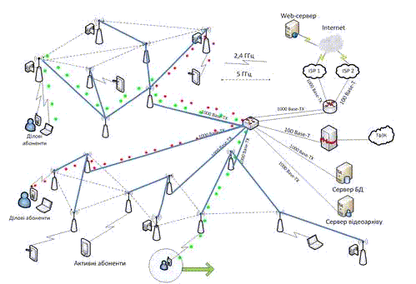
SERVICE-ORIENTED ARCHITECTURE IN DIGITAL TRANSFORMATION
Notes:
З огляду на те, що спостереження здійснюються дискретно, потрібна дискретна модель, яка в найпростішому випадку має вигляд (2):
Зрештою маємо моделювання з двовимірним вектором (t,τ).
Зазначимо, що самоорганізація моделей динамічних систем принципово не відрізняється від самоорганізації статичних моделей. Єдина відмінність — очевидне скорочення наявних у нашому розпорядженні точок за рахунок кількості g запам’ятовуваних точок та використання відповідних шаблонів. Якщо ввести узагальнену змінну (3) та узяти (4) то можна скористатись алгоритмом самоорганізації.
Сучасні інфокомунікації конче потребують нових методів дослідження. Запропонована методика самоорганізації моделі мережі на базі динамічних систем найбільш адекватна і дає змогу визначити основні параметри мережі з необхідною точністю.

Slide 12
OBJECT MODEL OF INFOCOMMUNICATIONS NETWORK MANAGEMENT SYSTEM

Slide 13
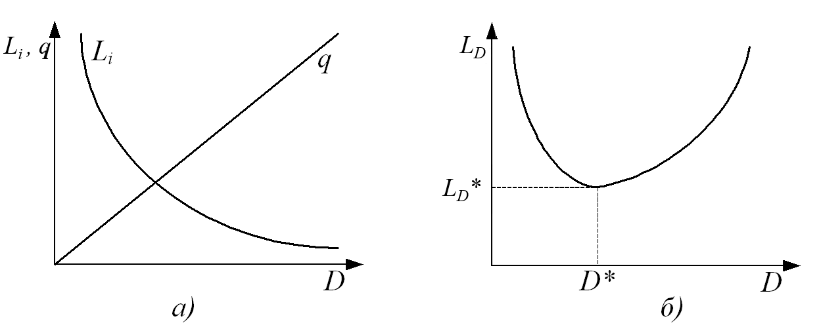
THE INFLUENCE OF THE LEVEL OF DECOMPOSITION ON THE COMPLEXITY OF ANALYSIS OF THE CONTROLLED OBJECT
L_{i} – the complexity of each network element
q – number of elements
L_{D} – the complexity of the controlled network object
L_{D}* – minimal complexity under given conditions and restrictions
D – level of decomposition
D* – the optimal level of decomposition which provides the minimum
complexity under given conditions and restrictions

Slide 14
BLOCK - SCHEME OF THE ALGORITHM OF DETERMINATION OF THE OPTIMAL MANAGEMENT SYSTEM BASED ON THE METHOD OF MULTICRITERIAL OPTIMIZATION
BEGINNING
Determination of intervals of admissible values ​​of indicators
Initialization of the maximum allowable quality indicators
Application of the conditional coefficient of preference
Network element selection
Selection of the value of K1
Yes
No
No
k₁≤k_{1min} ?
Yes
System S’ is better than system S”
System S’ is worse than system S”
k_{1min}=k₁
Selection of the value of K2
No
FINISH
k₂≤k_{2min} ?
Yesк
k_{2min}= k₂
Have all the elements been surveyed ?
No
Yes

Slide 15
CONCLUSIONS
To achieve a high level of creation of a management system in emergencies in digital transformation a developed system is needed that would ensure the effective use of infocommunication networks and new information technologies.
It is important to identify and solve problems and tasks of readiness to manage infocommunication networks in emergency situations, state of emergency and special period. The difficulty of solving these problems is in the suddenness of emergencies. Arising, they change the usual conditions of the infocommunication network.
For creating a system of emergency management in the digital transformation of the state, it is necessary to perform the main tasks to ensure the implementation of state policy in the field:
• digitalization, digital development;
• digital economy, digital innovation and technology;
• e-government and e-democracy;
• development of digital skills and digital rights of citizens;
• open data, development of regional electronic information resources and interoperability;
• security of information, communication, telecommunications, development of broadband Internet access and telecommunications infrastructure;
• provision of electronic and administrative services;
• development of the IT industry.

Slide 16
Thank you for your attention!

