Slide 1


Cybersecurity in a Digital Era
Vitalii Savchenko
State University of Telecommunications
Notes:
Dear ladies and gentlemen, dear participants of the conference!
Thanks to previous speakers, we’ve already discussed some key issues of Digital Transformation and now I’d like to take a few minutes of your time considering another side of this process that’s called Cybersecurity.

Slide 2
Disruptive Technologies of Digital Transformation
Industries of Digital Transformation
Information Technologies
Telecommunications
Media and Leisure
Financial Services
Manufacturing
Retail Activity
Life Sciences
Government
Education
Health
…
Advanced analytics and artificial intelligence
Internet of things
Advanced robotics
Cloud services and digital platforms
Blockchain
Autonomous and semi-autonomous navigation
3D printing
Virtual and augmented reality
Notes:
At the beginning of my presentation, I’d like to attract your attention to the basic disruptive technologies that made Digital Transformation a reality.
Advanced analytics and artificial intelligence. High-performance computers can identify patterns and perform predictive analytics to facilitate automated learning and decision-making.
The Internet of things. Sensors and actuators enable the use of smart interconnected devices or products that can be remotely accessed or tracked.
Advanced robotics. Artificial intelligence, computer vision, sensors, and motors are enabling robots to perform increasingly complex tasks, with less repetitive and predictable patterns.
Cloud services and digital platforms; • Blockchain; • Autonomous and semi-autonomous navigation; • 3D printing; • Virtual and augmented reality and many-many other technologies implemented into different industries make a terribly wide field for Cybersecurity issues.
For the first view, it's logical to deny these novel approaches to keep the safety and stability of the business, but actually, for the moment, it’s not possible because of the emerging benefits of Digital Transformation.

Slide 3
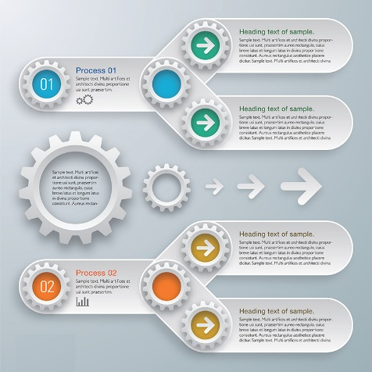
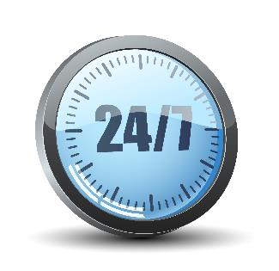



10 benefits of Digital Transformation (1)
Key Benefits of Digital Transformation
3
Automation
Availability
Customer service
Efficiency
Forecast
Automate time consuming & repetitive tasks
Provide 24/7 availability
Give great (personal) customer service
Improve efficiency, communicate better
Plan & forecast accurately
Kyiv, 15 December 2021
Notes:
Automation consumes time and resources and gives the opportunity to repeat the actions as many times as you want.
Availability ensures that your business can be available 24/7 whole year long.
Your customers will appreciate the products and services oriented to satisfy their needs.
Efficient business gets more and spends less.
You can predict your future to avoid troubles.

Slide 4





10 benefits of Digital Transformation (2)
Key Benefits of Digital Transformation
4
Staff morale
Accountability
Competition
Added value
Security
Improve staff morale and retention
Get better audit trails and accountability
Compete more effectively
Get a significant added value
(on exit)
Improve security, build trust
Kyiv, 15 December 2021
Notes:
Working in a technologically modern environment, your staff is motivated to improve their skills and qualifications.
It’s much easier to control all financial issues in a digitalized organization.
The rivalry between competitors is more clear and fair.
As a result, Digital Transformation of business gives significant opportunities in getting added value.
And... Security. Talking about security, I should say that Digital Transformation improves security issues as well, which leads to trust from the customers, but the problem of maintaining such security is difficult.

Slide 5


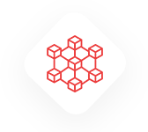




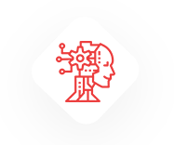


Digital Transformation and Security Threats
5
TECHNOLOGIES, TOOLS AND METHODS ENABLING DIGITAL TRANSFORMATION
Mobile-Tech
ARTIFICIAL INTELLIGENCE
MACHINE LEARNING
ROBOTICS
AUDIO-VIDEO RECORDING
INTERNET OF THINGS
BIG DATA
ADDITIVE MANUFACTURING
CLOUD
Web-Tech
CYBER
CRIMINALS
MALWARE
BOTNET
VIRUS
WORM
SPYWARE
PHISHING
1
2
3
4
5
6
7
Software programs designed to damage or do other unwanted actions on a computer system
Individuals
or teams of people who use technology to commit malicious activities on digital systems or networks with the intention of stealing sensitive information
Internet-connected devices, each of which is running one or more bots. It can be used to perform DDoS attack, steal data, send spam, and allows the attacker to access the device and its connection
Computer program that, when executed, replicates itself by modifying other computer programs and inserting its own code
Computer
program that replicates itself in order to spread to other computers. It often uses a computer network to spread itself, relying on security failures on the target computer to access it
Aims to gather information about a person or organization, without their knowledge, and send such information to hack another entity without the consumer's consent
Fraudulent
attempt to obtain sensitive information such as usernames, passwords and credit card details by disguising oneself as a trustworthy entity in an electronic communication
.
Kyiv, 15 December 2021
Notes:
As we’ve already mentioned, the basic technologies of Digital Transformation were born in the last few years and all of them are connected with fast computing, microelectronics, nano-technologies, and immense network communications.
High speed and sophisticated algorithms made all of them extremely vulnerable to traditional security threats. Viruses and Worms became more intelligent and can strike our computers as well as they did it earlier. Malware and Spyware sent by Cybercriminals, often by Phishing letters, can destroy whole industries, as it happened in Ukraine some time ago.
So, despite many benefits, Digital Transformation brings a serious concern about security issues. As more complicated technology appears as more serious security it requires.

Slide 6

Risk Factors of Digital Transformation
6
Digital Transformation brings forth unmatched opportunities and capabilities for growth and value creation,
but,
None of the Digital Transformation opportunities can be realized without dealing with the associated risks
Exponentially increasing penetration of smart devices
Growing customer expectations and changing demographics
Increase in Internet speed and its penetration
Technological innovations and inclination towards advanced technologies
Notes:
The well-known British leader in business analytics Deloitte-company offered key risk factors for Digital Transformation:
Exponentially increasing penetration of smart devices;
Growing customer expectations and changing demographics;
Increase in Internet speed and its penetration;
Technological innovations and inclination towards advanced technologies.
As a result of a deep study, Deloitte makes a conclusion that «None of the Digital Transformation opportunities can be realized without dealing with the associated risks». Managing such risks in the changing era is, thus, critical to an organization’s sustainability.

Slide 7
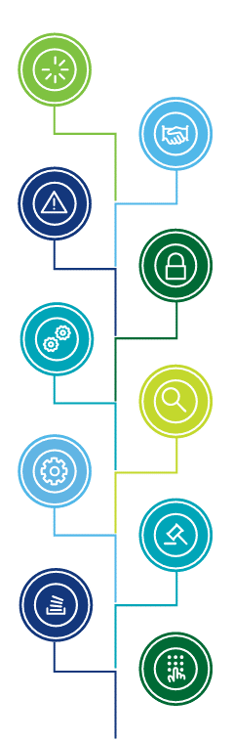
Understanding the risks of Digital Transformation
7
Technology
Potential for losses due to technology failures or obsolete technologies. Technology related risks have an impact on systems, people, and processes. Key risk areas may include scalability, compatibility, and accuracy of the functionality of the implemented technology.
Cyber
Protection of digital environment from unauthorized access/usage and ensuring confidentiality and integrity of the technology systems. Key controls may include
platform hardening, network architecture, application security, vulnerability management, and security monitoring.
Strategic
Usually derives from an organization’s goals and objectives. It can be external to the organization and, on occurrence, forces a change in the strategic direction of the organization. Typically would have an impact on customer experience, brand value, reputation, and competitive advantage in the market place.
Operations
An event, internal or external, that impacts an organization’s ability to achieve the business objectives through its defined operations. Includes risks arising due to inadequate controls in the operating procedures.
Data Leakage
Ensuring protection of data across the digital ecosystem at various stages of data life-cycle–data in use, data in transit and data at rest. Key focus control areas would be around data classification, data retention, data processing, data encryption, etc.
Third-party
Comprises of risks arising due to inappropriate controls at vendors/third party operating environment. Key controls would be around data sharing, technology integration, operations dependency, vendor resiliency, etc.
Privacy
Risk arising due to inappropriate handling of personal and sensitive personal data of customer/employee, which may impact privacy of the individual. Key controls includes notice, choice, consent, accuracy, and other privacy principles.
Forensics
Digital environment’s capability to enable investigation in the event of a fraud or security breach, including capturing of data evidences which is presentable in the court of law.
Regulatory
Adherence to statutory requirements including technology laws, sectoral laws, and regulations.
Resilience
Risk of disruption in operations or unavailability of services, due to high dependency on tightly coupled technology. Key areas of consideration would include business continuity, IT/Network disaster recovery, cyber
resiliency, and crisis management
Notes:
The main idea of secure Digital Transformation is in common understanding all the risks and threats in their combination. We have to realize that Cybersecurity is only part of the global risky environment for the organization and it can affect all other aspects of the risk.
Technology, Strategy, and Operational management. All of them depend on digital devices or services and can affect an organization’s ability to achieve its business objectives. They include risks arising due to obsolete technologies, inadequate controls in the strategic planning and operating procedures within the organization.
Third-party. Comprises risks arising because of inappropriate controls in vendors’ operating environment.
Data Leakage, Privacy, and Cyber Protection, as well as Digital Forensics and Regulatory, are totally conditioned by the security and cybersecurity policy in the organization. Key controls here may include platform hardening, network architecture, application security, vulnerability management, and security monitoring.

Slide 8
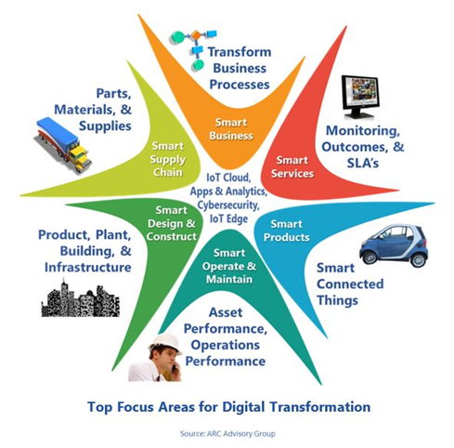
Drivers of Future Cyber Security
8
Technology
Evolution
Regulatory
Complexity
Sophistication
of Attacks
Limited
Resources
Notes:
Digital Transformation is a permanent process for years and there are four basic drivers of current and future Cybersecurity.
Technology Evolution. IT infrastructures are gradually growing in size and complexity, because of introducing new technologies like cyber-physical systems and the Internet of Things. While these systems provide opportunities for enhanced productivity and improved decision-making, they also broaden potential vulnerabilities.
Regulatory Complexity. Nowadays, several organizations operate in complex regulatory environments, which impose a need for compliance with many security regulations and standards.
Sophistication of Attacks. Over the years, cybersecurity attacks are increasing in sophistication through becoming asymmetric and less predictable. For example, ransomware attacks have been added to the list of phishing, DDoS and social engineering attacks, while the methods used by cybercriminals are constantly developing based on the use of advanced sniffing and encryption techniques.
Limited Resources. Many businesses lack the resources, expertise, and finances needed in order to cope with modern cybercrime.

Slide 9
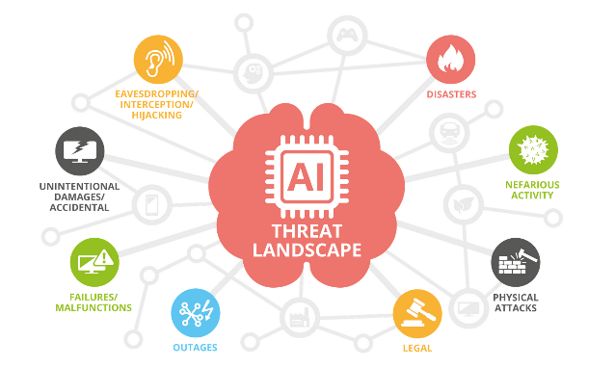

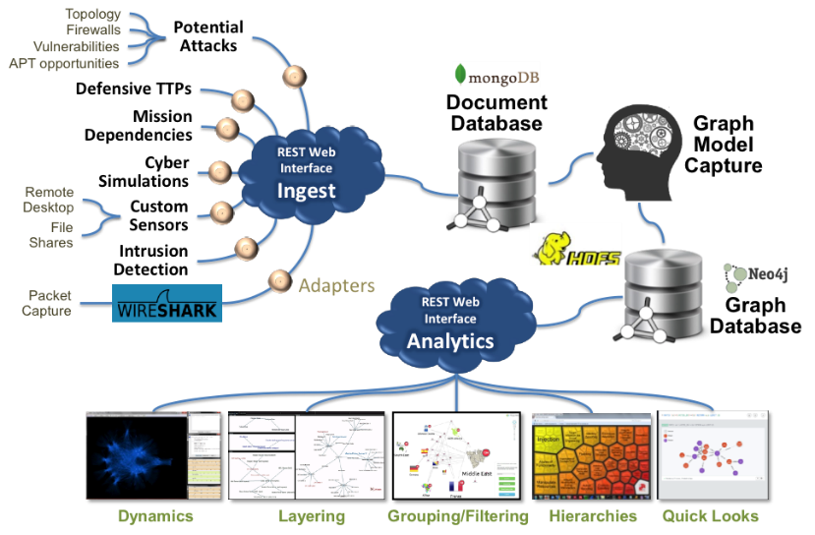
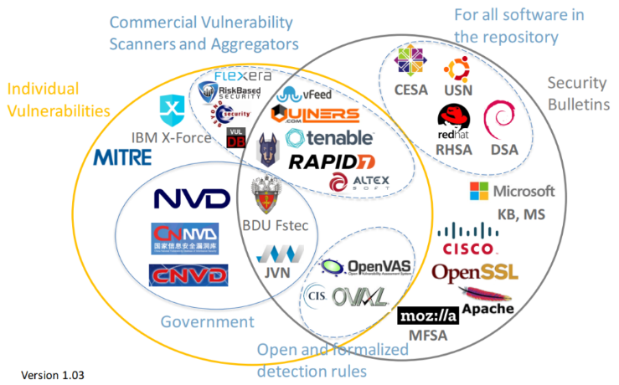
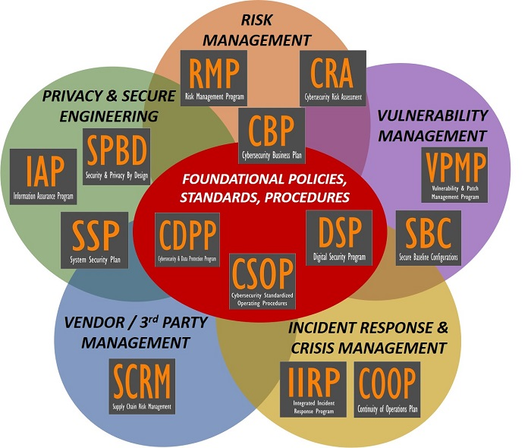
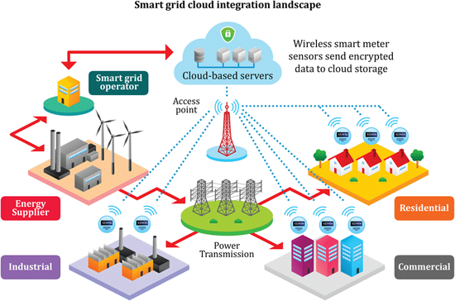
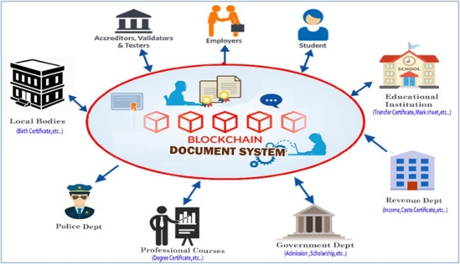
Emerging Cyber Security Solutions and Services
9
Security Automation and
Intelligence
Managed Security and
Security as a Service
Cyber Security Datasets and
Data-Driven Approaches
Vulnerability Databases
Standards
Integrated Policies for Cyber and
Physical Security
Decentralization and Blockchains
Notes:
Despite such a pessimistic perspective, Digital Transformation gives some opportunities for Emerging Cyber Security Solutions and Services.
Security Automation and Intelligence give rise to implementing machine learning systems, employing deep learning and artificial intelligence to identify indicators of complex attacks, which are hardly identifiable.
Managed Security and Security as a Service. Solutions for small organizations come with easy web-based interfaces for their configuration, which makes them appealing to employees with low-security expertise.
Cyber Security Datasets and Data-Driven Approaches. The collection of security-related datasets is becoming very important for the development of future cybersecurity systems based on machine learning and Artificial Intelligence.
Vulnerability Databases. Following many years of collecting information and knowledge about cyber threats, the cybersecurity community has established a range of vulnerability databases, which are used to maintain and disseminate information about known security vulnerabilities.
Decentralization and Blockchains. BitCoin cryptocurrency has revealed the capabilities of distributed storage that is currently exploited as a secure, privacy-preserving infrastructure in a wide range of applications.
Integrated Policies for Cyber and Physical Security. There is a close interaction between cyber and physical systems, including an inter-play between their security mechanisms. This close interplay is gradually leading to an integration of physical and cybersecurity measures and related policies.
Standards. Standards development organizations incorporate the latest technologies and best practices in their work. So standards-based solutions are usually more effective in increasing the cyber resilience of modern organizations.

Slide 10


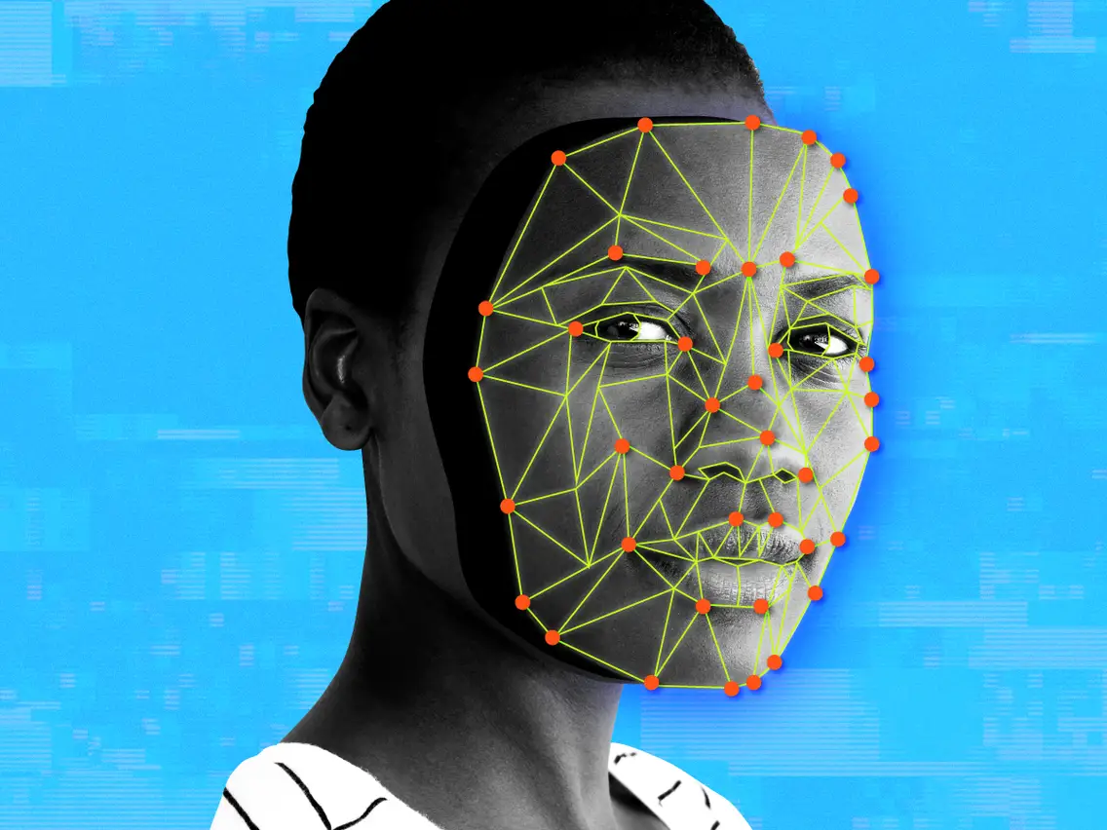
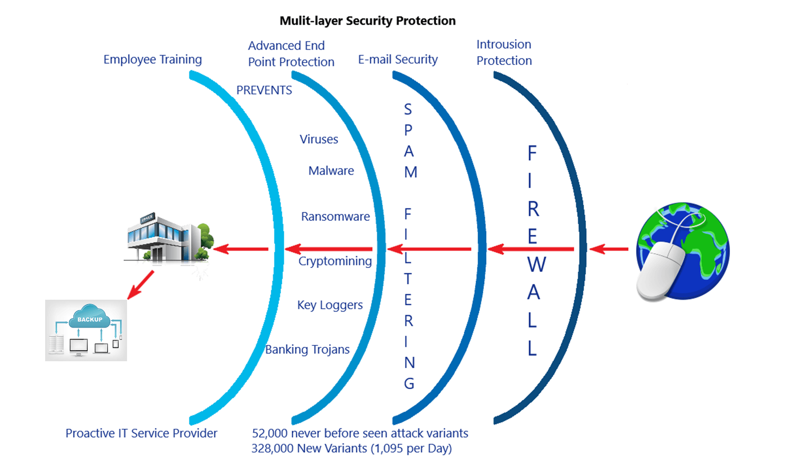


Why is Cybersecurity Lagging in Digital Transformation?
10
1. All organizations know that cybersecurity is critical but few people like to be confronted with this requirement
2. Many seem to believe that cybersecurity slows down digital transformation
3. Some organizations do not seem to have a sense of urgency to implement security in new technology
4. Cybersecurity is not a simple process
5. Making a business case for cybersecurity can be difficult
6. Mobile technology has changed security parameters
7. Data and information are undervalued
Notes:
Despite opportunities for Emerging Cyber Security Solutions in many organizations, Digital Transformation for this moment suffers from some misunderstandings. There are 7 of them:
1. All organizations know cybersecurity is critical, but few people like to be confronted with this requirement. Instead of viewing cybersecurity as a cost, companies should view it as a fundamental requirement.
2. Many seem to believe that cybersecurity slows down digital transformation. This is not the case with new technology anymore. These days, security solutions can even be done in the cloud. Unfortunately, many organizations do not involve their security team at the beginning of the business process. In fact, they are often called in too late.
3. Some organizations do not seem to have a sense of urgency to implement security in new technology. Only organizations that went through serious cyber troubles admit cybersecurity is valuable.
4. Cybersecurity is not a simple process. Now it's not an easy fix to potential cyberattacks. It requires developing a strategy that involves prioritizing the most critical processes, as well as identifying and protecting potential sources of vulnerabilities.
5. Making a business case for cybersecurity can be difficult. You cannot predict how much an attack will affect the company, but you will accurately know when an attack has occurred.
6. Mobile technology has changed security parameters. Technology such as mobile and IoT has made security parameters more complicated. Since there are several channels through which attacks can take place, anti-virus and firewall solutions are no longer enough.
7. Data and information are undervalued. Organizations often undervalue data and information even though these are the essence of the businesses and a source of revenue. But they do not reflect this in their cybersecurity policies.
Trying to address these problems will make the process of Digital Transformation more secure and sustainable.

Slide 11
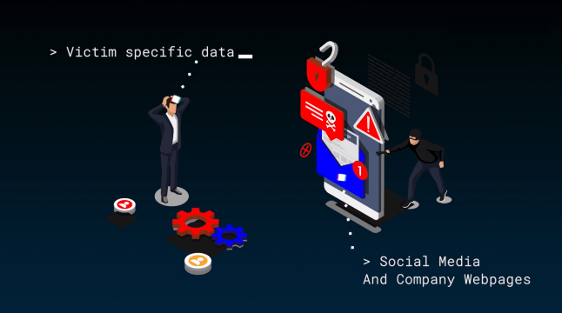

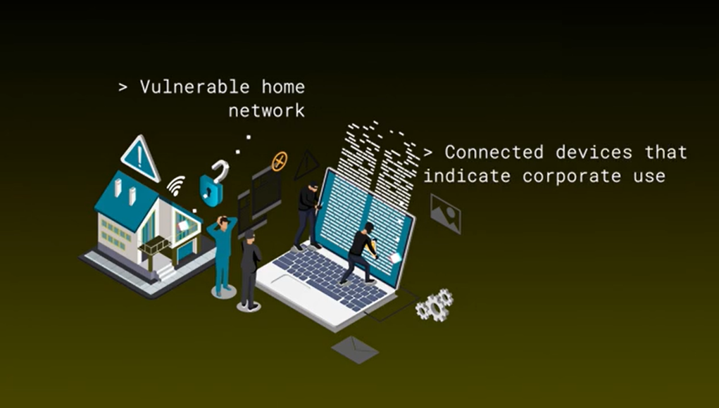
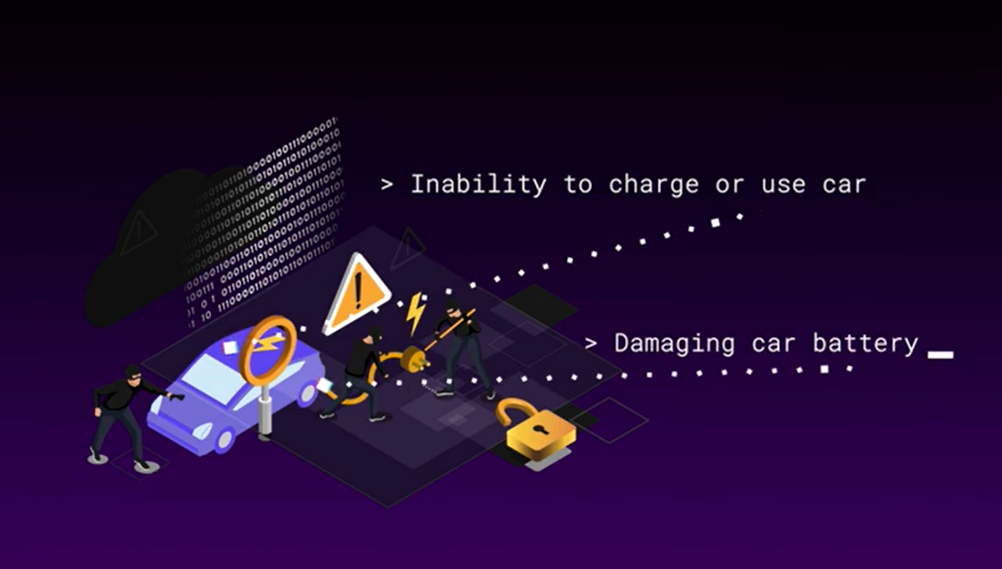
Cybersecurity Predictions
11
Automation will drive a new wave of Spear Phishing Campaigns
Cloud-Hosting providers will finally start fighting with cyber abuse
1
2
Hackers will infest home networks with worms more intensively
Car chargers will become an alternative vulnerability for smart cars
3
4
Notes:
The way of Digital Transformation is difficult and full of security problems in the future. We’ve tried to make some predictions about these issues:
Automation will drive a new wave of Spear Phishing Campaigns. Cybercriminals have already created tools that can automate the manual aspects of spear phishing. By combining such tools with programs that scan data from social media networks and company websites, phishers can send thousands of detailed, believable spear phishing emails, with content customized to each victim.
Cloud-Hosting providers will finally start fighting with cyber abuse. We predict that these Cloud-hosting providers will begin heavily cracking down on scams by deploying automated tools and file validation that spot spoofed authentication portals.
Hackers will infest home networks with worms more intensively. We expect to see malware that not only spreads across networks but looks for signs that an infected device is for corporate use.
Car chargers will become an alternative vulnerability for smart cars. Smart car charging cables carry more than just energy. We expect to see security researchers find similar vulnerabilities in smart car charging components that could at the very least allow them to prevent the powering and use of your car.

Slide 12
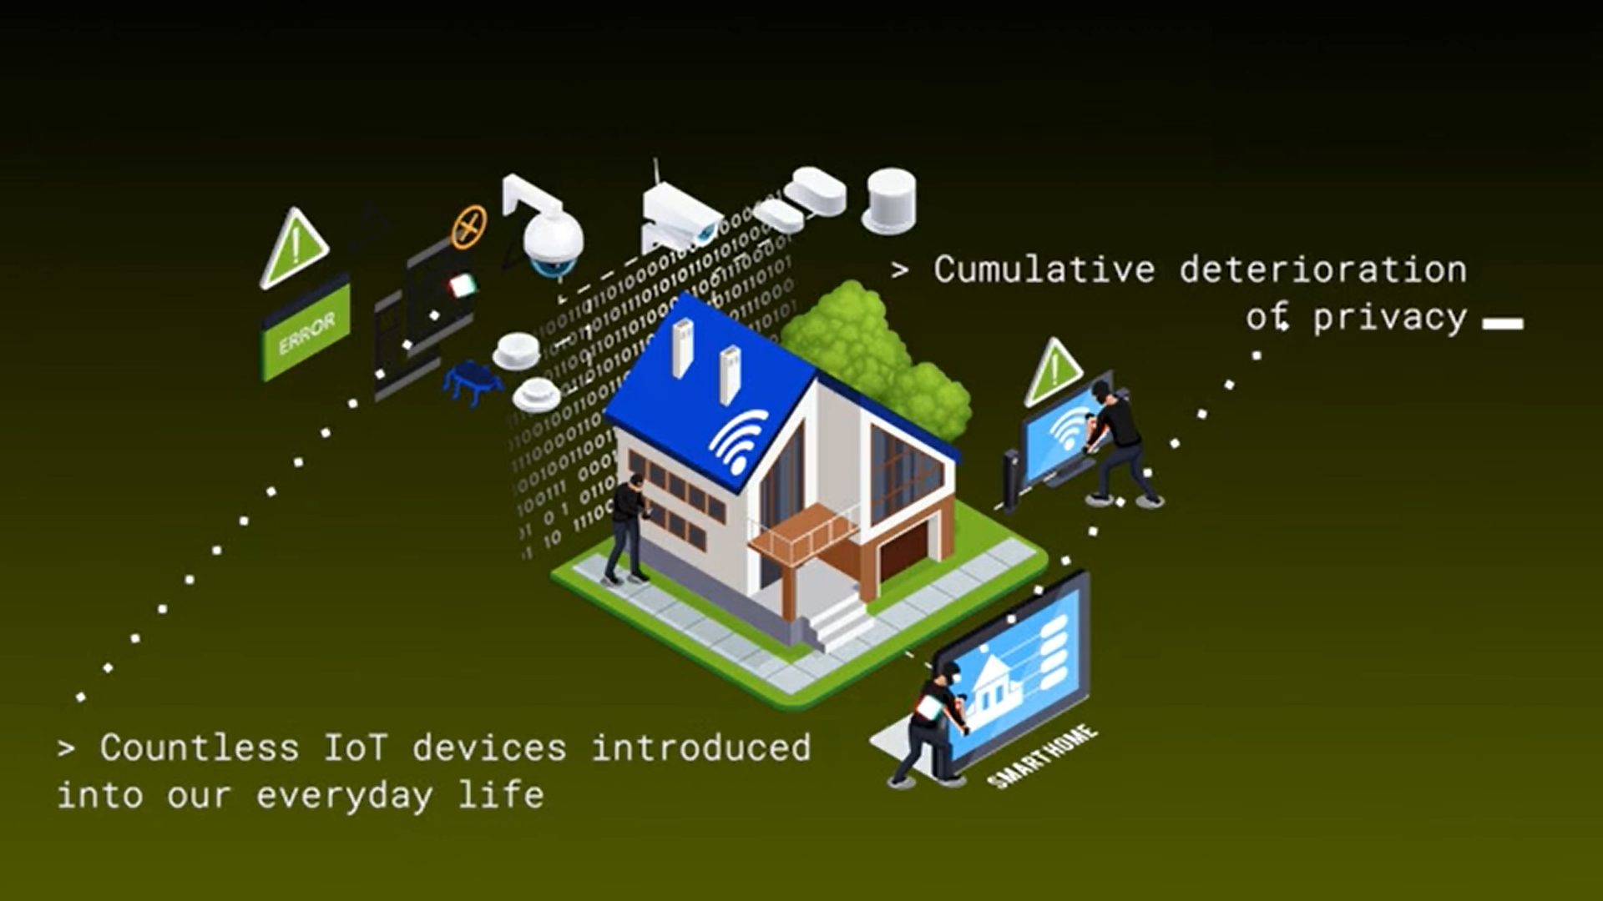
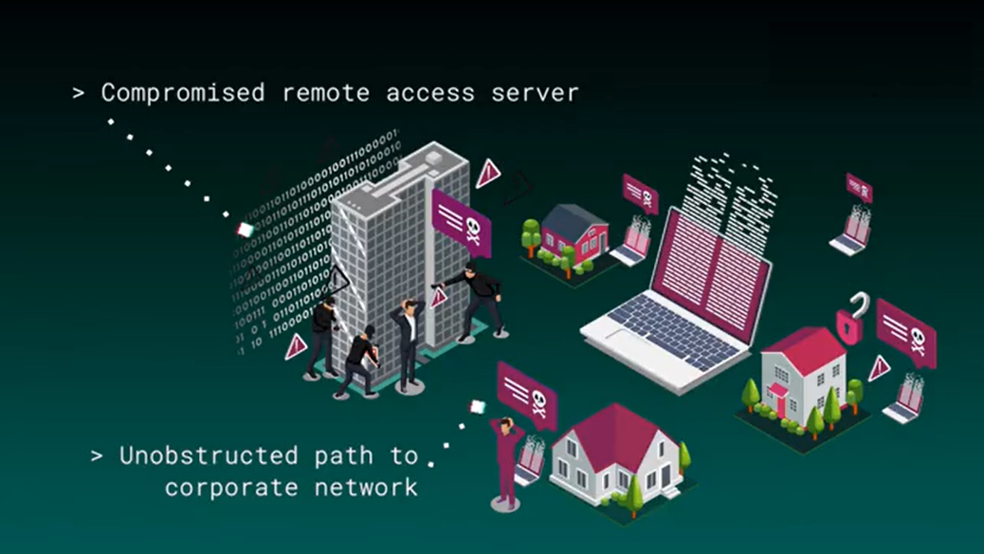
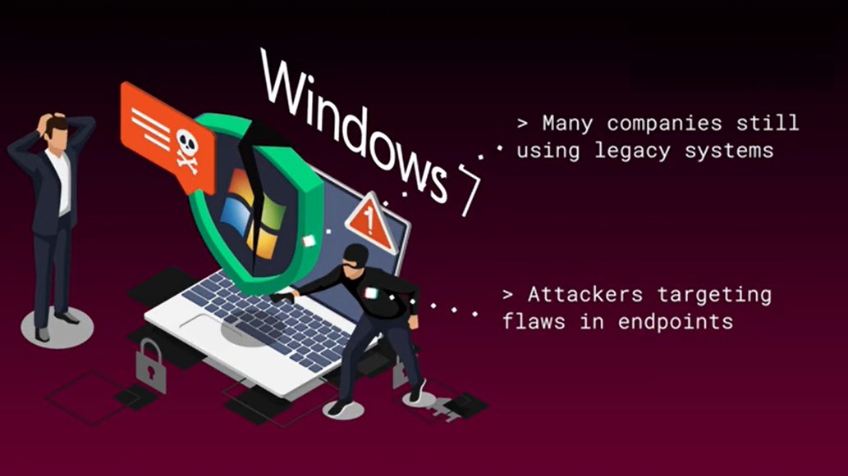
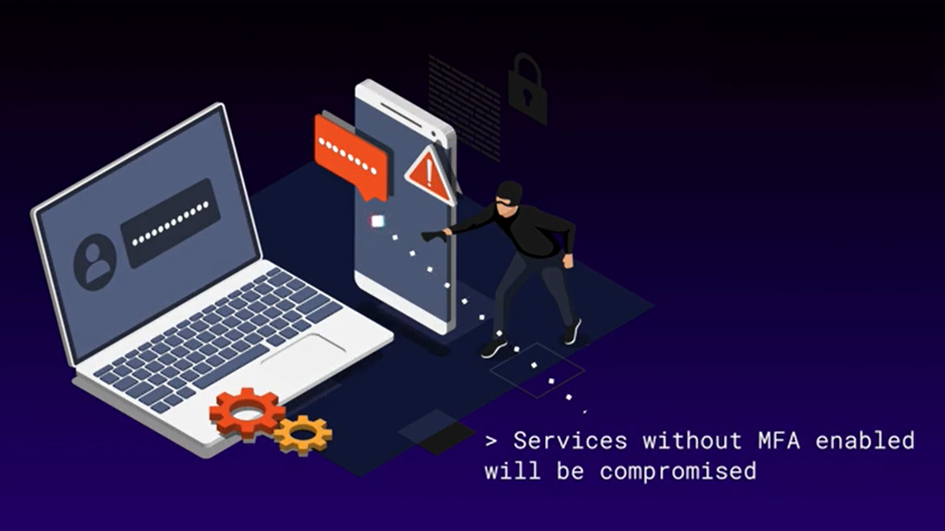
Cybersecurity Predictions
12
Users will think more about devices' privacy
Attackers will use VPNs for remote penetration
5
6
Attackers will pinpoint security gaps in legacy endpoints
Every service without Multi-Factor Authentication will suffer a breach
7
8
Notes:
Users will think more about devices' privacy. Users will finally revolt and make vendors take a privacy for home and consumer Internet of Things devices more seriously. We expect to see the market deal against IoT devices that collect personal data and regulate the capabilities to protect user privacy.
Attackers will use VPNs for remote penetration. Though VPN offers some security to remote employees, attackers realize that if they can access a VPN, they have a wide-open door to your corporate network.
Attackers will pinpoint security gaps in legacy endpoints. We expect cybercriminals to seek a significant security flaw in obsolete operational systems like Windows XP or Windows 7 hoping to exploit legacy endpoints that users can’t easily patch at home.
Every service without Multi-Factor Authentication will suffer a breach. We predict that every service that doesn’t have Multi-Factor Authentication enabled will suffer a breach or an account compromise.

Slide 13
Conclusions
13
    1. Digital Transformation is a complex process that combines activities, skills, and business models based on Digitization and Digitalization, leading to a new economy and society.
    2. Digital Transformation brings unmatched opportunities and capabilities for growth and value creation. However, none of the opportunities can be realized without dealing with the associated risks.
    3. Technology Evolution, Regulatory Complexity, Sophistication of Attacks, and Limited Resources make Cybersecurity a key factor of Digital Transformation.
    4. Digital Transformation creates new opportunities and Emerging Solutions and Services for Cyber Security.
    5. The increase in the number of connected devices, further informatization of business processes, and predictions of the security situation show that the role of cybersecurity in the era of digital transformation will only increase.
Notes:
Everything that’s been considered in this presentation leads to the following conclusions:
1. Digital Transformation is a complex process that combines activities, skills, and business models based on Digitization and Digitalization, leading to a new economy and society.
2. Digital Transformation brings unmatched opportunities and capabilities for growth and value creation. However, none of the opportunities can be realized without dealing with the associated risks.
3. Technology Evolution, Regulatory Complexity, Sophistication of Attacks, and Limited Resources make Cybersecurity a key factor of Digital Transformation.
4. Digital Transformation creates new opportunities and Emerging Solutions and Services for Cyber Security.
5. The increase in the number of connected devices, further informatization of business processes, and predictions of the security situation show that the role of cybersecurity in the era of digital transformation will only increase.

Slide 14
References
14
  The Differences Between Digitization, Digitalization, and Digital Transformation in Manufacturing. URL: https://www.yokogawa.com/library/resources/white-papers/the-differences-between-digitization-digitalization-and-digital-transformation-in-manufacturing/
  Deloitte. Managing Risk in Digital Transformation. URL: https://www2.deloitte.com/in/en/pages/risk/articles/managing-risk-in-digital-transformation.html
  What is Digital Transformation? - CM System Designs. URL: https://www.cmsystemdesigns.com
  Rethinking Cybersecurity in the Digital Transformation Age. URL: https://www.alliedtelesis.com/ua/en/blog/rethinking-cyber-security-digital-transformation-age
  The Importance of Cybersecurity in Digital Transformation. URL: https://securityboulevard.com/2018/05/the-importance-of-cybersecurity-in-digital-transformation/
  2021 Cybersecurity Predictions. URL: https://www.watchguard.com/wgrd-resource-center/cyber-security-predictions-2021
  Greg Gorbach. Elements of Successful Digital Transformation. URL: https://www.arcweb.com/industry-best-practices/elements-successful-digital-transformation
Thank you for your attention!
Notes:
Here is the list of References.
Thank you for your attention!

