Slide 1


Ukrainian Numbering, Naming and Addressing Operation Center
State University of Telecommunications
Selection of user services relevant to the "here and now" situation and the challenges of digital transformation
Yurii Kargapolov
CEO UNAOC, Consortium,
State University of Telecommunications
ceo@num.net.ua
http://num.net.ua
ITU Workshop for Europe and CIS on ICT Infrastructure as a Basis for Digital Economy
Kiev,
December 15, 2021

Slide 2
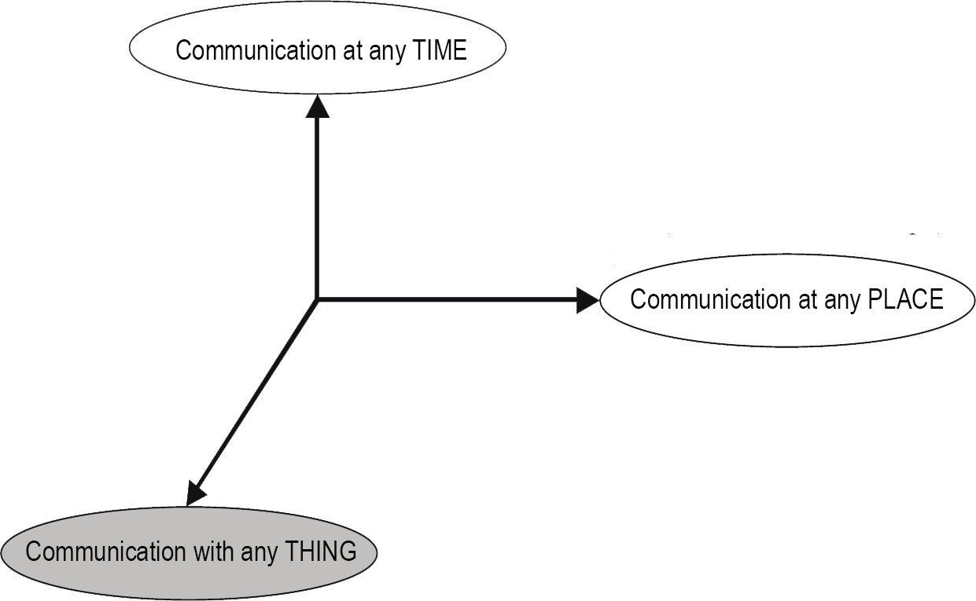
Services and Network Structures
Y.2026(12) Functional requirements and architecture of the next generation network for support of ubiquitous sensor network applications and services
Purpose of any network structures are to provide services
Does it mean that more complicated degree of network structures generates more complex relations during to provide services?
And if yes - that features should be recognized as key to these processes?
in move;
at night;
daytime
……
outdoors;
inside the room (away from the computer or any gadget);
at computer or gadget;
at any object that in move or in static;
driving
……
between:
computers or any gadget;
people without using a computing devices;
a person and a thing using standard equipment;
things including objects that on move as well as on static
…….

Slide 3
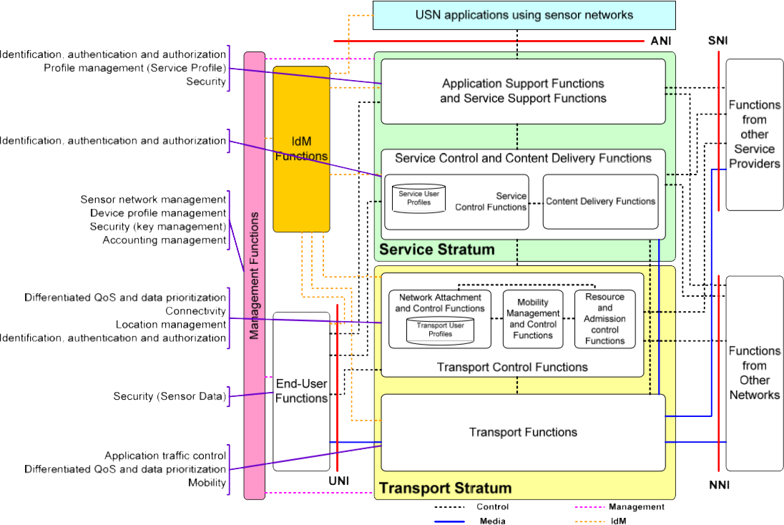
The Axiom on Electronic Communications Needs
Forming on the basis of network structures
a convergent environment in which:
any user
at any time
on any place
using any own identifier(s)
using own device(s)
can receive from any chosen operator
the necessary service "here and now"
Social
IoT
Utility
ITS
ECO
Grid
Weather
ITU-T Recommendation Y.2026 «Functional requirements and architecture of the next generation network for support of ubiquitous sensor network applications and services»
Agriculture
Construction
Industry
Medicine

Slide 4
Reference Model
End-User Functions
Application and Service Support Functions
Management
Application level
Applications
Management Capabilities
Security Capabilities
Functions from Service Providers
Service Control Function
Data store, analytics and business logic
Service support and application support level
Generic Support Capabilities
Special Support Capabilities
Where is IdM Functions place?
Functions from Other Networks
Content Delivery Function
Transport Control Function
Networking Capabilities
Aggregation, filtering and transmission of data
Network level
Specific Security Capabilities
Specific Management Capabilities
Generic Security Capabilities
Generic Management Capabilities
Transport Capabilities
End-User Functions
Service Support Functions
Data collection and gathering
Device Capabilities
Gateway Capabilities
Device level
ITU-T Recommendation Y.2060 «Overview of the Internet of things»

Slide 5
Reference Model
End-User Functions
Application and Service Support Functions
Management
Applications
Application level
Management Capabilities
Security Capabilities
Functions from Service Providers
Service Control Function
Data store, analytics and business logic
Service support and application support level
Generic Support Capabilities
Special Support Capabilities
IdM Functions
Identification of Digital Entities and Processes
Identifiers Properties Management
Identification Processes Management
IdM Management
Functions from Other Networks
Content Delivery Function
Transport Control Function
Aggregation, filtering and transmission of data
Networking Capabilities
Special Security Capabilities
Specific Management Capabilities
Generic Security Capabilities
Generic Management Capabilities
Network level
Transport Capabilities
End-User Functions
Service Support Functions
Data collection and gathering
Device Capabilities
Gateway Capabilities
Device level
ITU-T Recommendation Y.2060 «Overview of the Internet of things»

Slide 6
Digital Entity Model
Digital Entity (DE)
Intrinsic attributes
User-defined attributes
ID
Attributes of the life cycle
Owner attributes
Permission scheme
Type DE
Other attributes
DATA
ITU-T Recommendation X.1255 «Framework for discovery of identity management information»

Slide 7
Digital Entity Model
7
Digital Entity (DE)
Intrinsic attributes
User-defined attributes
ID
Attributes of the life cycle
Owner attributes
Input and output formats of DE
Properties of DE
Permission scheme
Functions and working conditions
Security and Safety requirements
Formalized procedure (model) actions
Verification of actions and data on the scheduled access model
Regexp
Request on authentication
Validation of actions and data regarding the correctness, completeness and compliance of the model input parameters
Request on authorization of the access rights

Slide 8
Digital Entity Model
Properties of DE
Input and output formats of DE
Functions and working conditions
Security and Safety requirements
Name of DE
Specifications of source data
Telecommunication protocols for DE service
Certification Centers
Network Addresses
Output specification
Formalized description of the data structure of the DE
Validity time intervals for certificates in use
Subject Matter Protocols for the DE
Minimum data set used by DE
General description
Maximum data set used by DE
Permissible min. and max. values ​​of the DE parameters

Slide 9
Services and DEs. Circumstances and relevant actions.
DE
DE
DE
DE
DE
Services “Cloud”
DE
DE
DE
DE
Time
DE
DE
DE
Place
Subject Situation

Slide 10
Conclusions: relevant actions and relevant architecture.
Existing service ecosystem management architecture
Proposed service ecosystem management architecture
DB of Service₁
C
S₁
C
S₁
S_{n}
DB of Service₁
DB of Service_{i}
DB of Service_{n}
S_{i}
S_{j}
M
M
DB of Service_{n}
ID Registry
DB of Service_{j}
Services Registry
CDB
+ cache of DBs
S_{n}
Data flow
Data + ID flow
ID flow

Slide 11











How the technology works
Service user
1st element of technology:
ENUM domain registration
Services
Operators
ENUM
4th element of technology:
Request for service
and maintenance
+380503301213
3.1.2.1.0.3.3.0.5.0.8.3.e164.arpa
Service request for user data via app or web
+380503301213
Services:
ECO
ITS services set
agriculture
Open_key=83791F0A70000872601D1
Grid
IoT
medicine
Input data for the request:
- MSISDN=+380503301213
Open_key=
83791F0A70000872601D1
MSISDN
The 2nd element of technology:
Services registration and association creation
Service user
ENUM Registry
Service Registry
Service server URI
and arguments
for service application
Service
operator #1
Registration of
ENUM
cert=6160FCCB000087260111
Arguments and instructions for the API:
- client_number=31215
- &client_phone =+380503301213
- &client_guide=sd
- &client_address=registrant_id
- & open_IOT_cert=83791F0A70000872601D1
- api.serviceregistry.enum.company.business/services/NN
etc
Service
registration
Center of trust
Administrator
open_IOT_cert=83791F0A70000872601D1
3rd element of technology:
Providing system participants with certificates
Service server URI
and arguments
for service application
open_IOT_cert=83791F0A70000872601D1
open_IOT_cert=83791F0A70000872601D1
Center of trust
Service server URI
and arguments
for service application
Service
operator #2
5th element of technology:
Finding the resources needed to maintain and deliver services
Service
operator #N
3.1.2.1.0.3.3.0.5.0.8.3.e164.arpa
60 IN NAPTR 100 10 "U" "SMARTHOME" "!^.*$!client_number=31215&client_phone=+380503301213&client_guide=sd&client_address=registrant_id&cert=6160FCCB000087260111!" api.serviceregistry.enum.company.business/services/1
60 IN NAPTR 100 10 "U" "LIGHT" "!^.*$!phoneNumber=+380504567890&cert=6160FCCB000087260111!" api.serviceregistry.enum.company.business/services/35
58 IN NAPTR 100 10 "U" "ZHKH" "!^.*$!phone_number= +380504567890&cert=6160FCCB000087260111!" api.serviceregistry.enum.company.business/services/33
60 IN NAPTR 100 10 "U" "SMARTHOME" "!^.*$!client_number=31215&client_phone=+380503301213&client_guide=sd&client_address=registrant_id&cert=6160FCCB000087260111!" api.serviceregistry.enum.company.business/services/1
60 IN NAPTR 100 10 "U" "LIGHT" "!^.*$!phoneNumber=+380504567890&cert=6160FCCB000087260111!" api.serviceregistry.enum.company.business/services/35
58 IN NAPTR 100 10 "U" "ZHKH" "!^.*$!phone_number= +380504567890&cert=6160FCCB000087260111!" api.serviceregistry.enum.company.business/services/33

Slide 12
Ukrainian Numbering, Naming and Addressing Operation Center
State University of Telecommunications
Thanks!
Questions?
Yuri Kargapolov
CEO
UNAOC, Consortium,
State University of Telecommunications
ceo@num.net.ua
http://num.net.ua
UNOC
2016, UNOC ©

